Slide 1


Intelligent Warehouse Robot Navigation
ARTIFICIAL INTELLIGENCE CSF407
Prachi Garg 2023A7PS0548P Jyotsna Lal 2023A7PS0660P Soham Kudva 2023A7PS0589P
Daksh Tyagi 2023A7PS0647P

Slide 2

Problem Statement
Design an intelligent agent for a warehouse robot operating on a grid. The robot must navigate through the warehouse while avoiding obstacles. It must collect all required items placed at different locations.
After collecting all items, it must reach the delivery location.
The objective is to solve this task efficiently under Level 3 constraints.
Level attempted: L3 - multi-item collection, weighted movement cost,and final delivery

Slide 3

Problem Formulation
State Representation:
State = (robot position, collected items mask) Actions:
Up, Down, Left, Right Transition:
Move to valid non-obstacle cells; Collect item automatically
Goal:
All items collected AND robot reaches delivery cell Path Cost:
Cost of entering destination cell (Normal=1, Weighted=Higher)
BITS Pilani, Pilani Campus

Slide 4

Why Level 3 Was Attempted
To model a real-world warehouse delivery scenario involving multiple item pickups instead of a single target.
To handle multi-objective optimization, balancing cost, energy, and item value simultaneously.
To simulate realistic constraints such as limited energy and obstacles in the environment.
To evaluate how different search algorithms perform in complex, large-scale state spaces.
To move beyond simple shortest-path problems and design a solution suitable for
practical robotic navigation tasks.

Slide 5


Algorithms Selected
BFS:
Uninformed
Shortest steps
UCS:
Lowest cost
Optimal energy
Greedy:
Heuristic only
Fast, not optimal
A*:
Cost + Heuristic
Best balance
BITS Pilani, Pilani Campus

Slide 6

Heuristics Used
H1: Manhattan
Nearest item + MST over items + Delivery Cell
H2:
Same concept but Uses Landmark Distance and Triangle Inequality H2 reduces node expansions significantly
BITS Pilani, Pilani Campus

Slide 7
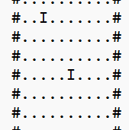
Easy Case
Easy Case Grid Representation S → Start position of the robot
I → Items to be collected
D → Delivery location
# → Obstacles/walls
. → Free navigable cells
Objective: Collect all items and reach delivery within energy constraints
BITS Pilani, Pilani Campus

Slide 8
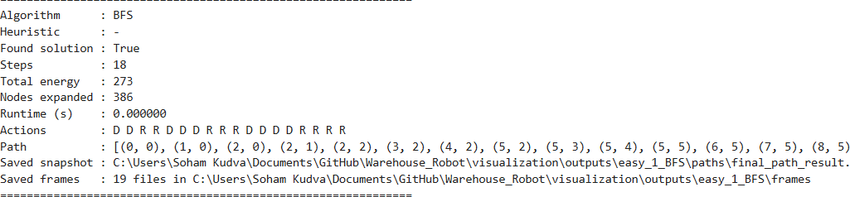
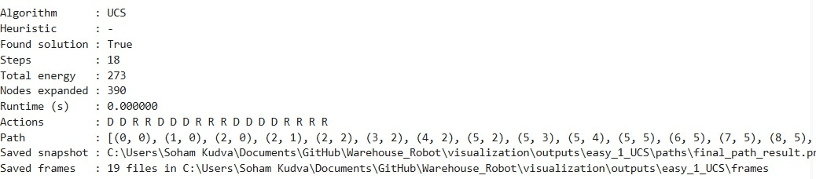
Easy - BFS vs UCS
OUTPUT ON TERMINAL FOR BFS
OUTPUT
ON TERMINAL FOR UCS
BITS Pilani, Pilani Campus

Slide 9
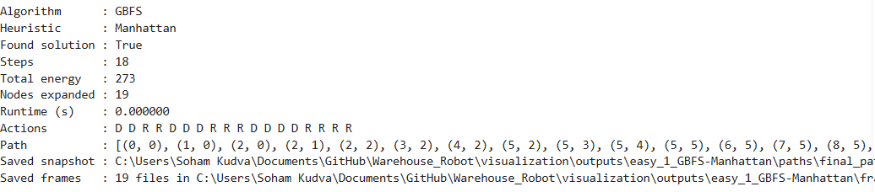
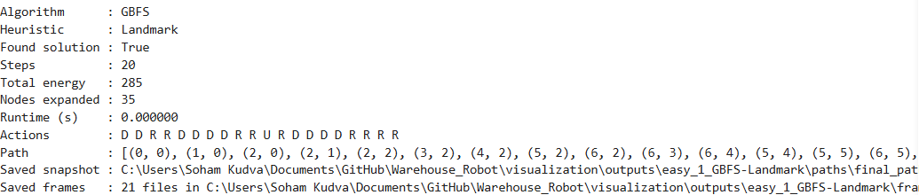
Easy - Greedy
OUTPUT ON
TERMINAL FOR
GREEDY USING H1
OUTPUT ON TERMINAL FOR
GREEDY USING H2
BITS Pilani, Pilani Campus

Slide 10
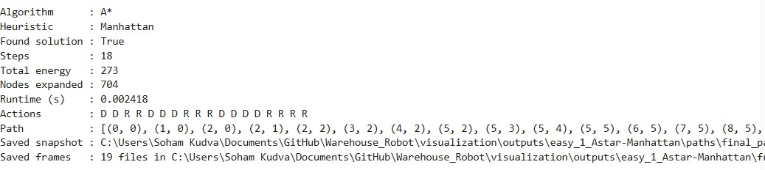
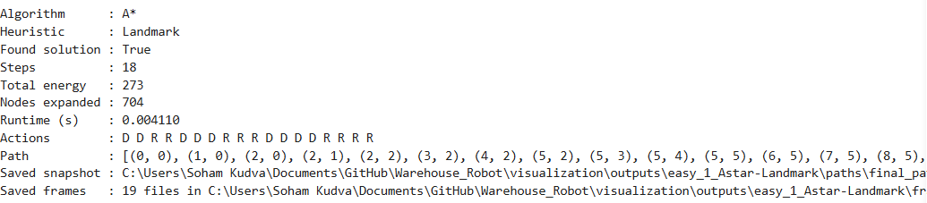
Easy - A*
OUTPUT ON TERMINAL FOR
A* USING H1
OUTPUT ON TERMINAL FOR
A* USING H2
s

Slide 11
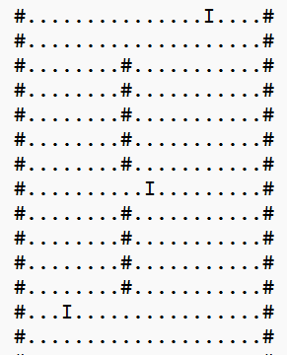





Medium Case
Larger grid with multiple items placed at distant locations Presence of obstacles (#) creates restricted pathways
Requires careful path planning to avoid unnecessary exploration Increased complexity due to longer paths and multiple decision points Tests algorithm performance beyond simple, direct navigation
BITS Pilani, Pilani Campus

Slide 12
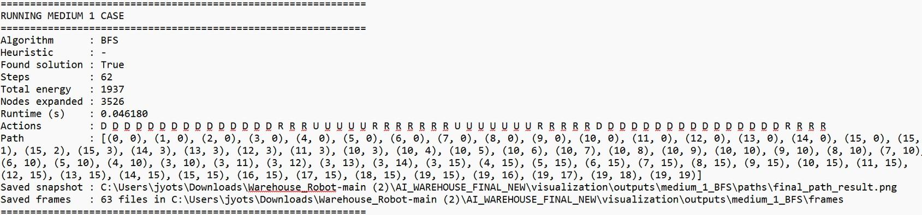
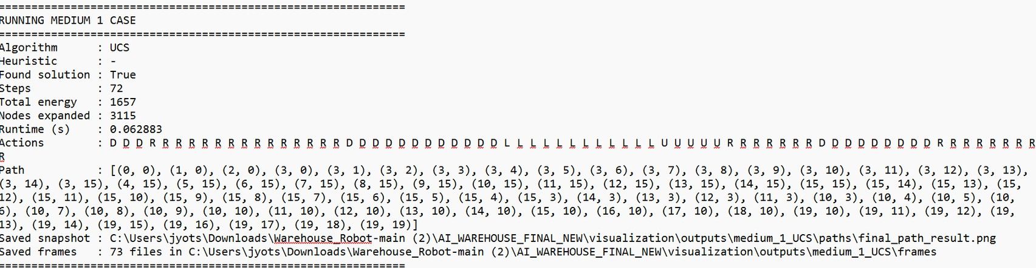
Medium - BFS vs UCS
OUTPUT ON TERMINAL FOR BFS
OUTPUT ON TERMINA L FOR UCS

Slide 13
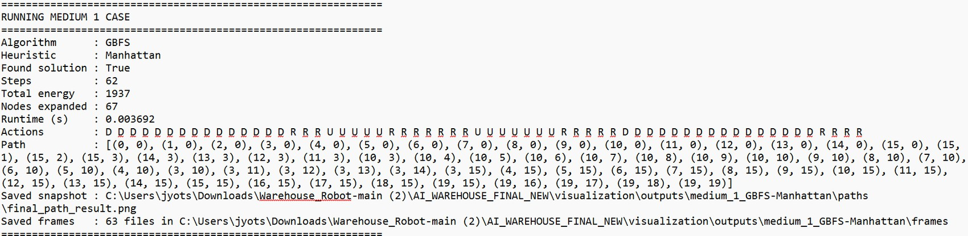
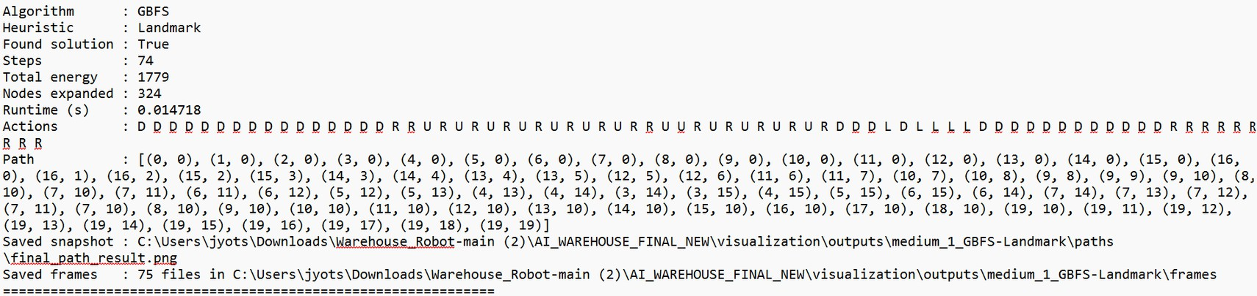
Medium - Greedy
OUTPUT ON TERMINAL FOR
GREEDY USING H1
OUTPUT ON TERMINAL FOR
GREEDY USING H2

Slide 14
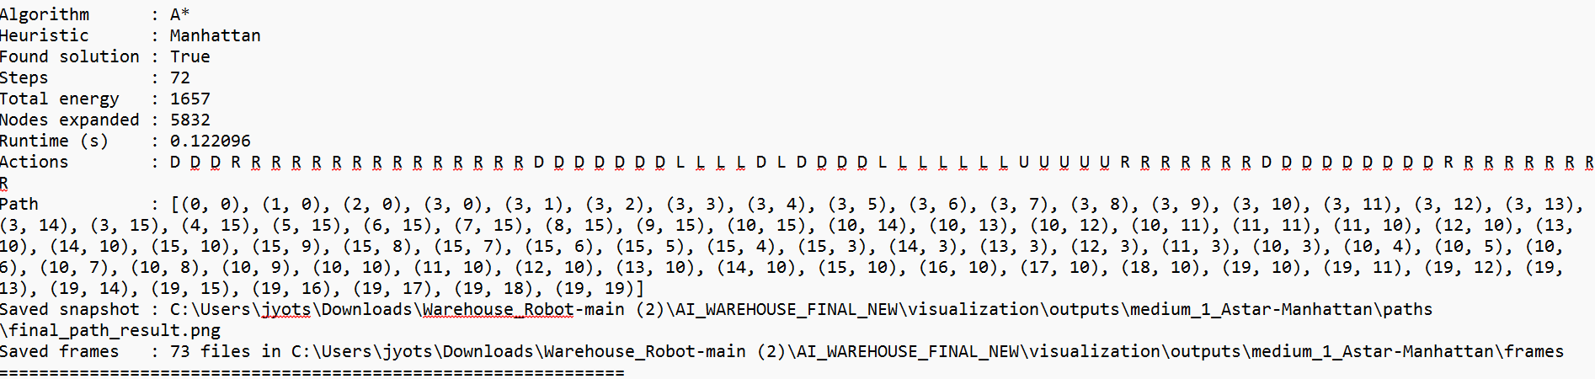
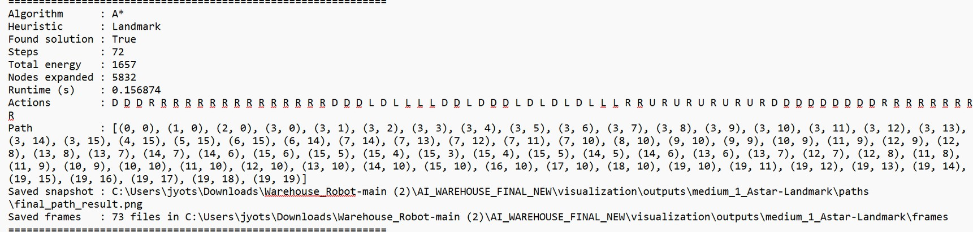
Medium - A*
OUTPUT ON
TERMINAL FOR
A* USING H1
OUTPUT ON
TERMINAL FOR
A* USING H2

Slide 15
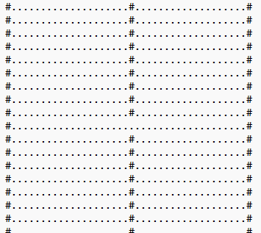
Hard Case
Large grid with multiple widely spaced items Maze-like obstacle
structure restricts movement Requires long detours and strategic path planning Very high search space and complexity
Simulates real-world challenging navigation

Slide 16
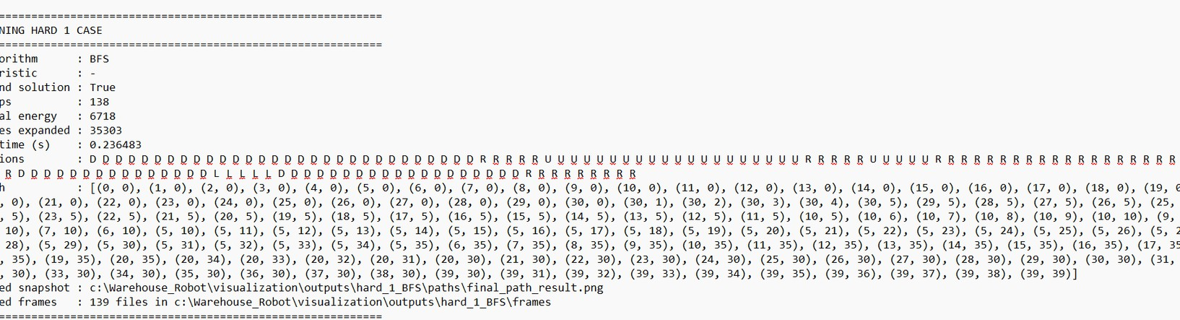
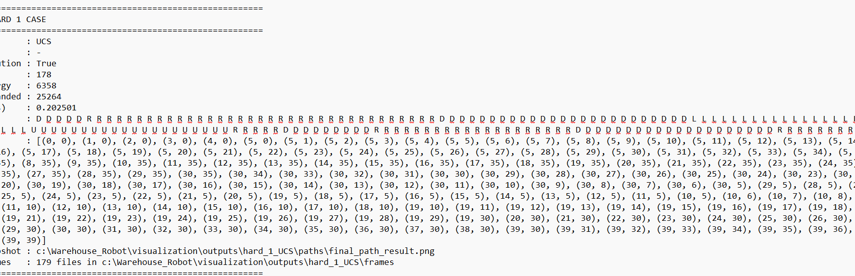
Hard - BFS vs UCS
OUTPUT ON TERMINAL FOR BFS
OUTPUT ON TERMINAL FOR UCS

Slide 17
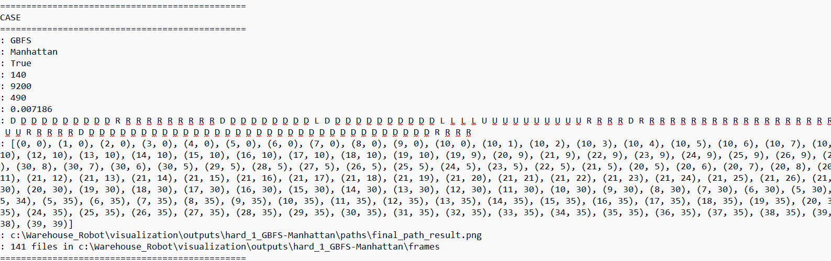
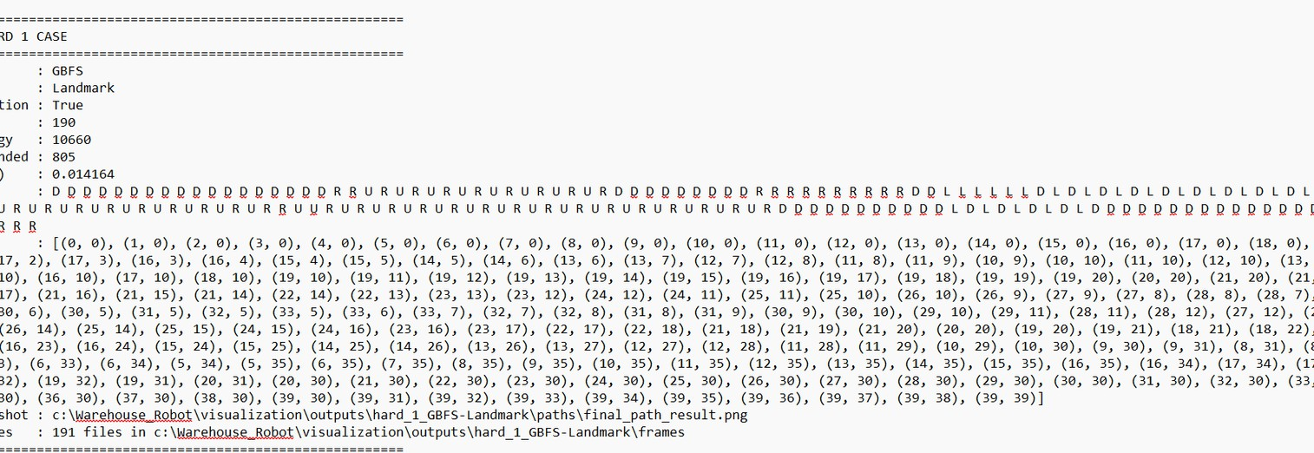
Hard - Greedy
OUTPUT ON TERMINAL FOR
GREEDY USING H1
OUTPUT ON TERMINAL FOR
GREEDY USING H2

Slide 18
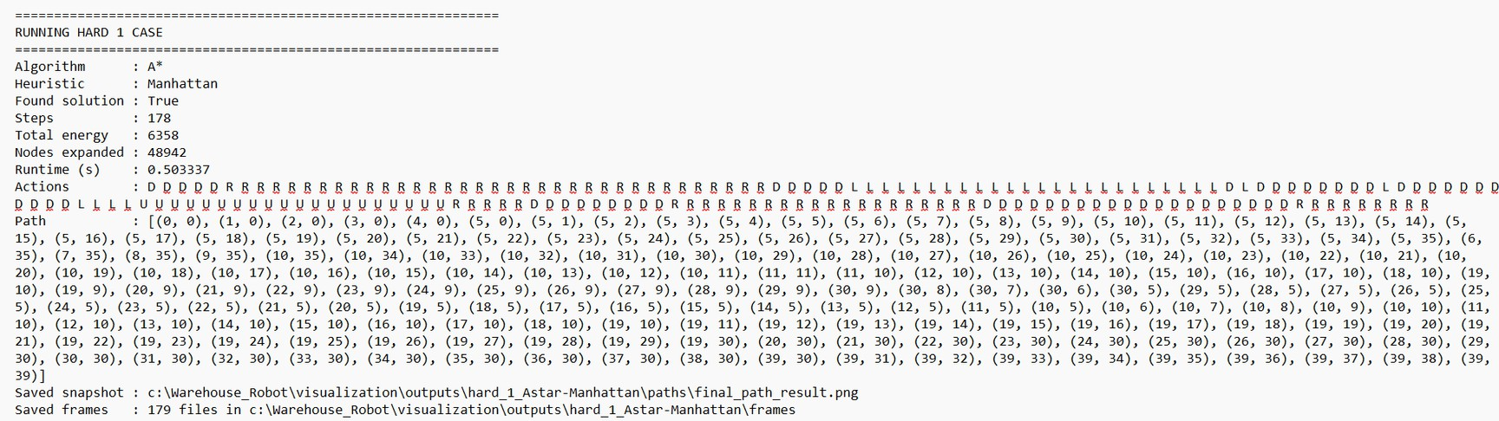
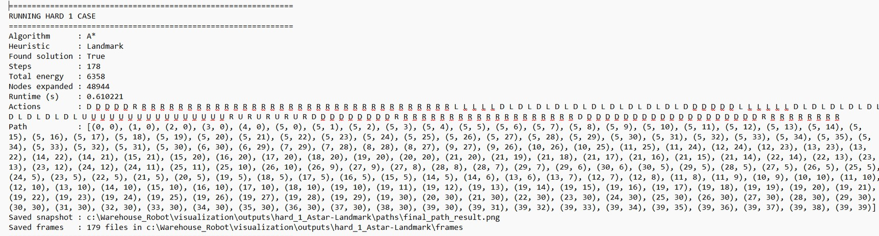
Hard – A*
OUTPUT ON TERMINAL FOR
A* USING H1
OUTPUT ON TERMINAL FOR
A* USING H2

Slide 19
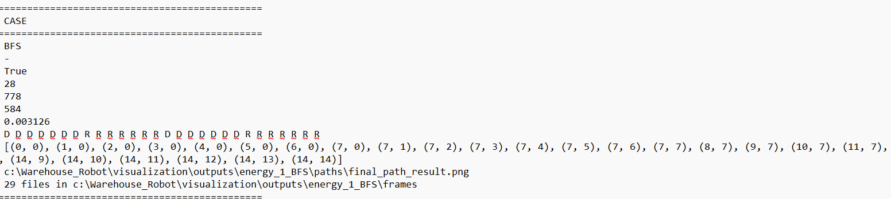
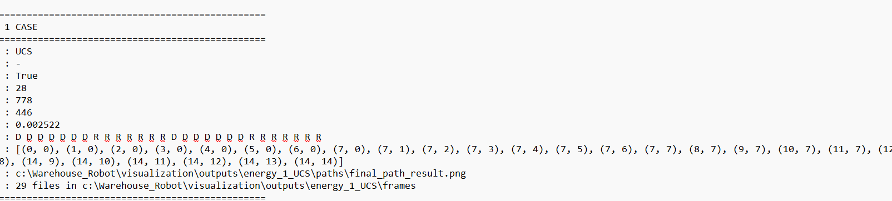
Energy- BFS vs UCS
OUTPUT ON TERMINAL FOR BFS
OUTPUT ON TERMINAL FOR UCS

Slide 20
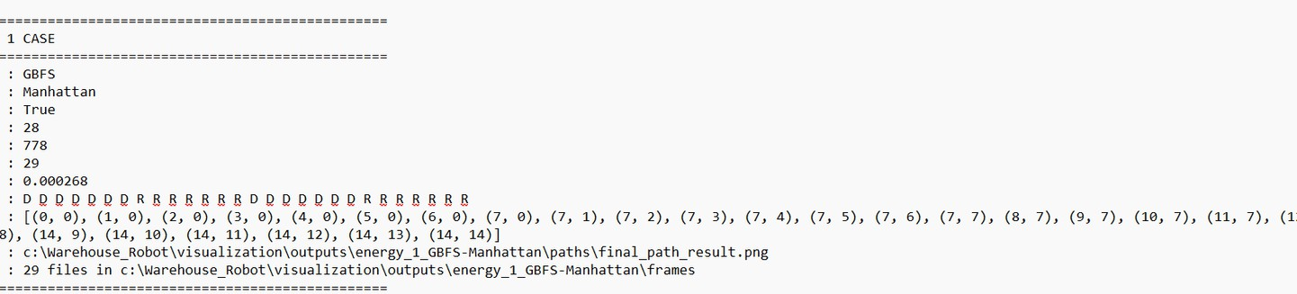
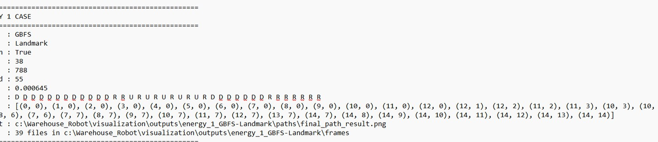
Energy- GBFS
OUTPUT ON TERMINAL FOR
GREEDY USING H1
OUTPUT ON TERMINAL FOR
GREEDY USING H2

Slide 21
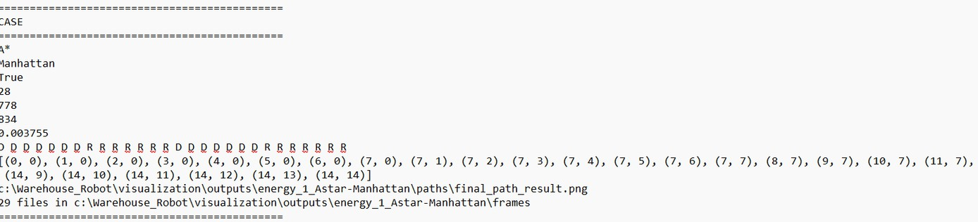
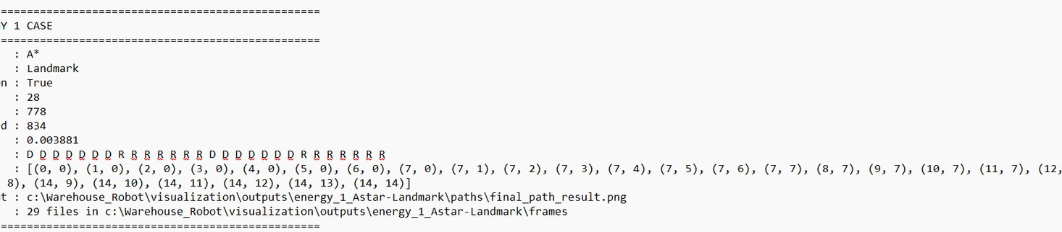
Energy– A*
OUTPUT ON TERMINAL FOR
A* USING H1
OUTPUT ON TERMINAL FOR
A* USING H2

Slide 22
Empirical Validation
BFS/UCS expand many nodes (as predicted) Greedy reduces expansion but not always optimal A* best balance of optimality and efficiency
Do results match theory? Yes in trends.
Why not exact? Finite maps, obstacles, heuristic guidance. Results align with theory.
BITS Pilani, Pilani Campus

Slide 23
Performance Metric | D2 Theoretical Prediction | D3 Empirical Result (L3 Implementation) +1
Path Optimality | UCS and A* will find the minimum cost path to the delivery zone. | Confirmed. In the Hard Case, both UCS and A* achieved the optimal 138 steps/energy.
Search Efficiency | BFS/UCS will expand the most nodes due to uniform, uninformed exploration. | Confirmed. BFS/UCS expanded ~25,258 nodes in the Hard Case, showing poor scalability.
Heuristic Guidance | A* will drastically reduce node expansions compared to uninformed search. | Confirmed. A* (Manhattan) reduced expansions by ~90% (from 25,258 down to 2,601).
Speed vs. Quality | Greedy (GBFS) will be the fastest but may yield sub-optimal "longer" paths. | Confirmed. GBFS was the fastest (512 nodes) but produced a sub-optimal 170-step path.
Heuristic Choice | Stronger heuristics (H2) will generally outperform simple ones (H1). | Variable. Manhattan (H1) actually outperformed Landmark (H2) in expansions for the maze-like Hard Case.

