Slide 1
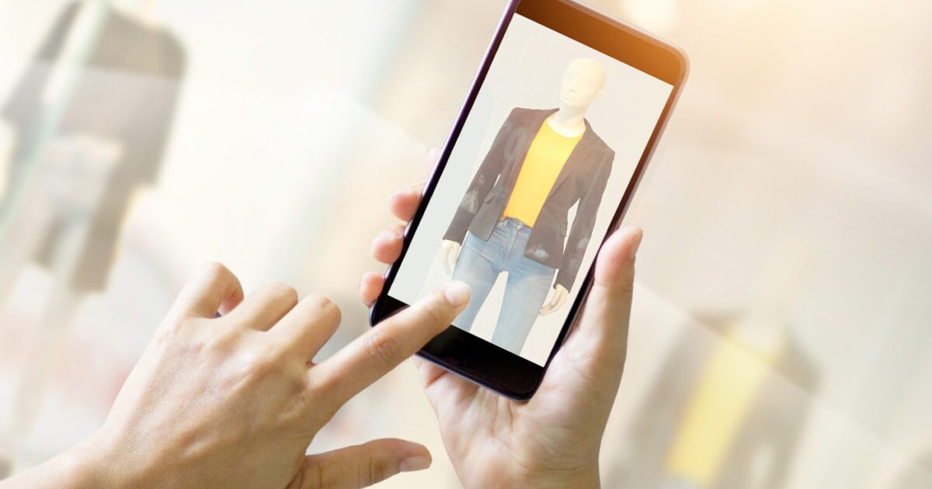
F
a
S
hCam
……a Image Recognition Search Engine

Slide 2
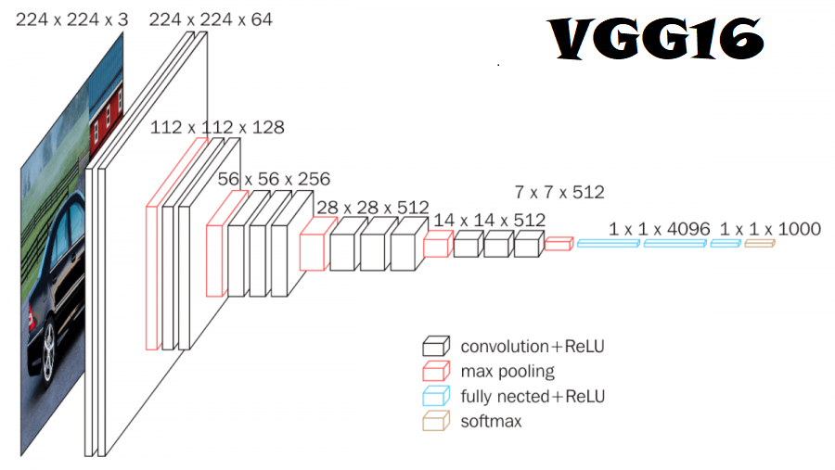
BaseLine Model
KNN Model
CNN Model
VGG16 Model
<50%

Slide 3
Ready with Baseline Model approx. 92% accuracy.

Slide 4
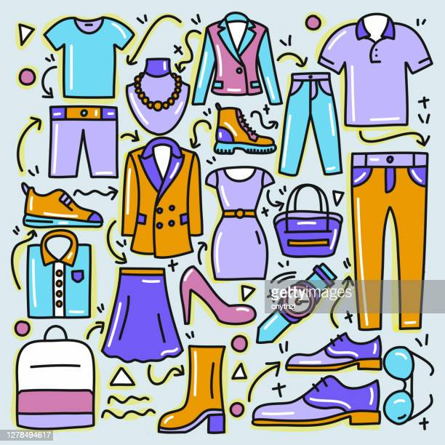
Working Model
Our Current model taking more than 100 different categories of fashion world. Some are like T-Shirts, Tops, Shirts, Jeans, Shoes, Jackets, Watches, Dresses, Handbags and so on also we are working on clear and some noisy or self-clicked pictures also yesterday only, we applied the on some Live pictures as well.

Slide 5
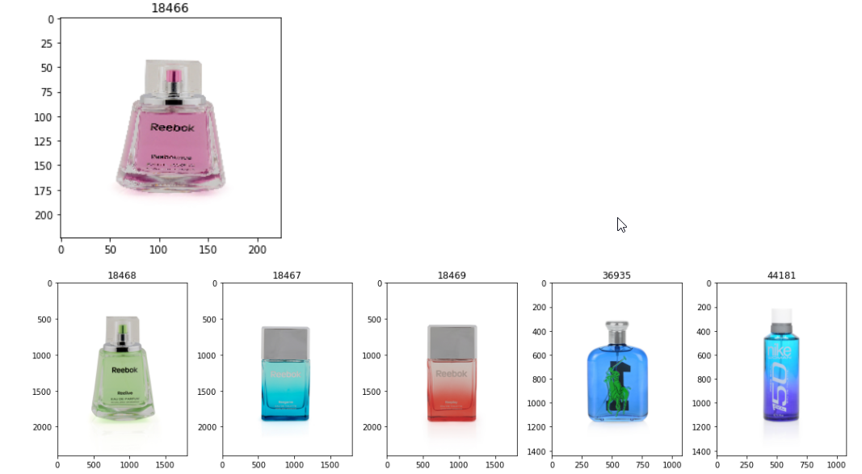
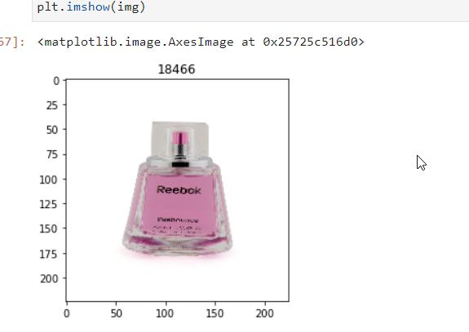
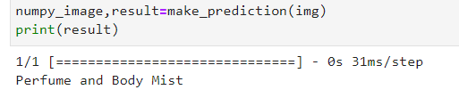
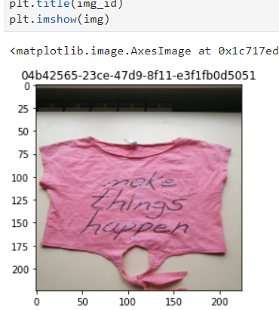
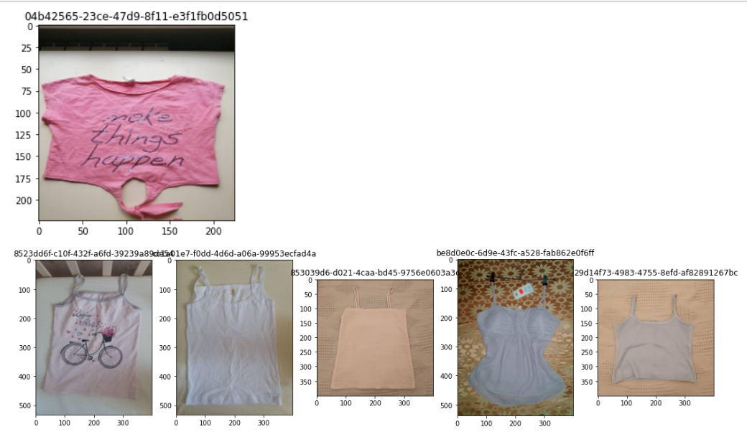
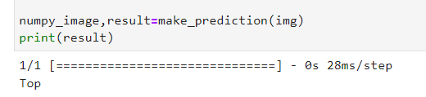
Performance (coding)
Input
image
Class as Output
Similar top 5 images
Input Image
Similar top 5 images
Class as Output

Slide 6
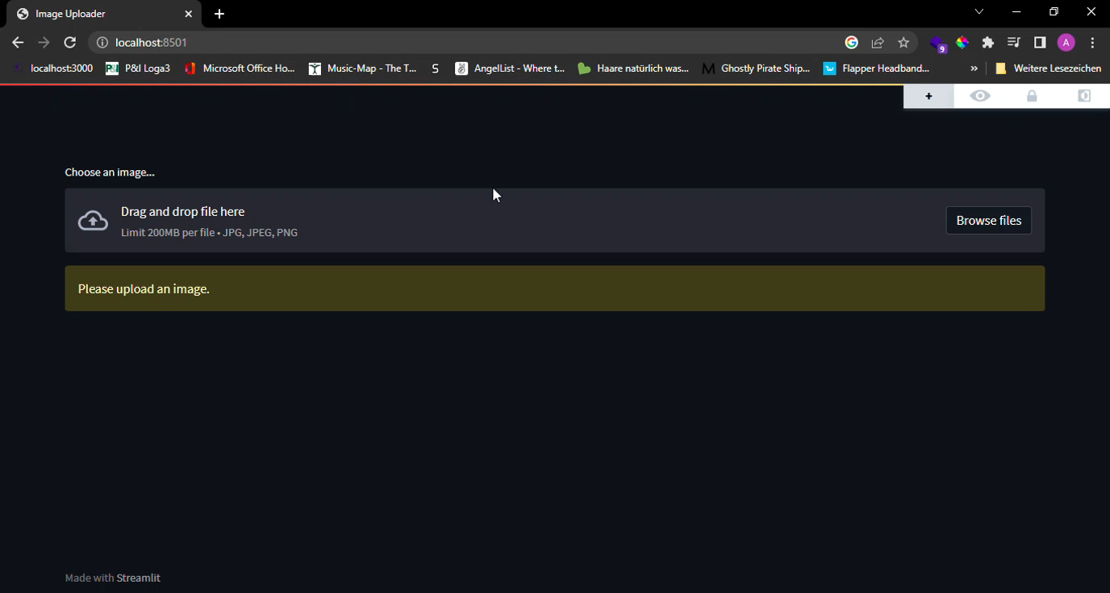
First view of FashCam (with image uploading)

Slide 7
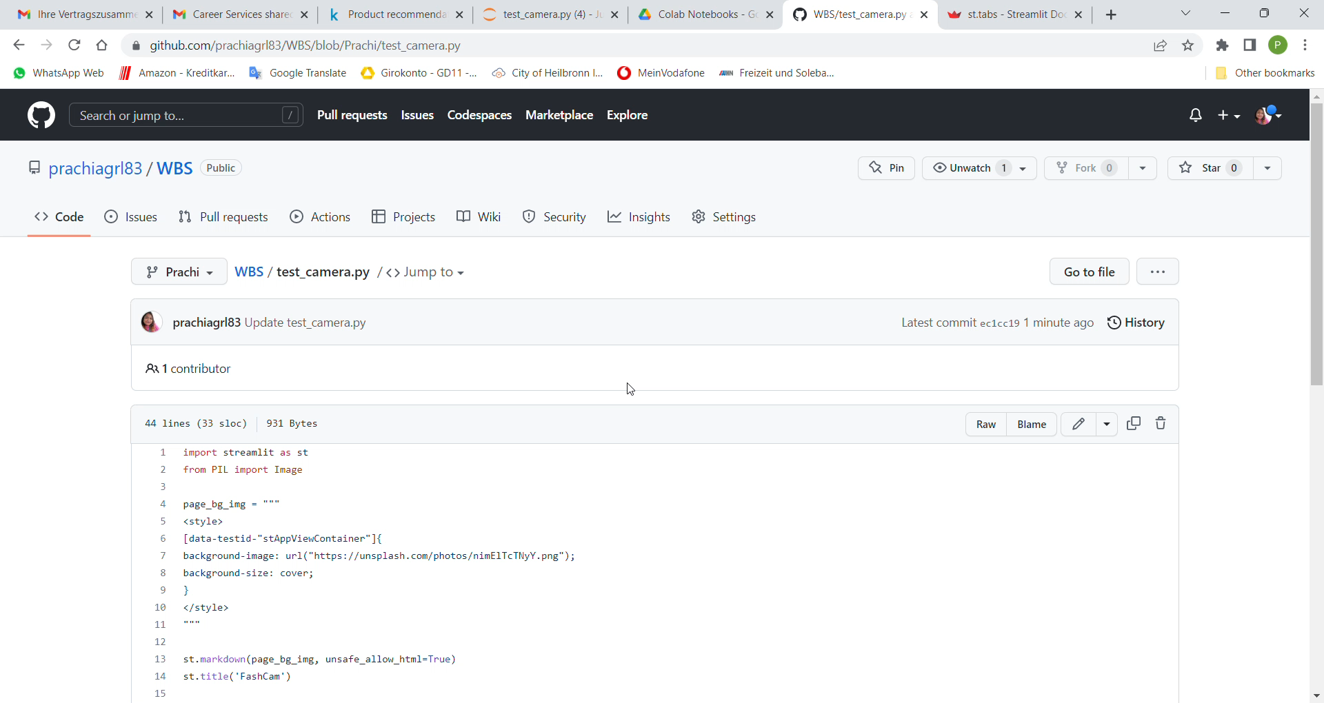
Pilot view of FashCam (with live image capture)

Slide 8
….Coming back soon with more enhanced version of our app.
Stay Connected & Happy Coding!

