Slide 1
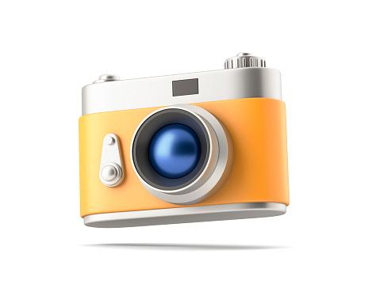
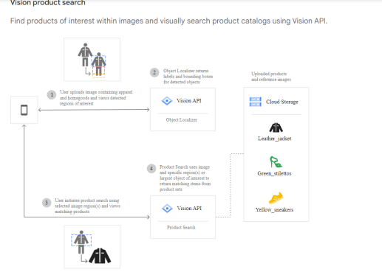
FashCam
By Angelos n Prachi
Visual search engine platform that can find products from the pictures

Slide 2
Idea
A pretty straightforward idea that can be useful for many e-commerce businesses.
App that takes an image from the user as input and displays the corresponding products from the provider's e-commerce store.
The app provider can collect images with desired products to train future models, perform further analysis, or improve personalized recommendations.
The app works similarly to Google Lens, but only searches for and recommends products based on the similarity provided by the e-commerce store there are about 45,000 different images in our dataset, they are mainly images with clothes and accessories. of course, more images with worn clothes will be added to train our model.
There is a wide variety of open data sources.

Slide 3
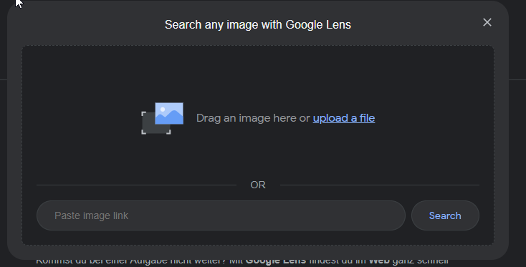
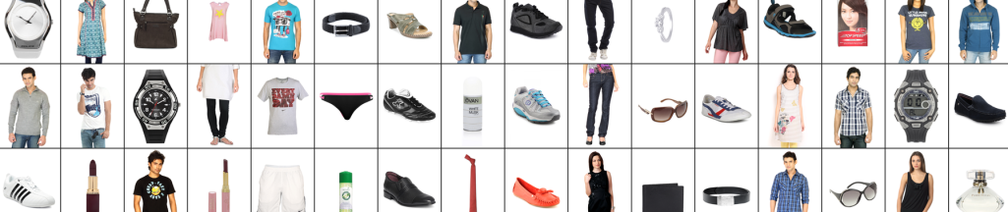
Technologies: Computer vision, image recognition
toolstack : scikitlearn, keras, tensorflow
Dataset: https://www.kaggle.com/datasets/paramaggarwal/fashion-product-images-dataset

Slide 4
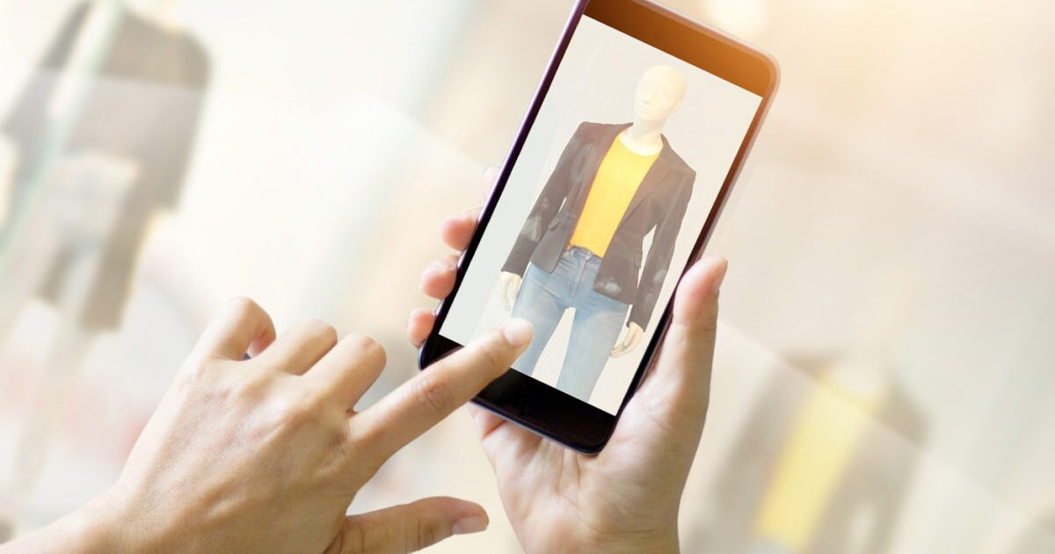
F
a
S
hCam

Slide 5
Ready with Baseline Model and 80% accuracy.

Slide 6
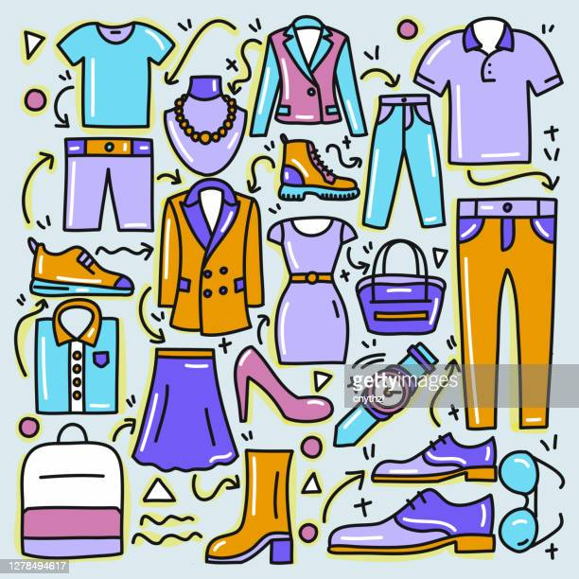
Our Current Algorithm taking more than 100 different categories of fashion world. Some are like T-Shirts, Tops, Shirts, Jeans, Shoes, Jackets, Watches, Dresses, Handbags and so on.

