Slide 1



CDAC Final Project - Feb 2026
Sunbeam Institute of Information Technology - Pune
Project Mentor - Manjusha Nikam

Slide 2

Team Members
Sanika Deshpande
Prachi Bobade

Slide 3
Problem Statement
No instant delivery in traditional shopping
Users cannot check real-time product availability
Lack of pincode-based delivery systems
Inefficient inventory across warehouses
Poor user experience in existing systems

Slide 4
Objectives
Build a fast and scalable e-commerce platform
Enable real-time stock availability
Provide location-based delivery system
Optimize warehouse & inventory management
Ensure secure and smooth checkout process

Slide 5
Scope of the Project
Develop a quick-commerce e-commerce application
Enable user registration, login, and product browsing
Implement cart and checkout system
Provide multiple payment options (UPI, Card, COD)
Manage products, orders, and inventory (Admin panel)
Use warehouse-based system for fast delivery
Support order processing (pick, pack, ship)
Provide basic order tracking for users
Build a scalable prototype with core features only

Slide 6
Functional Modules
Customer
Browse products based on location
Add items to cart & make payments
Track order status in real-time
Admin
Manage product inventory
Assign orders to delivery partners
View sales & performance analytics

Slide 7
Key Features
Customer
Login/Register (OTP)
Browse & search products
Add to cart & checkout
Live order tracking
Admin
Manage products & inventory
Order management
Pricing & analytics

Slide 8
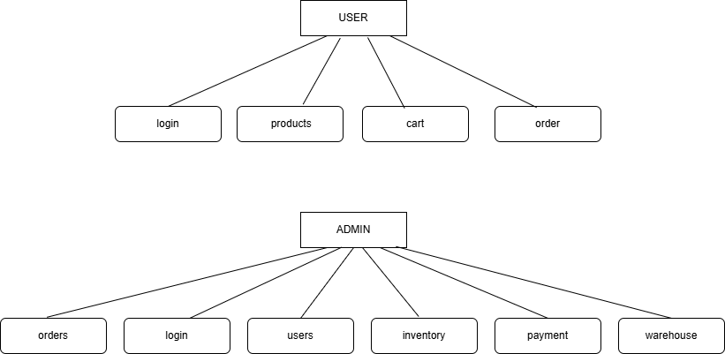
ER Diagram - Level 1

Slide 9
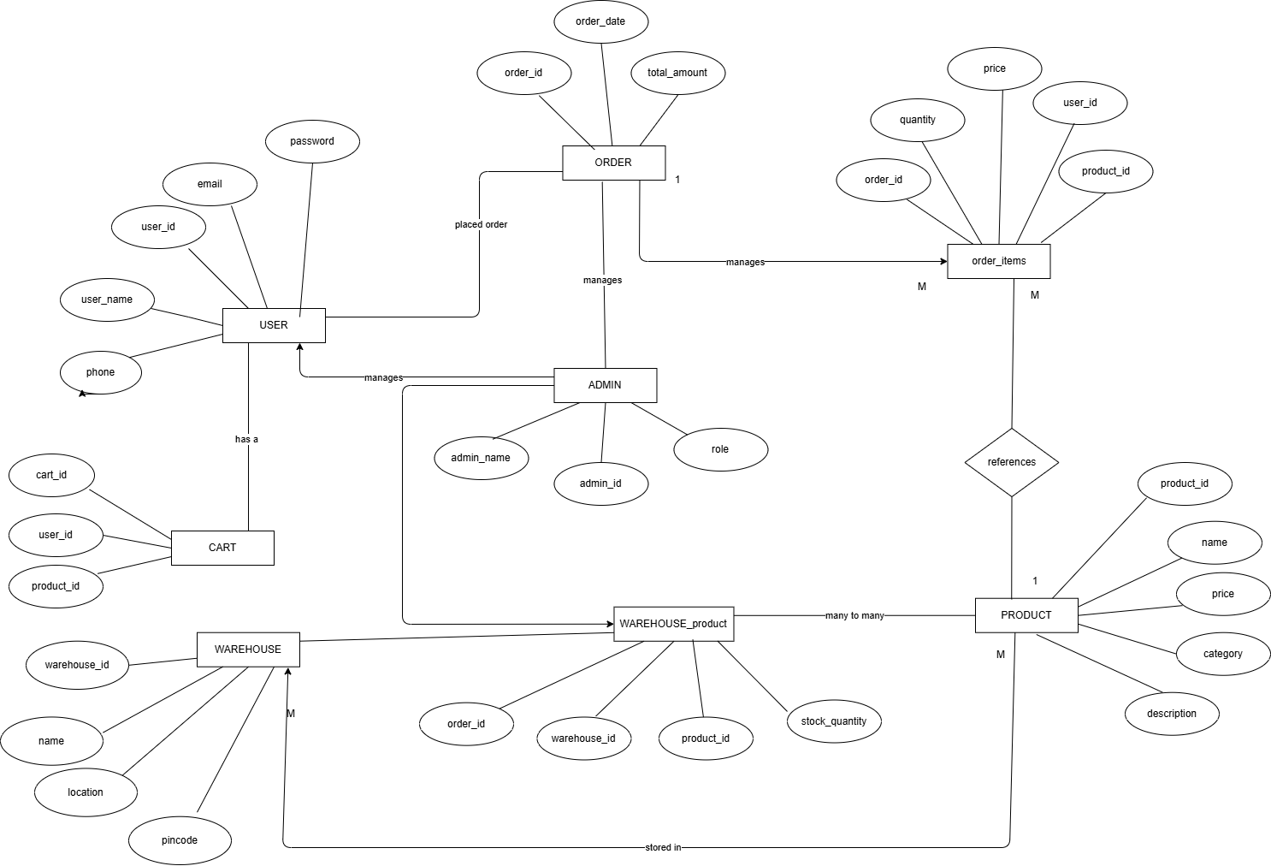
ER Diagram - Level 2

Slide 10
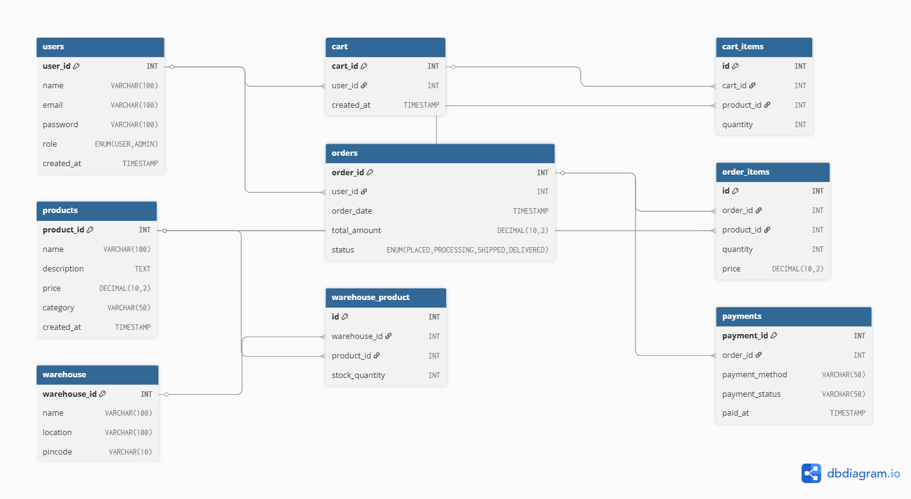
Database Design

Slide 11
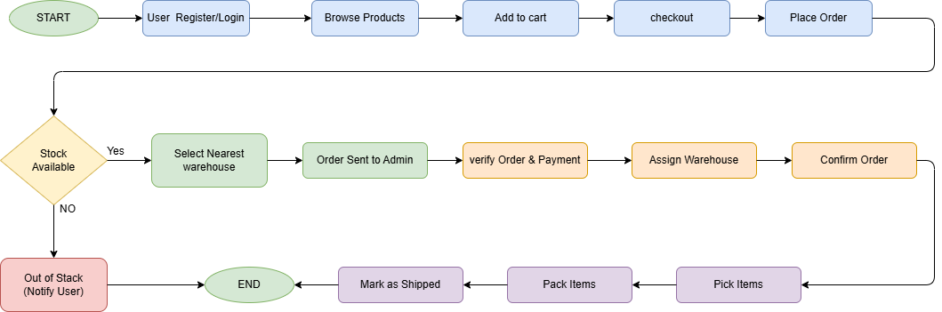
Project Flow

Slide 12
Project Flow

Slide 13
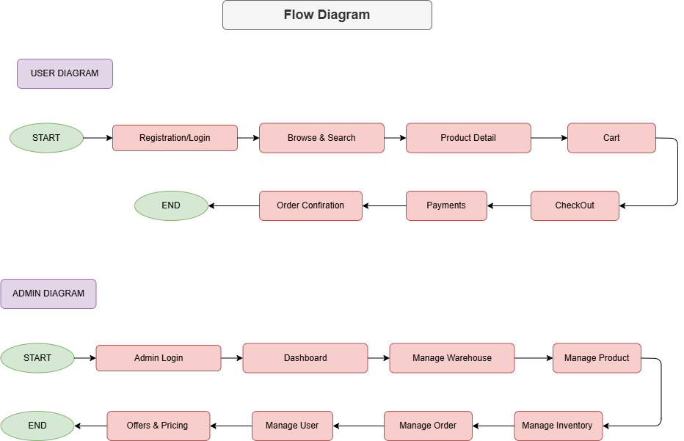
Flow - User & Admin

Slide 14
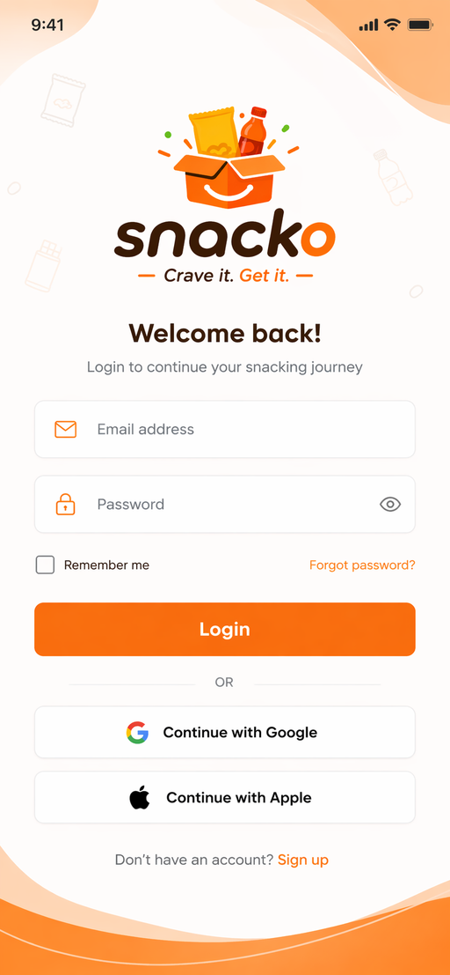
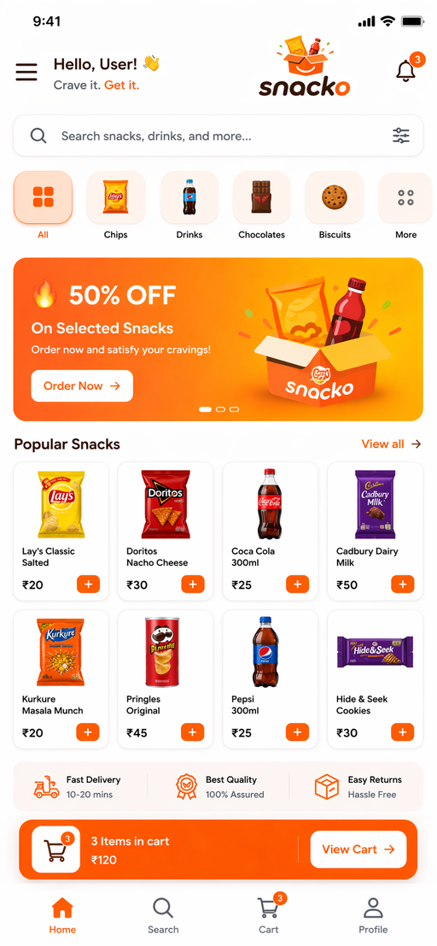
UI Design

