Slide 1
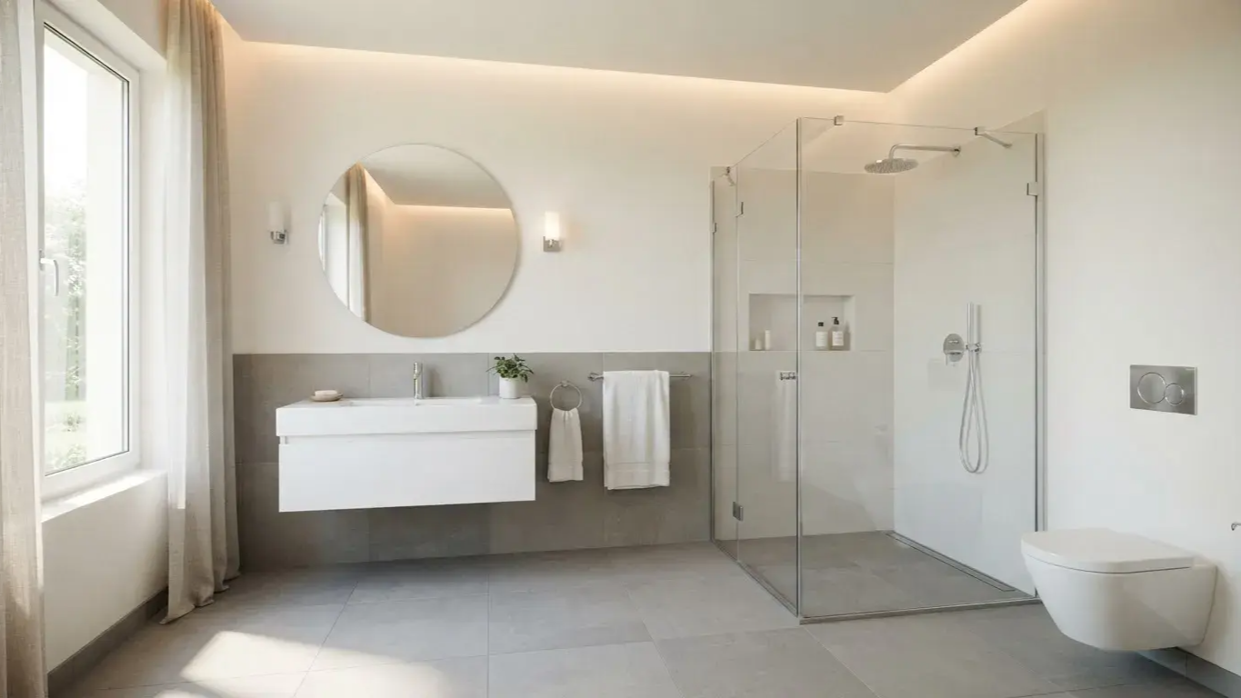
Project Overview
KOHLER AI
Bathroom Designer
& Planner
Constraint-Aware Personalized Bathroom Design with Interactive
3D Visualization

Slide 2
One
User
Requirements
Optimized
Intelligent
Bundle
Room dimensions,
Design
budget, aesthetic
Value, Balanced, or
theme, power, and
Luxury product
Workflow
preferences
combinations
The Problem: Traditional
design requires manual
measurement, product
selection, dimension
checking, price comparison,
KOHLER AI
Interactive 3D
and compatibility verification.
Designer
Bathroom
Deterministic
Real-time
optimization engine
visualization and
processing
natural-language
constraints
refinement

Slide 3
How the System Works
Tech Stack: React, Tailwind CSS, Vite,
Three.js, and Zustand.
Initial Input
UI & State
Optimization
3D Rendering
Refinement
Optimized
User provides
Management
Engine
React Three Fiber
Loop
Design
bathroom
React UI and
JavaScript logic
and Three.js render
NLP parser updates
Interactive 3D
dimensions, budget,
Zustand manage
evaluates product
the scene
parameters for re-
bathroom design is
and theme
interface and
combinations
optimization
ready
shared state

Slide 4
How the “AI” Makes Recommendations
1
Apply Hard Constraints
Explainable Optimization via
Filter out incompatible options
Exhaustive Search — Not a
2
Apply Soft Constraints
Trained ML Model
Score remaining options based on preferences
Calculate Final Score
Final Score = (Style + Quality +
3
Determine the best combination using the scoring
Preference) - (Budget + Space +
formula
Compatibility Penalties). The engine
evaluates all 3,136+ combinations (7
Evaluate Combinations
4
Exhaustively search through all possible
Toilets × 8 Showers × 7 Vanities × 8
combinations
Faucets).
Select Mode
5
Choose the recommendation mode (Value, Balanced,
Luxury)

Slide 5
From Recommendation to Interactive 3D
Bathroom
1
2
3
Product Data
Fixture
Room Geometry
Input
Component
Construction
Dynamic scene construction
Creation
using React Three Fiber and
Gathering product
Defining the bathroom's
information for design
Building 3D models of
layout and structure
Three.js
bathroom fixtures
Current implementation uses heuristic
placement; production would require
6
5
4
CAD-grade collision and plumbing
Interactive
WebGL
Material and
validation.
Exploration
Rendering
Lighting
Allowing users to rotate,
Displaying the 3D
Application
zoom, and inspect
bathroom on the web
Adding realistic textures
and lighting effects

Slide 6

Natural-Language
Refinement &
Future Scope
Mapping rule-based intent to parameters and
scaling for production
Current NLP
Current Prototype
Future Production
Final Loop
Rule-based parser mapping
Local catalog, client-side JS
Real KOHLER API, LLM-
User → Intent →
phrases (e.g., "more
optimization, and Three.js
based intent extraction, and
Constraints → Optimization
luxurious") to parameter
visualization.
backend geometric
→ 3D Visualization →
weights.
validation.
Refinement.

