Slide 1
Lending Club Case Study
Prachi Goliwadekar
Rathnagiri Nagarajan

Slide 2
General Info
During the EPGP course, this case study serves as an assignment aimed at comprehending the given scenario, applying EDA techniques acquired throughout the coursework, and offering insights into data patterns to address business objectives.

Slide 3
Background of Lending Club
Lending Club is a consumer finance company which specializes in lending various types of loans to urban customers.
The company could face the following issues if it doesn’t evaluate the loan applicant diligently:
Credit Loss:
Common financial loss for lending companies
Arises from lending to 'risky' applicants
Occurs when borrowers fail to pay or default on their loans
Defaulters ('Charged-Off' Customers):
Borrowers who cause the largest amount of loss to lenders
Organization aims to identify and stay away from such borrowers
Goal is to minimize credit loss and financial risks

Slide 4
Objective
The objective is to use EDA techniques against past loan applicant’s data to:
Determine critical factors that will Improve ability to identify High-risk applicants and take precautionary actions
Cut down credit loss by identifying High Risk applicants driving attributes (or driver variables) that may lead to loan default
Improve Business portfolio and risk assessment

Slide 5
EDA Techniques used in evaluating case study
Analyze, clean and prepare data for statistical analysis
Univariate analysis
Unordered Categorical Variable Analysis
Ordered Categorical Variable Analysis
Derived Variable Analysis
Bivariate Analysis
Correlation Analysis

Slide 6
Analyze Dataset and Clean data
Following methods were employed to prepare dataset for analysis
Find and drop the columns with all Null Values
Drop columns with few values or not be useful for analysis
Exclude rows that has outliers
Clean and Correct the datatype of columns
by removing trailing characters like “%” and converting it into relevant datatypes
split date string column into day, month and year columns
Rounding off columns to 2 decimal places
Consider only the rows with loan_status != “Current”, the reason being they are already paying customers
Drop text columns that may not be useful

Slide 7
Analyze Dataset Contd..,
Create and Add derived columns especially the following for histograms bins (buckets)
Loans Issue month bins as follows: Q1, Q2, Q3, Q4
Debt to Income ratio bucket: Very Low, Low, Moderate, High and Very High
Loan Amount bucket:0-5k, 5K – 10K, 10K-15K, 15K-above

Slide 8
Univariate Analysis
The following variables were considered for Univariate Analysis:
Loan amount
Funded amount
Investors funded amount
Interest Rate
Installment amount
Annual Income of applicants
Debt to Income Ratio

Slide 9
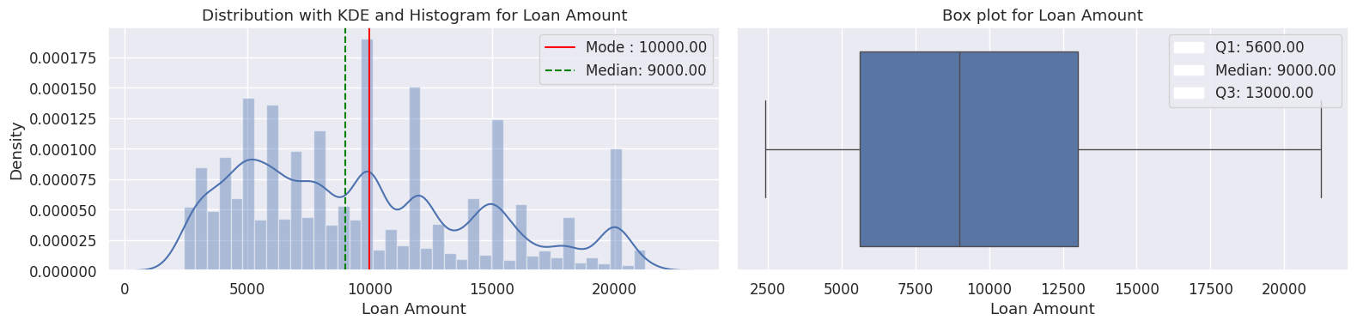
Univariate Analysis - Loan amount
* The loan amount has been treated to remove outliers and accordingly the quantiles bottom 5% and top 90% removed
The KDE curve indicates there is multi-modal clusters, With the peak of the KDE line is at 5000 and further smaller peak at 10000 and so on, indicating the most common loan amount is around the modal clusters of 5,000 and 10000.
The median is 10000, signifying that half of the loans are below 10000 and half are above.
While the box plot indicates that most of the loan amount is in range of 5600 and 13000, the difference between the smaller modes from modal clusters 5000 or 10000 and median from box plot confirms that the plot is rightward skew, with the "tail" of higher loan amounts greater than 15000, pulling the median towards higher value despite the majority number of loans provided being smaller.

Slide 10
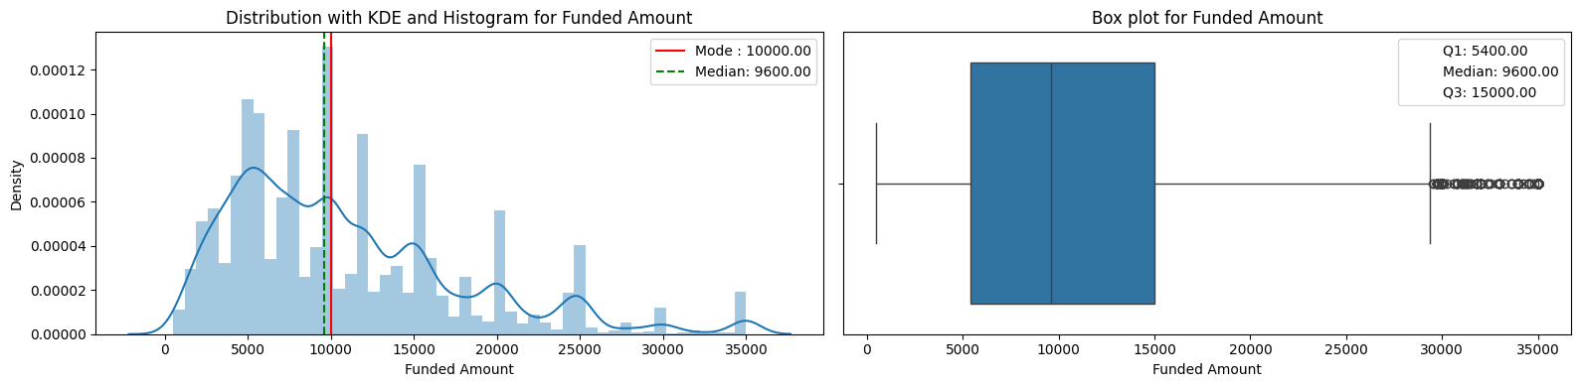
Univariate Analysis – Funded Amount
The KDE curve indicates there is multi-modal clusters, With the peak of the KDE line is at 5000 and further smaller peaks at 10000 and so on, indicating the most common loan funded amount is around the modal clusters of 5,000 and 10000.
The median is 9600, signifying that half of the loans are below 10000 and half are above.
While the box plot indicates that most of the loan amount is in range of 5000 and 15000, the difference between the smaller mode 5000 and median from box plot confirms that the plot is rightward skew, with the "tail" of higher loan funded amounts greater than 15000, pulling the median towards higher value despite the majority number of loans funded being smaller.

Slide 11
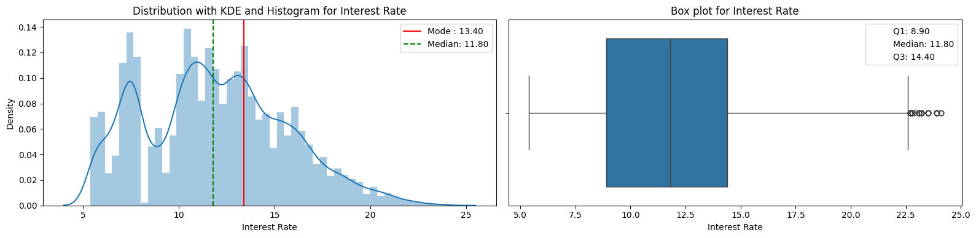
Univariate Analysis – Interest Rate
The KDE curve indicates there is multi-modal clusters, With the peak of the KDE line is at 10.8 and further smaller peaks at 7.5, 13.40 and so on, indicating the most common Interest rate is around the modal clusters of 10.8 and 13.40.
The median is 11.8, signifying that half of the Interest rates are below 11.8 and half are above.
While the box plot indicates that most of the Interest rates is in range of 8.90 and 14.40, the difference between the smaller mode 7.5 or 10.8 or 13.40 and median from box plot confirms that the plot is rightward skew, with the "tail" of higher *Interest rate amounts greater than 14.0, pulling the median towards higher value despite the majority number of Interest rates being smaller.

Slide 12
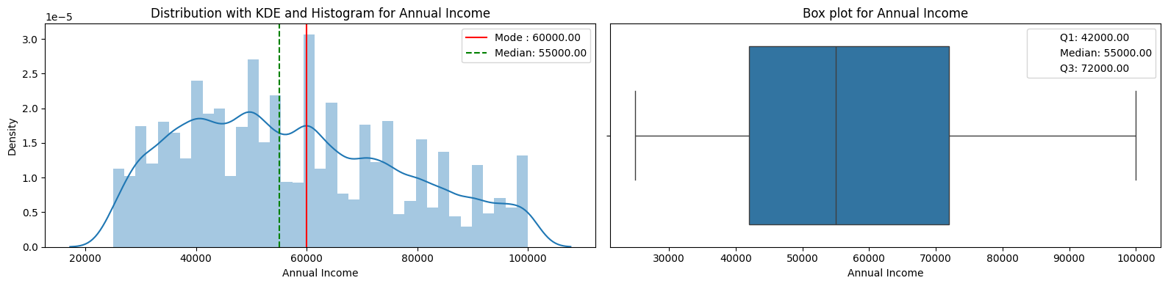
Univariate Analysis – Annual Income
* Due to large number of outliers the quantiles of bottom 5% and top 85% were excluded from the analysis
Before removal of outliers, Most of the annual income was between 5 lacs to 10 lacs and therefore This column required major outlier treatment. So, the Annual income corresponding to bottom 5% and top 15% were removed and only data between 5% to 85% were considered.
The KDE curve indicates there is multi-modal clusters, With the peak of the KDE line is at 50000 and further smaller peaks at 40000 and 60000 and so on, indicating the most common Annual Income is around the modal clusters of 40000 and 60000.
The median is 55000, signifying that half of the Annual Income are below 55k and half are above.
While the box plot indicates that most of the Annual Income is in range of 42000 and 72000, the difference between the smaller mode values of 50000 or 40000 or 60000 and median from box plot confirms that the plot is rightward skew, with the "tail" of higher *Annual Income* amounts greater than 72000, pulling the median towards higher value despite the majority number of Annual Income being smaller.

Slide 13
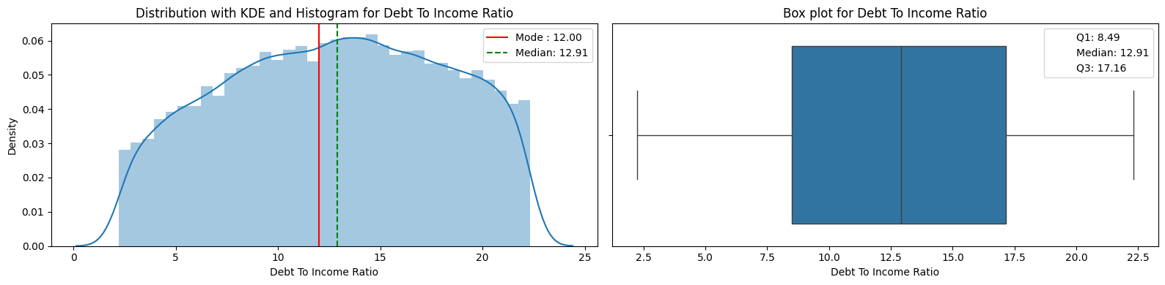
Univariate Analysis – Debt to Income (DTI) Ratio
* Due to large number of outliers the bottom 5% and top 10% were excluded from the analysis
The KDE graph and histogram plot now shows a central tendency and single modal with most of the applicant debt to income ratio were in the range of 8.49% and 17% approximately.
The single modal cluster seems to be concentrated around the 12% which shows most loans are being given to applicants with Low DTI (0-15%).
This suggests most applicants have a strong financial position and a lower to medium risk of defaulting on debt obligations

Slide 14
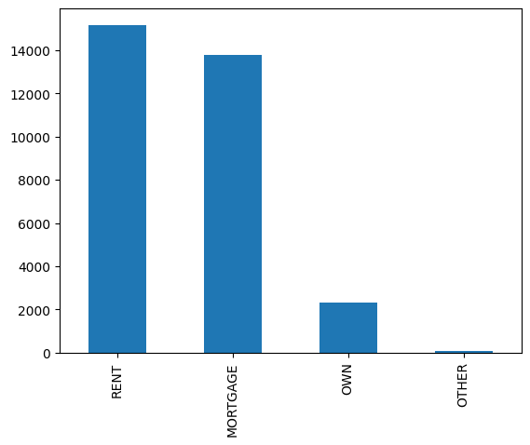
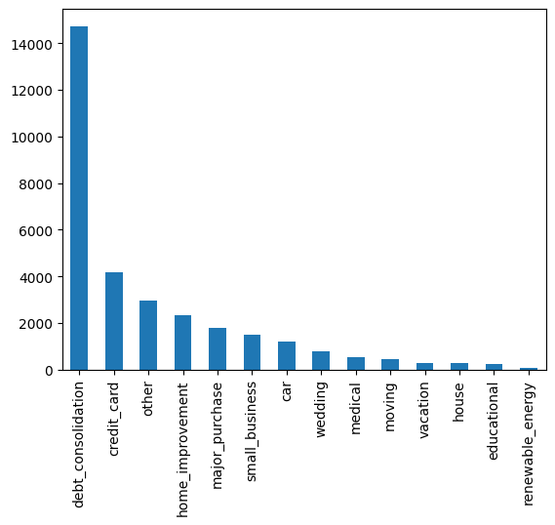
Unordered Categorical Variable Analysis
Majority of the homeowner status are
in status of RENT and MORTGAGE
Majority of the purposes of loan is debt consolidation

Slide 15
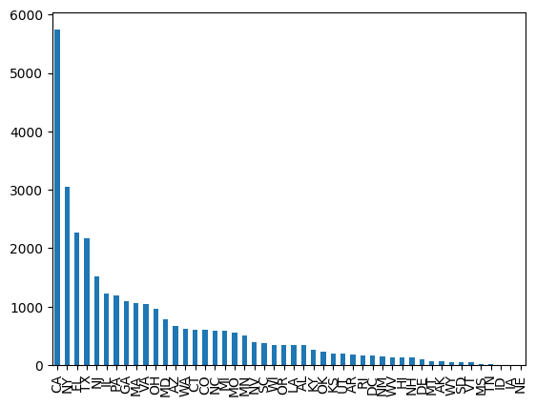
Unordered Categorical Variable Analysis
CA State has the maximum amount of loan applications

Slide 16
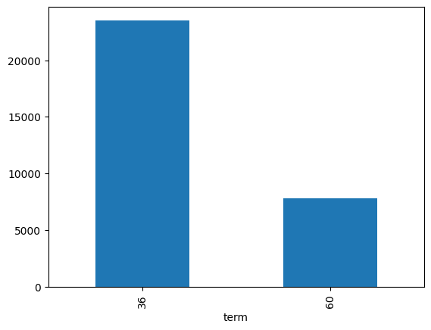
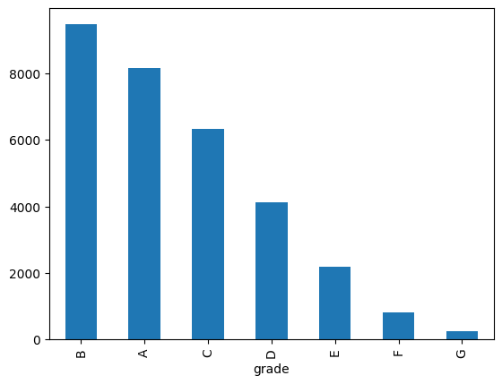
Ordered Categorical Variable Analysis
Most of the loans are of 36 months duration
Most of the loans are of Grade B

Slide 17
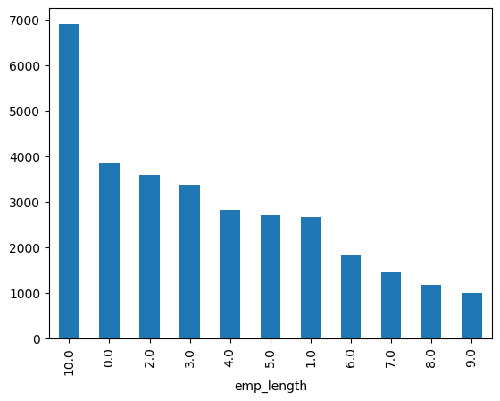
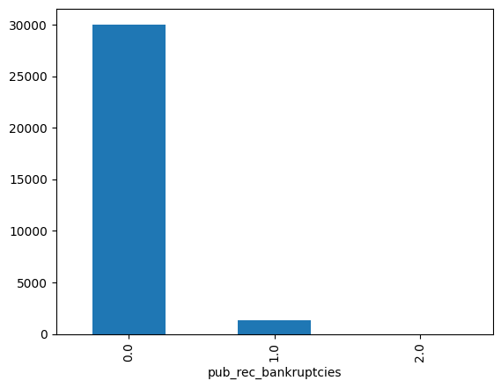
Ordered Categorical Variable Analysis
Majority of the employment length of the customers are 10+ years and then in the range of 0-2 years
Majority of the loan applicants are in the category of not having a public record of bankruptcies

Slide 18
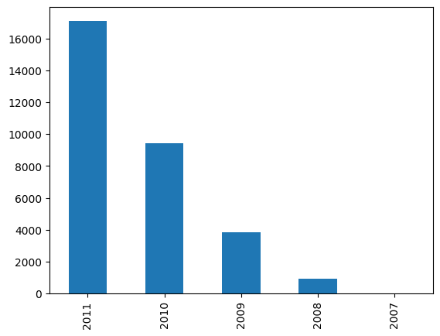
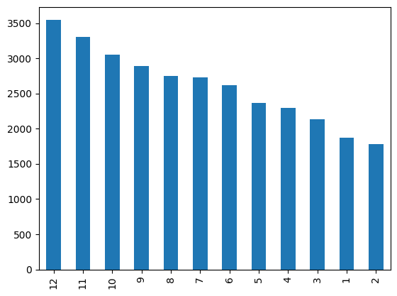
Derived Variable Analysis
Loan application count year over year
Loan application counts highest in year end
The lowest loans application count are in the month of Jan/Feb/March and highest counts are in 10/11/12.
Possibly because by year ends people face the financial challenges
Possibly because of festive seasons
Possibly because they are consolidating debt by year end

Slide 19
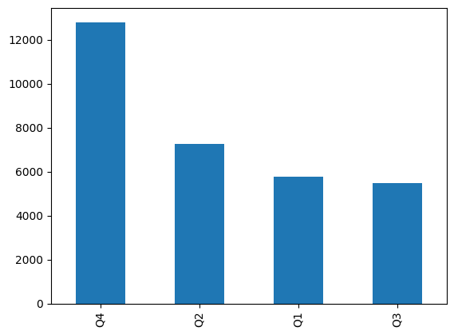
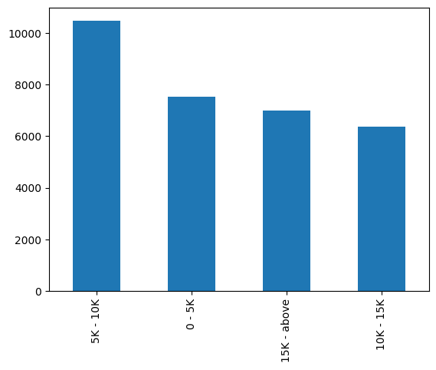
Derived Variable Analysis
Highest loan application volume in Quarter 4 of a year
Highest loan amount applications fall in the range of 5k to 10k

Slide 20
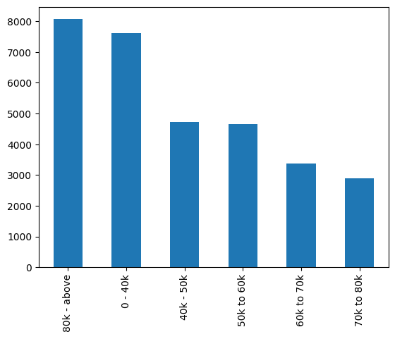
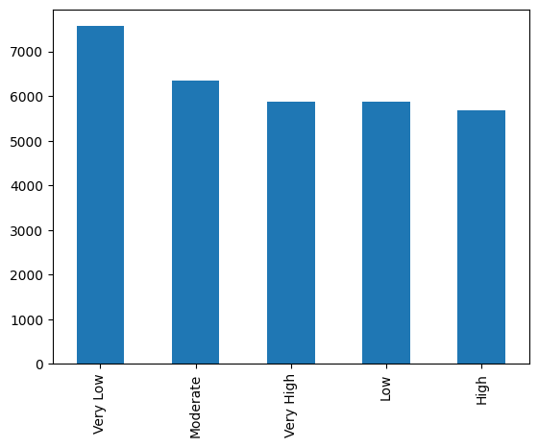
Derived Variable Analysis
Most applicants have Very low or Moderate DTI ratio indicating financially stable applicants
Highest loan applicant income is 80k and above

Slide 21
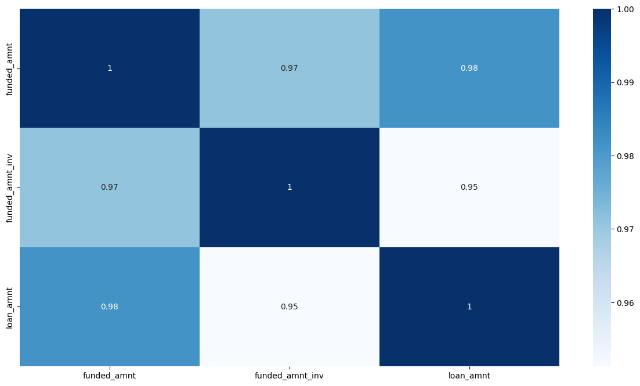
Derived Variable Analysis – Identify Key correlations
Loan Amount, investors funded amount and the funded amount all have high correlation – indicating most people get funded their loan amount

Slide 22
Bivariate Analysis
A Statistical Method used to analyze the relationship between two variables.
We Analyze the “Charges off” loan status against different relevant attributes of loan dataset.

Slide 23
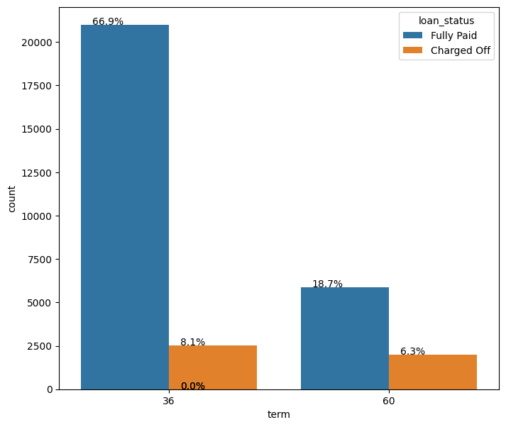
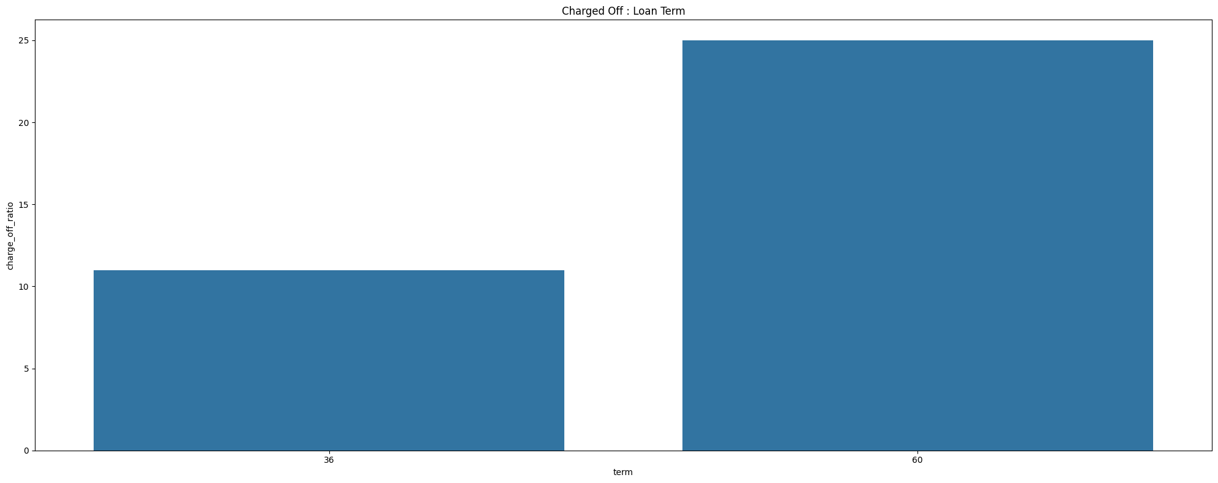
Bivariate Analysis – Term Limit Vs Loan Status
The high volume of loans are in the category of term = 36
The overall percentage of volume of Charge Off's is slightly higher in term = 36 (8%) as compared to term=60 (6%)
If we calculate the ratio of Charge Off's within a category
Charge Offs ratio is for the term=60 is 25% which is much higher than term=36 (10%)
term=60 is the loan applications which require more scrutiny
Most of the applicants with term=60 potentially will have high Charge Offs

Slide 24
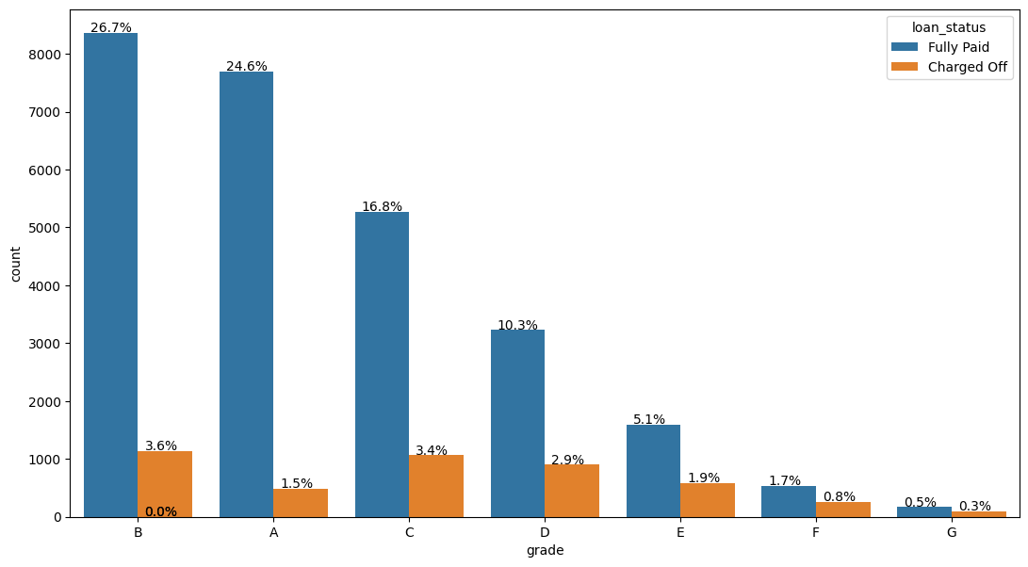
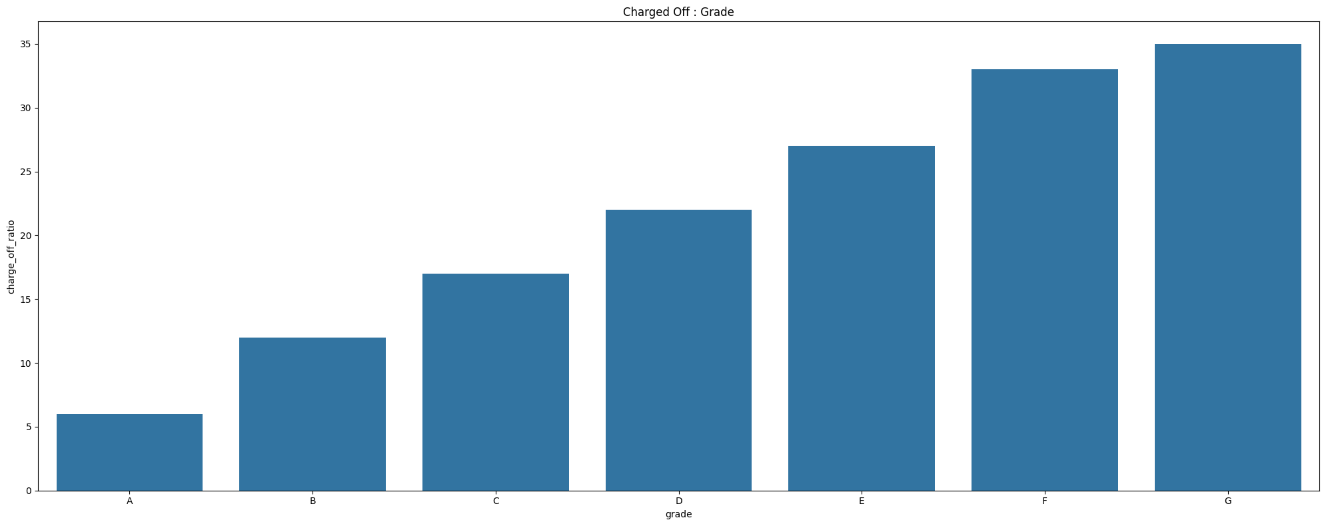
Bivariate Analysis – LC Grade Vs Loan Status
Most of the loan volume is in grade=B
Highest percentage of overall Charge Offs are in grade B (3.7%) and C(3.6%)
If we analyze the Charge Off Ratio to loan status within a category
The highest percentage of Charge Offs are in the grade=G
Highest cluster of Charge Offs are in the grades G,F (> 30%)
The volume of Grade G is extremely low 158 thus it does not contribute to overall risk significantly
Inferences
Highest risk of charge offs are in the grades of B and C in terms of volume
But, In terms of ratio percentages, Grade "F" and "G" have very high chances of charged off. Grade "A" has very less chances of charged off.
Probability of charged off is increasing from "A" to "G"

Slide 25
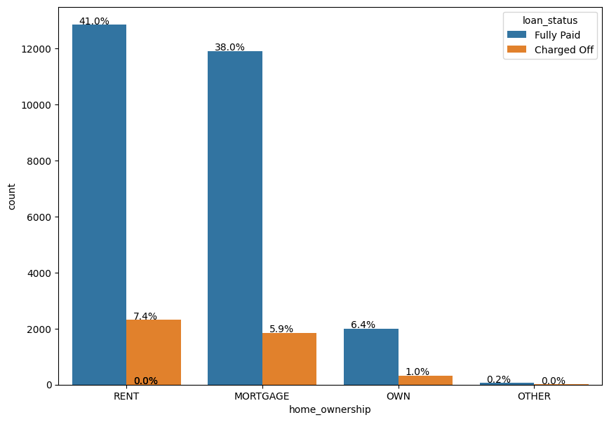
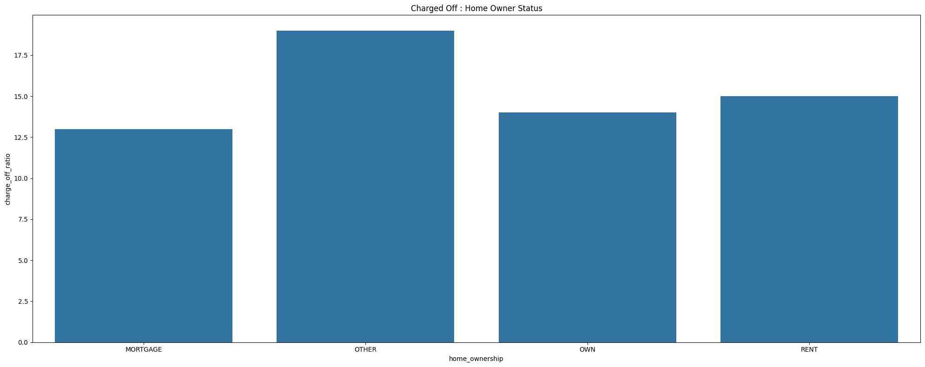
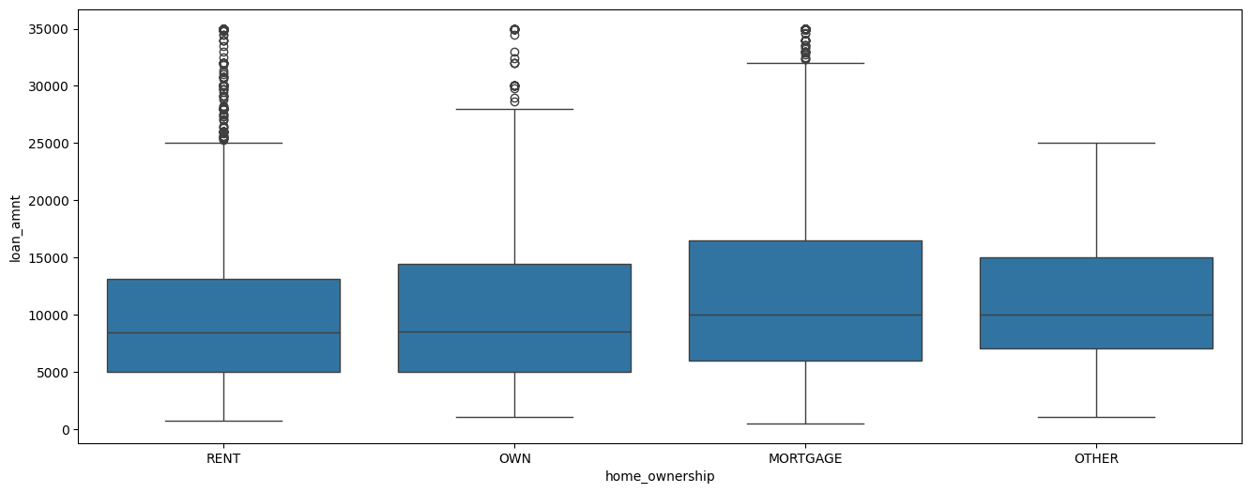
Bivariate Analysis – Home Ownership Vs Loan Status
Overall highest Charge Off numbers are in the category of RENT and MORTGAGE
Within each homeownership category the ratio of Charge Off’s is higher (ignoring Others) on Rented applicants
The homeownership status of RENT and MORTGAGE are at the highest risk of Charge Offs

Slide 26
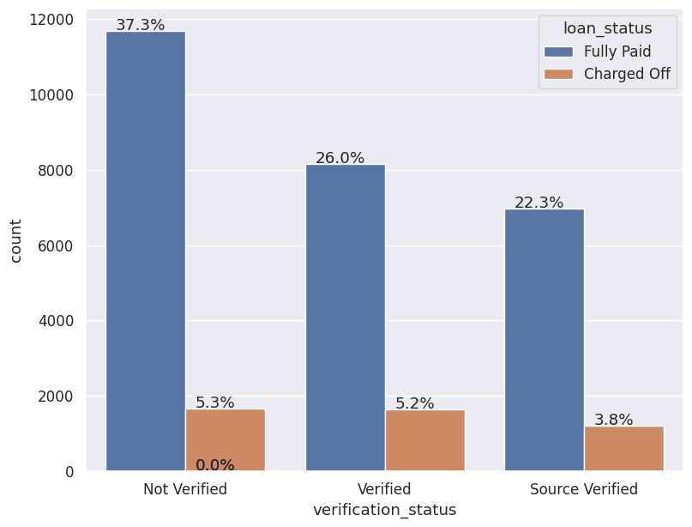
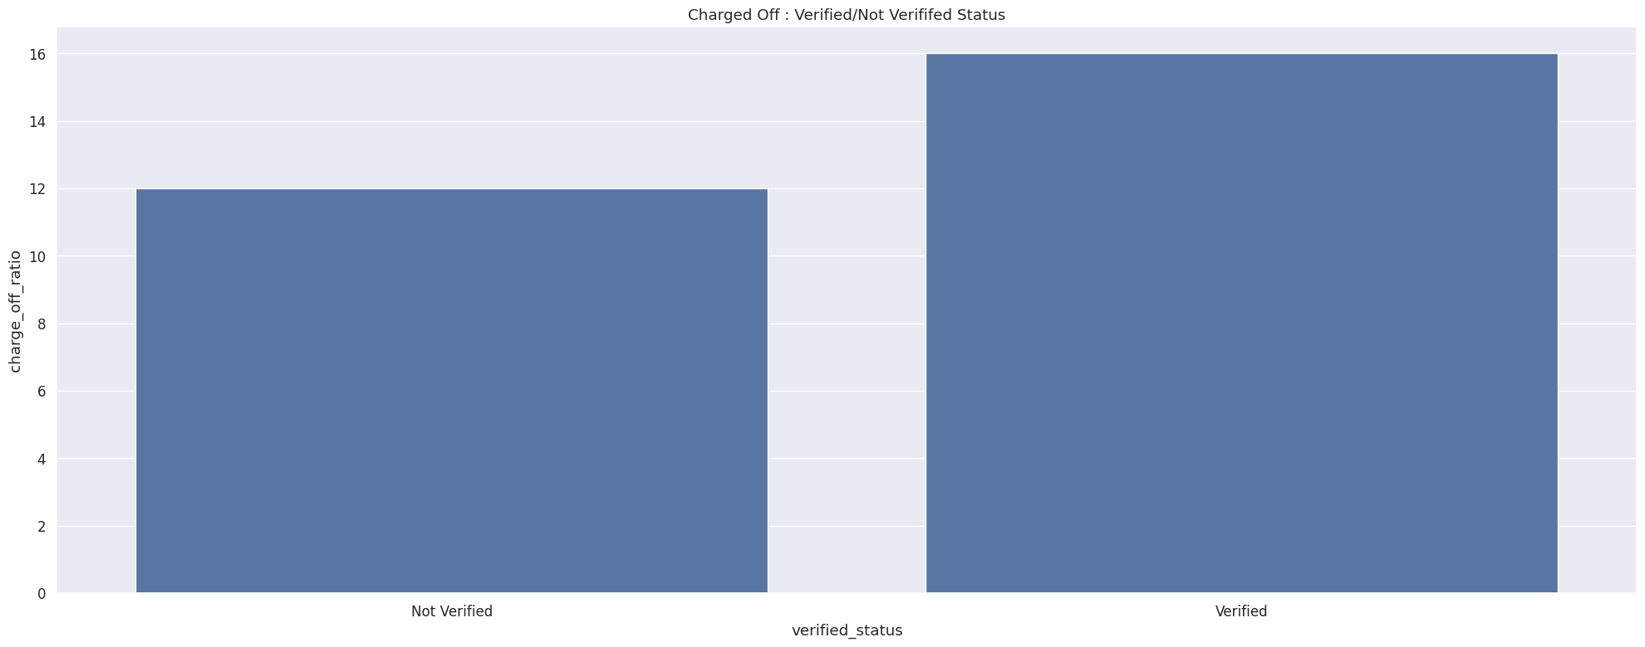
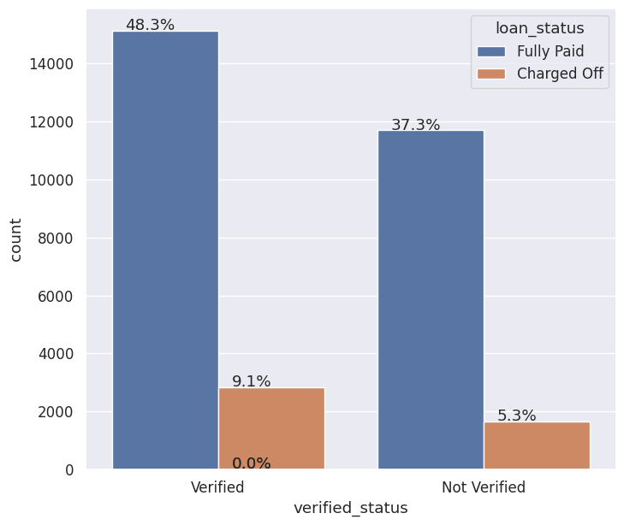
Bivariate Analysis – Verification Status Vs Loan Status
Overall number of applications that have not been verified, when status is source verified or LC verified, the highest number is in the Status of Not Verified Status
When Status of Source Verified and LC Verified is combined as a single Verified Status, then number of charged off customers are higher in Verified status
However, the number of charged off customer in terms of charged off ratio are not significantly impacting with the status of being Verified or Not Verified.

Slide 27
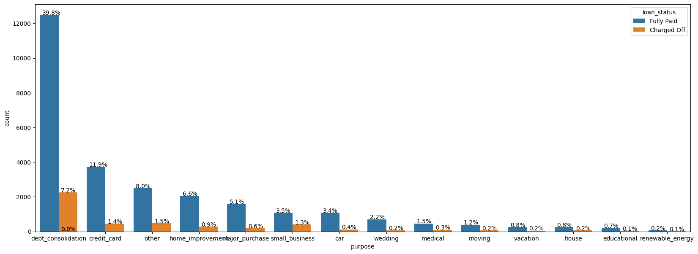
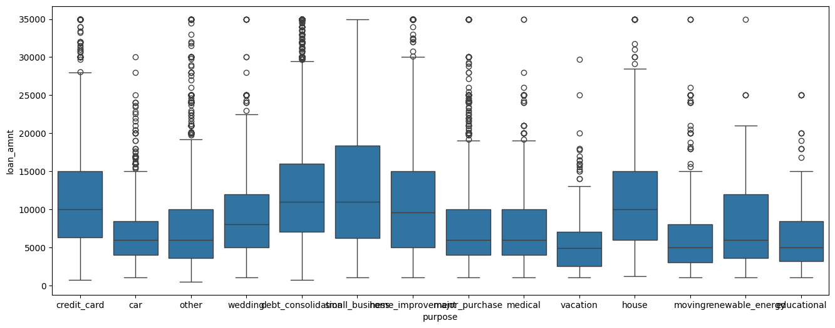
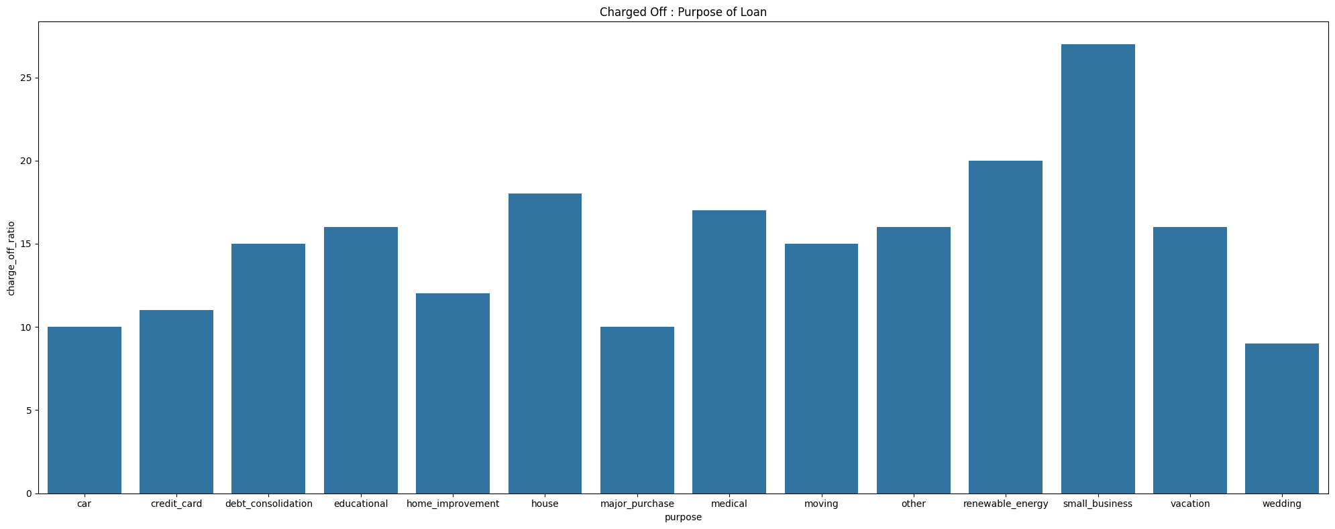
Bivariate Analysis – Loan Purpose Vs Loan Status
Highest risk of Charge Offs are the category of debt consolidation
Highest probability of Charge Offs within a category are small business but the volume is extremely low
Highest loan amount ranges are in small business, debt consolidation and house
Inferences
Highest risk of Charge Off's are the purpose of debt consolidation
Small Business applicants have high chances of getting charged off.
Renewable energy has lowest risk of Charge Off's in volume

Slide 28
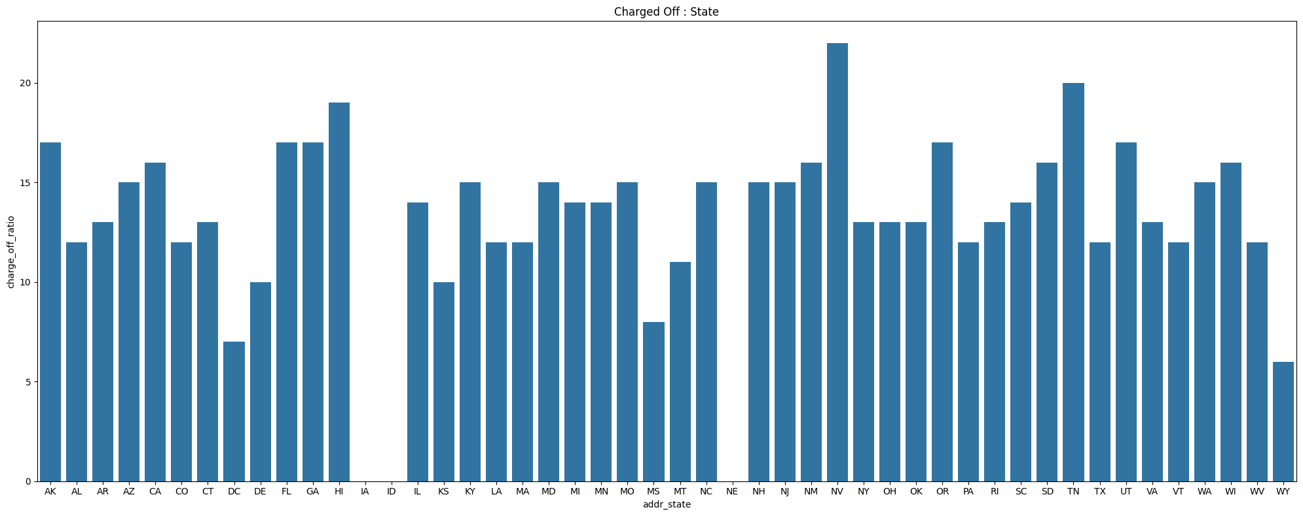
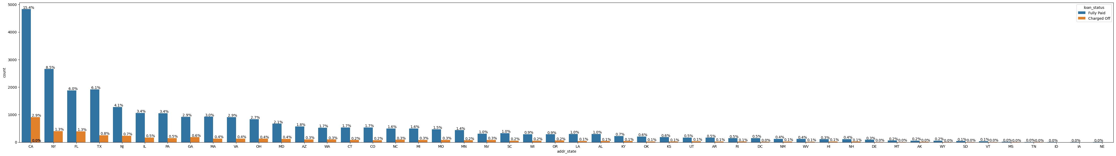
Bivariate Analysis – Address State Vs Loan Status
Highest volume of loans is from CA and purely based on volumes the highest Charge Off's are from CA
Within each state NE and NV has the highest Charge Offs
NE has very low volume this cannot be considered
Loan applications from NV will have high risk
Inferences
Loan applications from NV (Nevada) have high risk of Charge Offs
NE has very high probability of Charge Offs. Volume too low
NV,CA and FL have high percentage of Charge Off's

Slide 29
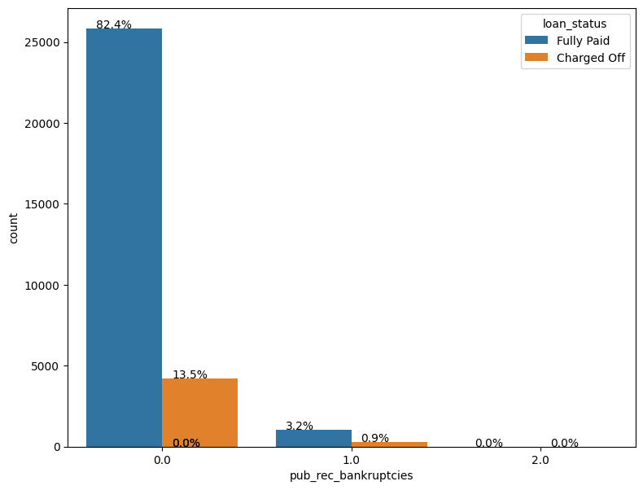
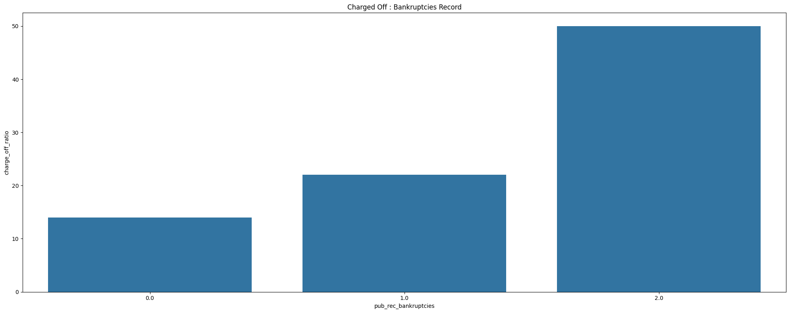
Bivariate Analysis – Public Bankruptcy Record Vs Loan Status
The high volume of loans are in the category of no Bankruptcies
The overall percentage ratio of Charge Off's is slightly higher with one bankruptcy (22%) or more as compared to no bankruptcy (14%)
Therefore, the lender needs to be very careful with people having bankruptcy record, since they have very high chance of defaulting

Slide 30
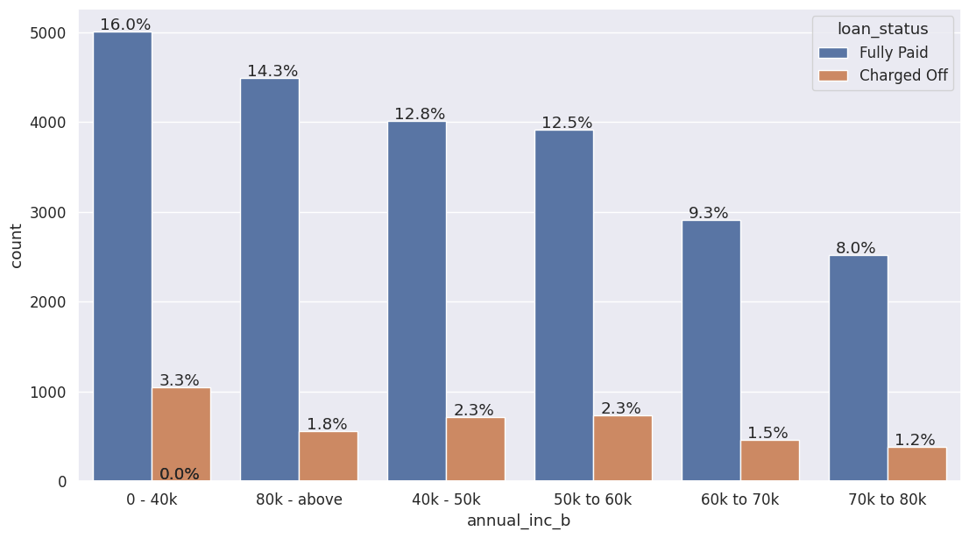
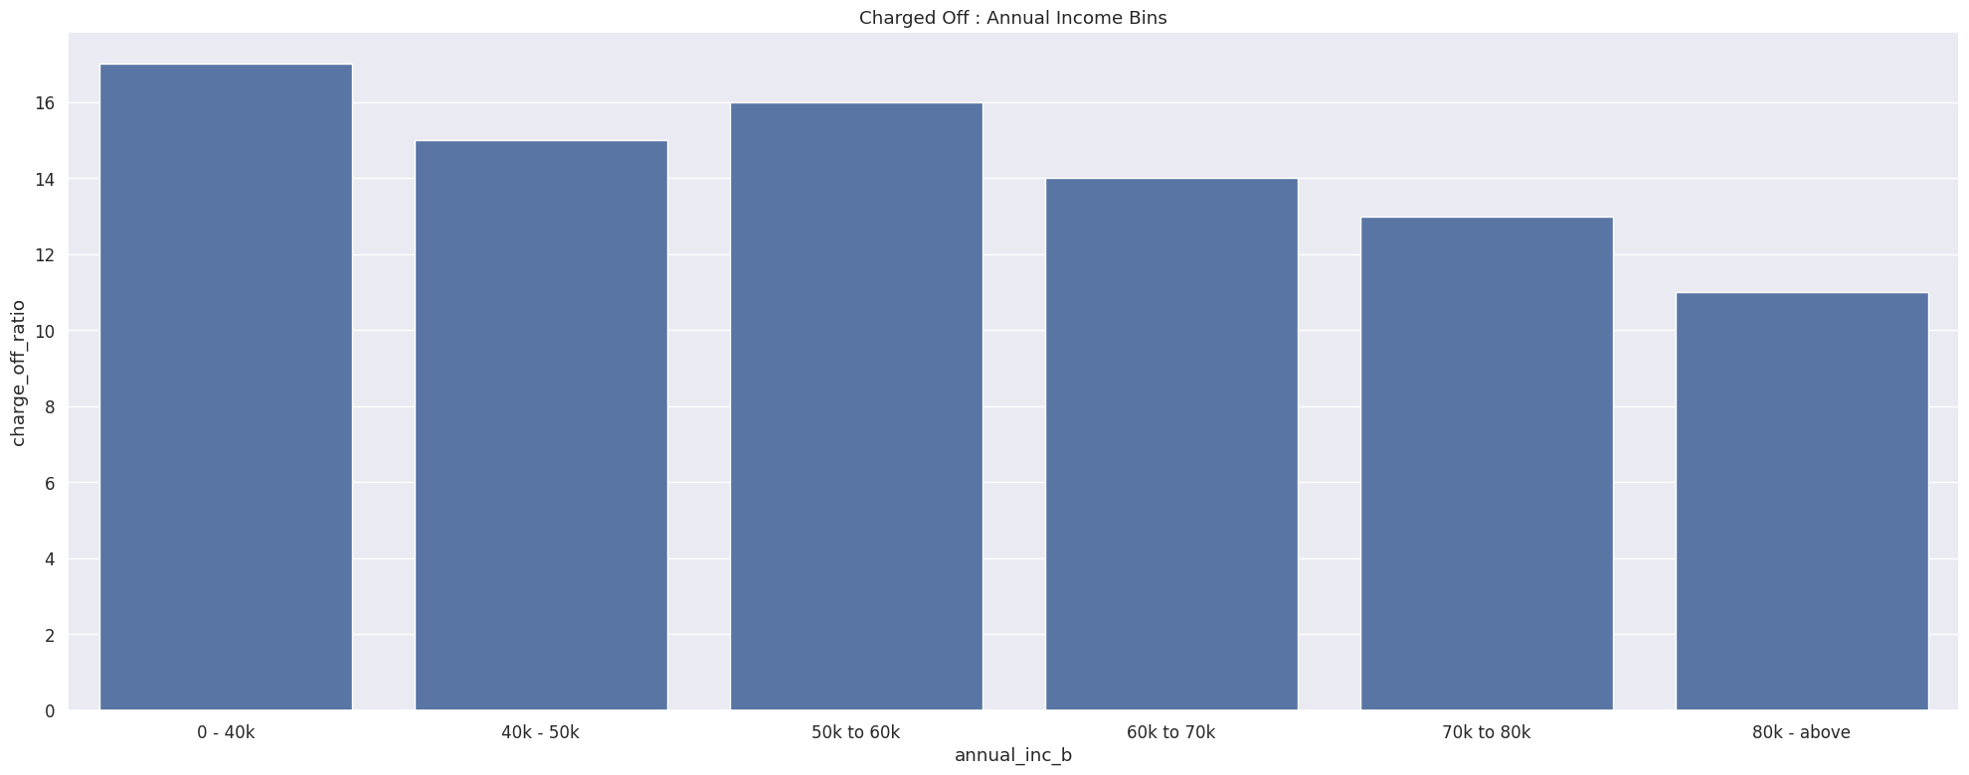
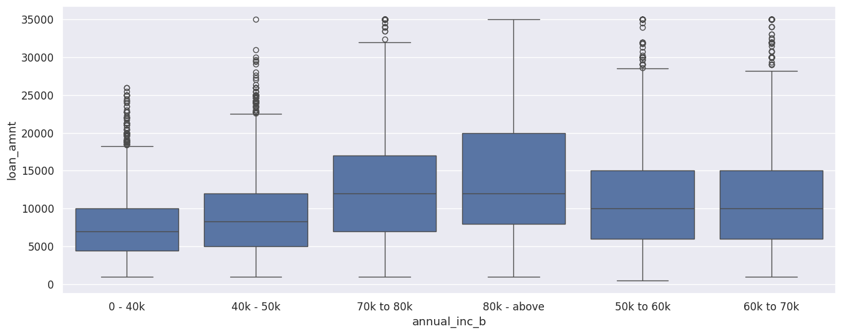
Bivariate Analysis – Annual Income Vs Loan Status
Highest number of loans are disbursed to applicants with annual income of 40k or below
The percentage ratio of Charge Off's is higher for applicants with annual income of 0-40K and 50-60K
Inference
The Lending Company should be careful to approve loans for applicants with annual income of less than 40k or even better anybody less than 60k
Income range 80000+ has less chances of charged off
Increase in annual income charged off proportion decreases.
* Annual Income data filtered with quantiles range between 5% and 90% to remove outliers

Slide 31
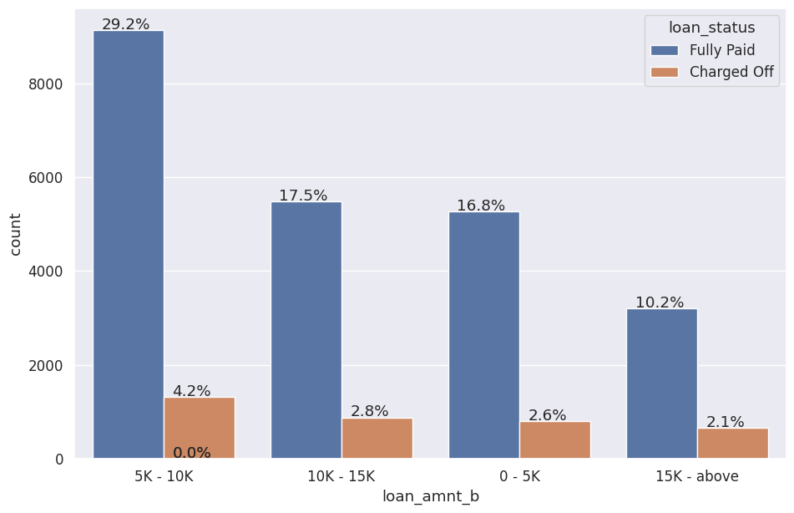
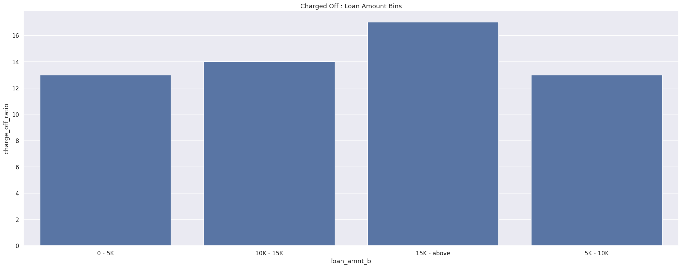
Bivariate Analysis – Loan Amount Vs Loan Status
Based on volume highest percentage of Charge Offs are in the category of 5K to 10k of loan amount
The Charge Off ratio of all the customers within the loan amount of 15K and above is at the highest Charge Off risk
Inferences
Charge Off risk of loan amount 15K and above is at the highest risk
* Loan Amount data filtered with quantiles range between 5% and 90% to remove outliers

Slide 32
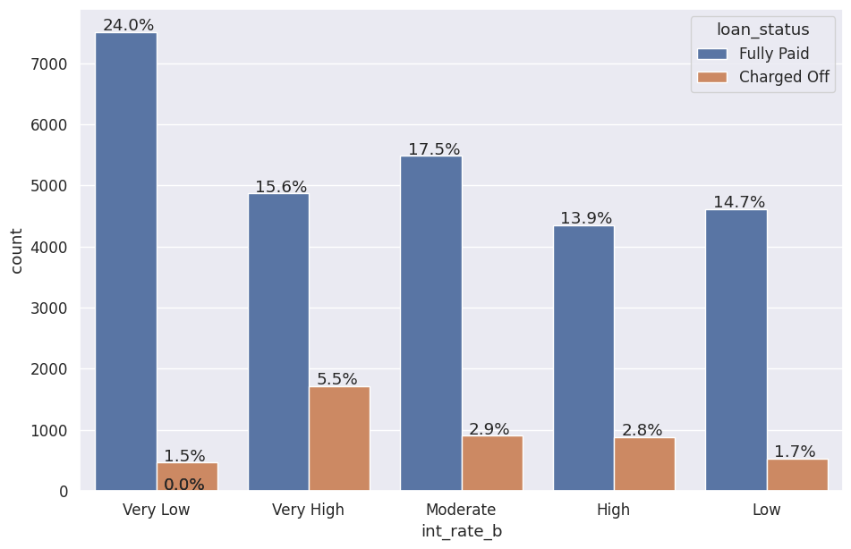
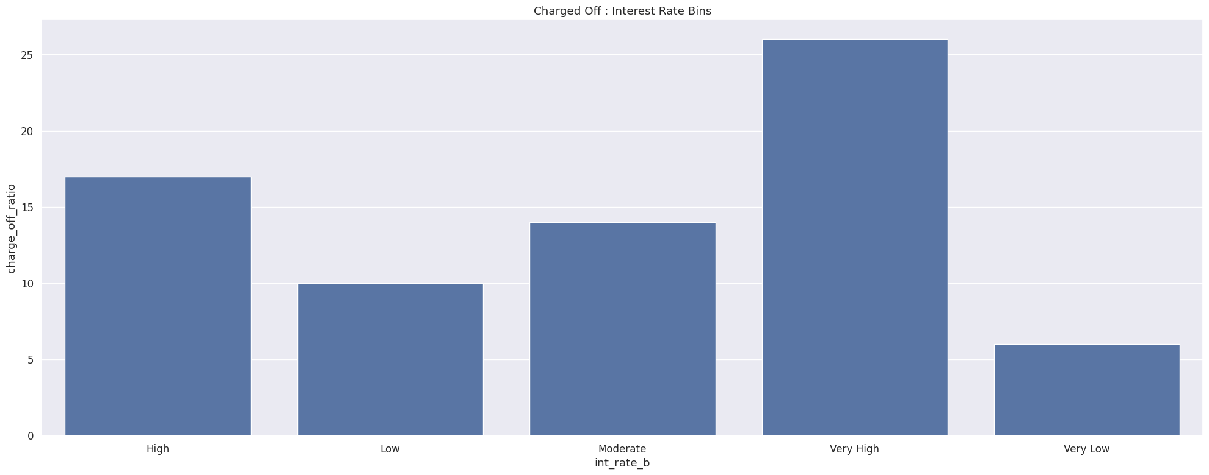
Bivariate Analysis – Interest Rate Vs Loan Status
Based on volume highest percentage of Charge Offs are in the category of Very High Interest Rate
The Charge Off ratio of all the customers within the interest rates of Very high is at the highest Charge Off risk
Inferences
Charge Off risk of Very High Interest Rate of 15% and above is at the highest risk

Slide 33
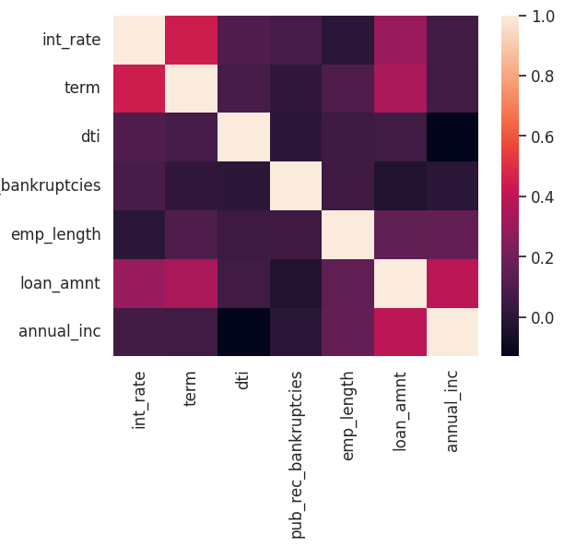
Correlation Analysis
Negative Correlation
Loan amount has negative correlation with those with public record of bankruptcies
annual income has a negative correlation with dti
Strong Correlation
term has a strong correlation with loan amount
term has a strong correlation with interest rate
annual income has a strong correlation with loan_amount
Weak Correlation
public record of bankruptcies has weak correlation with most of the fields

Slide 34
Conclusion Summary

Slide 35
Univariate Analysis Summary - Customer Demographics
Majority of the loan applicants are in the range of 40000- 75000 annual income
Majority of the debt-to-income ratio is in the range of 8% to 17% indicating low (0-15% to moderate DTI (15%-20%) which suggests strong to acceptable financial position and lower risk of defaulting on debt obligations
Majority of the homeowner status are in status of RENT and MORTGAGE
Highest loan applications are in the category of debt consolidation
CA (California) state has the maximum amount of loan applications
Majority of the loan applicants are in the category of not having any public record of bankruptcies, which indicates positive financial stability, good credit history and low risk
Majority of the employment length of the customers are 10+ years and then in the range of 0-2 years

Slide 36
Univariate Analysis Summary
Loan Demographics
Highest loan amount applications fall in the range of 5k to 10k
Majority of the interest rate is in the range of 8% to 15%
Majority of the installment amount is in the range of 180 to 400
Majority of the loan applications counts are in the term of 36 months
Majority of loan application counts fall under the category of Grade B
Time Based Analysis
Loan application counts are increasing year over year
Highest loan application volume in Quarter 4 of every year
Lowest loan applications are in Q1
Possibly because by year ends people face the financial challenges
Possibly because of festive seasons
Possibly because they are consolidating debt by year end

Slide 37
Univariate Analysis Summary – Inferences
The customer demographic data shows which segment of customers to target for highest volume of loan and not default
Indicates more analysis is needed why other categories are not as high as other few
Indicates the Lending Club to be prepared to handle high volume in Q4
Indicates the Lending Club to target customers in other quarters to increase sales

Slide 38
Bivariate Analysis Summary – Inferences
Lending Club Company need to be aware of the following driver variables about:
1. Term Limit
Individuals seeking 60-month loan terms require more rigorous evaluation due to the increased default risk (25%) compared to those with shorter 36-month terms.
2. Grades
Charge-off volume is highest for grades B and C.
However, grades F and G have the highest charge-off ratios.
Probability of charge-off increases steadily from A to G.
3. Applicants Homeownership
The homeownership status of RENT and MORTGAGE are at the highest risk of Charge Offs
4. Verification Status
Charge-off rate is not significantly impacted by verification status (Verified or Not Verified), though purely in terms of volume Not Verified applicants are higher.
Focus on other factors to improve lending decisions.
Investigate potential flaws in the verification process.

Slide 39
Bivariate Analysis Summary – Inferences
5. Loan Purpose
Debt consolidation has the highest volume of charge-offs.
Small business loans carry a higher risk of charge-off.
Renewable energy projects experience the lowest volume of charge-offs.
6. Address State
Highest volume of loans is from CA and purely based on volumes the highest Charge Off's are from CA
Loan applications from the state NV are having high risk of defaulting,
The lending company needs to be cautious about lending to applicants from NV
7. Public Bankruptcy Records
The lender needs to be very careful with people having any public bankruptcy record in their name, since they have very high chance of defaulting.
8. Annual Income
The Lending Company should be careful to approve loans for applicants with annual income of less than 40k or even better anybody less than 60k.
Income range 80k+ has less chances of charged off
Increase in annual income charged off proportion decreases.

Slide 40
Bivariate Analysis Summary – Inferences
9. Loan Amount
For loan amount, the highest volume of charge-offs falls within the $5,000 to $10,000 category.
However, customers with loan amounts of $15,000 and above have the highest charge-off ratio, indicating a greater risk per loan.
10. Interest Rates
High interest rates are associated with increased charge-off risk. This could be due to affordability issues or applicants with high need regardless of interest rate.
Loans with interest rates of 15% and above face the highest charge-off risk.

