Slide 1
Lending Club Case Study
Prachi Goliwadekar
Rathnagiri Nagarajan

Slide 2
General Info
During the EPGP course, this case study serves as an assignment aimed at comprehending the given scenario, applying EDA techniques acquired throughout the coursework, and offering insights into data patterns to address business objectives.

Slide 3
Background of Lending Club
Lending Club is a consumer finance company which specializes in lending various types of loans to urban customers.
The company could face the following issues if it doesn’t evaluate the loan applicant diligently:
Credit Loss:
Common financial loss for lending companies
Arises from lending to 'risky' applicants
Occurs when borrowers fail to pay or default on their loans
Defaulters ('Charged-Off' Customers):
Borrowers who cause the largest amount of loss to lenders
Organization aims to identify and stay away from such borrowers
Goal is to minimize credit loss and financial risks

Slide 4
Objective
The objective is to use EDA techniques against past loan applicant’s data to:
Determine critical factors that will Improve ability to identify High-risk applicants and take precautionary actions
Cut down credit loss by identifying High Risk applicants driving attributes (or driver variables) that may lead to loan default
Improve Business portfolio and risk assessment

Slide 5
EDA Techniques used in evaluating case study
Analyze, clean and prepare data for statistical analysis
Univariate analysis
Unordered Categorical Variable Analysis
Ordered Categorical Variable Analysis
Derived Variable Analysis
Bivariate Analysis
Correlation Analysis

Slide 6
Analyze Dataset and Clean data
Following methods were employed to prepare dataset for analysis
Find and drop the columns with all Null Values
Drop columns with with few values or not be useful for analysis
Exclude rows that has outliers
Clean and Correct the datatype of columns
by removing trailing characters like “%” and converting it into relevant datatypes
split date string column into day, month and year columns
Rounding off columns to 2 decimal places
Consider only the rows with loan_status != “Current”, the reason being they are already paying customers
Drop text columns that may not be useful

Slide 7
Analyze Dataset Contd..,
Create and Add derived columns especially the following for histograms bins (buckets)
Loans Issue month bins as follows: Q1, Q2, Q3, Q4
Debt to Income ratio bucket: Very Low, Low, Moderate, High and Very High
Loan Amount bucket:0-5k, 5K – 10K, 10K-15K, 15K-above

Slide 8
Univariate Analysis
The following variables were considered for Univariate Anlysis:
Loan amount
Funded amount
Investors funded amount
Interest Rate
Installment amount
Annual Income of applicants
Debt to Income Ratio

Slide 9
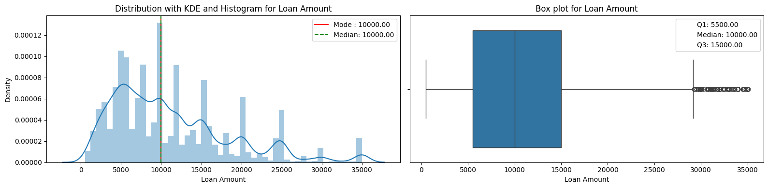
Univariate Analysis - Loan amount
The KDE curve indicates there is multi-modal clusters, With the peak of the KDE line is at 5000 and further smaller peak at 10000 and so on, indicating the most common loan amount is around the modal clusters of 5,000 and 10000.
The median is 10000, signifying that half of the loans are below 10000 and half are above.
While the box plot indicates that most of the loan amount is in range of 5000 and 15000, the difference between the smaller mode 5000 and median from box plot confirms that the plot is rightward skew, with the "tail" of higher loan amounts greater than 15000, pulling the median towards higher value despite the majority number of loans being smaller.

Slide 10

Univariate Analysis – Funded Amount
The KDE curve indicates there is multi-modal clusters, With the peak of the KDE line is at 5000 and further smaller peaks at 10000 and so on, indicating the most common loan funded amount is around the modal clusters of 5,000 and 10000.
The median is 9600, signifying that half of the loans are below 10000 and half are above.
While the box plot indicates that most of the loan amount is in range of 5000 and 15000, the difference between the smaller mode 5000 and median from box plot confirms that the plot is rightward skew, with the "tail" of higher loan funded amounts greater than 15000, pulling the median towards higher value despite the majority number of loans funded being smaller.

Slide 11
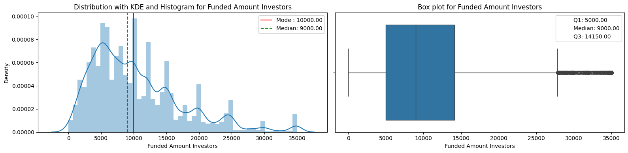
Univariate Analysis – Investors Funded Amount
Most of the loan funded amounts inv are between 5K to 14 K

Slide 12
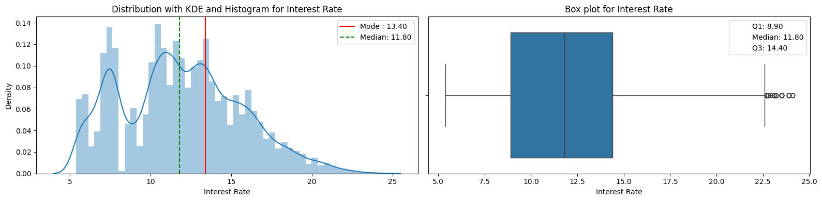
Univariate Analysis – Interest Rate
The KDE curve indicates there is multi-modal clusters, With the peak of the KDE line is at 10.8 and further smaller peaks at 7.5, 13.40 and so on, indicating the most common Interest rate is around the modal clusters of 10.8 and 13.40.
The median is 11.8, signifying that half of the Interest rates are below 11.8 and half are above.
While the box plot indicates that most of the Interest rates is in range of 8.90 and 14.40, the difference between the smaller mode 7.5 or 10.8 or 13.40 and median from box plot confirms that the plot is rightward skew, with the "tail" of higher *Interest rate amounts greater than 14.0, pulling the median towards higher value despite the majority number of Interest rates being smaller.

Slide 13
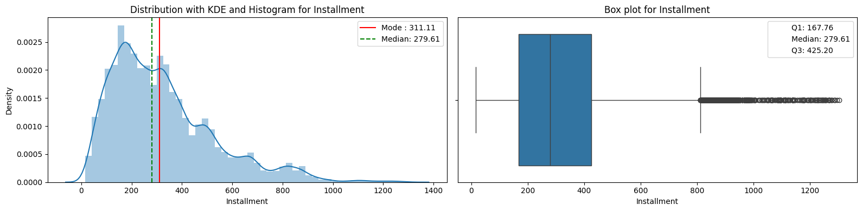
Univariate Analysis – Interest Rate
Most of the installments are between 180 to 420

Slide 14
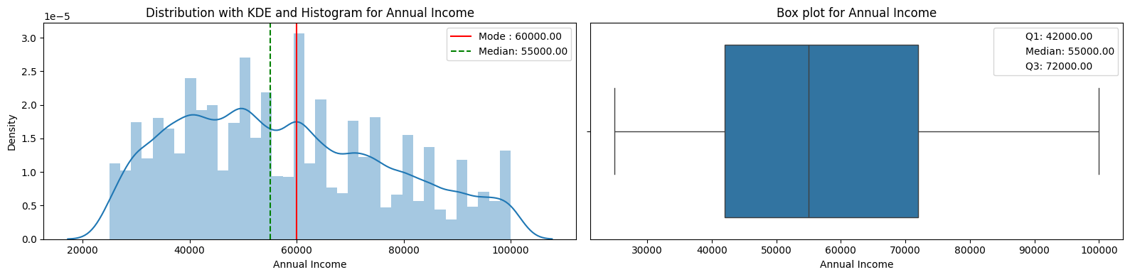
Univariate Analysis – Annual Income
Before removal of outliers, Most of the annual income was between 5 lacs to 10 lacs and therefore This column required major outlier treatment. So, the Annual income corresponding to bottom 5% and top 15% were removed and only data between 5% to 85% were considered.
The KDE curve indicates there is multi-modal clusters, With the peak of the KDE line is at 50000 and further smaller peaks at 40000 and 55000 and so on, indicating the most common Annual Income is around the modal clusters of 40000 and 60000.
The median is 55000, signifying that half of the Annual Income are below 55k and half are above.
While the box plot indicates that most of the Annual Income is in range of 42000 and 72000, the difference between the smaller mode values of 50000 or 40000 or 60000 and median from box plot confirms that the plot is rightward skew, with the "tail" of higher *Annual Income* amounts greater than 72000, pulling the median towards higher value despite the majority number of Annual Income being smaller.

Slide 15
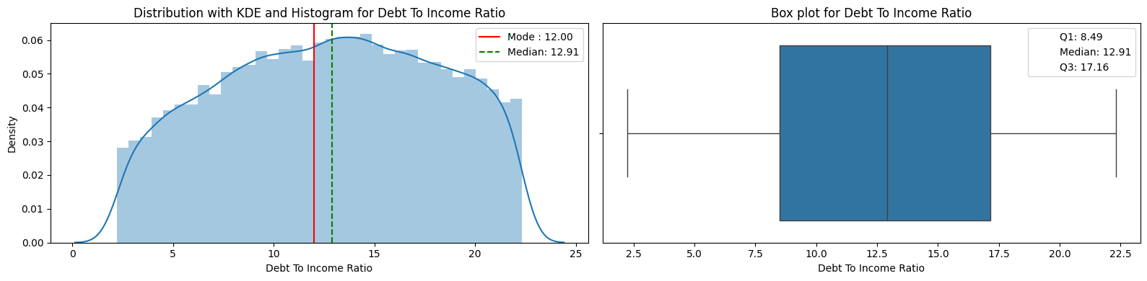
Univariate Analysis – Debt to Income (DTI) Ratio
Due to large number of outliers the bottom 5% and top 10% were excluded from the analysis
The KDE graph and histogram plot now shows a central tendency and single modal with most of the applicant debt to income ratio were in the range of 8.49% and 17% approximately.
The single modal cluster seems to be concentrated around the 12% which shows most loans are being given to applicants with Low DTI (0-15%).
This suggests most applicants have a strong financial position and a lower to medium risk of defaulting on debt obligations

Slide 16
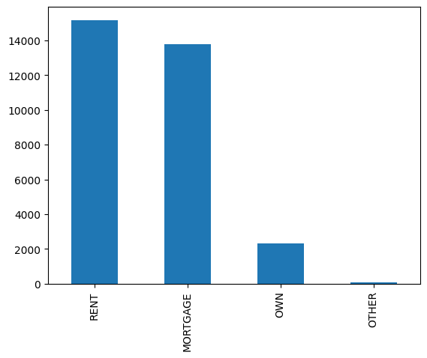
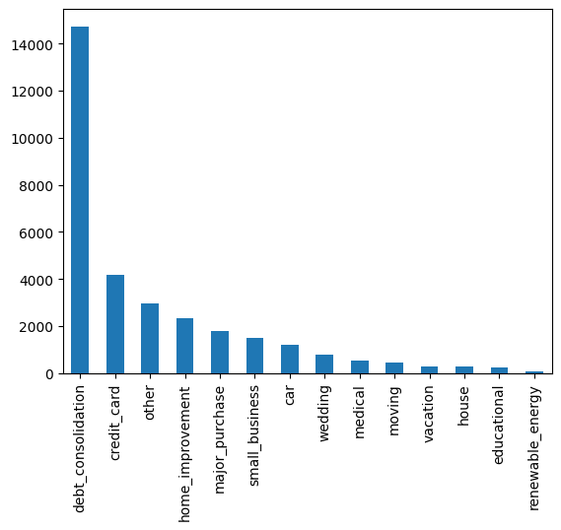
Unordered Categorical Variable Analysis
Majority of the homeowner status are
in status of RENT and MORTGAGE
Majority of the purposes of loan is debt consolidation

Slide 17
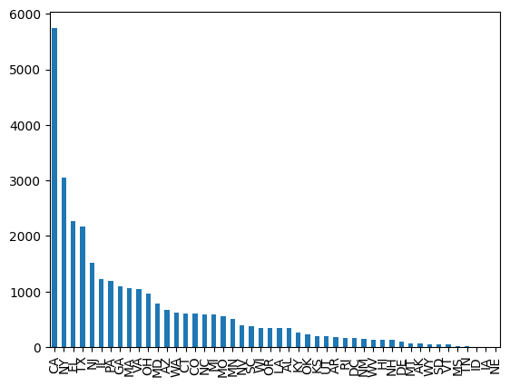
Unordered Categorical Variable Analysis
CA State has the maximum amount of loan applications

Slide 18
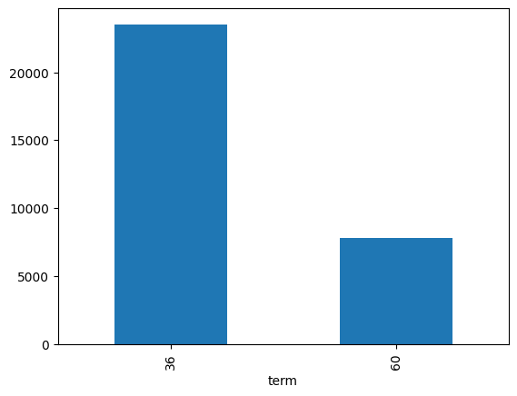
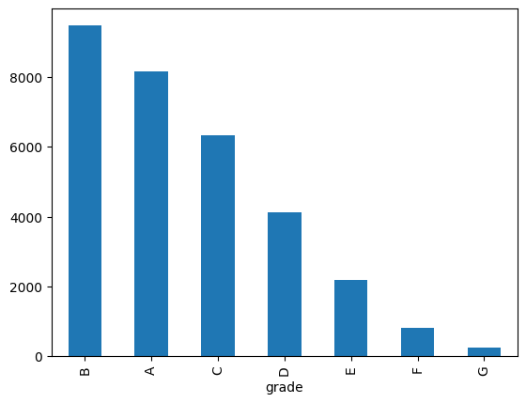
Ordered Categorical Variable Analysis
Most of the loans are of 36 months duration
Most of the loans are of Grade B

Slide 19
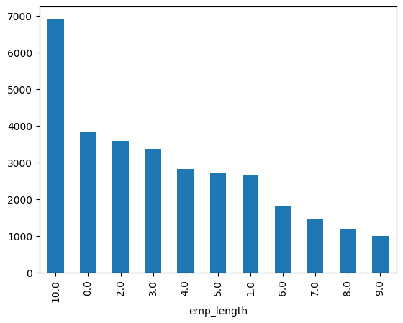
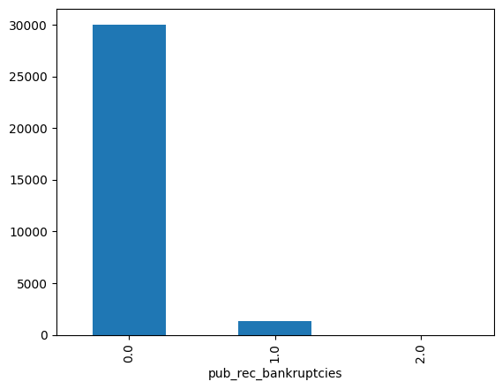
Ordered Categorical Variable Analysis
Majority of the employment length of the customers are 10+ years and then in the range of 0-2 years
Majority of the loan applicants are in the category of not having a public record of bankruptcies

Slide 20
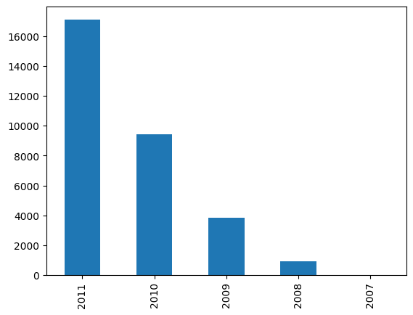
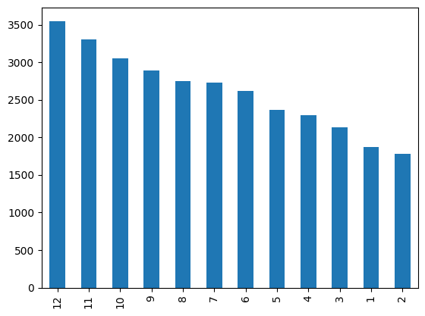
Derived Variable Analysis
Loan application count year over year
Loan application counts highest in year end
The lowest loans application count are in the month of Jan/Feb/March and highest counts are in 10/11/12.
Possibly because by year ends people face the financial challenges
Possibly because of festive seasons
Possibly because they are consolidating debt by year end

Slide 21
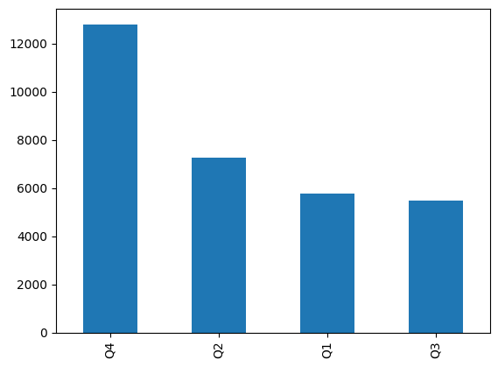
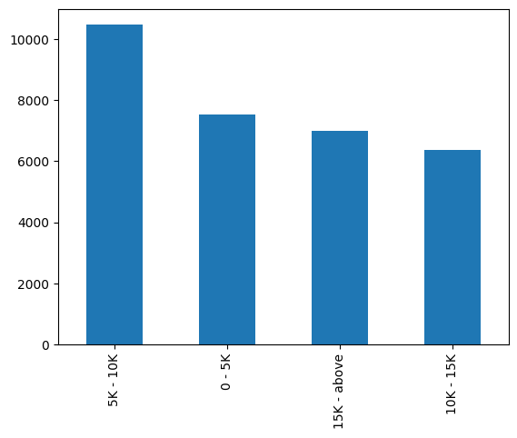
Derived Variable Analysis
Highest loan application volume in Quarter 4 of a year
Highest loan amount applications fall in the range of 5k to 10k

Slide 22
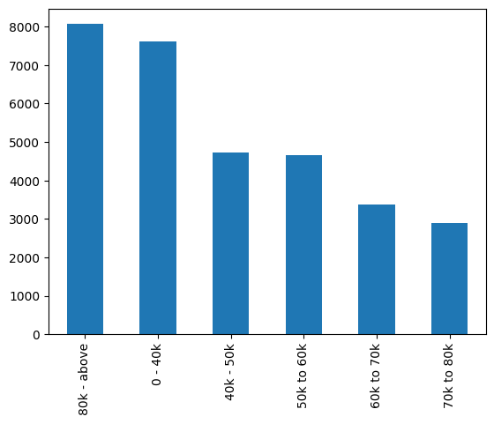
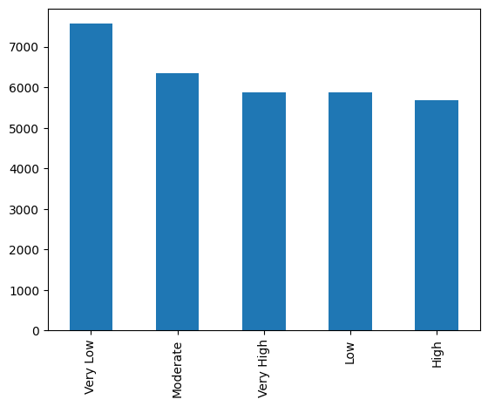
Derived Variable Analysis
Most applicants have Very low or Moderate DTI ratio indicating financially stable applicants
Highest loan applicant income is 80k and above

Slide 23
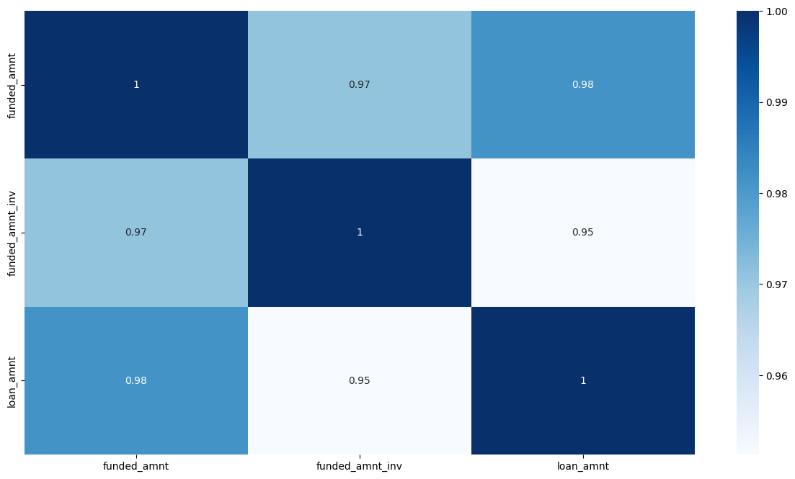
Derived Variable Analysis – Identify Key correlations
Loan Amount, investors funded amount and the funded amount all have high correlation – indicating most people get funded their loan amount

Slide 24
Bivariate Analysis
A

Slide 25
Summary Observations

Slide 26
Univariate Analysis Summary - Customer Demographics
Majority of the loan applicants are in the range of 40000- 75000 annual income
Majority of the debt-to-income ratio is in the range of 8% to 17% indicating low (0-15% to moderate DTI (15%-20%) which suggests strong to acceptable financial position and lower risk of defaulting on debt obligations
Majority of the homeowner status are in status of RENT and MORTGAGE
Highest loan applications are in the category of debt consolidation
CA (California) state has the maximum amount of loan applications
Majority of the loan applicants are in the category of not having any public record of bankruptcies, which indicates positive financial stability, good credit history and low risk
Majority of the employment length of the customers are 10+ years and then in the range of 0-2 years

Slide 27
Univariate Analysis Summary – Loan Demographics
Highest loan amount applications fall in the range of 5k to 10k
Majority of the interest rate is in the range of 8% to 15%
Majority of the installment amount is in the range of 180 to 400
Majority of the loan applications counts are in the term of 36 months
Majority of loan application counts fall under the category of Grade B

Slide 28
Univariate Analysis Summary – Time Based Analysis
Loan application counts are increasing year over year
Highest loan application volume in Quarter 4 of every year
Lowest loan applications are in Q1
Possibly because by year ends people face the financial challenges
Possibly because of festive seasons
Possibly because they are consolidating debt by year end

Slide 29
Univariate Analysis Summary – Inferences
The customer demographic data shows which segment of customers to target for highest volume of loan
Indicates more analysis is needed why other categories are not as high as other few
Indicates the Lending Club to be prepared to handle high volume in Q4
Indicates the Lending Club to target customers in other quarters to increase sales

Slide 30
Conclusion

