Slide 1
Road Accident Patterns and Safety Analysis
- A Data-Driven Approach to Reducing Accidents
Group 15
Dhruvi Mehta -(202318003)
Prachi Mehta -(202318008)
Riya Dave -(202318011)
Simran Dalvi -(202318042)

Slide 2
CONTEXT

Slide 3
Context
Road traffic accidents are a major cause of injury and death globally, creating both human and economic burdens.
Understanding factors like accident severity, weather conditions, vehicle types, and road surface conditions is vital for safety policies.
This analysis uses UK road accident data (2019-2022) to identify high-risk conditions, with the goal of aiding decision-makers in resource allocation.

Slide 4
PROBLEM STATEMENT

Slide 5
Problem Statement
Road accidents have significant social, economic, and health impacts. However, understanding how factors like location, vehicle type, road conditions, and weather interact to influence accident frequency and severity remains challenging.
Policymakers and traffic authorities face limited access to real-time, comprehensive data, making it difficult to identify trends, allocate resources effectively, and implement targeted interventions to prevent accidents.

Slide 6
DATASET

Slide 7
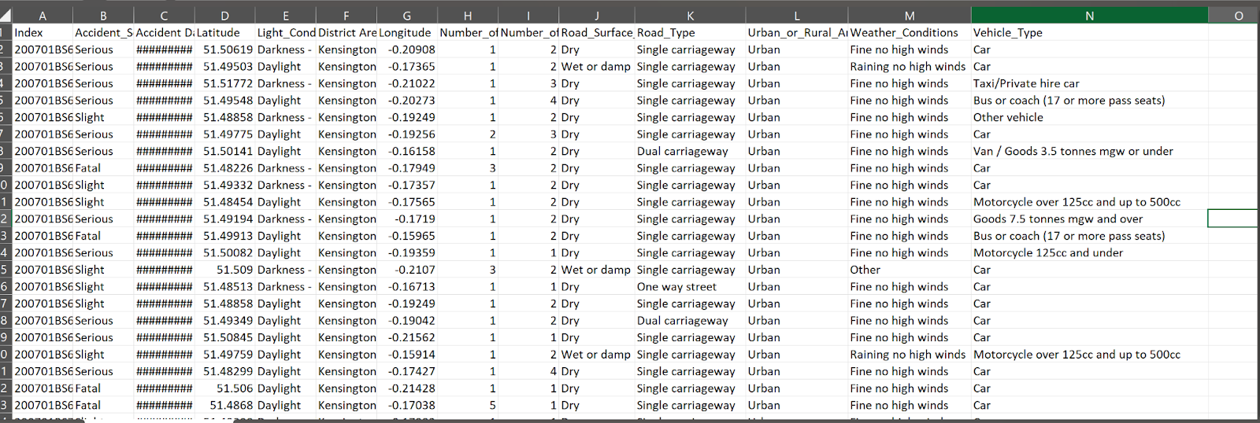
Dataset Description
The dataset contains 14 fields and 660,679 records, detailing accident severity, date, location, road conditions, vehicle types, weather conditions, and more.
This information enables a thorough analysis of accident patterns and safety factors.

Slide 8
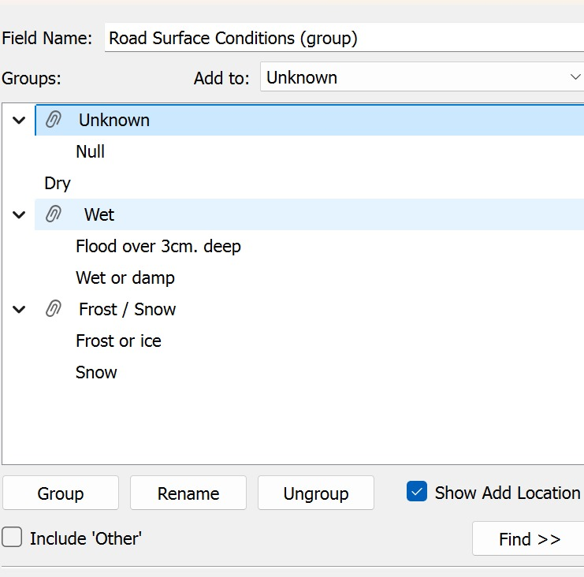
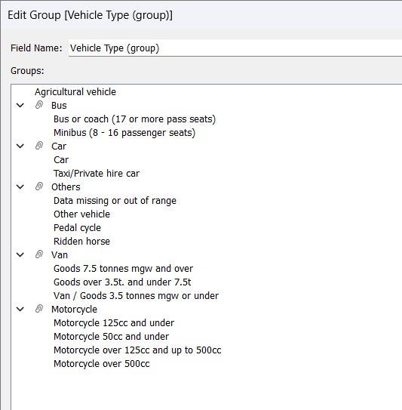
Grouped Fields
Road Surface Condition
Classifies road surface conditions into four categories: Dry, Frost/Snow, Unknown, Wet.
Vehicle Type
Groups vehicle types into six categories: Agricultural vehicle, Bus, Car, Motorcycle, Others, Van.

Slide 9
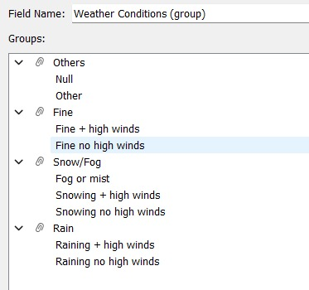
Weather Conditions
Groups weather conditions into Fine, Rain, Snow/Fog, and Others.

Slide 10
Calculated Fields
CY (Current Year) Fields:
PY (Previous Year) Fields:
YoY (Year-over-Year) Fields
CY Accidents: Counts accidents in the current year.
CY Casualties: Sums casualties in the current year.
CY Fatal Casualties: Sums fatalities in the current year.
CY Serious Casualties: Sums serious injuries in the current year.
CY Slight Casualties: Sums slight injuries in the current year.
Formula (example):
SUM(IF YEAR([Accident Date])=[Current Year] THEN [Number of Casualties] END)
PY Accidents: Counts accidents in the previous year.
PY Casualties: Sums casualties in the previous year.
PY Fatal Casualties: Sums fatalities in the previous year.
PY Serious Casualties: Sums serious injuries in the previous year.
PY Slight Casualties: Sums slight injuries in the previous year.
Formula (example):
SUM(IF YEAR([Accident Date])=[Previous Year] THEN [Number of Casualties] END)
YoY Accidents: Calculates the percentage change in accidents from last year to this year.
YoY Casualties: Calculates the percentage change in casualties from last year to this year.
YoY Fatal Casualties: Calculates the percentage change in fatalities from last year to this year.
YoY Serious Casualties: Calculates the percentage change in serious injuries from last year to this year.
YoY Slight Casualties: Calculates the percentage change in slight injuries from last year to this year.
Formula (example):
([CY Accidents] - [PY Accidents]) / [PY Accidents]

Slide 11

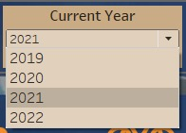
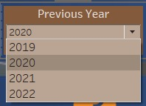
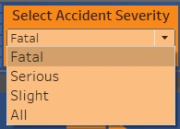
Parameters
CY (Current Year) Fields:
PY (Previous Year) Fields
Accident Severity

Slide 12
HYPOTHESIS

Slide 13
Weather Paradox
Mild weather events may lead to more severe accidents than extreme weather conditions.
Traditionally, severe weather conditions like heavy rain, snow, or fog are seen as the main contributors to accidents. However, this hypothesis suggests that mild weather changes, such as sudden light rain or slight temperature drops, may actually lead to more severe accidents.
In mild adverse conditions, drivers may become overconfident, failing to adjust their speed or account for slippery surfaces. This complacency can result in more severe accidents than in extreme weather, where drivers tend to be more cautious.

Slide 14
Size-Effect Illusion
Smaller vehicles may contribute to more severe accidents in collisions with larger vehicles
While it’s generally assumed that larger vehicles are more likely to cause severe accidents due to their mass and momentum, this hypothesis suggests focusing on the vulnerability of smaller vehicles in collisions with larger ones.
When smaller vehicles collide with larger ones, the size difference often leads to catastrophic outcomes for the smaller vehicle, resulting in higher fatality and injury rates. This challenges the idea that larger vehicles always pose a greater risk by highlighting the increased danger to smaller vehicles in mixed-vehicle collisions.

Slide 15
Urban Myopia
Poorly maintained urban infrastructure may lead to higher accident rates than traffic congestion alone.
Urban areas are high-risk zones not only because of traffic congestion but also due to hidden hazards in outdated or poorly maintained infrastructure. Features like poorly marked roads, sudden lane changes, and inadequately lit intersections increase accident risks, particularly for unfamiliar drivers.
Unlike urban areas, rural regions have simpler road designs and fewer infrastructure issues, presenting fewer challenges for drivers. This often results in lower accident frequency and severity, despite the generally lower traffic volumes.

Slide 16
QUESTIONS

Slide 17
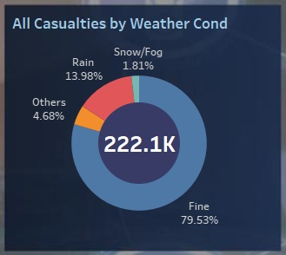
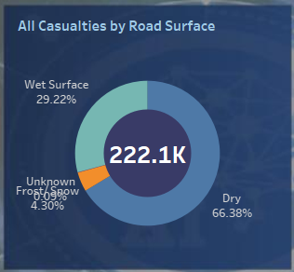
1. What are the key environmental and road conditions that contribute to severe accidents?

Slide 18
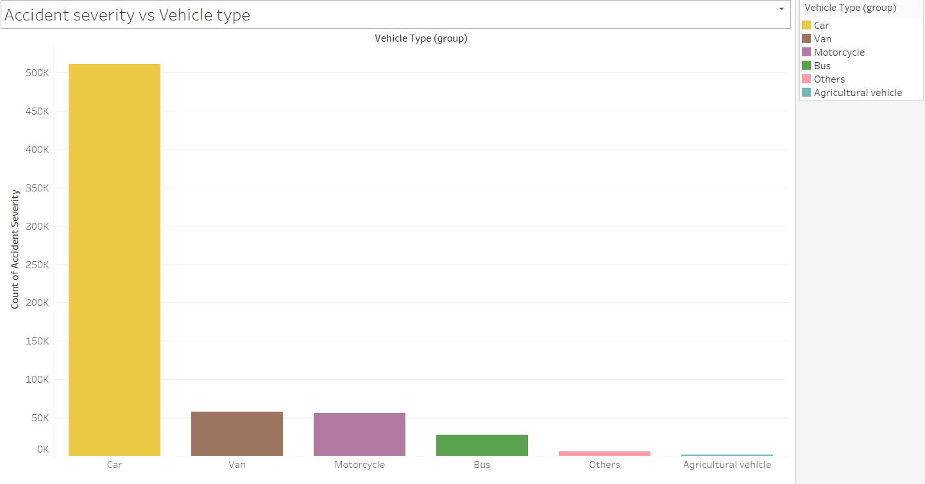
2. How do different vehicle types (cars, trucks, buses) impact accident severity and casualty rates?

Slide 19
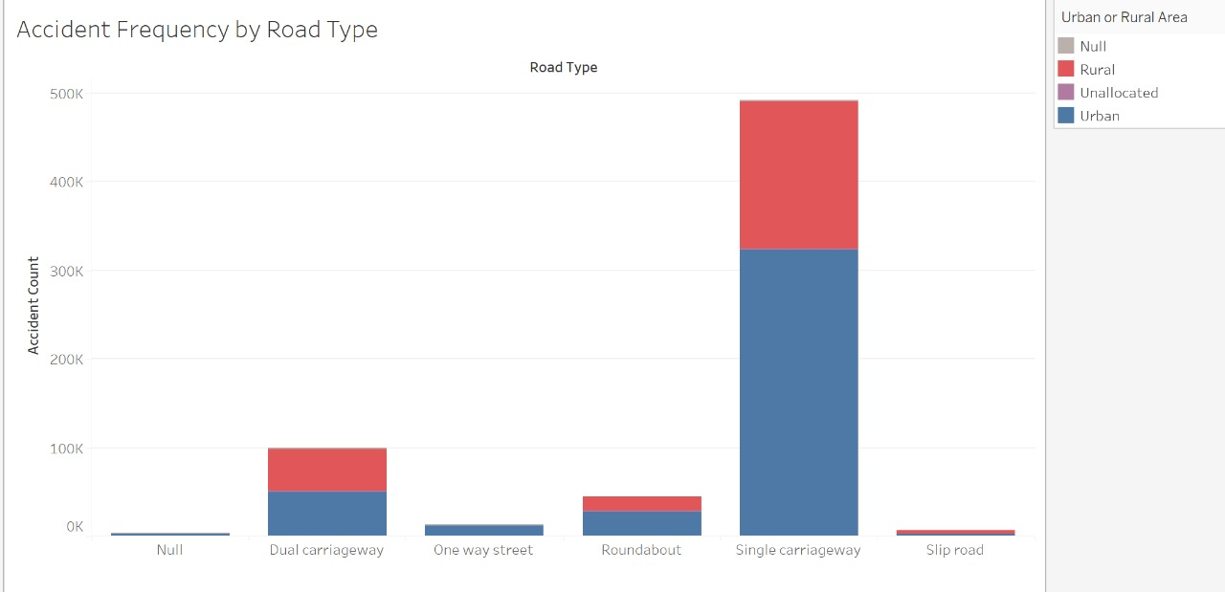
3. Which geographic areas (urban vs. rural) experience higher accident frequencies, and what specific factors contribute to these patterns?

Slide 20
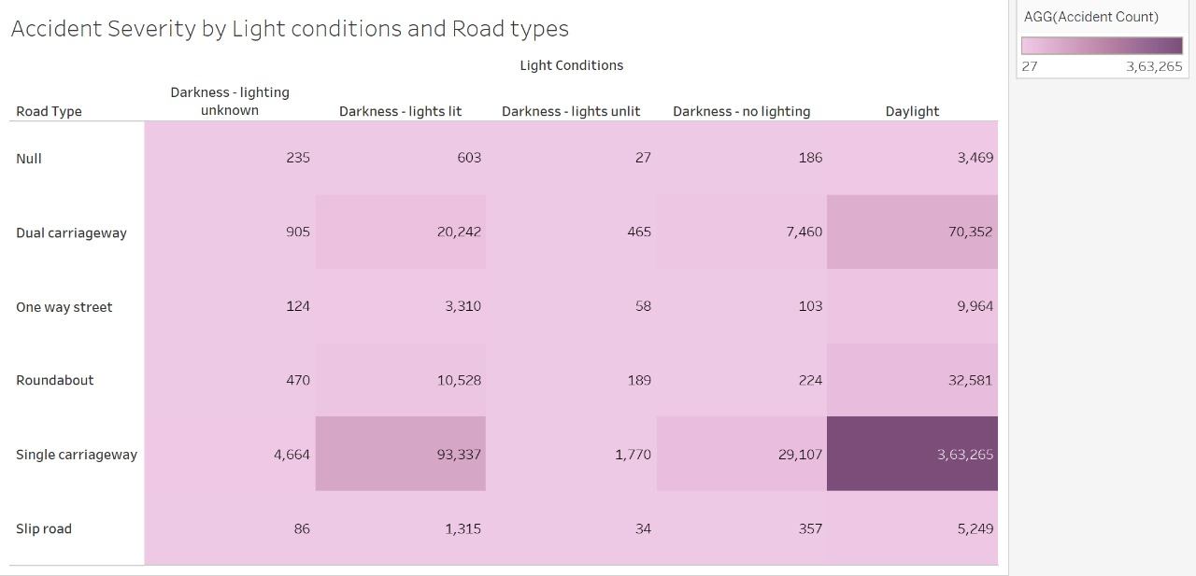

Slide 21
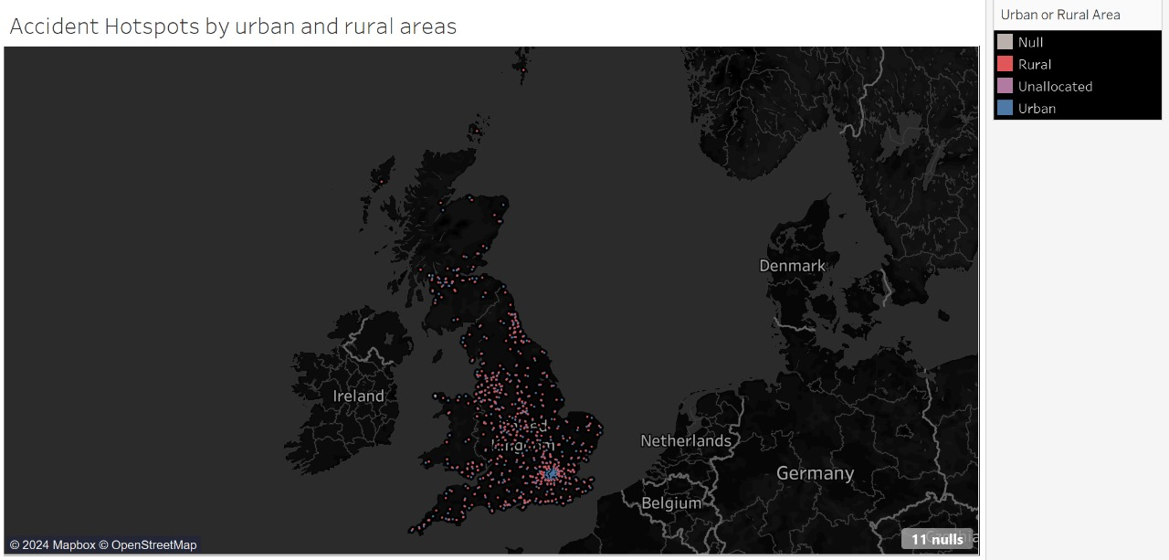

Slide 22
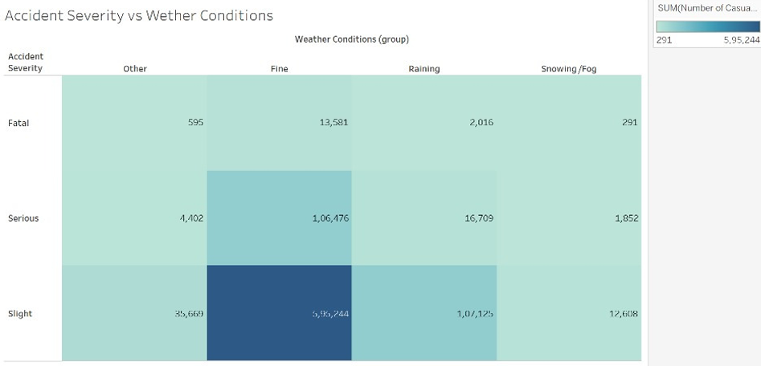
4. What trends in weather conditions correlate with higher accident rates, and are there seasonal patterns to consider?

Slide 23
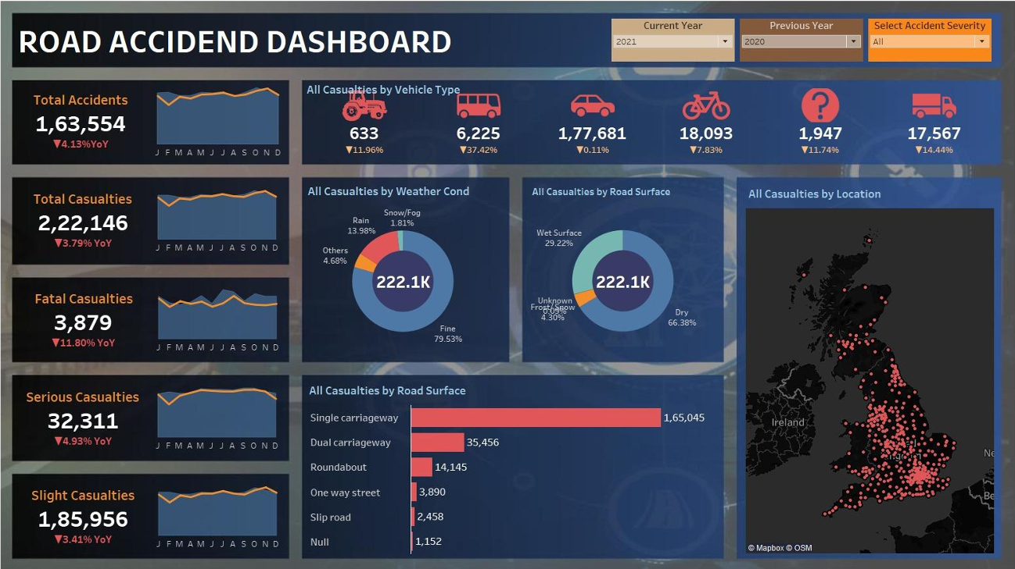
5. Can interactive visualizations be developed to provide actionable insights for traffic authorities, helping them allocate resources more effectively?

Slide 24
Conclusion
Weather Paradox Insight:
Mild weather conditions, like light rain, lead to more severe accidents than extreme weather due to driver overconfidence, suggesting a need for targeted awareness campaigns for safer driving in mild weather.
Urban Infrastructure Risks:
Poorly marked roads, sudden transitions, and inadequate lighting in urban areas increase accident frequency, emphasizing the need for infrastructure upgrades in high-risk city areas.
Vehicle Size Impact:
Smaller vehicles are more often involved in accidents but do not show disproportionately high severity, indicating that safety measures should address all vehicle types rather than focusing solely on size.
Policy Recommendations:
Policymakers should prioritize urban road improvements, encourage cautious driving in mild weather, and invest in real-time monitoring systems for quick, targeted accident prevention measures.

Slide 25
THANK YOU

