Slide 1

Counters
Prepared By
Dr. Girish Wadhwa
AP,DICE

Slide 2
Lecture Overview
Counting is frequently required in digital computers and other digital systems to record the number of events occurring in a specified interval of time.
Normally an electronic counter is used for counting the number of pulses coming at the input line in a specified time period.
The counter must possess memory since it has to remember its past states. As with other sequential logic circuits counters can be synchronous or asynchronous.

Slide 3
Classifications of Counters
Asynchronous Counters
  Only the first flip-flop is clocked by an external clock. All subsequent flip-flops are clocked by the output of the preceding flip-flop.
  Asynchronous counters are slower than synchronous counters because of the delay in the transmission of the pulses from flip-flop to flip-flop.
  Asynchronous counters are also called ripple-counters because of the way the clock pulse ripples it way through the flip-flops.
Synchronous Counters
  All flip-flops are simultaneously clocked by an external clock.
  Synchronous counters are faster than asynchronous counters because of the simultaneous clocking.
  Synchronous counters are an example of a state machines design.

Slide 4
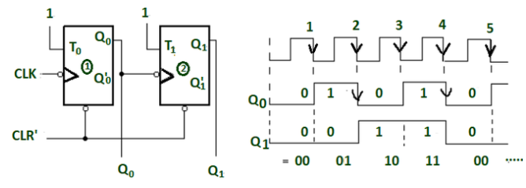
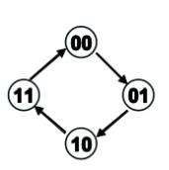
Example of Asynchronous Counters
A 2-bit binary counter (Mod-4) .
2- bit binary ripple counter using JK FF
Timing diagram
Truth table
State diagram

Slide 5
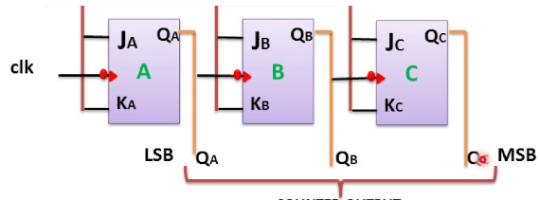
Example :
A 3-bit binary counter (Mod-8) .
3- bit binary ripple counter using JK FF

Slide 6
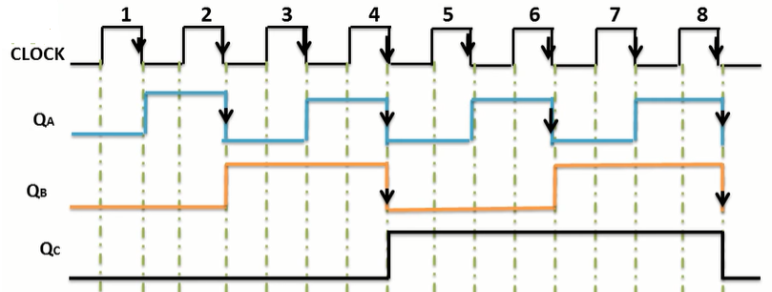
Example :
A 3-bit binary counter (Mod-8) .
3- bit binary ripple counter using JK FF

Slide 7
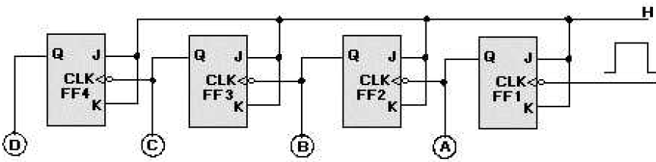
Modulus-8 Asynch/Ripple Counter
Ripple counters work like a chain reaction that ripples through the counter because of the time involved.
Figure shows a basic four-stage, or modulo-16, ripple counter.
The inputs and outputs are shown in next figure.
The four J-K flip-flops are connected to perform a toggle function; which divides the input by 2.
The HIGHs on the J and K inputs enable the flip-flops to toggle.
The inverters on the clock inputs indicate that the flip-flops change state on the negative-going pulse.
The ripple counter is also called an ASYNCHRONOUS counter

Slide 8
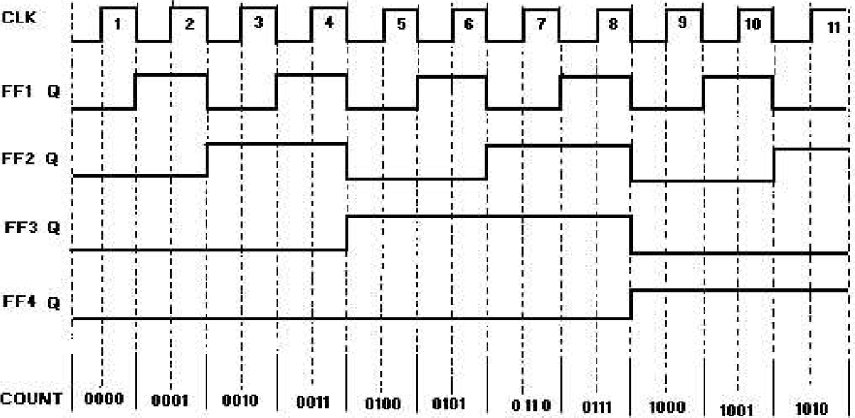
Modulus-8 Asynch/Ripple Counter

Slide 9
BCD Counters :
BCD counter : binary counter that counts from 0000 (0) to 1001 (9) before it recycles. And its called also a decade counter.
A decade counter is any counter that has 10 distinct states . And any decade counter that counts in binary from 0000 to 1001 is a BCD counter.
The Mod-10 counter , that we explained on the previous example, is a BCD decade counter.

Slide 10
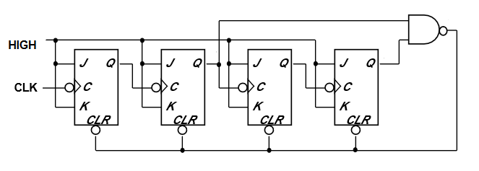
Connect the NAND gate to the asynchronous Clear inputs of all FFs.
Mod-10 counter will count from 0000 through 1001.
So, it must be rest to 0000 state when the count of 1010 is reached.
Therefore, FF outputs B and D must be connected as the NAND gate inputs.
In other words , the NAND gate will go low when B=D=1 (1010 state), thin the low at NAND output will immediately clear the counter to 0000 state.
DCBA
0000
0001
0010
0011
0100
0101
0110
0111
1000
1001
1010
Mod-10 counter
A
B
C
D

Slide 11
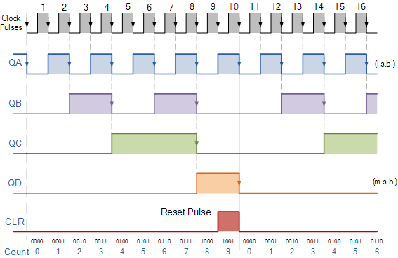
BCD counter timing diagram

Slide 12
Ring Counters
One flip-flop (stage) for each state in the sequence.
The output of the last stage is connected to the D input of the first stage.
An n-bit ring counter cycles through n states.
No decoding gates are required, as there is an output that corresponds to every state the counter is in.
CS1104-13
Ring Counters

Slide 13
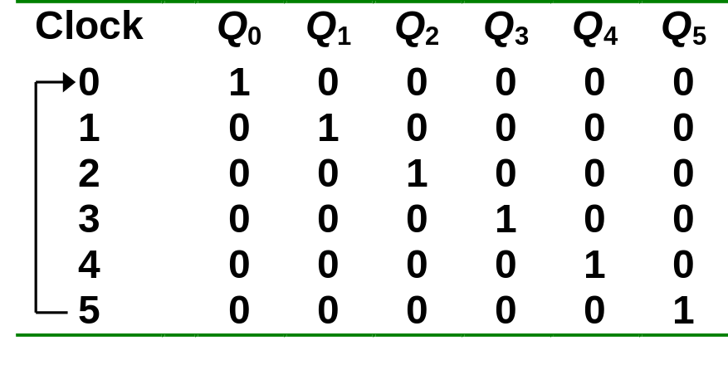
Ring Counters
Example: A 6-bit (MOD-6) ring counter.
PRE
Q₀
Q₁
Q₂
Q₃
Q₄
Q₅
D
Q
D
Q
D
Q
D
Q
D
Q
D
Q
CLR
CLK
100000
000001
010000
000010
001000
000100
CS1104-13
Ring Counters

Slide 14
Johnson Counters
The complement of the output of the last stage is connected back to the D input of the first stage.
Also called the twisted-ring counter.
Require fewer flip-flops than ring counters but more flip-flops than binary counters.
An n-bit Johnson counter cycles through 2n states.
Require more decoding circuitry than ring counter but less than binary counters.
CS1104-13
Johnson Counters

Slide 15
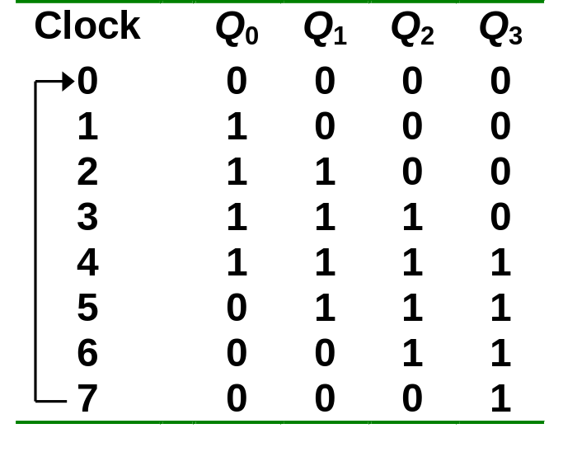
Johnson Counters
Example: A 4-bit (MOD-8) Johnson counter.
Q₀
Q₁
Q₂
D
Q
D
Q
D
Q
D
Q
Q'
Q₃'
CLR
CLK
0000
0001
1000
0011
1100
0111
1110
1111
CS1104-13
Johnson Counters

Slide 16
Thanks
&
Any query ?

