Slide 1

SRM INSTITUTE OF SCIENCE AND TECHNOLOGY
FACULTY OF ENGINEERING AND TECHNOLOGY
DEPARTMENT OF NETWORKING AND COMMUNICATIONS
18CSS101J- MINI PROJECT
TIC TAC TOE
By
PRACHI (RA2111026010111)
CH MALVIKA REDDY (RA2111026010125)
ANURADHA KRISHNAN (RA2111026010134)
BRANCH - CSE with specialisation in AIML
SECTION - T1
BATCH - 1

Slide 2
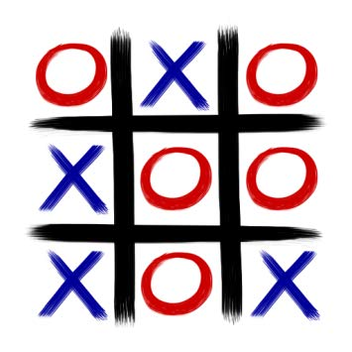
Tic Tac Toe
Tic Tac Toe (also called Noughts and crosses, Xs and Os, XOX Game, 3 in a row) is a very popular children’s pencil and paper board game, which is often played and enjoyed by many adults, as well. Because of its simplicity, this 3 row per 3 row board game may seem trivial at first, however, Tic Tac Toe involves its share of analytics and rapidity.

Slide 3
ACKNOWLEDGEMENT
We would like to express our deepest gratitude to our guide, Dr. M Sindhuja for her valuable guidance, consistent encouragement, personal caring, timely help and providing me with an excellent atmosphere for doing research. All through the work, in spite of her busy schedule, she has extended cheerful and cordial support to us for completing this research work.

Slide 4
System Requirements
Hardware Required:
· 4 GB free RAM
· 3.5 GB disk space
Software Required:
· Windows Operating System
· Visual Studio Code (with C/C++ extension)
· MS Word
· Google Chrome

Slide 5
ABOUT THE PROJECT:
The tic-tac-toe game is played on a 3x3 grid the game is to played by a player vs the computer. First the player marks moves with a cross, then the computer will mark next with the naught. The symbol which has formed a horizontal, vertical, or diagonal sequence of three marks first, wins.
This Project deals with the implementation of Tic-Tac-Toe game and is based on c language .
This project utilizes a data path to accept input from the user. This unit then synthesizes the next move (based on the current input and previous states) and generates the desired output output.

Slide 6
OBJECTIVES
The Objectives of our project are :
To draw the game board
Ask the player for the coordinates of thier next mark.
Calculate the available free spaces and make the computers move.
To check whether there is a sequence of three marks on the game board.
Announce whether the game has been won, lost or tied by the player.
In this project the use of arrays is important. The Xs and Os are kept in different arrays, and they are passed between several functions in the code to keep track of how the game goes. With the code here you can play the game using X against the computer.

Slide 7
ALGORITHM
STEP 1 : START
STEP 2 : Declare global variables char array board[][] ,constant PLAYER, constant COMPUTER. initialize the last two.
STEP 3 : Declare required functions. resetBoard(), printBoard(), checkFreeSpaces(), playerMove(), computerMove(), checkWinner(), printWinner().
STEP 4 : In main function declare and initialise char winner and response.
STEP 5: Open a do while with condition while the response to want to play another game is yes.
STEP 6 : Assign winner and response to ‘ ‘.
STEP 7 : Call function resetBoard().
STEP 8 : Open while loop with condition , if winner = ‘ ‘ and function checkFreeSpaces returns a non zero int.
STEP 9 : Call function printBoard().
STEP 10 : Call function playerMove().
STEP 11 : Assign winner to checkWinner().
STEP 12 : If winner != ‘ ‘ and checkFreeSpaces returns 0 break.
STEP 13 : Call function computerMove().
STEP 14 : Assign winner to checkWinner().
STEP 15 : If winner != ‘ ‘ and checkFreeSpaces returns 0 break.
STEP 16 : Call function printBoard().

Slide 8
STEP 17 : Print line “ Would you like to play again “
STEP 18 : Scan the entered value and assign it to response.
STEP 19 : Exit do-while loop and print “ thanks for playing “.
STEP 20 : return 0.
STEP 21 : STOP
FUNCTION - void resetBoard()
STEP 1 : Open a for loop. Initialize int i and give conditions.
STEP 2 : Open a nested for loop . Initialize j and give conditions.
STEP 3 : Assign the respective values of board[x][y] as ‘ ‘.
FUNCTION - void printboard()
STEP 1 : Print top row of the board printing the elements of board[0][].
STEP 2 : Print horizontal line.
STEP 3 : Print middle row of the board printing the elements of board[1][].
STEP 4 : Print horizontal line.
STEP 5 : Print bottom row of the board printing the elements of board[2][].
STEP 6 : Print next line.

Slide 9
FUNCTION - int checkFreeSpaces()
STEP 1 : Declare and initialize freeSpaces = 9.
STEP 2 : Open two nested for loops, the first one dealing with int i and the second with int j.
STEP 3 : If board[i][j] is not ‘ ‘, apply post decrement on freeSpaces.
STEP 4 : return freeSpaces.
FUNCTION - void playerMove()
STEP 1 : Declare int x and y .
STEP 2 : Open do while loop with condition board[x][y] != ‘ ‘ .
STEP 3 : Print ‘ Enter row’.
STEP 4 : Scan value entered and assign to x. Decrement x.
STEP 5 : Print ‘ Enter column’.
STEP 4 : Scan value entered and assign to y. Decrement y.
STEP 6 : If board[x][y] != 0 , print ‘ Invalid move ‘ . Else assign board[x][y] to PLAYER. Break.
FUNCTION - computerMove()
STEP 1 : Declare int x and y .
STEP 2 : Open If statement with the condition checkFreeSpaces() returns value greater than 0. Else printWinner(‘ ‘).
STEP 3 : Open do while loop with condition board[x][y] !=0. Assign value to x and y using rand() %3.
STEP 4 : Assign board[x][y] to COMPUTER.

Slide 10
FUNCTION - char checkWinner()
STEP 1 : Open for loop initialize i and give conditions.
STEP 2 : If any row of array board[][] has same elements return board[i][0].
STEP 3 : Open another for loop initialize i and give conditions.
STEP 4 : If any column of array board[][] has same elements return board[0][i]
STEP 5 : If any diagnols are same then return respective board[][] value.
FUNCTION - void printWinner()
STEP 1 : If winner is equal to PLAYER, print ‘ YOU WIN’.
STEP 2 : Else If winner is equal to computerter, print ‘ YOU LOSE’.
STEP 3 : Else print ‘ It’s a tie’.

Slide 11
FLOWCHART
START
Declare and initialize global variables: board[][], char PLAYER , char COMPUTER
Declare functions resetBoard(), printBoard(), checkFreeSpaces(), playerMove(), computerMove(), checkWinner(), printWinner().
Declare and initialise char winner and response.
Assign winner and response to ‘ ‘.
Call function resetBoard()
False
winner = ‘ ‘ && checkFreeSpaces > 0
True

Slide 12
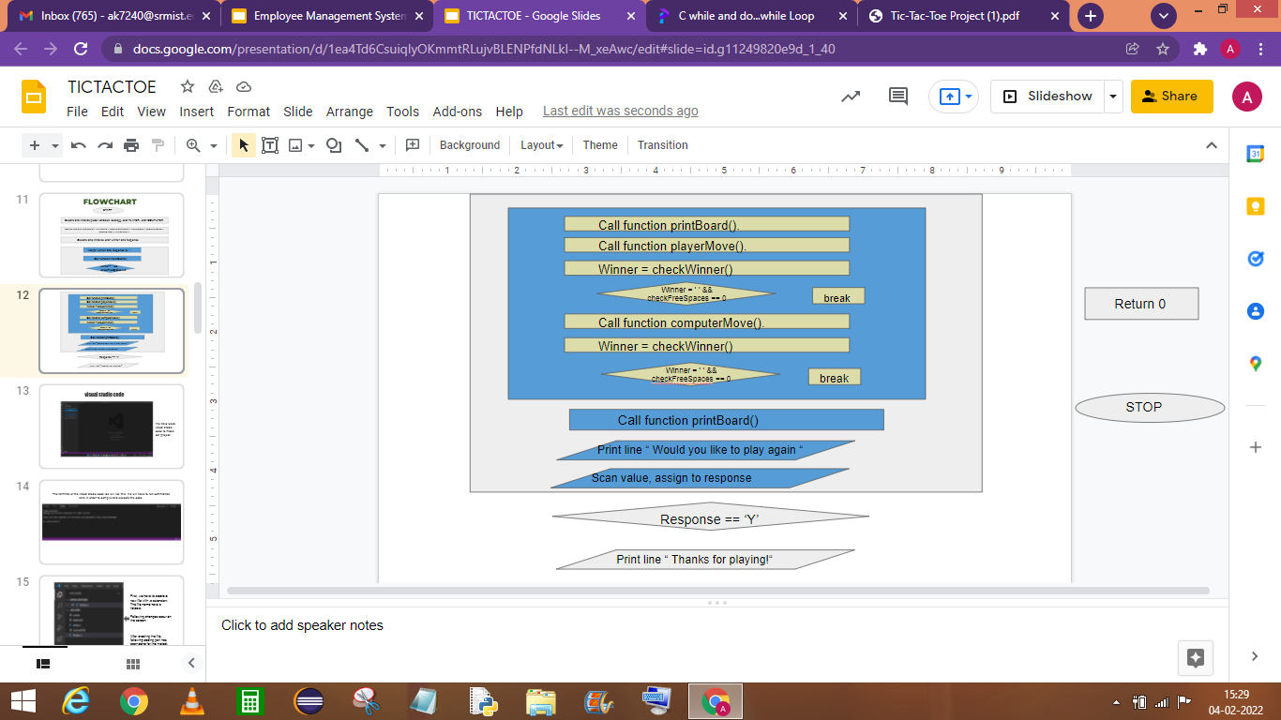
False
True
Call function printBoard().
Call function playerMove().
Winner = checkWinner()
Winner = ‘ ‘ &&
checkFreeSpaces == 0
break
Call function computerMove().
Winner = checkWinner()
Winner = ‘ ‘ &&
checkFreeSpaces == 0
break
Call function printBoard()
Print line “ Would you like to play again “
True
Scan value, assign to response
False
Response == ‘Y’
Return 0
STOP

Slide 13
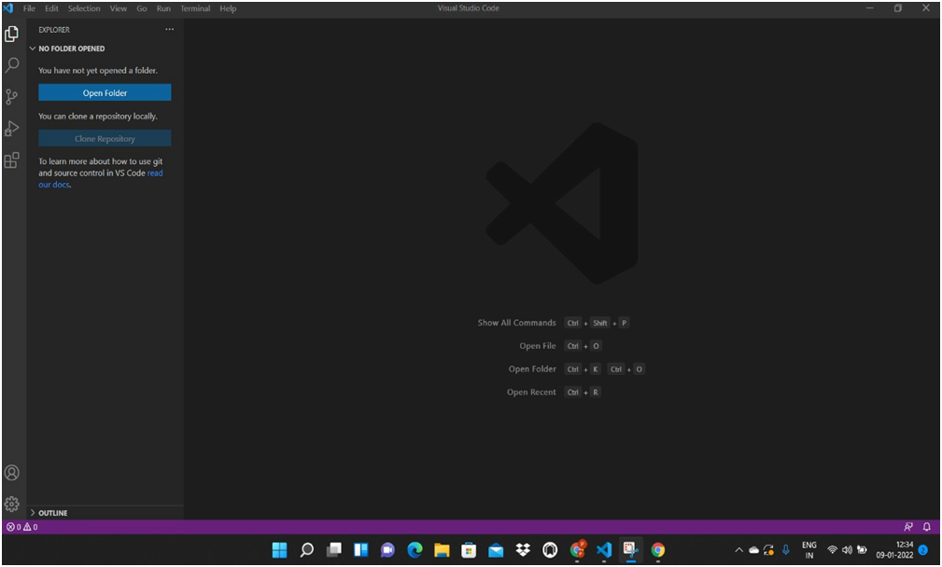
visual studio code
We have used visual studio code to make our project.

Slide 14
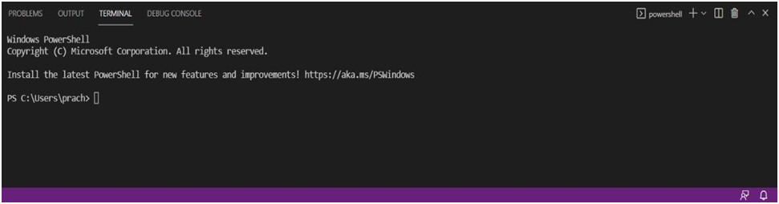
The terminal of the visual studio code ide will like this. We will have to run commands here in order to compile and execute the code.

Slide 15
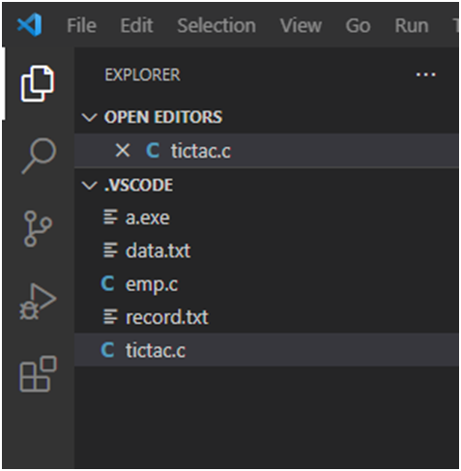
First, we have to create a new file with .c extension. The file name here is tictac.c.
Following changes occur on the screen.
After creating the file, following coding part has been done for the project.

Slide 16
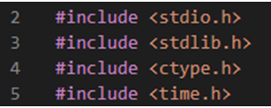
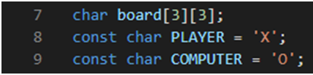
EXPLANATION OF THE CODE
HEADER FILES
We have used these 4 header files in the program.
<stdio.h> - Functions such as printf(), scanf() are used.
<stdlib.h> - Functions such as srand() & rand() are used.
<ctype.h>- Function such as toupper() is used .
<time.h> - Function such as time() is used.
GLOBAL VARIABLES
A character array named “board” is defined for creating the overall structure of the game. Two char variables “PLAYER” and “COMPUTER” are declared and initialized with ‘X’ and ‘O’ respectively.
These values will remain constant throughout the program.

Slide 17
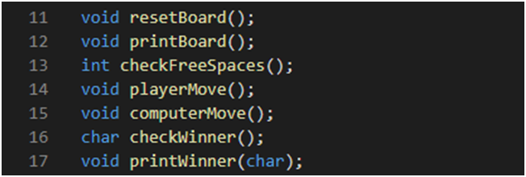
FUNCTION DECLARATION
The additional functions used in this code have been declared here as they have been defined after the main function.
The prototypes of the functions contain
The name of the function
The return type
Parameter if any is used

Slide 18
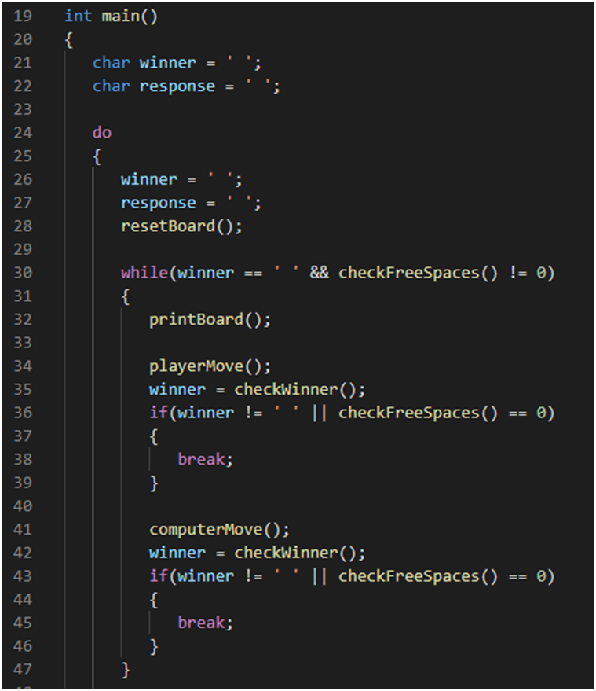
MAIN FUNCTION
The main function has do-while and while-do loops
When the program is run, the resetBoard() function is called.
The while loop gets executed as long as the conditions are true, i.e, there is no winner and there is still space on the game board.
Further the other functions are called and executed for the running of the game.

Slide 19
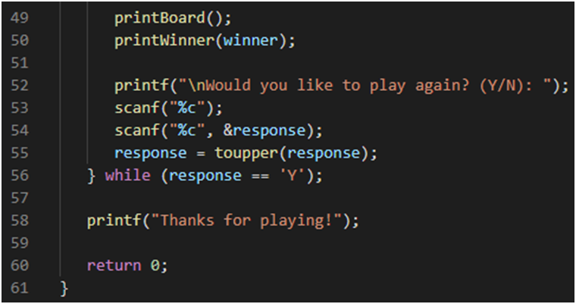
When a winner is detected, a message is returned that tells whether the player has won,lost or tied.
The do-while loop has been used so that the user can play the game multiple times. A message will be printed asking if you want to play again and if the player chooses ‘Y’ then the do-while loop will get executed again.

Slide 20
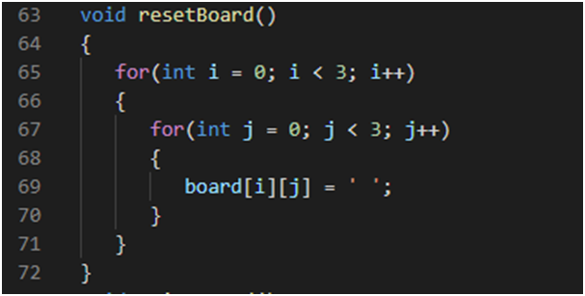
FUNCTION - resetBoard()
This function is used to reset the game board.
This is done by replacing all the values of the board[][] array to ‘ ‘, a blank space.
Here a nested for loop is used inorder to access all the elements of the 2D array
This is a void function, hence there is no return value.

Slide 21
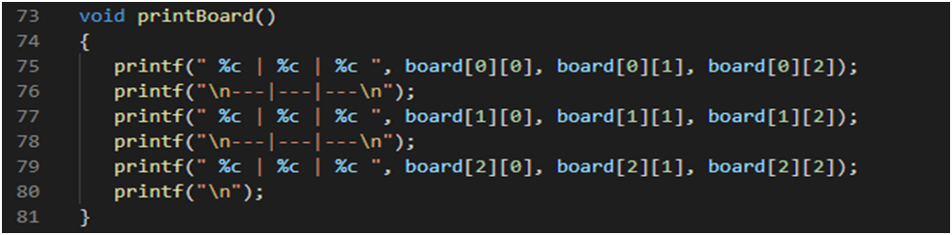
FUNCTION - printBoard()
This function is used to print the lines on the screen within which the ‘X’ and ‘O’s wil get placed. During the printing, the elements of the 3*3 char array ,board[][], gets printed, each of them separated by | and - - - .
As this too is a void function it does not return any value.

Slide 22
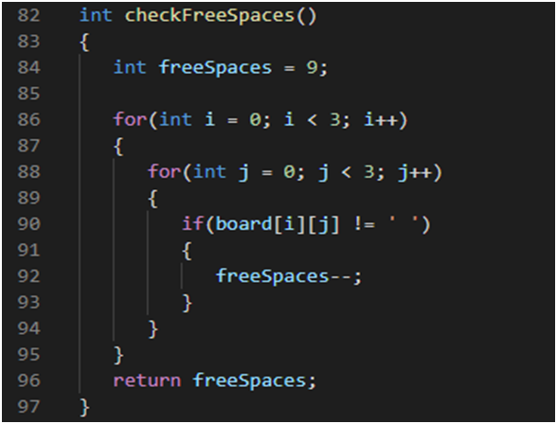
FUNCTION - checkFreeSpaces()
The function is used to check the number of free spaces or unused places on the board.
This has been done by counting the number of elements of the board[][] array that have an ‘ ‘ value.
As before, a nested for loop is used to access the elements of the 2D array. And if an element contains a blank space, the variable freeSpaces is decremented.
This is an integer function and the integer freeSpaces is returned.

Slide 23
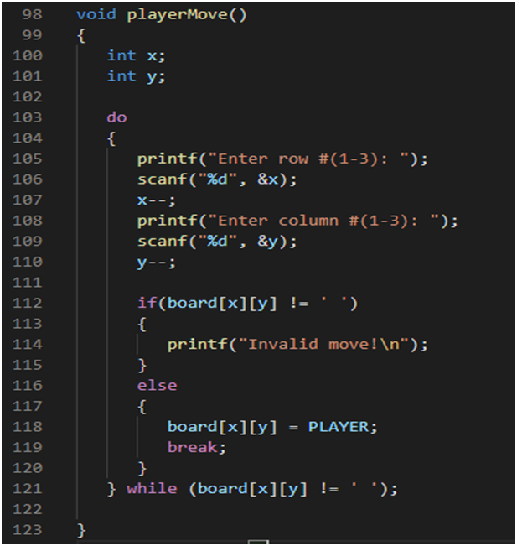
FUNCTION - playerMove()
In this function, the move of the player gets recorded.
The user is asked to enter x and y values (the coordinates) in which they want to place their cross.
Then an if loop is used to test whether the user given position is free by checking whether board[x][y] has a blank space.
If the position has a blank space then board[x][y] will be assigned to the char PLAYER ( ‘X’)
If the position does not have a blank space then “invalid move” gets printed and the user will get to enter a valid position.
This has been facilitated by the do while loop condition
This is a void function and does not return any values.

Slide 24
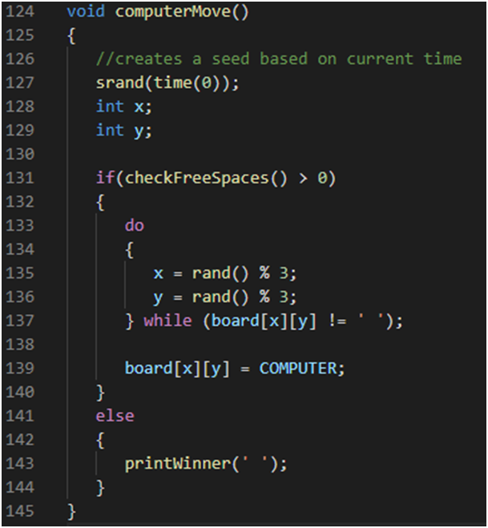
FUNCTION - computerMove()
This function is used during the computers turn to mark the ‘O’ position.
srand(time(0)) is used in the generation of random numbers.
An if condition is used to check for free spaces on the board using the checkFreeSpaces() function.
Then x and y are assigned random values ranging between 0-2, using rand() % 3.
A do while loop is given to repeat the block if the position at board[x][y] is not free.
If it is free then it gets assigned to the COMPUTER value ‘O’.
Also if the first if condition is not satisfied then the printWinner(‘ ‘) function is called.
This is a void function and does not return any value.

Slide 25
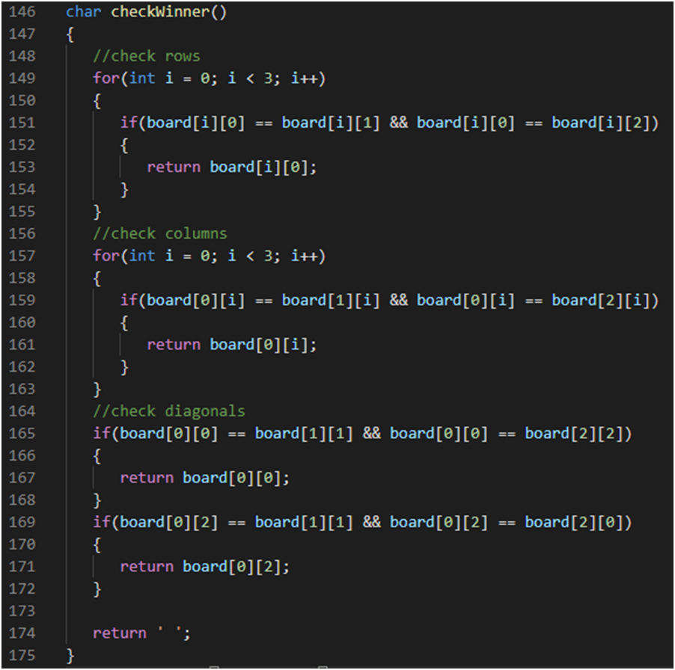
FUNCTION - checkWinner()
This function is used for checking if there is a winner during each round of the game.
Checking happens in three categories: rows,columns and diagonals. Each one of them is tested using for and if control statements.
This is a character function and will return a char.
If any of the rows, columns or diagonals contain the same character then that character gets returned.
Else ‘ ‘ will get returned.

Slide 26
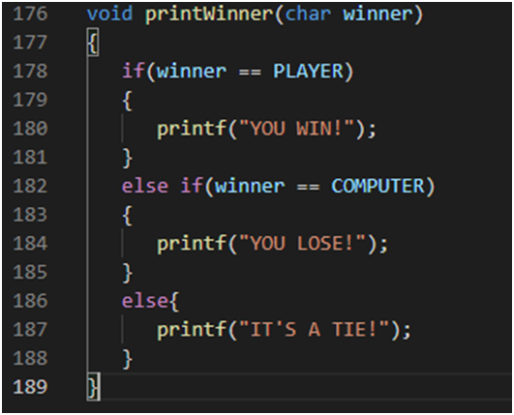
FUNCTION - printWinner()
This function is used to print a message depending on the winning, losing or tie status of th player.
If conditions are used to check who the winner is.
This a void function so it has no return value .
char winner is the parameter used here.

Slide 27
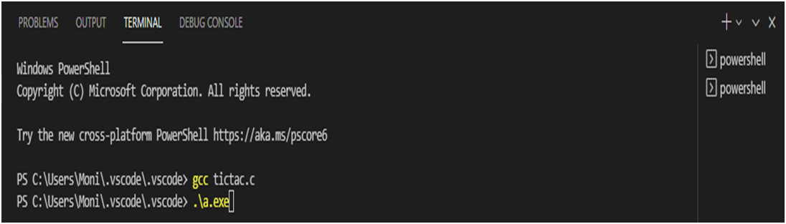
OUTPUT
For executing the program, given commands need to be entered in the terminal.

Slide 28
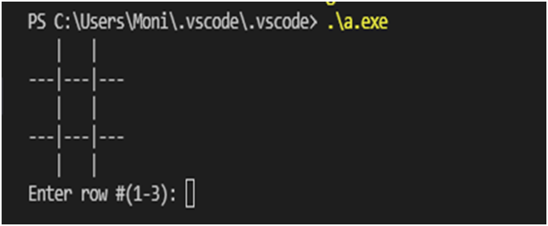
After the execution of the commands, the terminal will look like this.

Slide 29
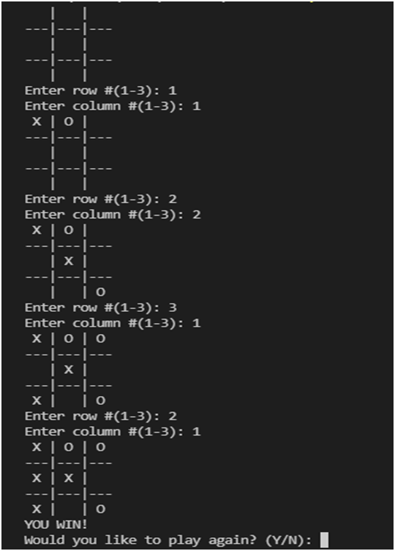
The user gets asked to give their chosen coordinates and their token gets placed there.
The game outcome is given.
And the user gets asked if they want to play again. If yes then the board will reset and the user can play again.
Case 1- If the player wins.

Slide 30
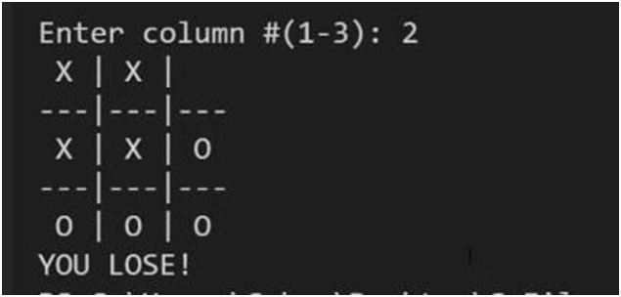
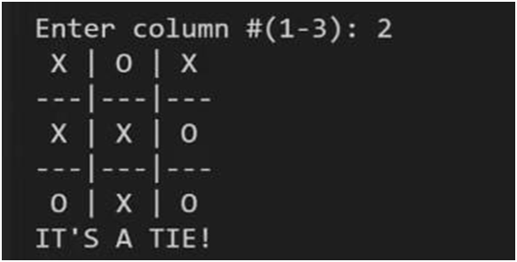
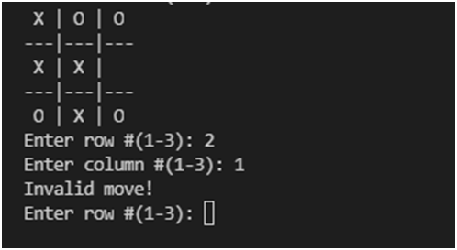
Case 2- If player loses
Case 3- If the match gets tied.
In case of invalid entry

Slide 31
SAMPLE CODE
#include <stdio.h>
#include <stdlib.h>
#include <ctype.h>
#include <time.h>
char board[3][3];
const char PLAYER = 'X';
const char COMPUTER = 'O';
void resetBoard();
void printBoard();
int checkFreeSpaces();
void playerMove();
void computerMove();
char checkWinner();
void printWinner(char);

Slide 32
int main()
{
char winner = ' ';
char response = ' ';
do
{
winner = ' ';
response = ' ';
resetBoard();
while(winner == ' ' && checkFreeSpaces() != 0)
{
printBoard();
playerMove();
winner = checkWinner();
if(winner != ' ' || checkFreeSpaces() == 0)
{
break;
}

Slide 33
computerMove();
winner = checkWinner();
if(winner != ' ' || checkFreeSpaces() == 0)
{
break;
}
}
printBoard();
printWinner(winner);
printf("\nWould you like to play again? (Y/N): ");
scanf("%c");
scanf("%c", &response);
response = toupper(response);
} while (response == 'Y');
printf("Thanks for playing!");
return 0;
}

Slide 34
void resetBoard()
{
for(int i = 0; i < 3; i++)
{
for(int j = 0; j < 3; j++)
{
board[i][j] = ' ';
}
}
}
void printBoard()
{
printf(" %c | %c | %c ", board[0][0], board[0][1], board[0][2]);
printf("\n---|---|---\n");
printf(" %c | %c | %c ", board[1][0], board[1][1], board[1][2]);
printf("\n---|---|---\n");
printf(" %c | %c | %c ", board[2][0], board[2][1], board[2][2]);
printf("\n");
}

Slide 35
int checkFreeSpaces()
{
int freeSpaces = 9;
for(int i = 0; i < 3; i++)
{
for(int j = 0; j < 3; j++)
{
if(board[i][j] != ' ')
{
freeSpaces--;
}
}
}
return freeSpaces;
}

Slide 36
void playerMove()
{
int x;
int y;
do
{
printf("Enter row #(1-3): ");
scanf("%d", &x);
x--;
printf("Enter column #(1-3): ");
scanf("%d", &y);
y--;
if(board[x][y] != ' ')
{
printf("Invalid move!\n");
}
else
{

Slide 37
board[x][y] = PLAYER;
break;
}
} while (board[x][y] != ' ');
}
void computerMove()
{
//creates a seed based on current time
srand(time(0));
int x;
int y;
if(checkFreeSpaces() > 0)
{
do
{
x = rand() % 3;
y = rand() % 3;
} while (board[x][y] != ' ');

Slide 38
board[x][y] = COMPUTER;
}
else
{
printWinner(' ');
}
}
char checkWinner()
{
//check rows
for(int i = 0; i < 3; i++)
{
if(board[i][0] == board[i][1] && board[i][0] == board[i][2])
{
return board[i][0];
}
}
//check columns
for(int i = 0; i < 3; i++)
{
if(board[0][i] == board[1][i] && board[0][i] == board[2][i])

Slide 39
{
return board[0][i];
}
}
//check diagonals
if(board[0][0] == board[1][1] && board[0][0] == board[2][2])
{
return board[0][0];
}
if(board[0][2] == board[1][1] && board[0][2] == board[2][0])
{
return board[0][2];
}
return ' ';
}
void printWinner(char winner)
{
if(winner == PLAYER)
{
printf("YOU WIN!");

Slide 40
}
else if(winner == COMPUTER)
{
printf("YOU LOSE!");
}
else{
printf("IT'S A TIE!");
}
}

Slide 41
REFERENCES
https://www.youtube.com/watch?v=_889aB2D1KI
https://www.geeksforgeeks.org/

Slide 42
THANK YOU

