Slide 1


Slide 2
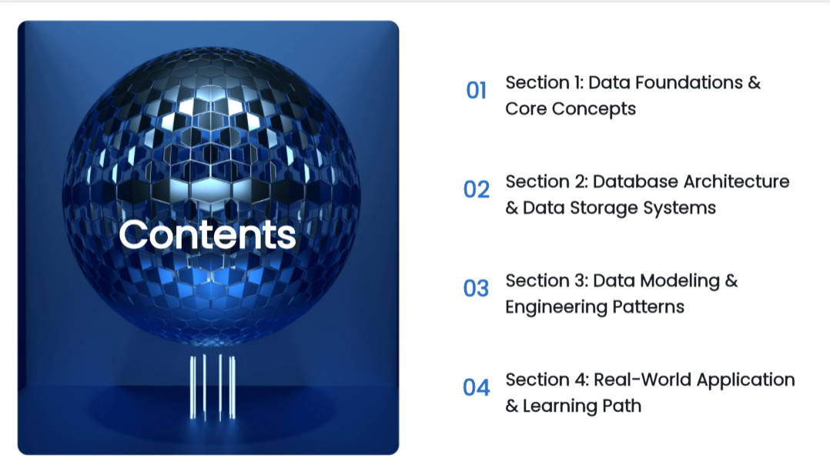

Slide 3


Slide 4
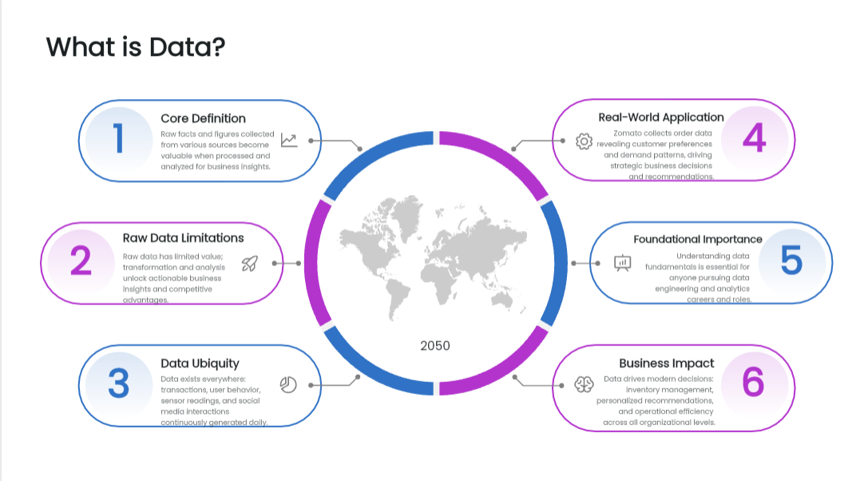

Slide 5
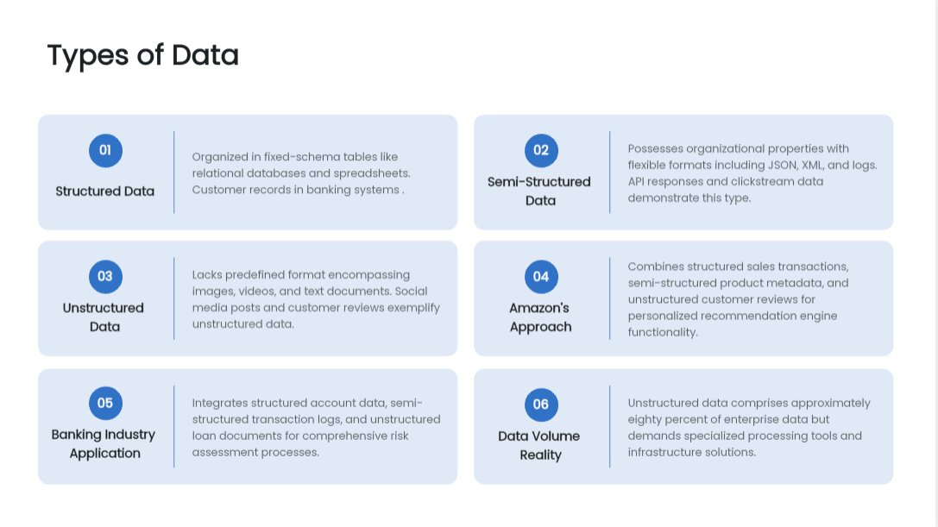

Slide 6
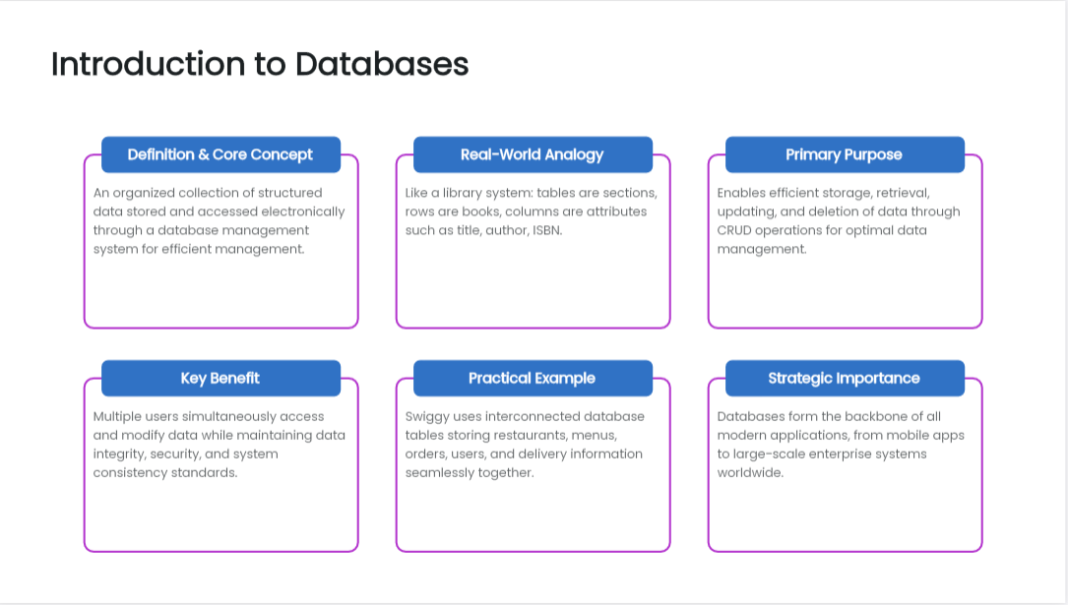

Slide 7
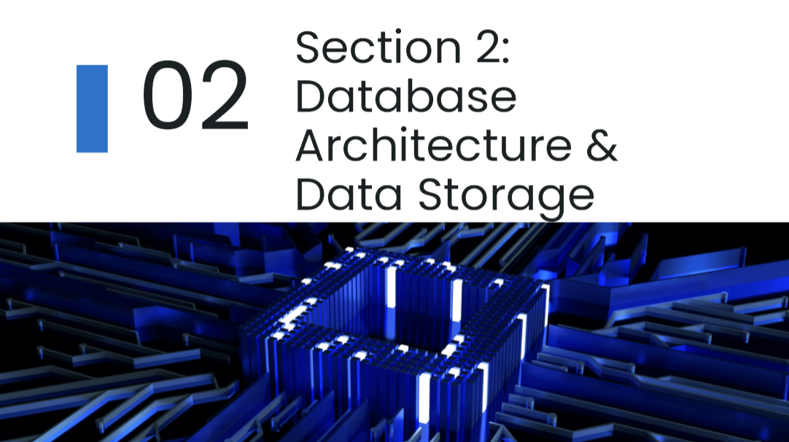

Slide 8
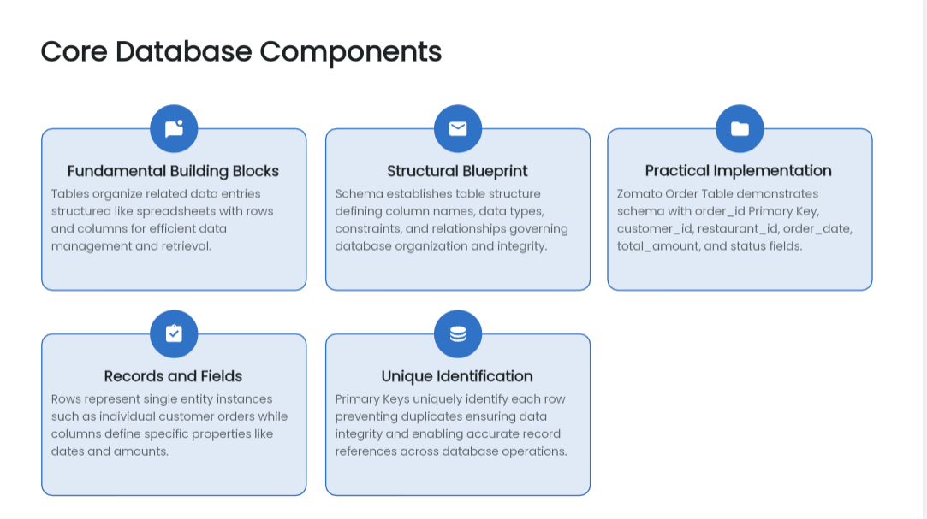

Slide 9
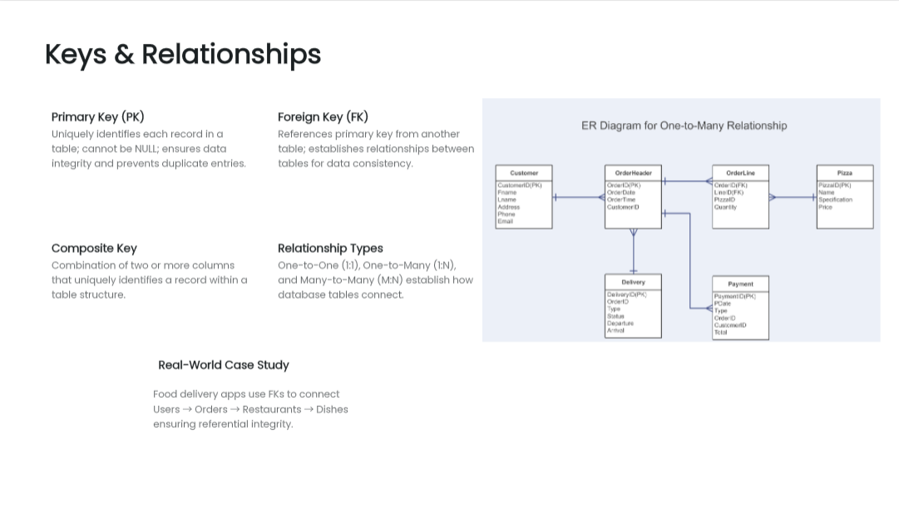

Slide 10
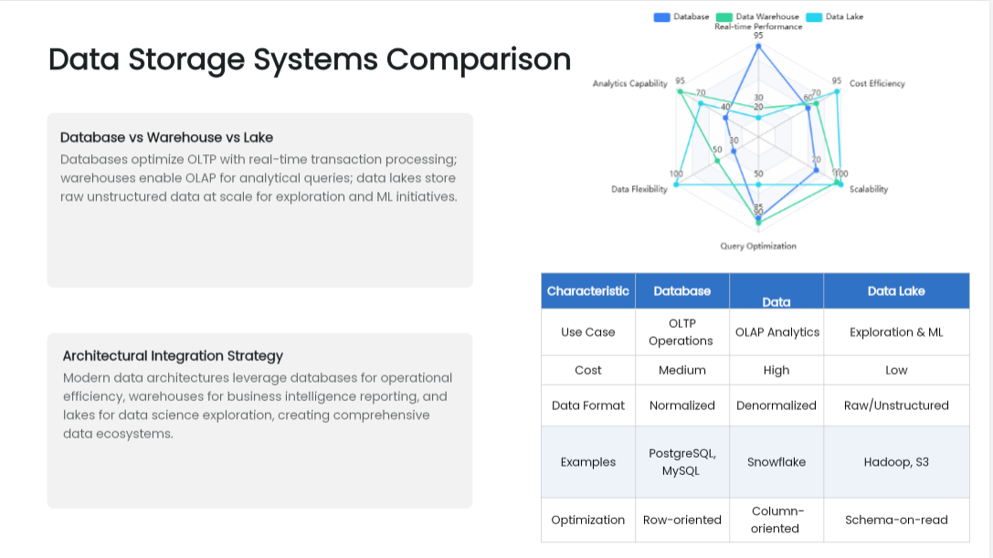

Slide 11
Modern Data Systems
Data Warehouse
Data Mart
A Data Warehouse is a centralised system used to store structured, cleaned, and historical data for reporting and analytics.
Stores processed data
Optimized for analytics (OLAP)
Used by BI tools (Power BI, Tableau)
Ex. A company stores 5 years of sales data to analyze revenue trends.
A Data Mart is a subset of a data warehouse, designed for a specific business team.
Smaller and faster
Easier for teams to use
Ex. Sales team uses only sales data mart instead of full warehouse.

Slide 12
Modern Data Systems
Data Lake
Lakehouse
A Data Lake stores raw data in its original format (structured, semi-structured, unstructured).
Stores everything as-is
Cheap storage (S3, ADLS)
No strict schema
A Lakehouse combines the power of:
Data Lake (cheap storage, raw data)
Data Warehouse (performance, analytics)
Supports ACID transactions
Handles all data types
BI tools can directly query it

Slide 13


Slide 14
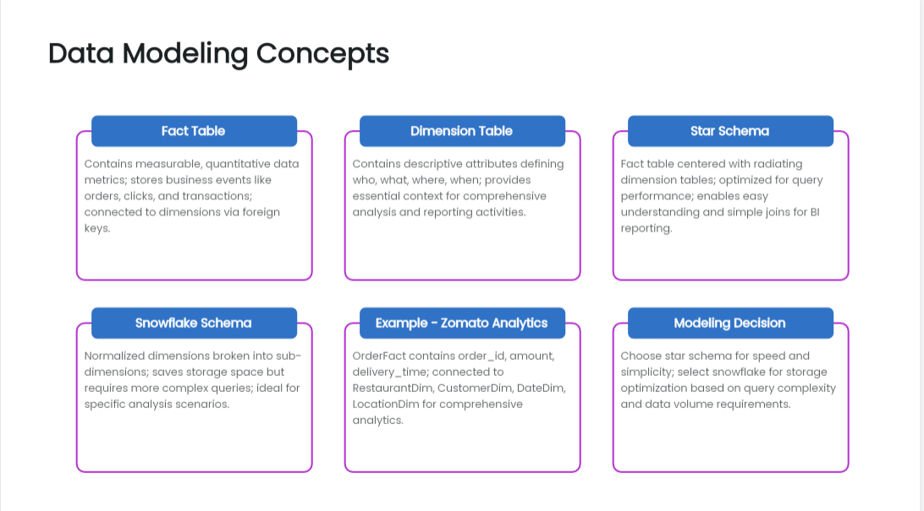

Slide 15
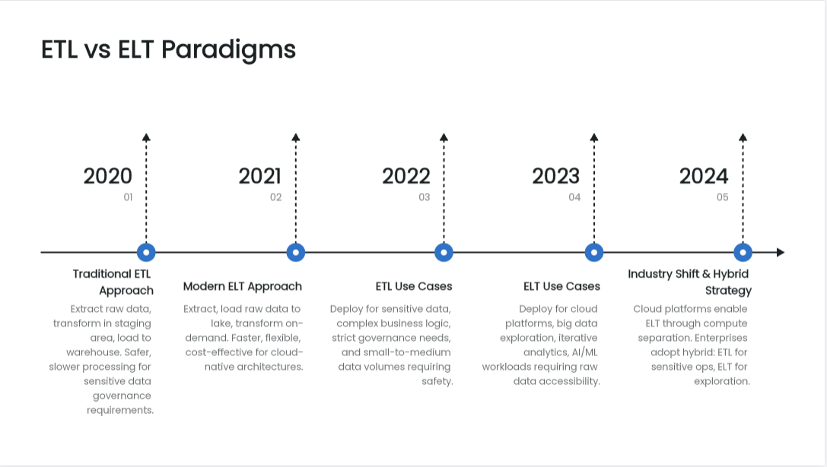

Slide 16
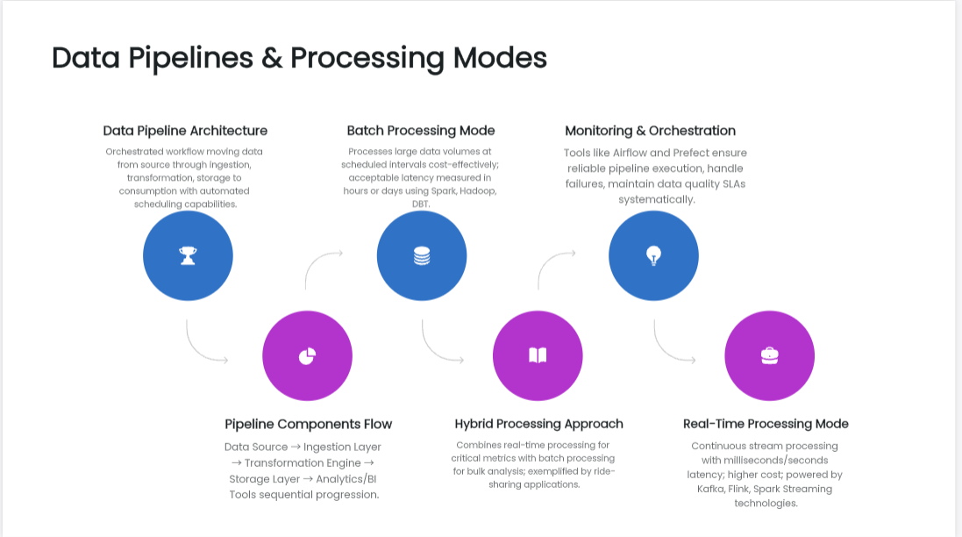

Slide 17
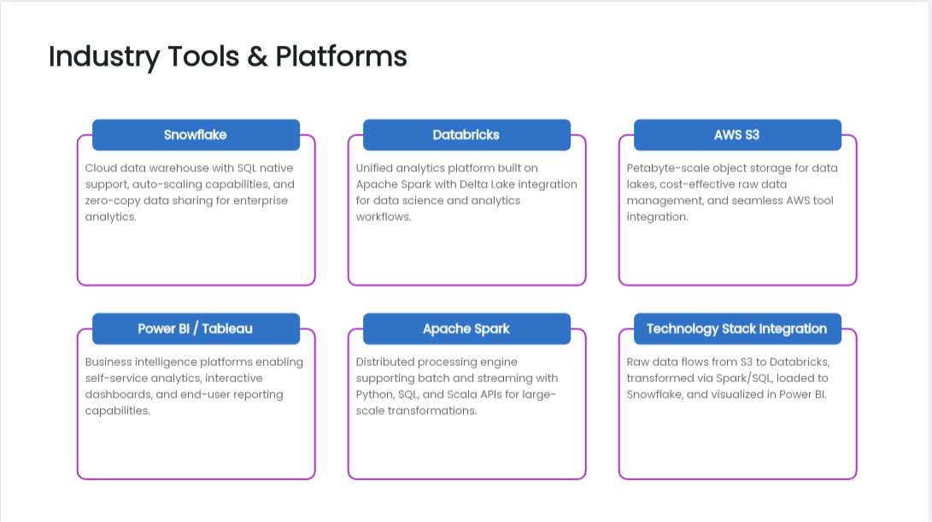

Slide 18


Slide 19
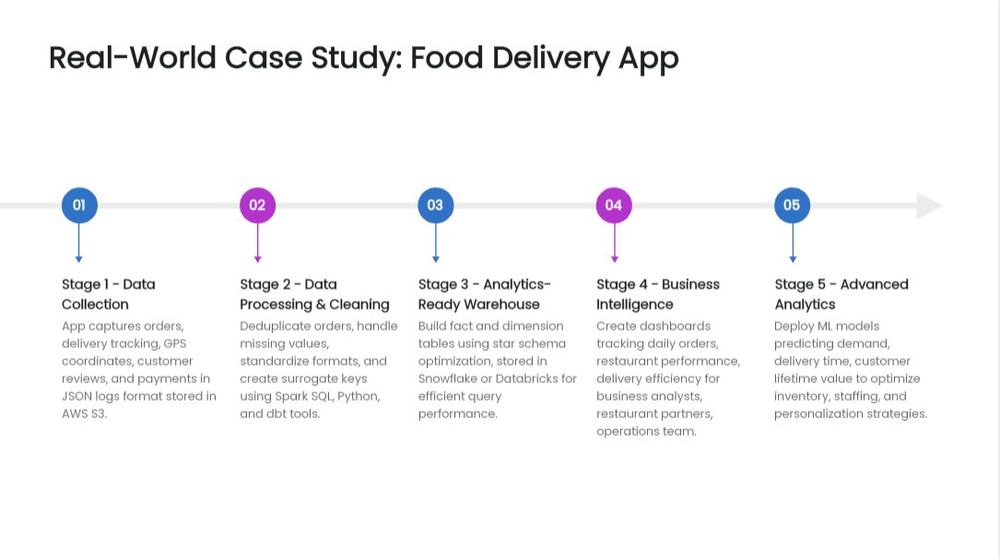

Slide 20
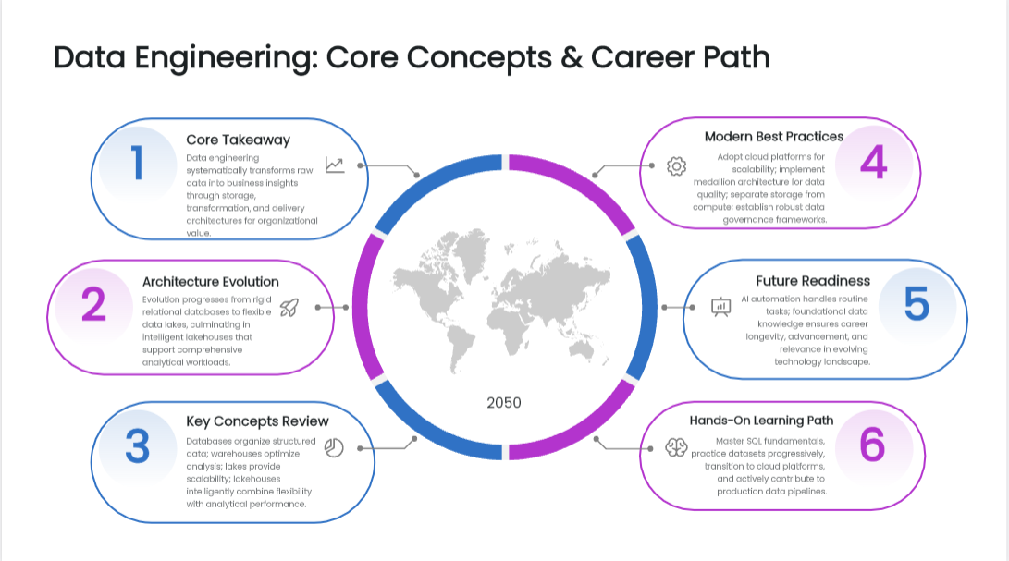

Slide 21


