Slide 1
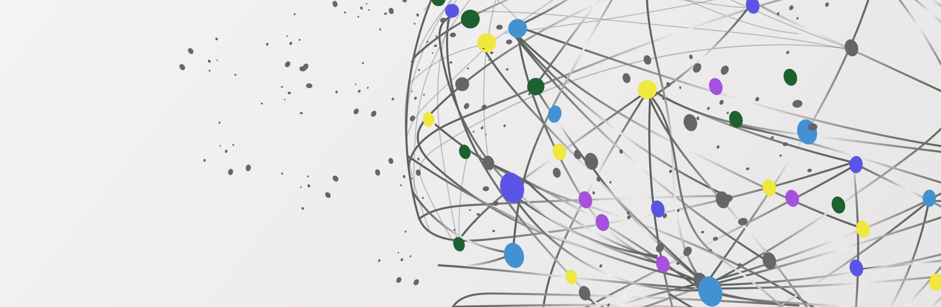
GenGraphy
Where Gen AI Chatbot Meets Intuitive Dashboard
PRACHI KANE
SRIVARDHINI REDDY

Slide 2
Problem Statement
Business users struggle with complex reporting tools, hindering their ability to generate customized reports.
Existing systems require technical expertise, leading to delays in accessing critical information.
Lack of flexibility limits the ability to tailor reports to specific needs and requirements.

Slide 3
Our Solution
Proposal: Flexible reporting chat solution powered by LLM and Language Chains.
Empowers business users to easily create, modify, and customize reports without technical expertise.
Provides intuitive and user-friendly interface for conversational interaction.
Prioritizes privacy concerns by restricting LLM’s access to sensitive data
Better than other solutions by reducing computational power using LLM APIs

Slide 4

Workflow
Heat Map
Gemini AI
Query Generator
Database
Result
Line graph
Bar Graph
Tech Stack :
Python, Streamlit, Goggle GenerativeAI, Sqlite, Plotly, HuggingFace, Prompt Engineering, Github,

Slide 5
Key Features
Key Features: Natural Language Understanding (NLU): Utilizes LLM to understand user queries and extract relevant information.
Customized Report Generation: Allows users to specify parameters using natural language.
Real-time Insights and Visualization: Generates reports in real-time with data visualization capabilities.

Slide 6
Advantages
Improved Efficiency: Enables quick report generation, reducing reliance on IT or data analysts.
Enhanced Flexibility: Empowers users to customize reports according to their needs.
Increased Productivity: Saves time and resources, allowing teams to focus on strategic initiatives.
Greater Insights and Decision-Making: Provides access to real-time insights for informed decision-making.

Slide 7
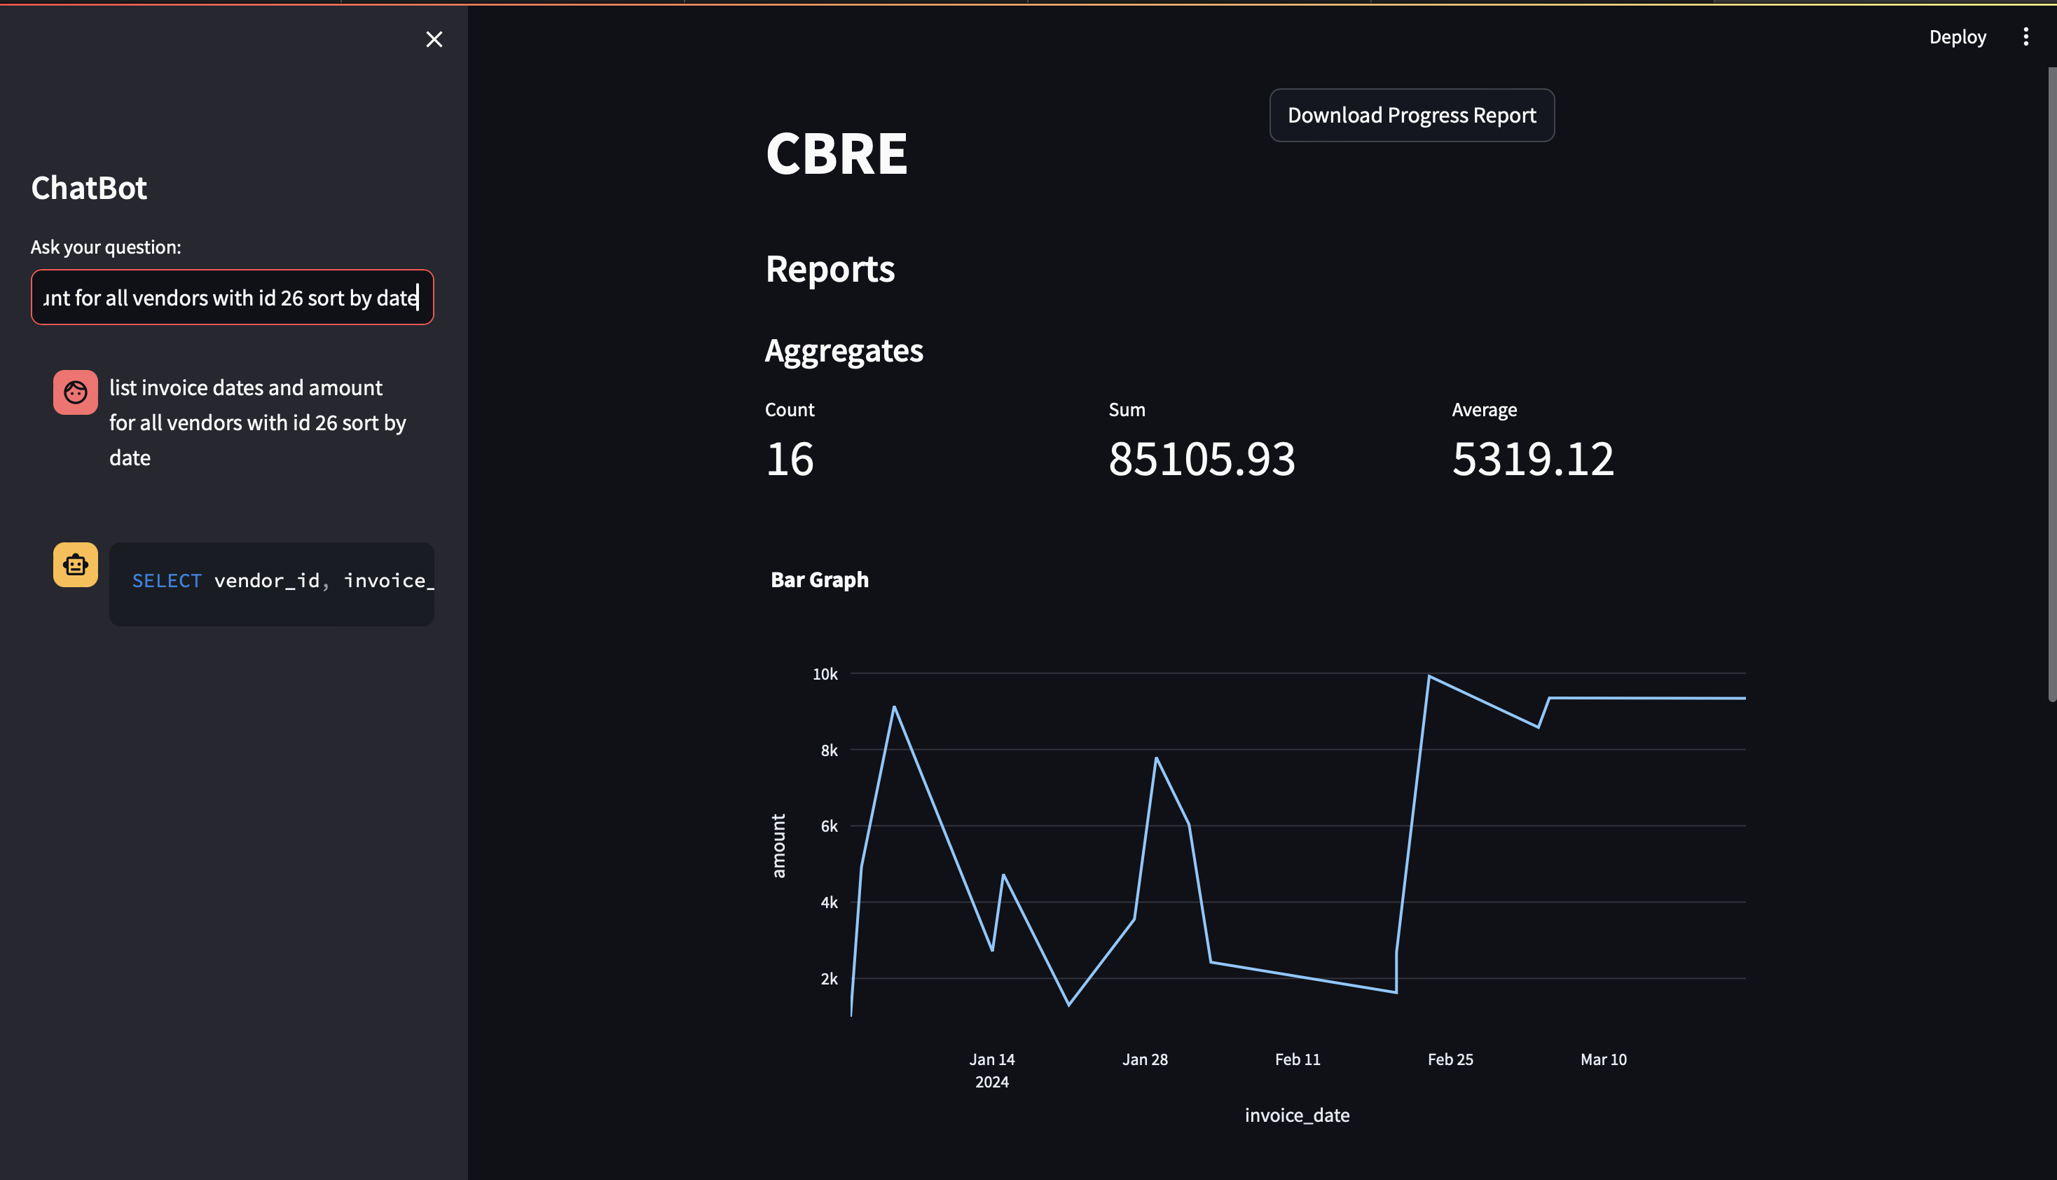
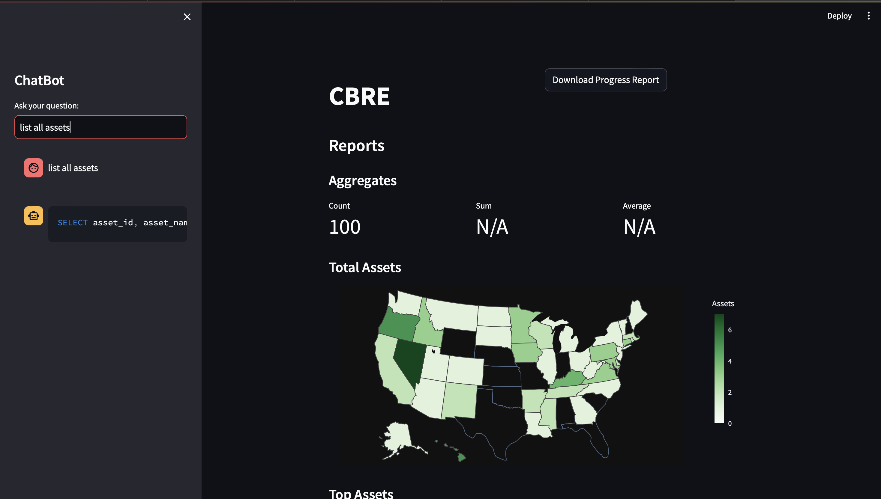
DEMO

Slide 8

Future work
Making GenGraphy more flexible - to be able to morph into sales analytics dashboards, P&L statements etc.
Incorporating more robust LLM models to improve the accuracy of the query/report generated

