Slide 1
SEMINAR ON
EMOTIV EPOC
Presented by:
Prachi Kolte
Guided by:
Prof.G.V.Garje

Slide 2
Overview:-
Introduction
2. EEG working with Epoc
3. Working of EPOC
4. Application
5. Pros and cons
6. Conclusion
7. References
Epoc
Brain Computer Interface(BCI)
Electroencephalogram(EEG)

Slide 3
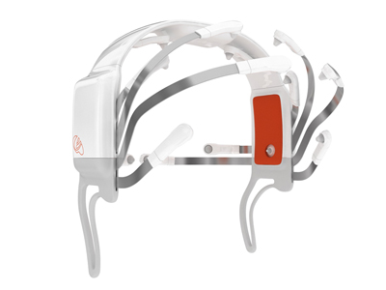
EPOC
Emotiv Epoc is a brain computer interfacing device.
It is basically a headset that can read and interpret brain waves.
Uses the Brain computer interface(BCI) and electrocephalogram(EEG) .

Slide 4
Brain computer interface(Bci)
It is a system that allows user to control a machine(eg.computer, an automated chair)Solely with a brain activity rather than the peripheral nervous system.
Control with a BCI is initiated when a user performs a specific mental task.
A brain-computer interface (BCI), sometimes called a direct neural interface or a brain-machine interface, is a direct communication pathway between a human brain and an external device

Slide 5
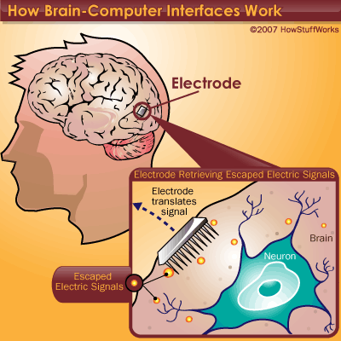
BCI ( Cont)
The Emotiv system measures the electrical activity associated with the brain and the muscles of the face
Bridge between the brain and signal

Slide 6
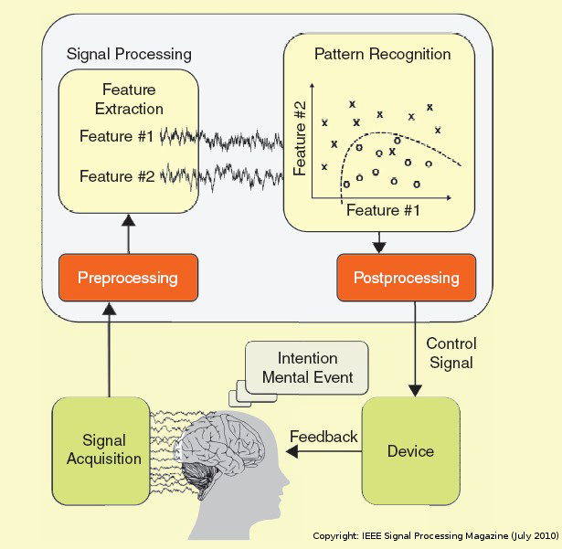
I THINK THUS I ACT..

Slide 7
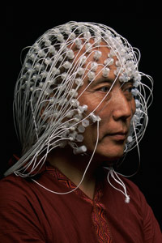
Electrocephalogram
(eeg)
Electroencephalography (EEG) is the recording of electrical activity along the scalp produced by firing of neurons within the brain.
Electroencephalography belongs to the Non Invasive BCI category.

Slide 8
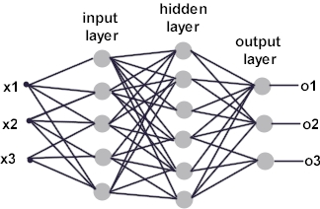
EEG (cont.)
It is a neurological test that involves attaching electrodes to the head of a person to measure and record electrical activity in the brain over time

Slide 9
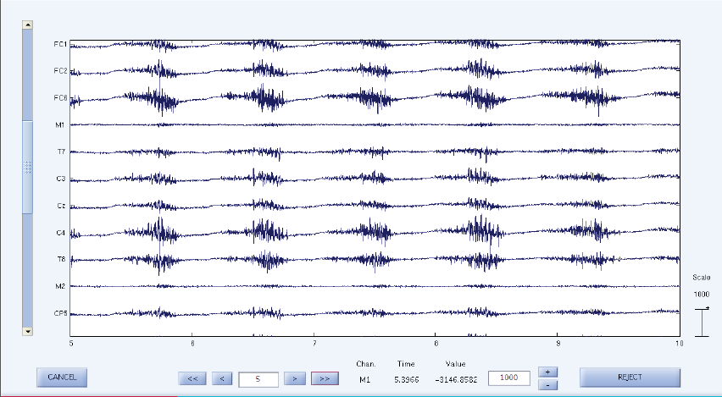
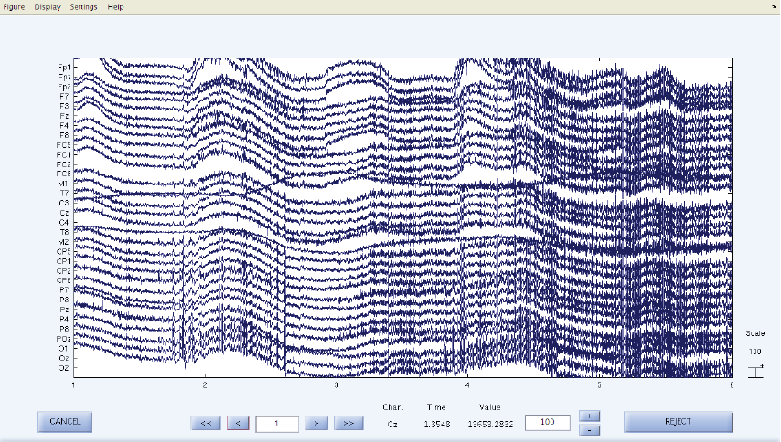
Chewing
Moving the head up and down

Slide 10
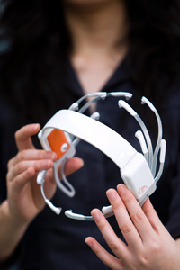
EPOC
EPOC isn't an acronym; it's a play on the word "epoch," which refers to a time of momentous technological development or beginning of important era.
Emotiv EPOC is the first high-fidelity brain computer interface that reads and interprets both conscious and non-conscious thoughts as well as facial expressions, body language and emotions.

Slide 11
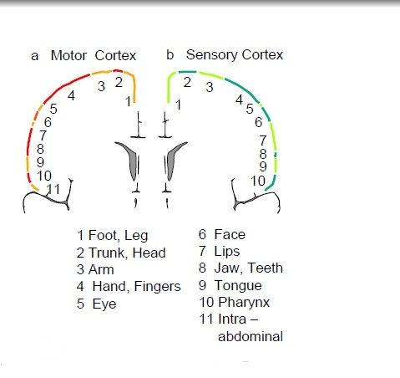
The EPOC is a low cost Human–Computer Interface (HCI) comprised of 14 channels of EEG data and a gyroscope measure for 2 dimensional controls . The electrodes are located at the positions AF3, F7, F3, FC5, T7, P7, O1, O2, P8, T8, FC6, F4, F8, AF4 according to the International system as shown in Fig.

Slide 12
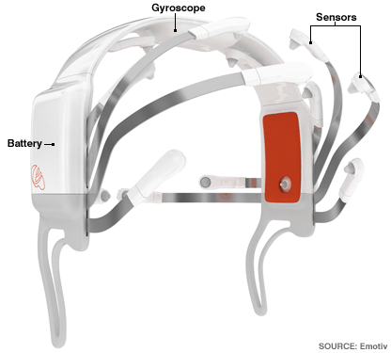
HARDWARE COMPONENTS
The main physical components are the 14 electrodes, the gyroscope, sensors and a Lithium-poly battery.
The device connects wirelessly with the computer or the embedded system.
A gyroscope is a device for measuring or maintaining orientation.

Slide 13
specification
Number of Channels | 14 (plus CMS/DRL references)
Channel names (Int. 10-20 locations) | AF3, AF4, F3, F4, F7, F8, FC5, FC6, P7, P8, T7, T8, O1, O2
Sampling method | Sequential sampling, Single ADC
Sampling rate | ~128Hz (2048Hz internal)
Resolution | 16 bits (14 bits effective) 1 LSB = 1.95μV
Bandwidth | 0.2 - 45Hz, digital notch filters at 40Hz and 60Hz
Dynamic range (input referred) | 256mVpp
Coupling mode | AC coupled
Connectivity | Proprietary wireless, 2.4GHz band
Battery type | Li-poly
Battery life (typical) | 12 hours
Impedance measurement | Contact quality using patented system

Slide 14
video

Slide 15
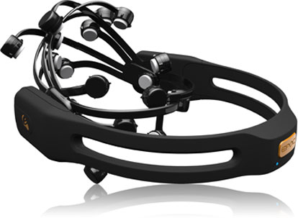
Wireless
receiver
Device
driver
Emotiv
Sdk
Library
(EDK.DLL)
emoengine
API INTERFACE
API CALLS
APPLICATION

Slide 16
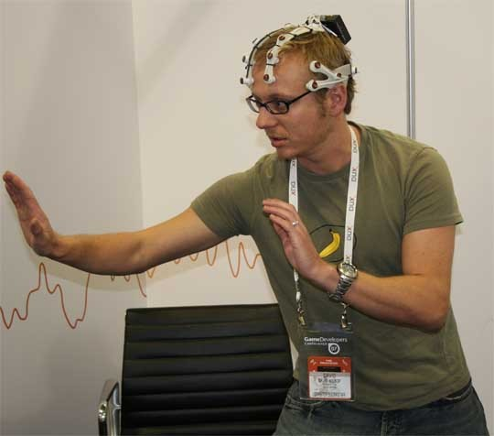
TRAINING
This sort of training is usually called Cognitive Training, where Data from training to classify their individual brainwave ‘signature’, for each focussed and intent thought trained.
There are four different mental states or facial gesture and predefined Actions that can be triggered when they occur.

Slide 17
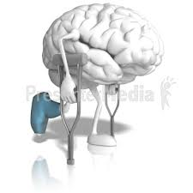
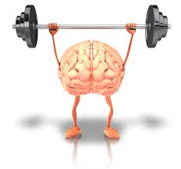
Training(cont.)
Self paced decision
Neural classifier recognizes which mental task is concentrated
Analyzing cont. EEG
Mutual learning process
Neural network learns patient specific EEG patterns
Response to EEG
Every response treated as unknown

Slide 18
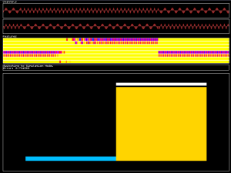
software
API is a simple software for the Modular EEG that implements an experimental Brain Computer Interface (BCI)
The programming language used in the API (application program interface) is known as Python C.

Slide 19
application
The lists of applications for this device are numerous ranging from medical applications to electro-mechanical to entertainment applications.
Currently it is still in research condition but still EPOC headset is available in market for entertaining
purpose

Slide 20

Present application
Currently this system is being used in Virtual 3D navigation and in gaming applications.
Here a person can control a character on the screen just through his or her facial expressions.
No physical movements of arms is required as in traditional gaming

Slide 21
Developer application
Two of the best known developer applications of the Emotiv Epoc are: The brain driver car and the mind controlled wheel chair
Anathor exciting application is THOUGHT controlled games.

Slide 22
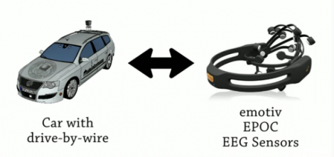
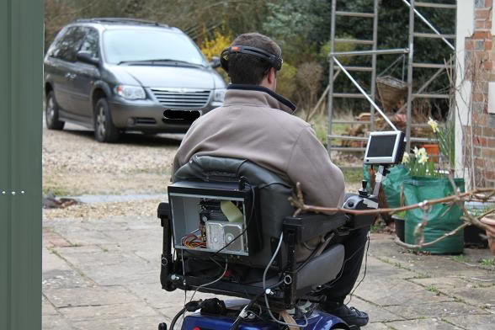
In the brain driver car the can be made to accelerate/decelerate or turn just by bio-electric signals from the 16 channel EPOC
An electric wheel chair can be made to navigate just by simple actions such as blinking and smiling.

Slide 23
Pros and cons
New method of interacting with machines/computer, where no physical touch is required.
Relatively cheap compared to other EEG devices.
No conduction gel required for the electrodes.
Current version limits to only four different actions(i.e., inputs)
Many applications still in beta stages
Hard to market since not many people are known to the idea of BCI.(only IBM is taking intrest in research)

Slide 24
conclusion
Brain-Computer Interface (BCI) is a method of communication based on voluntary neural activity generated by the brain and independent of its normal output pathways of peripheral nerves and muscles.
The neural activity used in BCI can be recorded using invasive or non-invasive techniques.
We can say as detection techniques and experimental designs improve, the BCI will improve as well and would provide wealth alternatives for individuals to interact with their environment.
Electroencephalography is the process of recording the electrical activity in the brain.
Emotiv Epoc is a neural headset that works on the principle of Electroencephalography or EEG.

Slide 25
references
1. ASM paper: “Measuring Subjectivity”-Supporting Evaluations with the Emotiv EPOC Neuroheadset
Daniel Cernea , Peter-Scott Olech, Achim Ebert,Andreas Kerren( 19 January 2012)
2. IEEE paper: Towards Brain First-Aid: A Diagnostic Device for Conscious Awareness
Ryan C. N. D’Arcy, Sujoy Ghosh Hajra, Member, IEEE, Careesa Liu, Member, IEEE,
Lauren D. Sculthorpe, and Donald F. Weaver(3 March 2011)
3. IEEE paper: Head movements based control of an intelligent wheelchair in an indoor environment
Ericka Janet Rechy-Ramirez, Huosheng Hu and Klaus McDonald-Maier(11 December 2012)

Slide 26
references
4. IEEE paper: Choice modeling and the brain: A study on the Electroencephalogram (EEG) of preferences
by Rami N. Khushaba , Luke Greenacre , Sarath Kodagoda , Jordan Louviere , Sandra Burke ,
Gamini Dissanayake(9 September 2012).
5. IEEE paper: Restoration of Whole Body Movement-Toward a Noninvasive Brain–Machine Interface SystemBy José L. Contreras-Vidal, Alessandro Presacco, Harshavardhan Agashe, and Andrew Paek ( 6 February 2012)
6. www.emotive.com

Slide 27
Thank You

