Slide 1


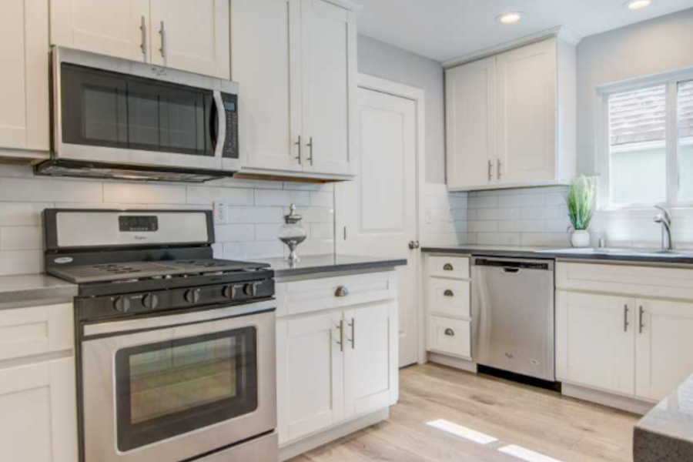

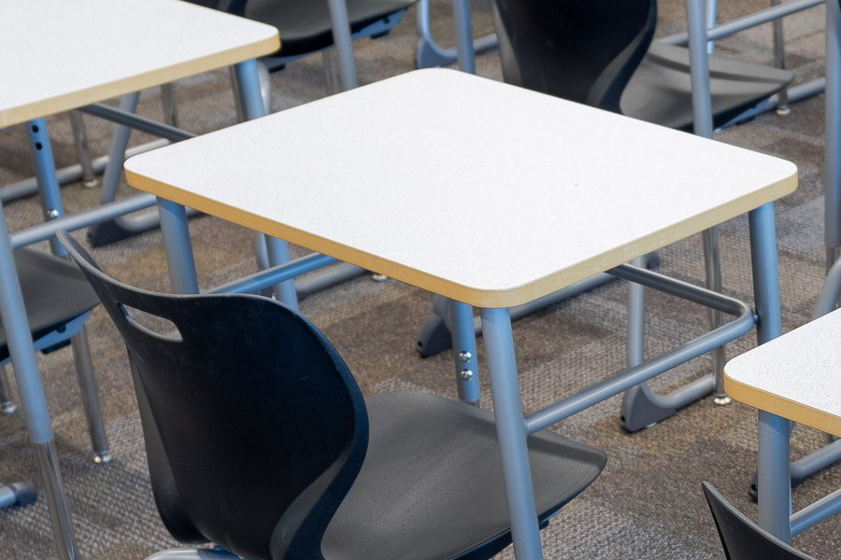

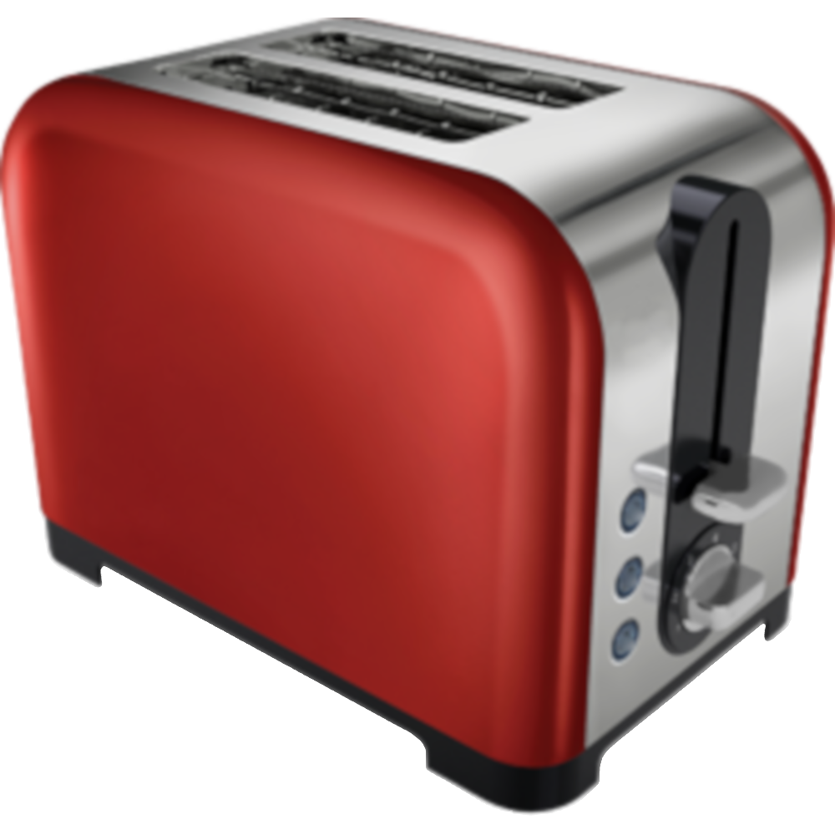


1.5s
250 ms
1000 ms
400 ms
2s or until response
5s

Slide 2
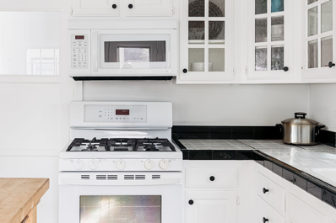
pot
2s
1500 ms
30s or until response
5s

