Slide 1
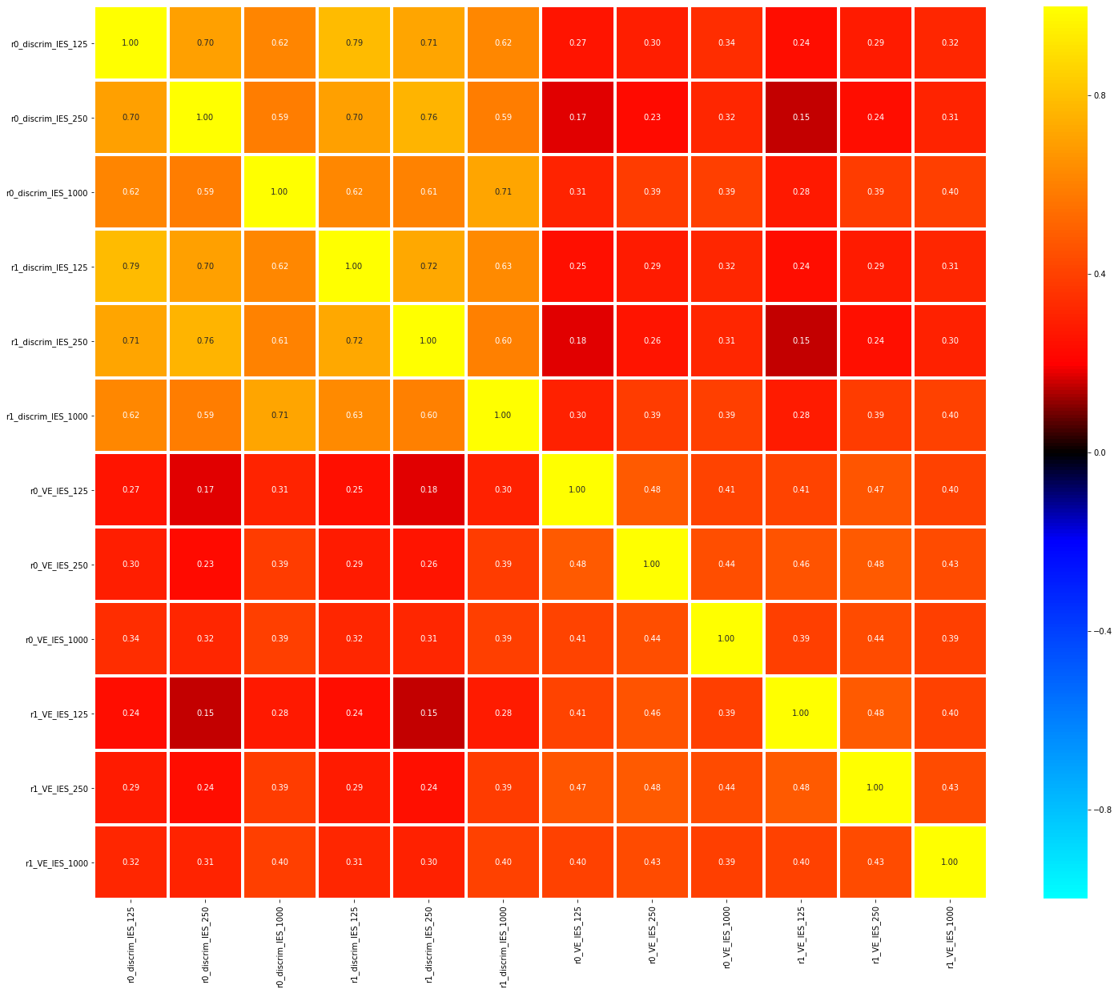
Decoding of time within tasks
Avg green vs avg purple per task

Slide 2
Task decoding within duration
Avg green vs avg purple

Slide 3
Task decoding across duration
Avg green vs avg purple

Slide 4
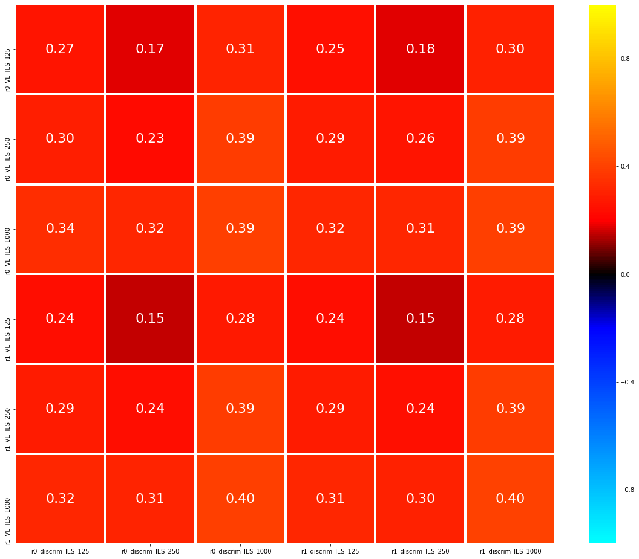
InvEff (N=100)
125
0.8
250
Split 0
0.4
1000
*
0.16
Correlation (r)
Numerical Estimate
0
125
*
- 0.16
- 0.4
250
Split 1
1000
- 0.8
125
250
1000
125
250
1000
Split 0
Split 1
Discrimination

Slide 5
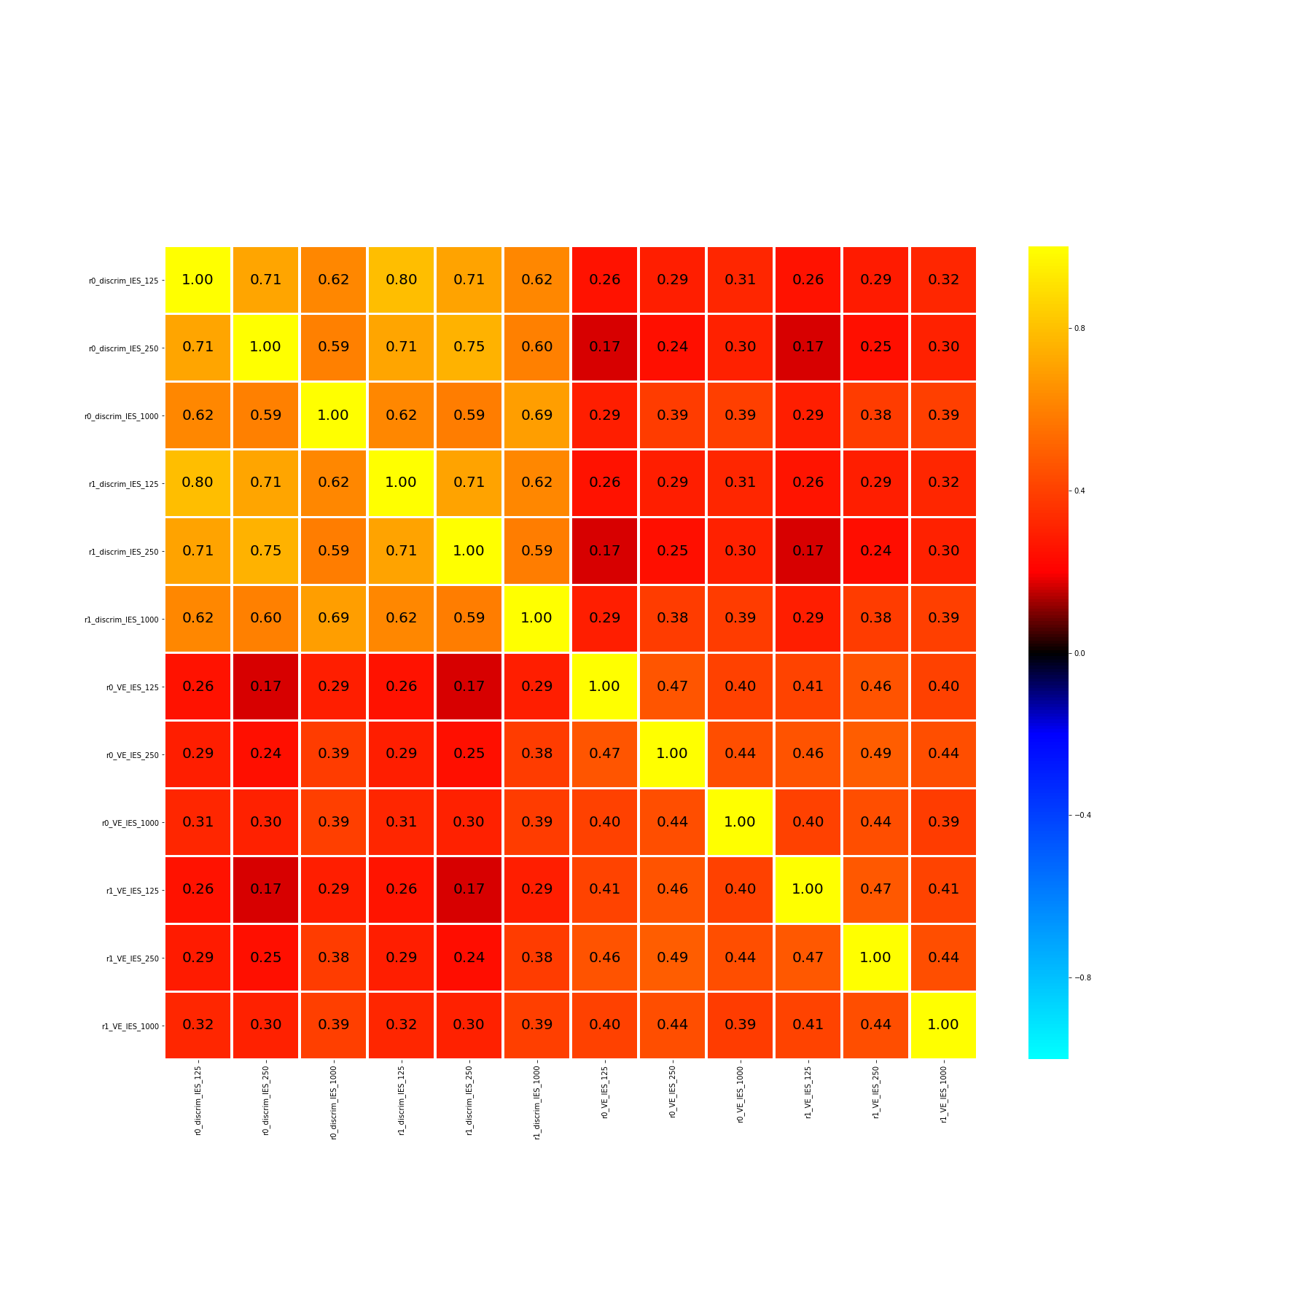

125
250
0.8
1000
Discrimination
125
0.4
250
*
0.16
1000
Correlation (r)
0
125
*
- 0.16
250
1000
- 0.4
Numerical Estimate
125
250
- 0.8
1000
125
250
1000
125
250
1000
125
250
1000
125
250
1000
Discrimination
Numerical Estimate

Slide 6
125
250
Discrimination
1000
125
250
Numerical Estimate
1000
125
250
1000
125
250
1000
Discrimination
Numerical Estimate

Slide 7
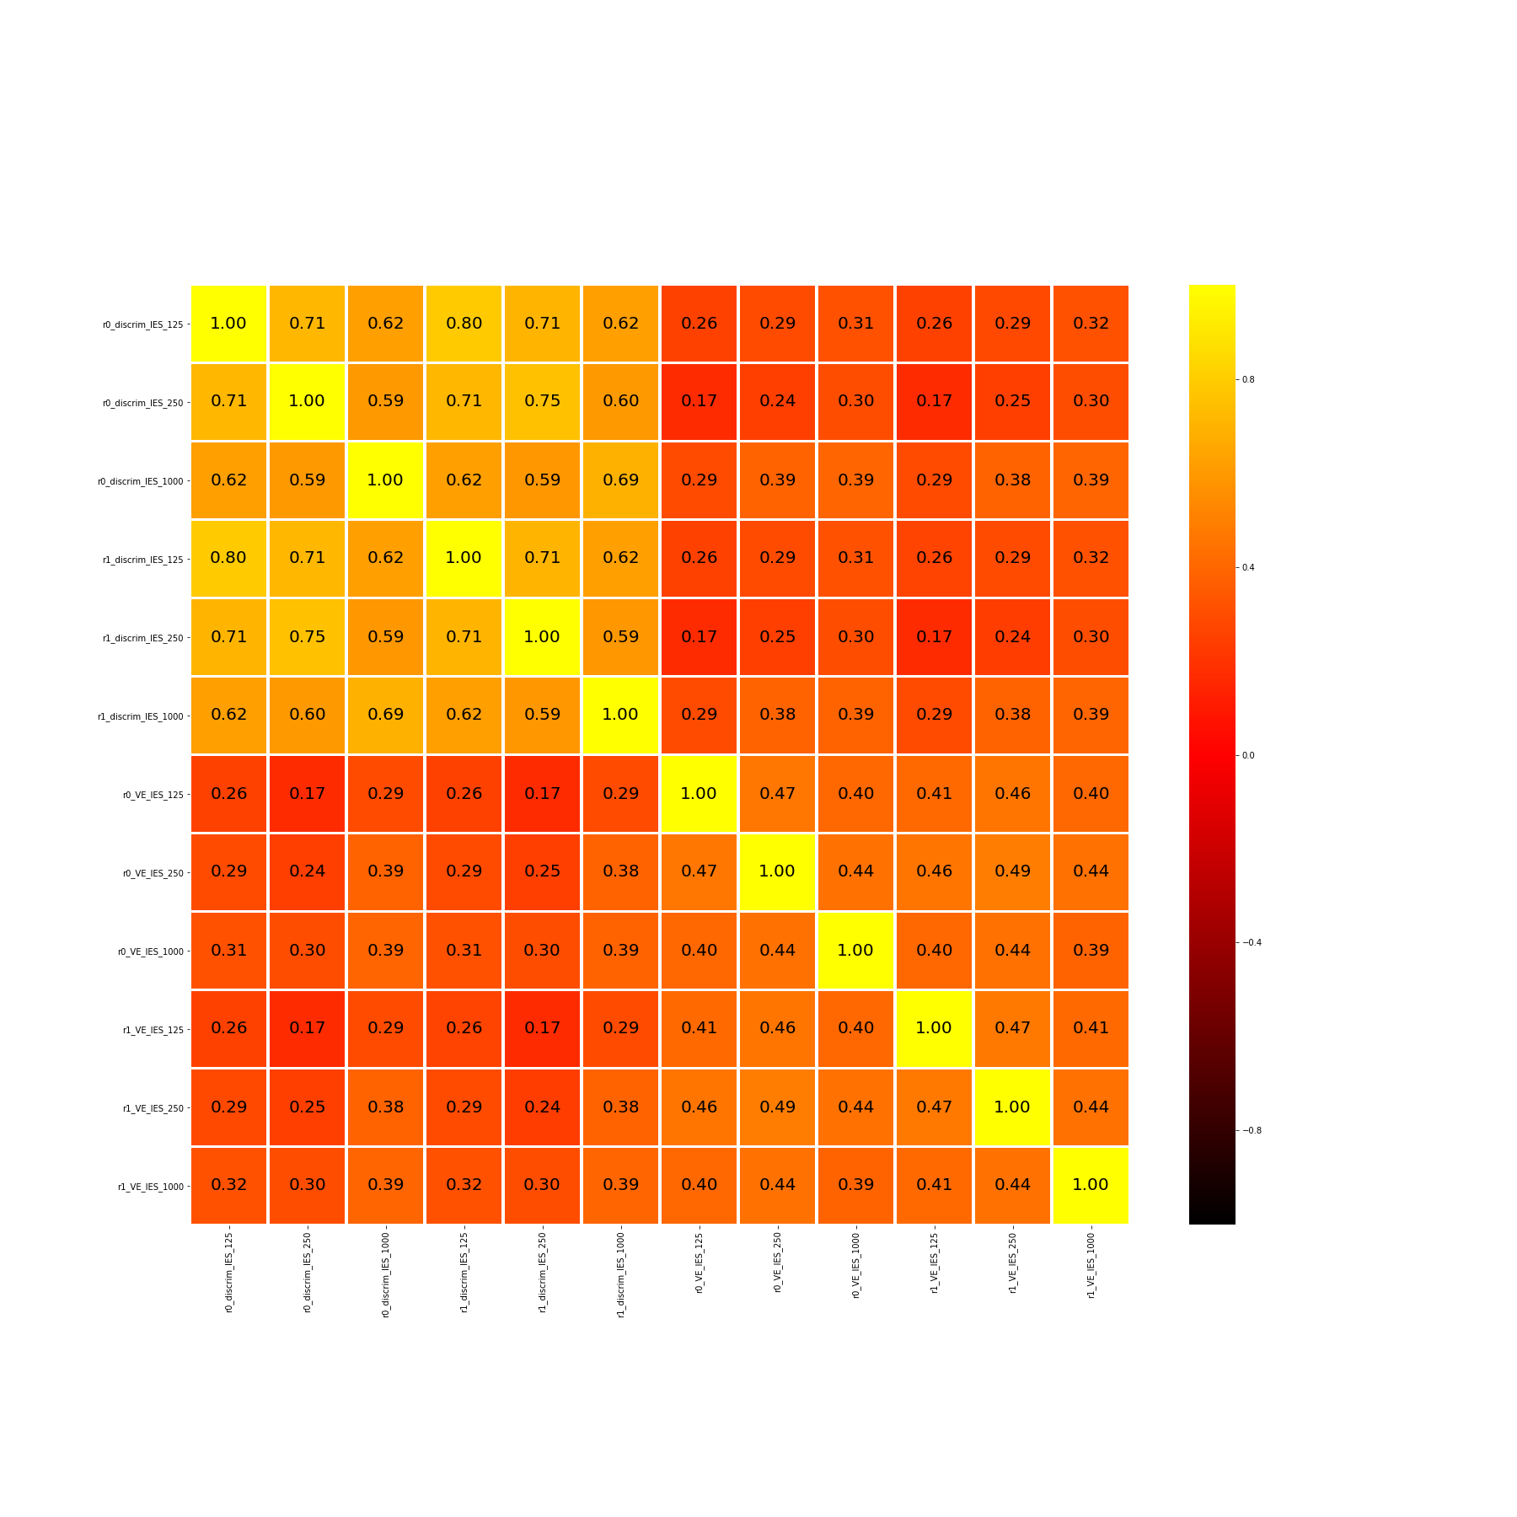
125
250
0.8
Discrimination
1000
Correlation (r)
125
0.4
250
Numerical Estimate
*
0.16
1000
0
125
250
1000
125
250
1000
Discrimination
Numerical Estimate

