Slide 1
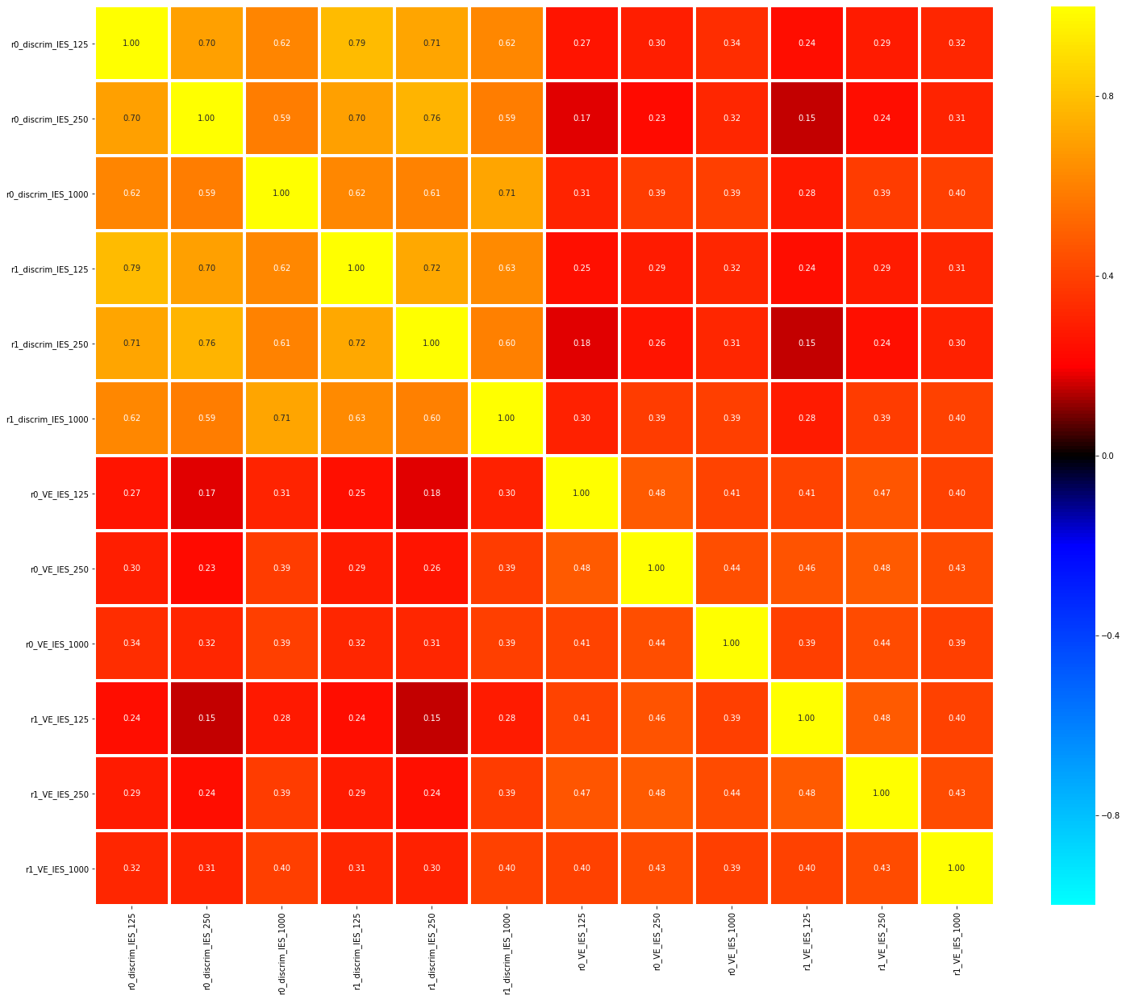
Decoding of time within tasks
Avg green vs avg purple per task

Slide 2
Task decoding within duration
Avg green vs avg purple

Slide 3
Task decoding across duration
Avg green vs avg purple

Slide 4
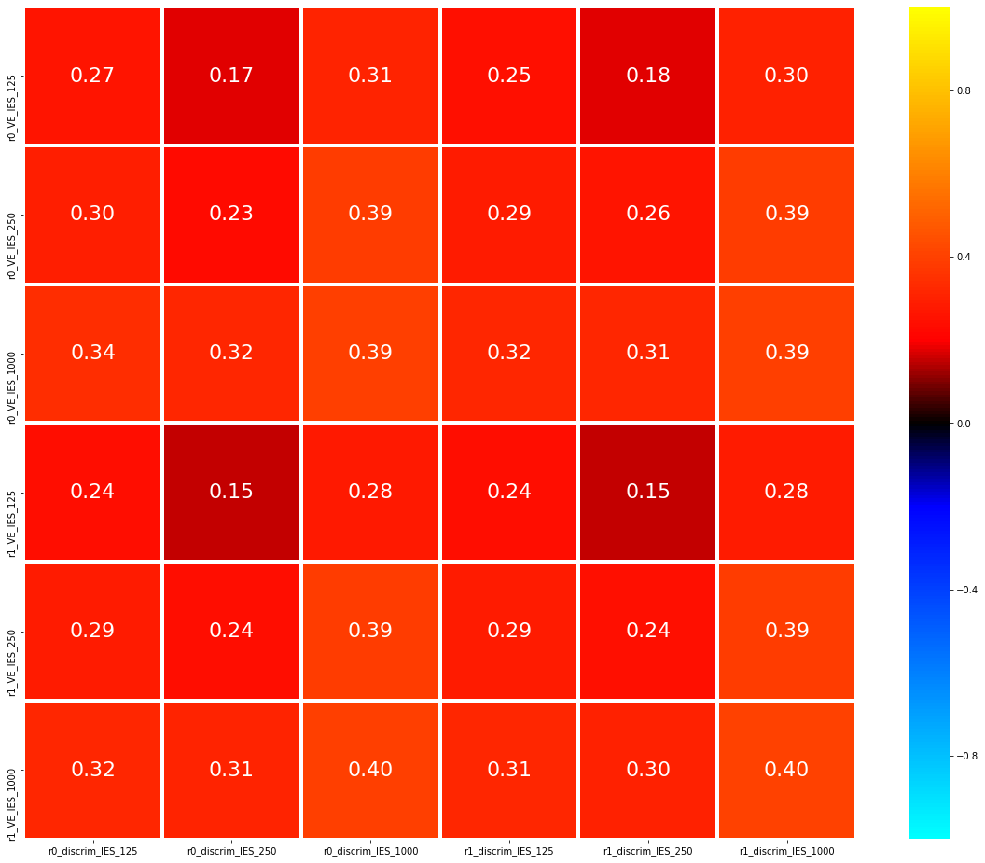
InvEff (N=100)
125
0.8
250
Split 0
0.4
1000
*
0.16
Correlation (r)
Numerical Estimate
0
125
*
- 0.16
- 0.4
250
Split 1
1000
- 0.8
125
250
1000
125
250
1000
Split 0
Split 1
Discrimination

Slide 5
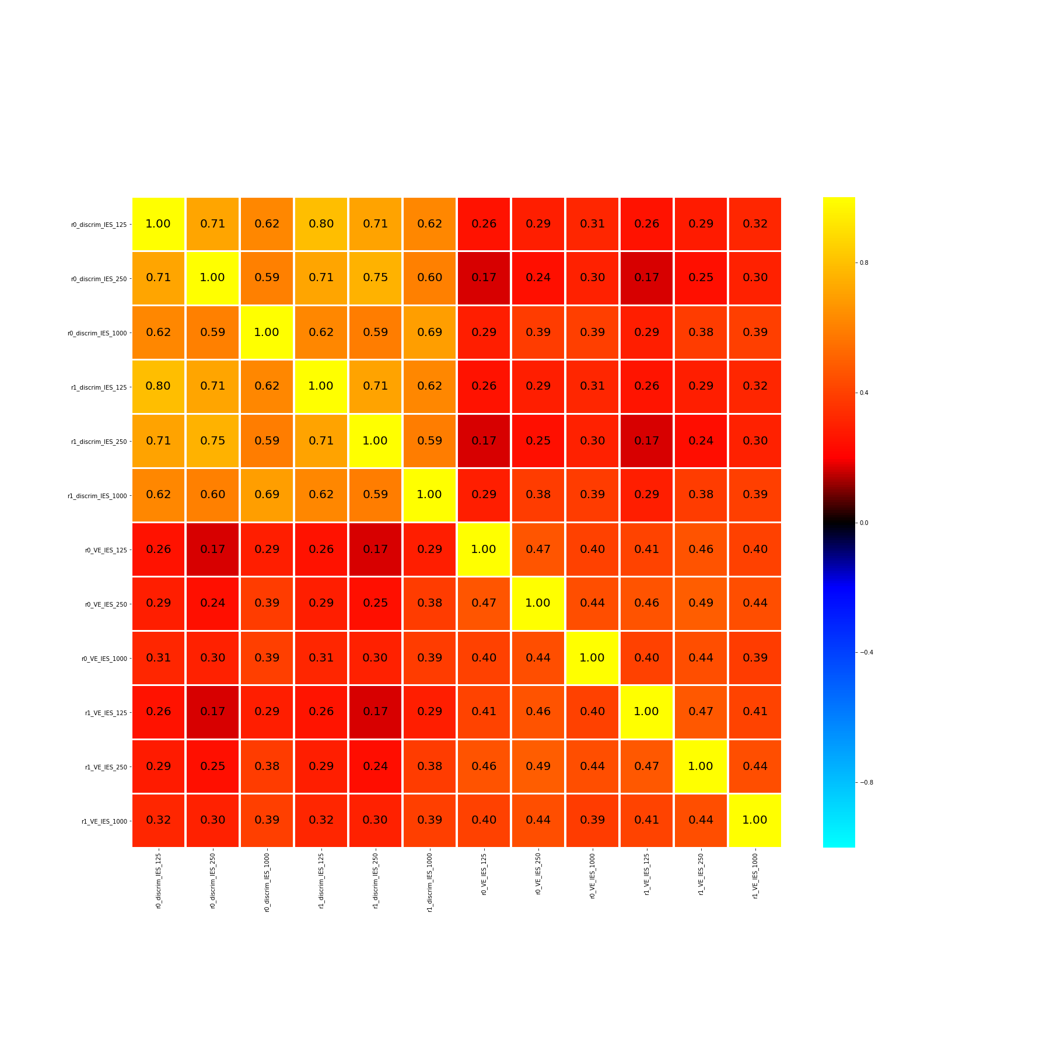

125
250
0.8
1000
Discrimination
125
0.4
250
*
0.16
1000
Correlation (r)
0
125
*
- 0.16
250
1000
- 0.4
Numerical Estimate
125
250
- 0.8
1000
125
250
1000
125
250
1000
125
250
1000
125
250
1000
Discrimination
Numerical Estimate

Slide 6
125
250
Discrimination
1000
125
250
Numerical Estimate
1000
125
250
1000
125
250
1000
Discrimination
Numerical Estimate

Slide 7
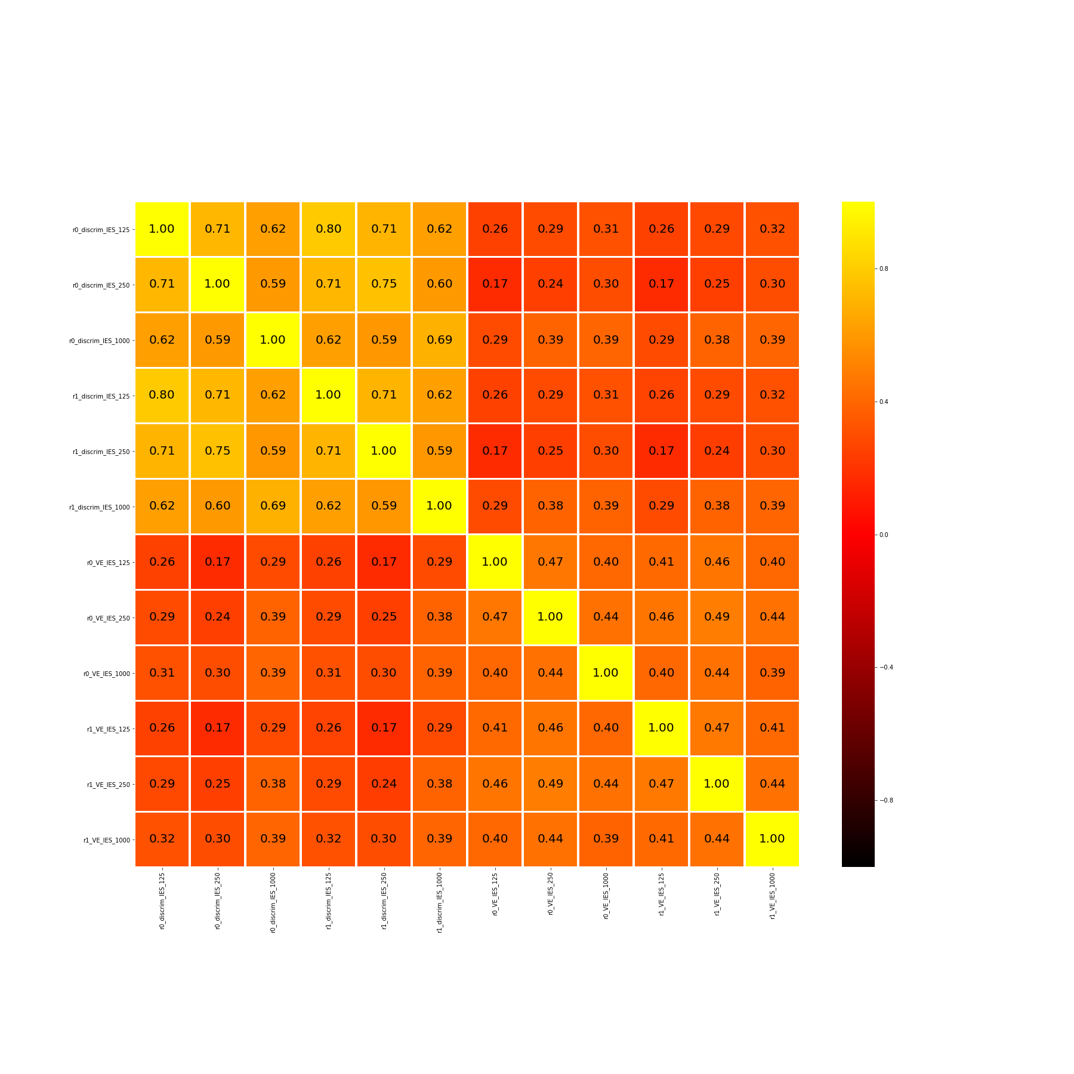
125
250
0.8
Discrimination
1000
Correlation (r)
125
0.4
250
Numerical Estimate
*
0.16
1000
0
125
250
1000
125
250
1000
Discrimination
Numerical Estimate

Slide 8
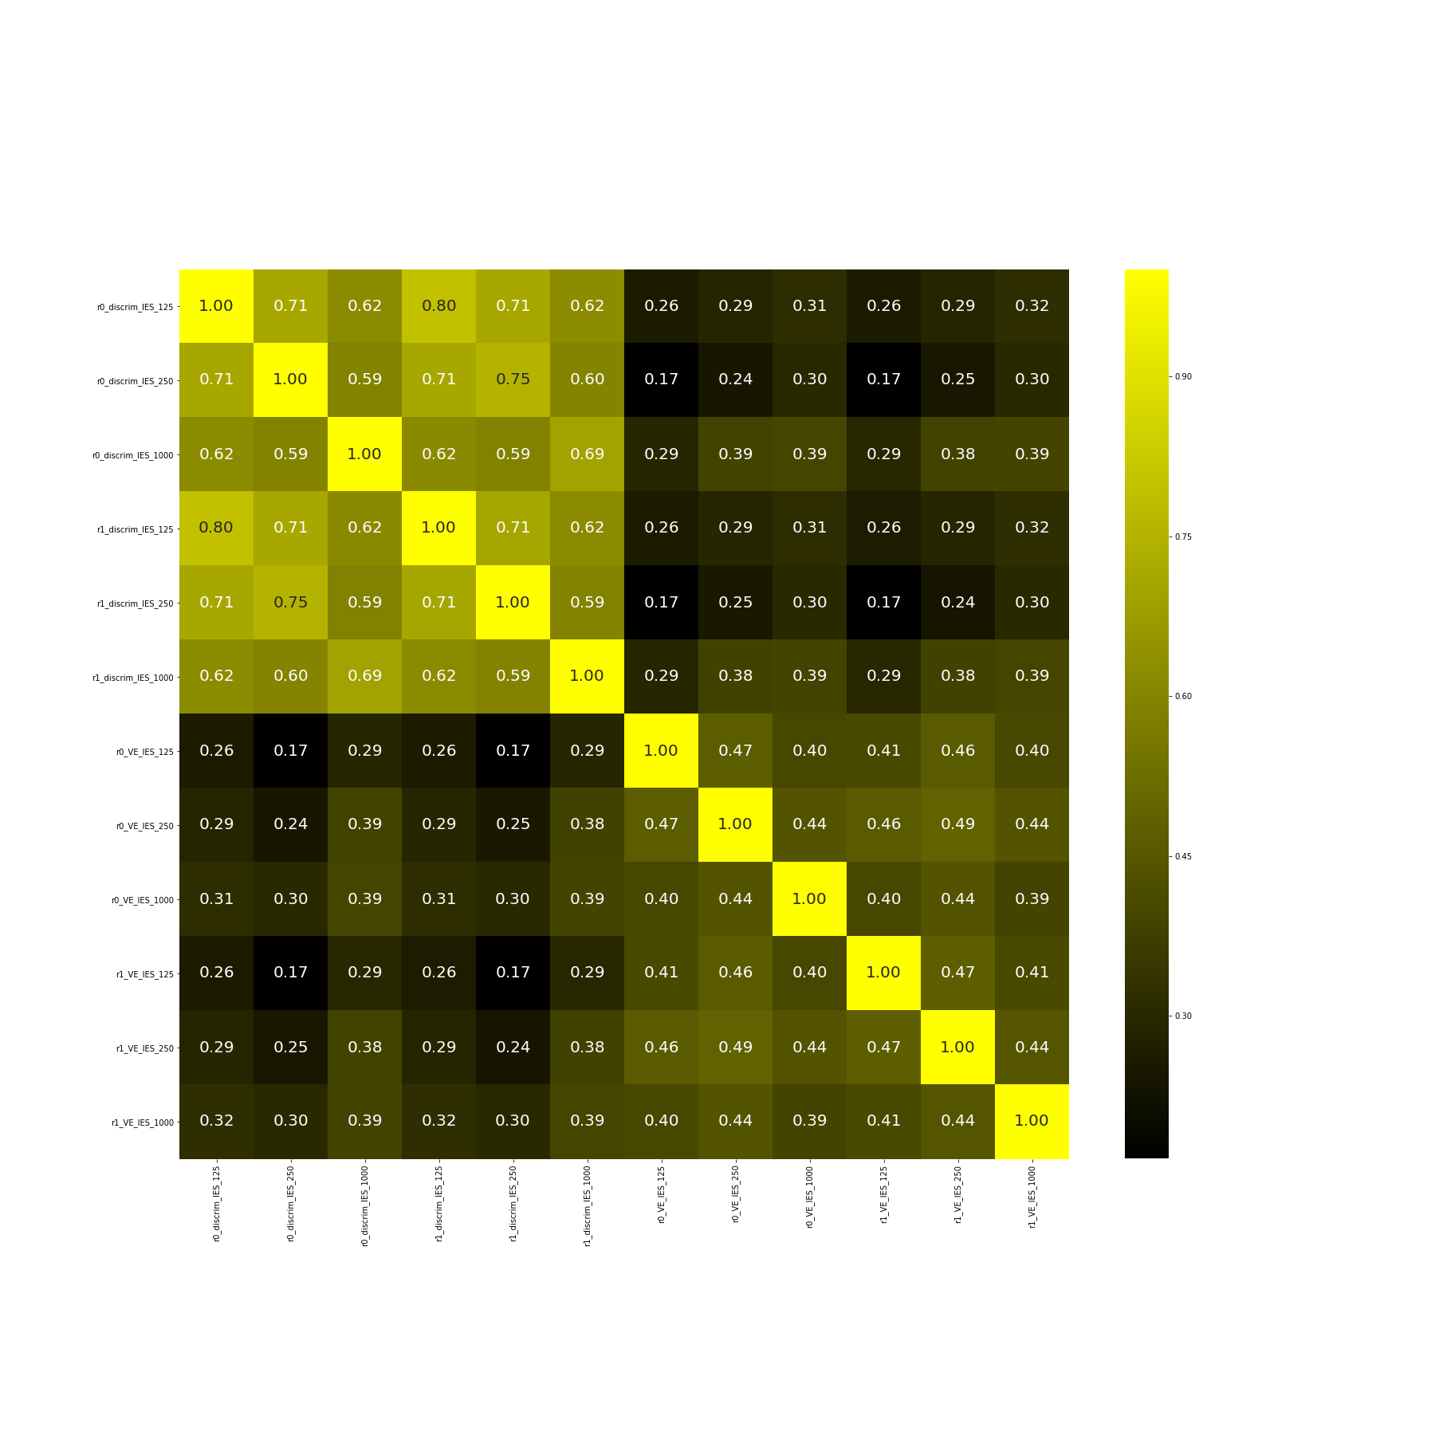
125
0.90
250
Discrimination
0.75
1000
0.60
Correlation (r)
125
0.45
250
Numerical Estimate
0.30
*
1000
0.16
125
250
1000
125
250
1000
Discrimination
Numerical Estimate

Slide 9
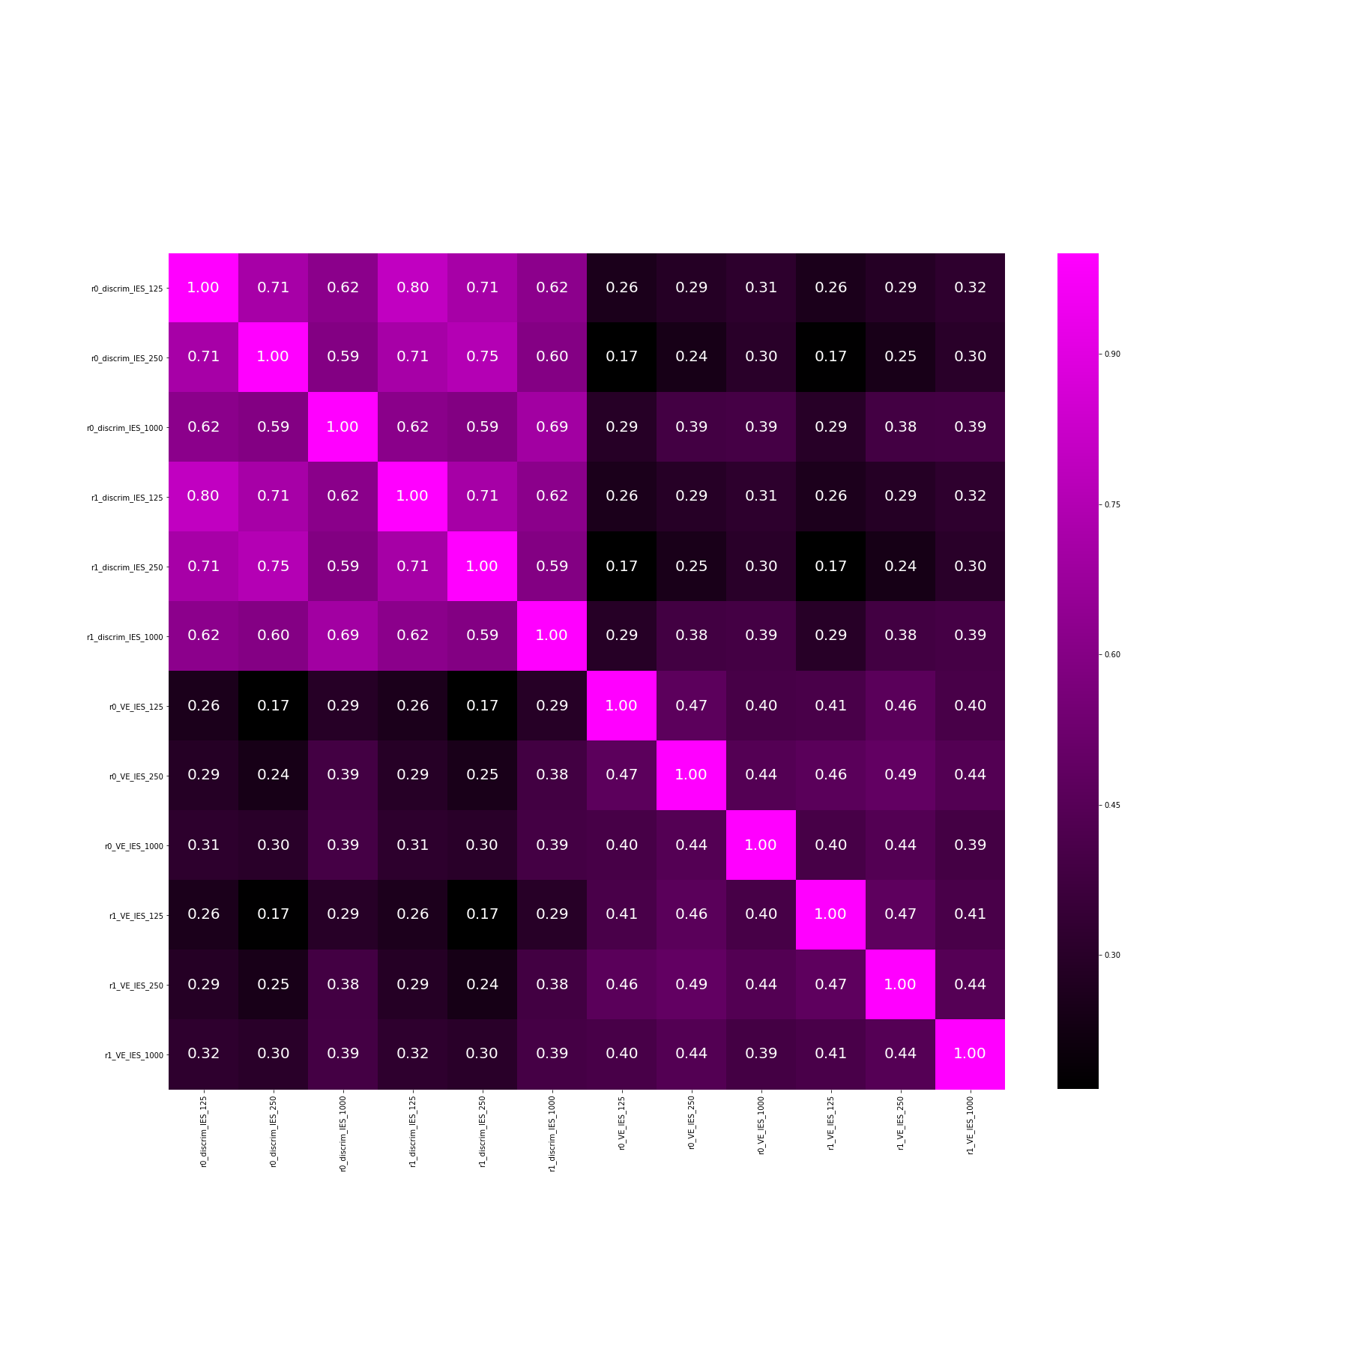
125
0.90
250
Discrimination
0.75
1000
0.60
Correlation (r)
125
0.45
Numerical Estimate
250
0.30
*
1000
0.16
125
250
1000
125
250
1000
Discrimination
Numerical Estimate

Slide 10

125
0.90
250
Discrimination
Discrimination
0.75
1000
0.60
Correlation (r)
125
0.45
Numerical Estimate
250
Numerical Estimate
0.30
*
1000
0.16
125
250
1000
125
250
1000
Discrimination
Numerical Estimate
Discrimination
Numerical Estimate

