Slide 1

GENBUS745: Robotic Process Automation
Enhancing Customer Experience Through Automated Feedback Analysis & Report Generation

Slide 2
Agenda
Introduction & Process Overview
Benefits
Implementation & Outcome
Business Use Cases

Slide 3
Introduction & Process Overview
Objective: The objective of this business case is to demonstrate the value of automating the analysis of customer feedback using Python and automatically generate a report with insightful visual.
Problem Statement: Manual processing of customer feedback is time-consuming, prone to errors, and lacks scalability, hindering the ability to extract actionable insights in a timely manner.
Overview of the Process: Our proposed solution involves automating the analysis of customer feedback data using Python programming and generate a report.
Automation Steps:
  Retrieve feedback data from an Excel file.
  Perform sentiment analysis on each feedback entry using a loop.
  Categorize feedback into positive, neutral, or negative sentiment categories.
  Generate a summary report of the sentiment analysis in a word document with an interactive visual.

Slide 4
Benefits
Time Savings: Manual processing of feedback data is labor-intensive and time-consuming. Automation streamlines the process, saving valuable time for the team.
Accuracy: Feedback analysis automation reduces the risk of human error, ensuring accurate sentiment analysis.
Efficiency: This automation frees up resources, allowing the team to focus on higher-value activities.
Timeliness: It provides timely insights, enabling swift action to address customer needs.
Scalability: It can handle increasing volumes of feedback data effortlessly, without compromising efficiency.

Slide 5
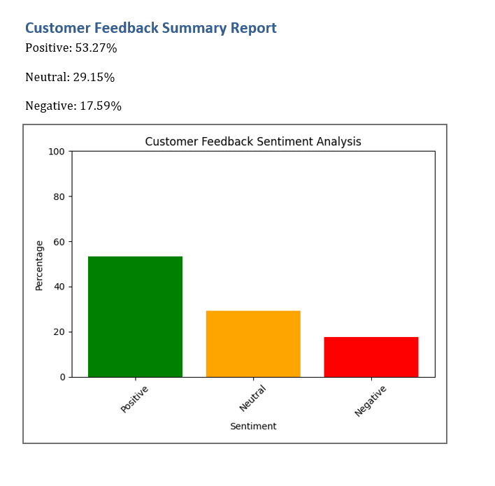
Implementation & Outcome
We have used Python for our automation and followed these steps -
Sentiment Analysis: Utilized Python’s TextBlob library to analyze sentiment of feedback text.
Data Retrieval: Read feedback data from an Excel file using for each loop for each customer.
Summary Calculation: Categorizes feedback into positive, neutral, or negative sentiments and calculates percentages.
Document Creation: Generates a Word document and adds summary report.
Visualization: Creates a bar chart using Matplotlib and embeds it into the Word document.
Report Generation: Saves the final report document as 'feedback_summary_report.docx'.
Snippet of Feedback Analysis Report Generated through Automation

Slide 6
Use Cases of the Automation
Sector | Companies | Use Cases of feedback analysis automation
Retail and E-commerce | Amazon, Walmart, Alibaba | Product optimization, customer service improvement, online experience enhancement
Hospitality and Travel | Marriott, Airbnb, Expedia | Guest experience enhancement, online review management, complaint resolution
Technology and Software | Google, Microsoft, Salesforce | Usability improvement, bug identification, customer support optimization
Financial Services | JPMorgan Chase, Bank of America, PayPal | Online banking enhancement, customer service improvement, reputation management
Healthcare | Pfizer, Johnson & Johnson, UnitedHealth Group | Patient satisfaction improvement, healthcare service optimization
Automotive | Toyota, BMW, Tesla | Vehicle feature enhancement, customer service improvement
Telecommunications | AT&T, Verizon, Vodafone | Service optimization, customer support improvement, reputation management
Consumer Goods | Procter & Gamble, Unilever, Coca-Cola | Consumer insight gathering, packaging optimization, brand reputation management
Hospitality and Entertainment | Disney, Netflix, Hilton | Guest experience enhancement, content optimization, online reputation management
Education | Pearson, Coursera, Khan Academy | Student satisfaction improvement, e-learning platform optimization

Slide 7
Conclusion
Automated feedback analysis along with automated report generation using python offers a multitude of business use cases across various departments and functions, empowering organizations to leverage customer insights for strategic decision-making and competitive advantage.
Files –
productservice_feedback_data.xlsx – Input Feedback Data
AutomatedFeedbackAnalyzer.ipynb – Python Code Notebook
Google Colab link for the Python code notebook – https://colab.research.google.com/drive/1rPbgAmEvxpphClqHG5nQ0kmyu5jWWkUm?usp=sharing
feedback_summary_report.docx – Feedback report generated by the automation
Chart.png – Visual generated by automation which is embedded in the report

Slide 8

Thank you
Contact –
Prachi Matapurkar
matapurkar@wisc.edu
MSBA – UW Madison

