Slide 1

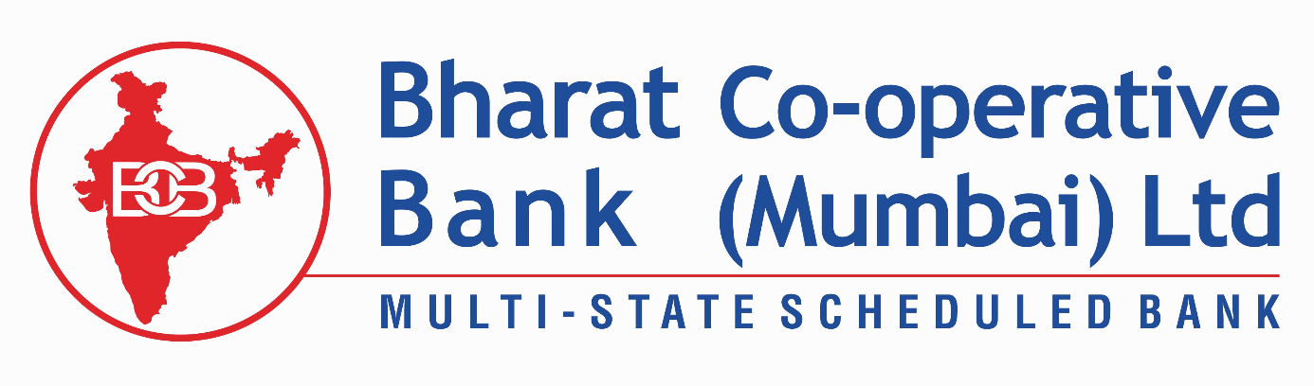




NEBULON '26
Round 2 PPT Submission
Team Name : Pixel Pair
Problem Statement : PS2
Team Members : Prachi Ajay Mule Omkar Khilare
Product Name : Wastewise
NEBULON '26 | TRANSSTADIA INSTITUTE
Notes:
1

Slide 2
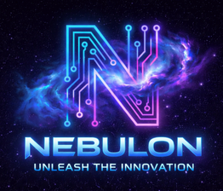
Problem Identified
Waste management in Indian cities lacks transparency and real-time tracking.
1. Citizens have no way to report or track waste pickup status.
2. Collectors lack a structured system to log and update waste movement.
3. Authorities cannot monitor illegal dumping, missed collections, or fraud.
4. Multiple waste types — organic, recyclable, hazardous, e-waste, medical — are often mixed or mishandled, creating health and environmental hazards.
5. No accountability chain exists from waste generation to final disposal.
Key Issues Found:
1. Illegal dumping near water bodies .
2. Missed garbage collection for days — waste piling on streets.
3. Medical waste mixed with general bins — serious health risk.
4. Collector fraud — skipping hazardous waste from official manifest.
5. E-waste dumped in open grounds — risk of heavy metal contamination.
NEBULON '26 | TRANSSTADIA INSTITUTE
Notes:
4

Slide 3
Solution / Approach
WasteWise — A full-stack waste tracking and management platform
For Citizens:
1.Report waste (type, weight, address, zone) and earn reward points
2.Track real-time status of reported waste from pickup to disposal
For Collectors:
1.View and accept assigned waste collection tasks by zone
2.Update waste status at each stage: collected, in-transit, processing
For Authorities:
1.Dashboard with zone-wise analytics, anomaly detection, and audit trail
2.View and manage public reports: illegal dumping, fraud, contamination
3.Monitor collector performance and flag suspicious activities
NEBULON '26 | TRANSSTADIA INSTITUTE
Notes:
4

Slide 4
Tech Stack
Frontend:
React 18 | React Router v6 | Recharts | Lucide React | React Hot Toast | Axios
Backend:
Node.js | Express.js | REST API
Database:
MongoDB | Mongoose ODM
Authentication & Security:
JSON Web Tokens (JWT) | bcryptjs | CORS | dotenv
File Handling:
Multer (image/file upload) | UUID (unique ID generation)
Dev Tools:
Nodemon | NPM | Git
NEBULON '26 | TRANSSTADIA INSTITUTE
Notes:
4

Slide 5
Workflow / Architecture
System Architecture.
1. Citizen Reports Waste
Login → Submit waste (type, weight, address, zone, photo) → Entry stored in MongoDB.
2. Collector Picks Up
Login → View assigned tasks by zone → Update status: Collected → In-Transit.
3. Processing Facility
Status updated: Processing → Recycled / Disposed. Full timeline recorded.
4. Authority Dashboard
Real-time stats, zone analytics, anomaly flags, report management.
NEBULON '26 | TRANSSTADIA INSTITUTE
Notes:
4

Slide 6
Impact / Benefits
For Citizens:
1.Transparent waste tracking from doorstep to disposal
2.Gamified reward points for responsible waste reporting
3.Direct channel to report illegal dumping and contractor fraud
For Municipal Authorities:
1.Real-time dashboards with zone-wise waste analytics
2.Automatic anomaly detection — flags diverted or mishandled waste
3.Complete audit trail for every waste entry (6-stage lifecycle)
For the Environment:
1.Reduces illegal dumping near lakes, roads, and open grounds
2.Ensures hazardous/medical/e-waste is properly segregated and processed
3.Promotes recycling through tracking organic and recyclable streams
NEBULON '26 | TRANSSTADIA INSTITUTE
Notes:
4

Slide 7

Thank you
NEBULON '26 | TRANSSTADIA INSTITUTE
Notes:
5

