Slide 1

Android Application development
Prachi Muley
Advisor: Dr. Ben Tribelhorn
MSCS Graduate Project
Dec 12, 2014

Slide 2
Outline
Motivation
Design
Functionality
Challenges
Things learned
Future work
Q&A

Slide 3
Motivation
Learn to develop an android application from scratch.
High demand of android developer in current market.
Goal:
To see job listings using my current location or a provided location.

Slide 4
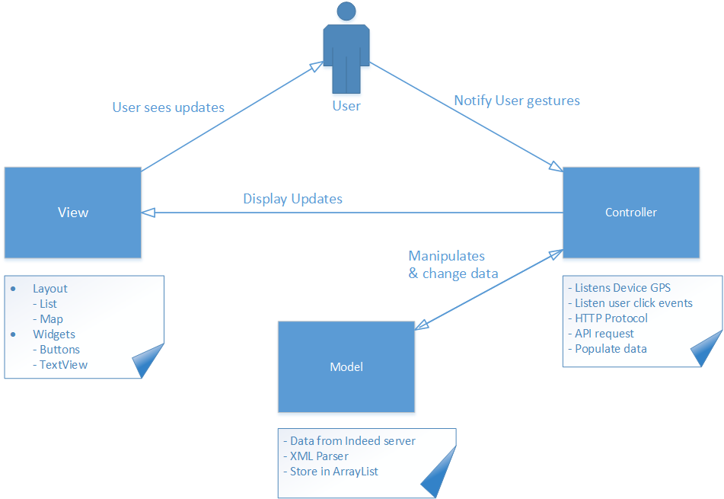
Basic Design
Notes:
Model-View-Controller Pattern
Model
- The data (ie state). Methods for accessing and modifying state
View
- Renders contents of model for user. When model changes, view must be updated
Controller
-Translates user actions (ie interactions with view) into operations on the model. Example user actions: button clicks, menu selections

Slide 5
Application Design
Primarily two components:
Implementation
UI Design

Slide 6
Implementation Details
HTTP AsyncTask
XML PullParser
Data structure
ArrayList
HashMap
Geocoder
Google Maps(API)
Notes:
AsyncTask: Proper and easy use of the UI thread. Does background operation and publish result on UI thread.
Geocoding is the process of transforming a street address or other description of a location into a (latitude, longitude) coordinate.

Slide 7
UI Design
Simple and intuitive user experience design.
Use of bright color buttons.
Text readable, short and understandable.
Use of different Views. E.g. TextView, ListView, MapView, WebView, etc.

Slide 8
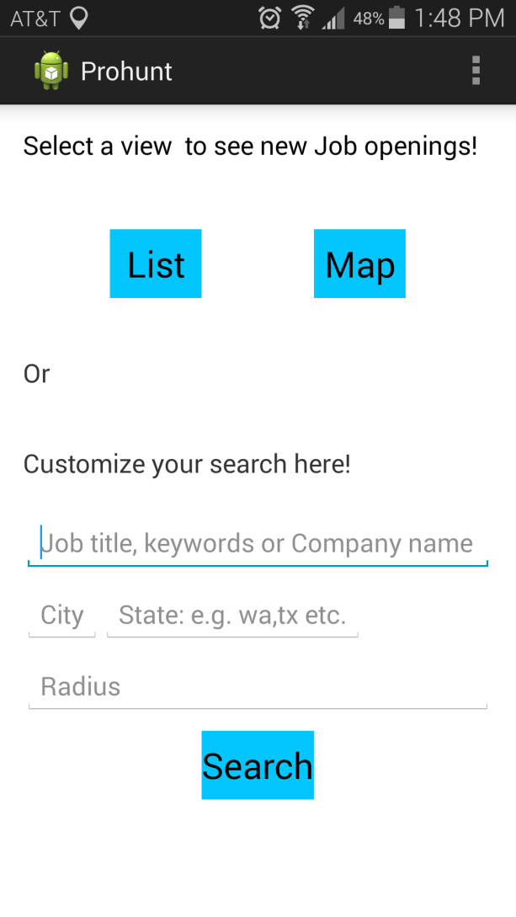
Functionality
The application contains three primary features.
List
Map
Search

Slide 9
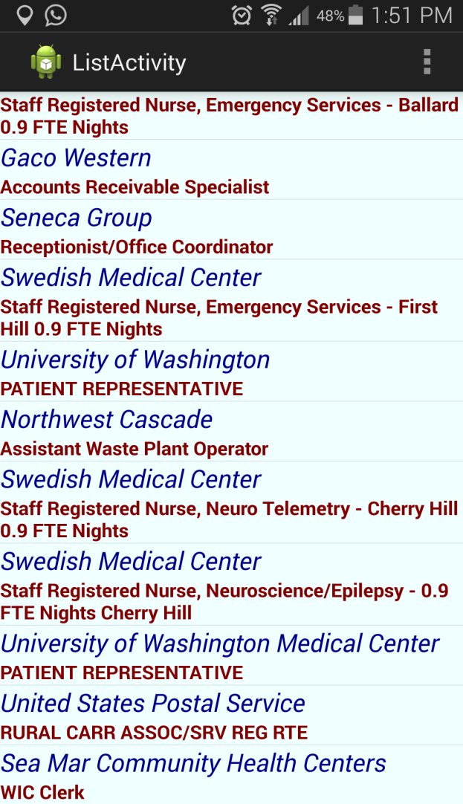
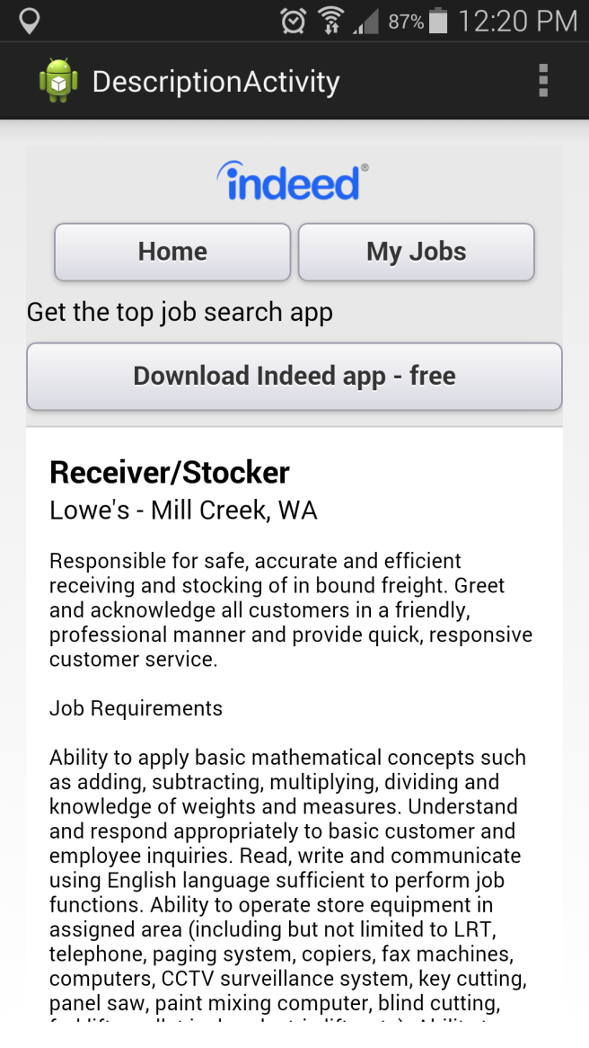
List Functionality
When clicked, it will show a list of job openings.
Each row contains company name and job title.
On row click user can see description about the job like requirements, details, contacts, etc.

Slide 10
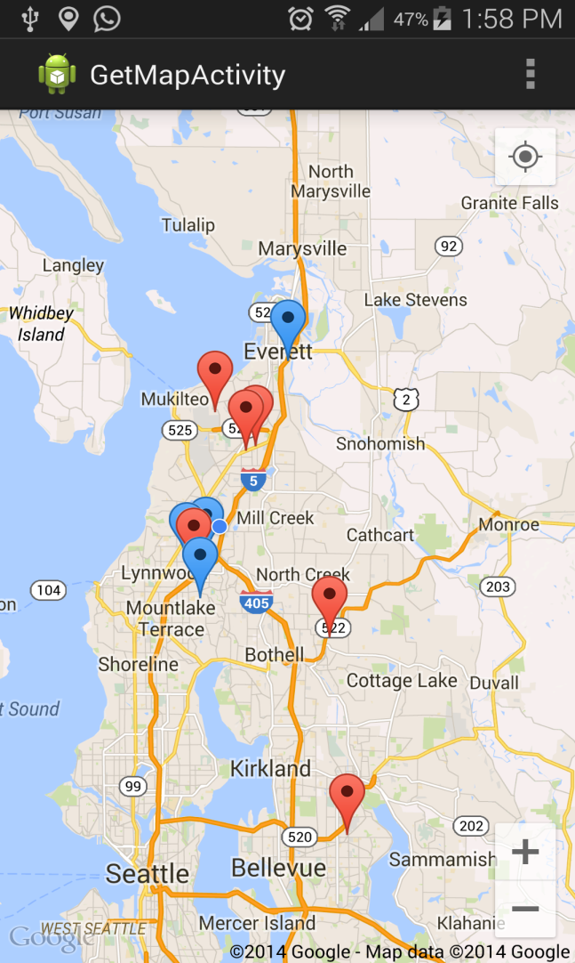
Map Functionality
When clicked, this will show you location of jobs into the map using marker.
Red Marker Vs Blue Markers
Lat/Long and geocoder for getting the location.

Slide 11
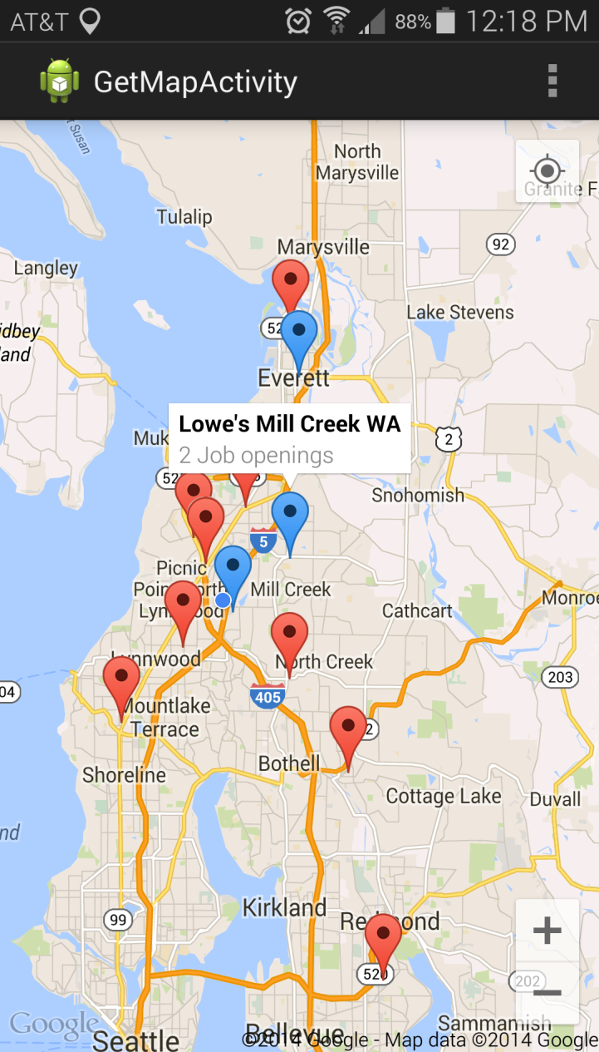
Map Functionality
On marker click an info window will open and show you company name, job title and number of jobs offered.
On info window click a list will show job offered in that particular company.
On each row click, a description page will open showing details of the job.

Slide 12
Search Functionality
For search functionality, user will provide search criteria e.g. job type, city, state, etc.
When user provides search criteria the application will show the job opening in MapView.
User can look at the details of any specific job.

Slide 13
Challenges
Getting current location from device GPS takes long time.
Populating ListView rows(Array Adaptor).
Error after android package updates.
Finding the exact location of a company.
Sending class object between activity was tricky(Parcelable).
Working with Google map android API v2 was the hardest.

Slide 14
Using Google play service
Download the API for Google play service
Get an SHA-1 fingerprint key.
Use that key to get Google Maps API key(with certificates).
Add this API key to your application manifest file.
Also specify requirement for OpenGL ES version 2 in manifest file.
Add Google play services lib to dependencies file.
Notes:
Download the API for Google play service
Get an SHA-1 fingerprint key from your debug file which is generated by android sdk tool
Use that key on Google API console for getting Google Maps API key(with certificates).
Add this API key to your application manifest file to get Google maps Started.
Also, add Google play services lib to the Android dependencies file to get it started.
For more information visit this link https://developers.google.com/maps/documentation/android/start#getting_the_google_maps_android_api_v2

Slide 15
Things learned
Eclipse based IDE, ADT, Android SDK.
Strengthen OOP, OOD, Decomposition, etc.
XML resource files
UI design
Third party APIs(i.e.Google play service).

Slide 16
Future work
Show job listing from multiple websites.
Storing data from multiple websites into database server.
User can submit resume for specific job.

Slide 17
Q&A

