Slide 1
Exploratory Data Analysis

Slide 2
Problem Statement
To develop a basic understanding of risk analytics in banking and financial services and understand how data is used to minimise the risk of losing money while lending to customers.

Slide 3
EDA
Exploratory Data Analysis – EDA – plays a critical role in understanding the what, why, and how of the problem statement.
It’s used to analyze the data sets by summarizing their main attributes.

Slide 4
Approach Used
'application_data.csv' contains all the information of the client at the time of application. The data is about whether a client has payment difficulties.
The data contains 307511 rows and 122 attributes.
The describe function returns a pandas series type that provides descriptive statistics which summarize the central tendency, dispersion, and shape of a dataset’s distribution,

Slide 5
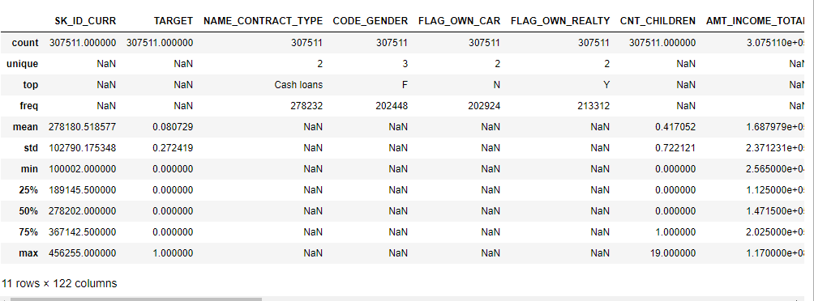
Summarizing the data

Slide 6
As it shows that Income of the client,(AMT_INCOME_TOTAL) has mean value 168797.91. Client with max income - 117000000.0 and minimum- 25650.0.

Slide 7
Data Quality check and missing values
Missing values in the dataset means those fields which are empty or no values assigned to them.
There are plenty of ways with which missing values are treated, the easiest ones are to replace the missing value with the mean, median, mode or a constant value.
We have found the percentage of the missing values of all the attributes

Slide 8
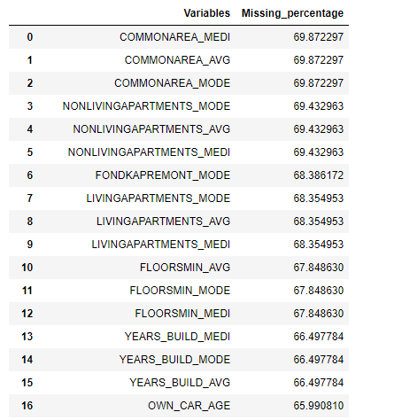
Screenshot of missing value of the atributes

Slide 9
In our analysis, we have removed columns with high missing values, i.e., dropped columns with more than 30% null values.
Thus after performing this, we reduced the columns from 122 to 72.
Out of the 72 columns 13 columns had missing values between 0 and 14 %.
Out of them, We have selected 5 columns and imputed the missing values .

Slide 10
Imputing missing values
Imputation method for application_data['AMT_GOODS_PRICE']
For imputing values for missing value variable, we select the statistical method which is equivalent to or nearest to the actual value.
#Actual value = 450000.0
#Mean = 538396.20
#Median = 450000
Here, we selected median for imputation

Slide 11
Similarly for 'AMT_GOODS_PRICE‘, 'EXT_SOURCE_2‘, we have used the median for imputing missing values.
For 'OBS_30_CNT_SOCIAL_CIRCLE‘, and DEF_30_CNT_SOCIAL_CIRCLE, we imputed the missing values with 0 as each attribute was showing limited unique values.
Eg, 'DEF_30_CNT_SOCIAL_CIRCLE'] had 10 unique values.

Slide 12
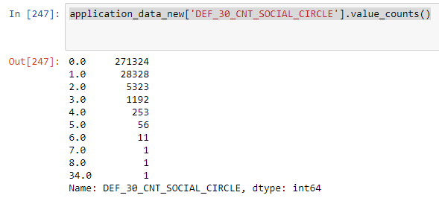

Slide 13
For the categorical variable, NAME_TYPE_SUITE (Who was accompanying client when he was applying for the loan), we have used mode to impute the missing values.
Firstly, we have changed the variable into categorical variable and then applied the imputation.
KNN can also be used here for imputation

Slide 14
All the variables were changed into their required data types, that is, into categorical and continuous form.

Slide 15
Outlier Analysis
We have used boxplot method to check outliers in few of our columns.
We have done the analysis on 3 attributes, AMT_CREDIT, AMT_INCOME_TOTAL, AMT_GOODS_PRICE

Slide 16
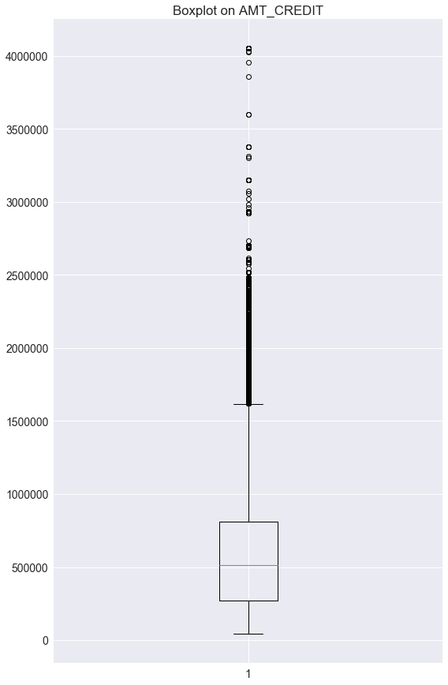
Boxplot to show the outliers of-AMT_Credit variable

Slide 17
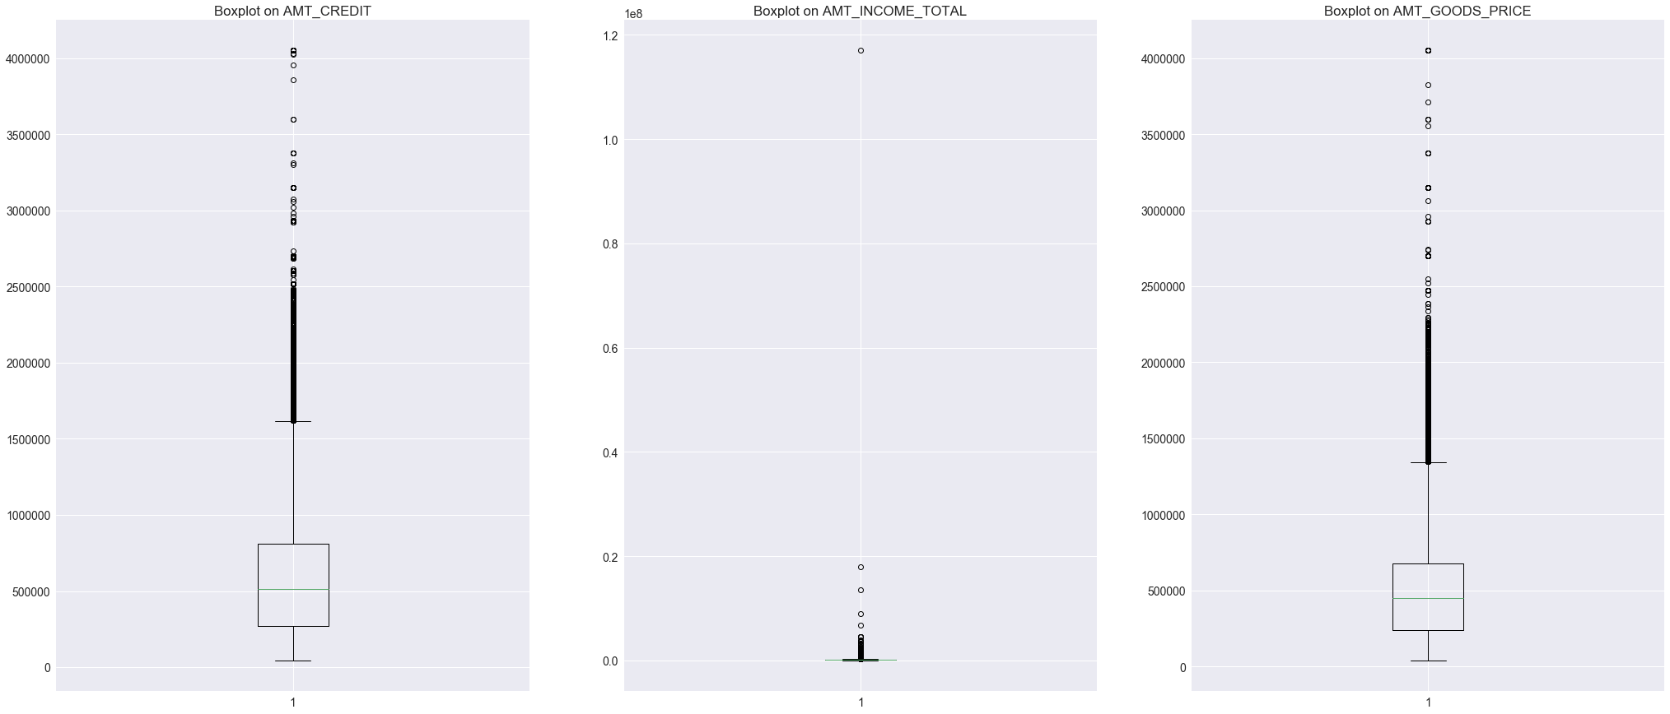
Boxplot of all the 3 variables

Slide 18
The data points falling above the upper fence and below the lower fence are the outliers.
Thus we have calculated the 25 percentile and 75 percentile of the data.
We have used interquartile range (IQR), for finding the percentile, iqr = q75 - q25
# #Calculate inner and outer fence:
minimum = q25 - (iqr*1.5)
maximum = q75 + (iqr*1.5)

Slide 19
Then replaced the outliers with NA and imputed them with median.

Slide 20
Converting continuous variable into bins
We have used AMT_GOODS_PRICE variabel for this, has 846 different values.
For simplicity, the graph is plotted for inital 1000 data points only.

Slide 21
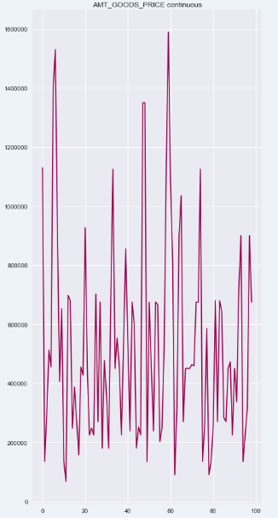
AMT_GOOD_PRICE continuous var

Slide 22
Here, it can be seen that it’s difficult to understand the data with continuous values, thus we have divided it into 10 bins, by using, pd.cut().
Then converted the data into these bins.
It could be observed that, it’s easy to interpret the data with different categories.

Slide 23
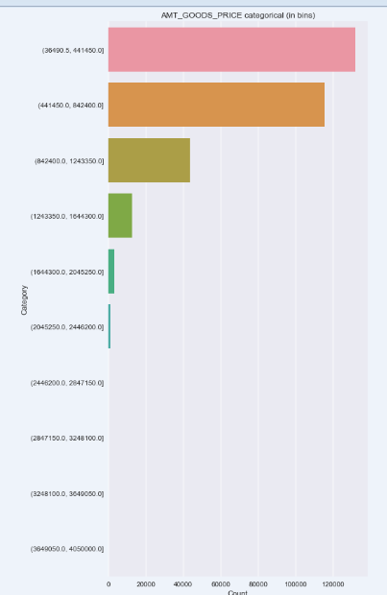
AMT_GOOD_PRICE categorical var

Slide 24
Analysis
We have checked the imbalance percentage on Target variable specifying- whether the client had difficulty in paying the loan or not.
Percentage for 1- client with payment difficulties:92.0
Percentage for 0 - all other cases:8.0
It could be observed that data is imbalanced as 92% of the data has the observations with client having payment difficulties.
This shows that the data is imbalance and bias towards Percentage for 1- client with payment difficulties

Slide 25
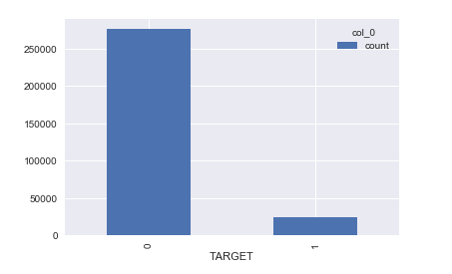
Analysis

Slide 26
Perform univariate analysis for all categorical variables
Analysis shows that:, there's no data for Code_gender= XNA for where Target=1,i.e., there's no observation present for gender 'XNA' for data having clients payment difficulties. This creates biassness in the result.
Similarly, for Variable name_income_type, there's no data for name_income_type is Businessman or Student for where Target=1,i.e., there's no observation present for Businessman or Student for data having clients payment difficulties. This creates biassness in the result.
Similarly there are no observations present for a particular category of categorical variable in many categorical variable.
Conclusion, For instance there's no data showing that a person who's a business man has ever had the payment difficulties, thus it would be difficlut to find If the applicant is not likely to repay the loan, i.e. he/she is likely to default

Slide 27
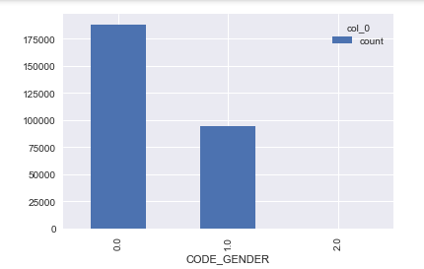
For Target=0

Slide 28
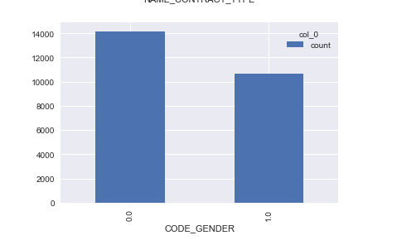
For target=1

Slide 29
Correlations for numerical columns
This is used to find the variables which are dependent on each other.
For the analysis, only independent variables are used and dependent variables are eliminated to remove redundancy as otherwise it could lead to multicollinearity.

Slide 30
Approach
We have used heatmap to find the correlation between the data.
correlation value lies between -1 to +1. Highly correlated variables will have correlation value close to +1 and less correlated variables will have correlation value close to -1.

Slide 31
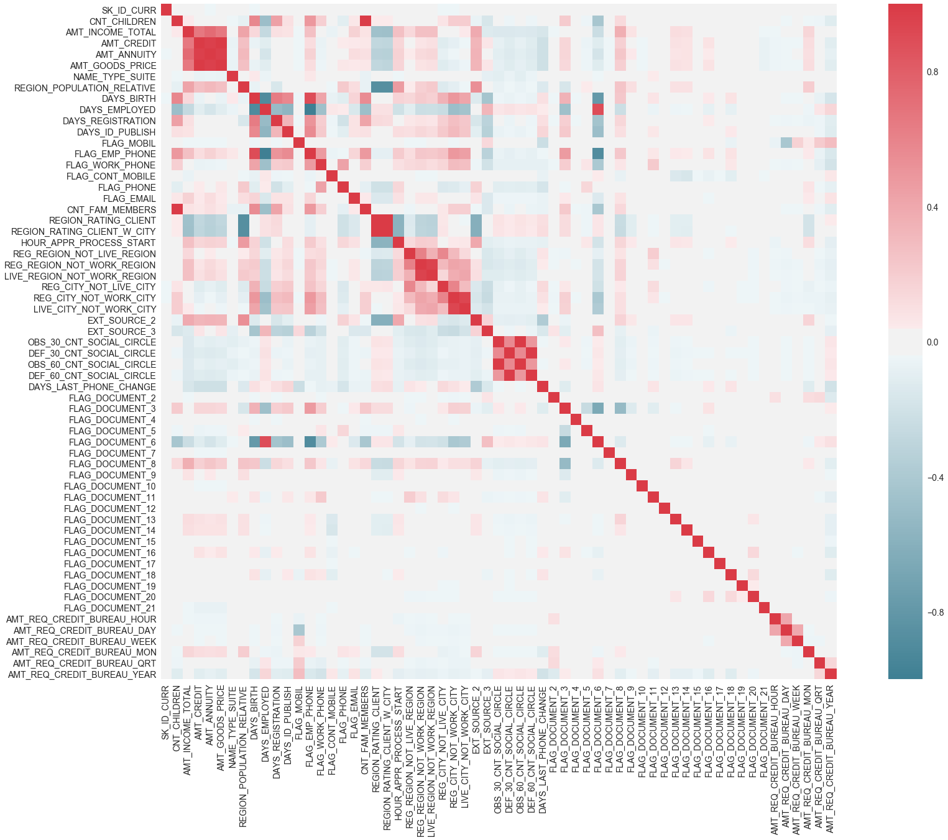
For target=0

Slide 32
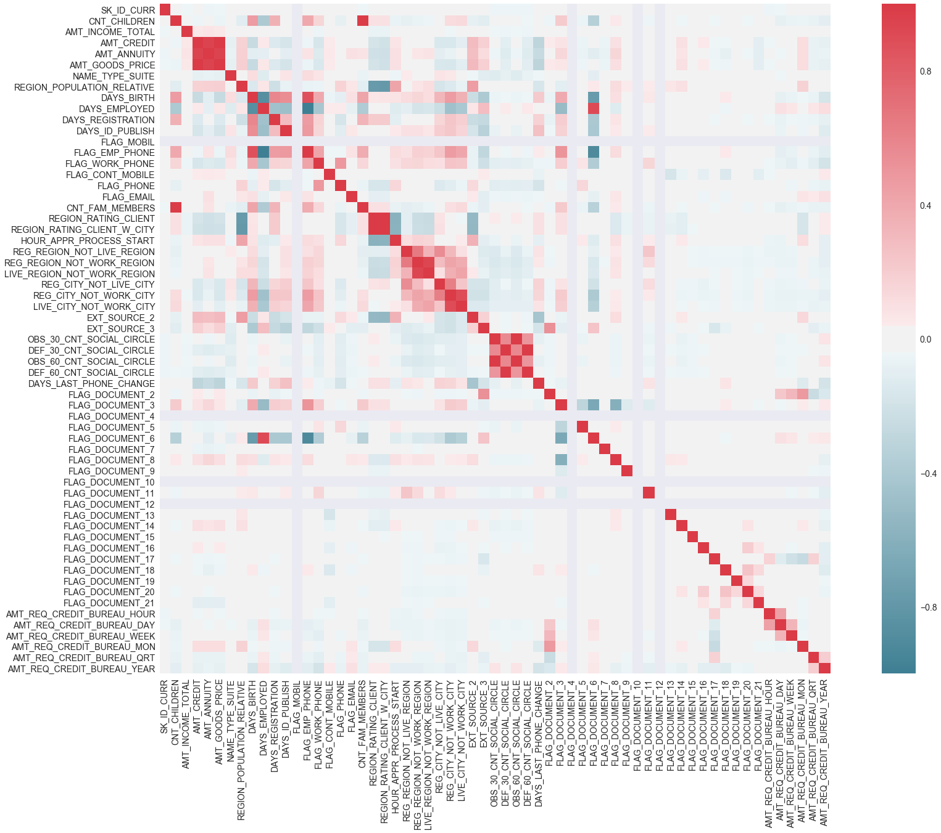
For target=1

Slide 33
CONCLUSION , HIGHLY CORRELATED VARIABLES For target=1 - client with payment difficulties:
HIGHLY CORRELATED VARIABLES
AMT_CREDIT,
AMT_ANNUITY
AMT_GOODS_PRICE,
DAYS_BIRTH,
FLAG_EMP_PHONE,
FLAG_work_PHONE,
REG_REGION_NOT_LIVE_REGION,
REG_REGION_NOT_WORK_REGION ,
LIVE_REGION_NOT_WORK_REGION,
REG_CITY_NOT_LIVE_CITY
These all contains redundant data and should be eiminated
Here , AMT_CREDIT is highly correlated with AMT_ANNUITY
AMT_GOODS_PRICE and AMT_ANNUITY is highly correlated with AMT_GOODS_PRICE

Slide 34
for target=0 - other client
HIGHLY CORRELATED VARIABLES are:
AMT_INCOME_TOTAL,
AMT_CREDIT,
AMT_ANNUITY,,
AMT_GOODS_PRICE,
DAYS_BIRTH,
FLAG_EMP_PHONE,
FLAG_work_PHONE,
REG_REGION_NOT_LIVE_REGION,
REG_REGION_NOT_WORK_REGION,
LIVE_CITY_NOT_WORK_CITY
These all contains redundant data and should be eiminated.
Here , AMT_INCOME_TOTAL is highly correlated with AMT_CREDIT , andAMT_GOODS_PRICE

Slide 35
It can be observed that not all variables with highest correlation are same in both the cases of target variable.

Slide 36
Univariate Analysis
It’s done on continuous variable.
We have used histogram to visualize the data, for both the cases of target variables

Slide 37
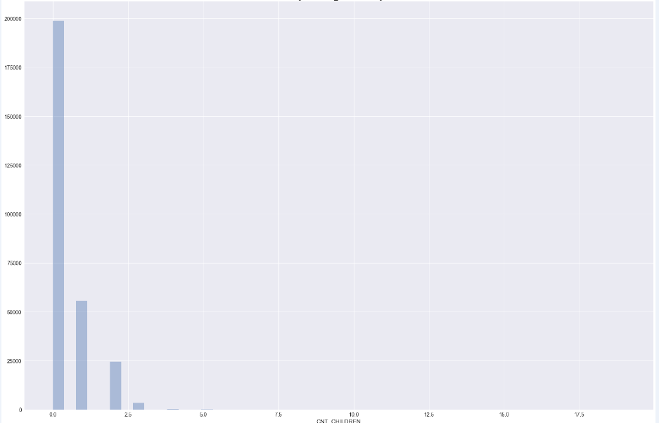
Histogram for CNT_children , target=0

Slide 38
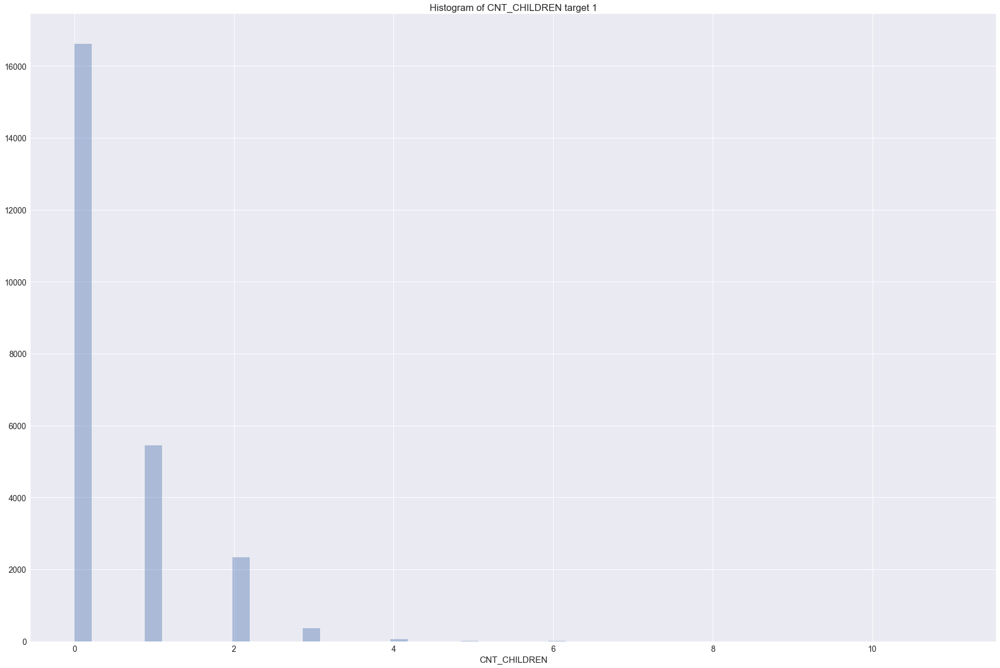
Histogram for CNT_children , target=1

Slide 39
Observation
Outlier can be seen for CNT_Childrenfor target 0 after 2. Mostly people have children between 0 and 2While CNT_Children for target 1 is o. There's no variation. Thus it's acting as constant and can be ingnored.
Similarly, Outlier can be seen for AMT_Credit for target 0 and target 1 after 1200000 value. Mostly people have Credit amount of the loan between 10 and 12 lakhs.

Slide 40
Bivariate Analysis
From the heatmaps,, bivariate analysis can be donecorrelation value lies between -1 to +1. Highly correlated variables will have correlation value close to +1 and less correlated variables will have correlation value close to -1.
CONCLUSION , HIGHLY CORRELATED VARIABLES
For target=1 - client with payment difficulties:
AMT_CREDIT,AMT_ANNUITYAMT_GOODS_PRICE, DAYS_BIRTH, FLAG_EMP_PHONE,, FLAG_work_PHONE, REG_REGION_NOT_LIVE_REGION, REG_REGION_NOT_WORK_REGION , LIVE_REGION_NOT_WORK_REGION,REG_CITY_NOT_LIVE_CITY
Here , AMT_CREDIT is highly correlated with AMT_ANNUITY AMT_GOODS_PRICE and AMT_ANNUITY is highly correlated with AMT_GOODS_PRICE

Slide 41
HIGHLY CORRELATED VARIABLES, for target=0 - other client AMT_INCOME_TOTAL, AMT_CREDIT, AMT_ANNUITY,, AMT_GOODS_PRICE, DAYS_BIRTH, FLAG_EMP_PHONE, FLAG_work_PHONE, REG_REGION_NOT_LIVE_REGION, REG_REGION_NOT_WORK_REGION, LIVE_CITY_NOT_WORK_CITY
Here , AMT_INCOME_TOTAL is highly correlated with AMT_CREDIT , and AMT_GOODS_PRICE

Slide 42
Previous_Application Analysis
The file contains 1670214 observations and 37 different columns.
We have done the missing value analysis on this and dropped the columns having more than 30% of missing values.
Thus the number of column were reduced from 37 to 23.

Slide 43
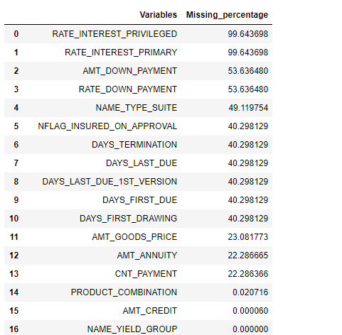
Missing value percentage

Slide 44
After that we have merged the two files on the common column , SK_ID_CURR, that contains the ID of loan in the sample.
This resulted in 1430155 observations and 94 attributes.

Slide 45
Conclusion
EDA is helpful in cleaning the data and finding the patterns out of it.
We have observed that many attributes contains the outlier. We can either remove and impute them with some values or can also use them to find the unusual pattern, like fraud detection.
The analysis also showed how we can find the dependency between two variables and remove the dependent variables.

Slide 46
As, according to the domain, it’s obvious that Credit amount of the loan is dependent on the income of the person. It can also be observed through the correlation matrix as well.

