Slide 1
Group no.:- 21
ENCRYPTION DECRYPTION
Presented by:-
MAHAK GUPTA
PRACHI SAMUEL
ZIA RAZAKI
ANAMIKA MALAKAR
NIDHI DUBEY

Slide 2
Key :-
Key is a 1 D vector of size 3,where 0th position contains the process id of the function,1st position contains seconds of current time and 2nd position contains minute of current time.
Vector<int> key(3);
key[0] = process id
Key[1]=second
Key[2]=minute
A process ID is a unique, positive number that represents a process. Its value ranges from 0 to 32768(2^15) which can be increased to 2^22.

Slide 3
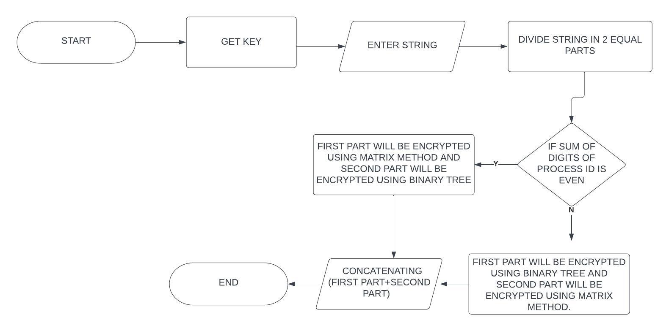
ENCRYPTION :-
Get key():
1.PID of the process using getpid() function.
2. Current time using time_t object.
So our key includes pid, current time(minutes, seconds)

Slide 4
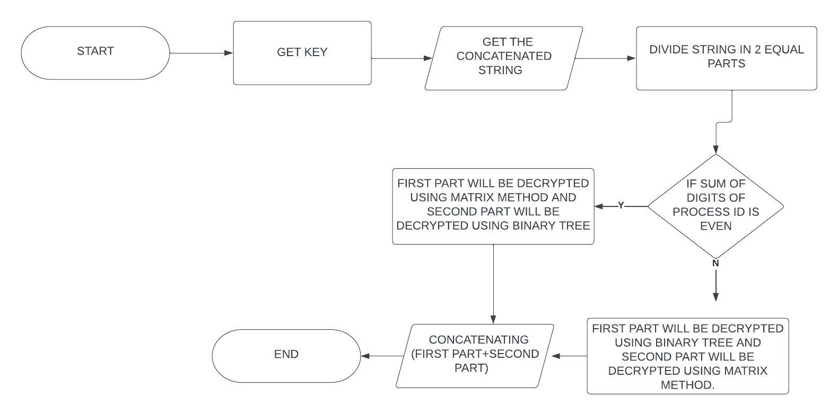
decryption :-

Slide 5
Encryption/Decryption steps for Matrix function:-
Sum of digits of process id even
30 (2+7+8+7+6)
For string :MAHAK
Character : MA
ENCRYPTION
Create vector of ascii values having row=length of string and column=3 & if any position is not filled then -1 will be assigned as default value.
Now add ASCII matrix with Keyid matrix.
Find standard deviation of the elements of resultant matrix.
Subtract standard deviation from resultant matrix.
Now converting integer value of matrix to natural number with the below mapping:
Y=2*x for x>=0 &
Y=1-2*x for x<0;
6. Pushing element of new vector + ‘0’ in the string.
Keyid={{2,7,8,7,6},{4,-1,-1,-1,-1},{4,-1,-1,-1,-1}}
Asc={{7,7,-1},{6,5,-1}}
Res=ASCII+KEYID={{9,14,7},{10,4,-2}}
Subtract Standard deviation=8 from res
Mul1={{1,6,-1},{2,-4,-10}}
(after converting integer to natural)
Final ={{2,12,3},{4,9,21 }}
FINAL_CRYPTED VECTOR={2,12,3,4,9,21}+’0’
={50,60,51,52,57,69}
Crypt= 2<349E

Slide 6
Crypt=2<349E
DECRYPTION
1.Encrypted string will be traversed by each character.
2.Pushing character ASCII value – ‘0’ in the vector rev_final.
3.Applying formula for converting Natural number to Integer number on rev_final and assigning it to make vector revmul1.
x=y/2 for y=even &
x=(1-y)/2 for y=odd;
4.Add standard deviation to revmul1.
5.Now subtract vector keyid from vector revmul1.
6.Corresponding row of res will give ASCII value for each character thus adding into vector Vec.
7.Now push character for respective ascii values from 1D vector one by one in the decrypted string.
Getting vector from encrypted text:
VECTOR={50,60,51,52,57,69}-’0’
={2,12,3,4,9,21}
Rev_final ={{2,12,3},{4,9,21 }}
revmul1 ={{1,6,-1},{2,-4,-10}}(natural no. to integer)
Add Standard deviation=8 to revmul1
Revmul1 ={{9,14,7},{10,4,-2}}
Res=revmul1-KEYID={{7,7,-1},{6,5,-1}}
Vec={77,65}
Character : MA

Slide 7
Encryption/Decryption steps for tree function:-
Half part: HAK
For Character: H
ASCII: 72
ENCRYPTION
Enter String.
For Each character convert into ascii
Compute Y=ASCII * PID + Seconds ,where PID =Sum of digits of process id.
For each digit of Y , Adding it into binary tree in level order.
Computing the inorder & preorder of tree and combining it into vector.
Taking two digits of combined vector adjacently and convert it into its character (if the number combined is less than 33 add 100 to make it greater than 100).
Add the character into crypted string.
Perform all operations till string is traversed completely.
ASCII: 72
PID: 30 (2+7+8+7+6)
Seconds: 40
Y: 2200
2
2
0
0
Level-order
Combined vector:
0220 2200
02 20 22 00=={102,120,122,100}
Crypted string of H:
fxzd

Slide 8
DECRYPTION
1.Encrypted string will be traversed by each character.
2.For each character convert it into its ASCII value (integer)(if ASCII >=100 then subtract 100 from it).
3.Storing its ASCII value into one vector which is a combination of inorder & preorder.
4.Computing inorder & Preorder form combined vector separately into two vectors.
5.Constructing a tree from inorder & preorder(if inorder & preorder are same construct tree from postorder & inorder)
6.Then computing trees level order and converting it into a number to make Y.
7.Now computing ASCII value from equation Y=ascii*pid+second;
8.For corresponding ASCII, add its character into decrypted string.
9.Perform all the steps till encrypted string is traversed completely.
Crypted string of H: fxzd
02 20 22 00 =={102,120,122,100}
Combined vector:
0220 2200
Inorder vector : 0220
Preorder vector: 2200
2
2
0
Y: 2200(level order)
Seconds: 40
ASCII=(Y-second)/pid
ASCII: 72
0
Character: H

Slide 9
THANK YOU
Contribution:
Mahak Gupta: Tree code, Tree idea, Presentation
Prachi Samuel: Tree code, Tree idea
Anamika Malakar: Presentation, Matrix Code
Nidhi Dubey: Matrix Code, Matrix Idea
Zia Razaki: Matrix Idea, Matrix Code

