Slide 1
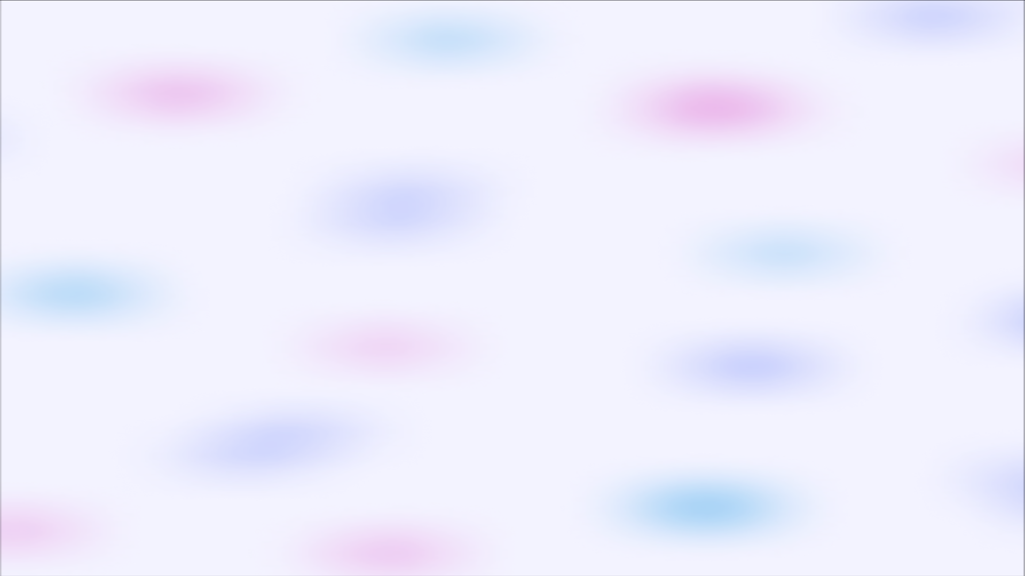

Customer Segmentation Analysis
NAME – Prachi Pardeshi
BATCH CODE - 21-OCT2024-CDA
PROJECT ID - PRDA-05
Project team's ID - PTID-CDA-MAR-25-401
DATE - 25/4/2025

Slide 2

Project Agenda
Introduction
Types of Segmentation
How to Analyze
SQL Queries Analysis
SQL Queries
Power BI Dashboard Analysis
Use of Customer Segmentation Analysis
Conclusion

Slide 3

Introduction
Welcome to our ultimate guide on cracking the code of customer segmentation! In today's fast-paced business world, knowing your target audience is the key to success. By unraveling the secrets of your customers and grouping them based on shared qualities, you'll unlock invaluable insights into their behaviors, desires, and needs. Enter customer segmentation analysis - a mighty tool that not only reveals the hidden gems of your audience but also empowers you to create knockout marketing campaigns that truly resonate.
At its core, customer segmentation analysis is all about breaking down your customer base into bite-sized tribes, each with distinct characteristics and quirks. You'll explore a vast array of factors like demographics, psychographics, and behavior to uncover the unique desires and preferences of each tribe. Armed with this knowledge, you can craft tailored marketing strategies that speak their language and leave a lasting impression.

Slide 4
Types of Segmentation
Demographic Segmentation
Psychographic Segmentation
Behavioral Segmentation
Demographic segmentation involves categorizing consumers by age, gender, income, and more. This strategic approach helps businesses tailor products and marketing to specific groups, acknowledging and capitalizing on the diverse needs and preferences within their target audience. It's a key tool for crafting precise, consumer-centric strategies in a dynamic market.
Behavioral segmentation delves into customer actions, preferences, and usage patterns. By understanding buying habits, brand interactions, and product usage, businesses tailor strategies to meet specific customer needs. This nuanced approach enhances marketing effectiveness, customer satisfaction, and overall business success.
Psychographic segmentation delves into consumer lifestyles, values, and attitudes. It goes beyond demographics to understand the motivations and aspirations that drive purchasing decisions. By identifying shared psychological traits, businesses tailor marketing strategies for a more resonant and impactful connection with their target audience.

Slide 5
How to Analyze
1
Data Collection
Gather relevant customer data through surveys, CRM systems, web analytics, and social media monitoring to build a comprehensive dataset.
Data Exploration
2
Use data visualization techniques and statistical analysis to uncover patterns, identify segments, and gain insights into customer behavior.
3
Segmentation Validation
Validate segmentation by conducting tests, experiments, and customer feedback. Refine and adjust segments based on real-world results.
Segment Profiling
4
Once the initial segmentation is established, it's crucial to delve deeper into each identified segment. Conduct a detailed analysis of the characteristics, behaviors, and preferences of customers within each segment.

Slide 6
SQL Queries Analysis
Utilizing SQL queries to extract valuable insights from customer data, enabling effective segmentation strategies. Identify patterns, preferences, and behaviors, optimizing marketing efforts for targeted customer segments.
Here's a summarized overview of the SQL queries for each question in the Customer Segmentation Analysis
Shopping Distribution According to Gender:
Query: Count the number of transactions for each gender.
Insight: Understand the distribution of shopping based on gender.
Which Gender Had the Highest Product Sales:
Query: Identify the gender with the highest number of products sold.
Insight: Determine the gender that contributed the most to product sales.
Which Gender Generated the Most Revenue:
Query: Find the gender that generated the highest revenue.
Insight: Identify the gender with the greatest impact on revenue generation.
Shopping Distribution According to Age:
Query: Count the number of transactions for each age category.
Insight: Understand the distribution of shopping based on age groups.
Which Age Category Had the Highest Product Sales:
Query: Identify the age category with the highest number of products sold.
Insight: Determine the age category contributing the most to product sales.
Which Age Category Generated the Most Revenue:
Query: Find the age category that generated the highest revenue.
Insight: Identify the age category with the greatest impact on revenue generation.
Distribution of Purchase Categories:
Query: Analyze the distribution of purchase categories.
Insight: Understand how different product categories contribute to overall sales.
Does Payment Method Have a Relationship with Other Columns:
Query: Investigate the relationship between payment methods and other columns.
Insight: Understand if payment methods correlate with other transaction details.
Distribution of Payment Methods:
Query: Examine the distribution of payment methods based on total transaction amounts.
Insight: Analyze the popularity and effectiveness of different payment methods.
Visualizing Data with Tableau/PowerBI:
Explanation: Discuss the use of visualization tools for deriving insights and providing suggestions to the company.

Slide 7
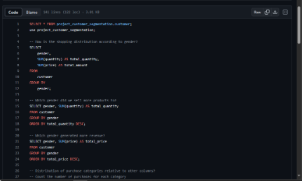
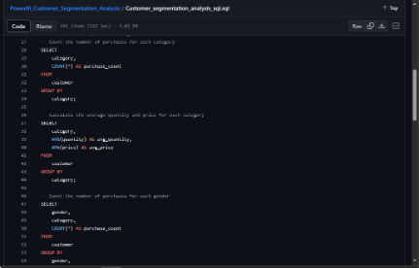
SQL Queries
In this section, we will explore the power of SQL queries for data analysis. Learn how to retrieve specific data, filter results, perform calculations, and more using SQL. Master the art of querying databases and unlock valuable insights from your data.
screenshot 1
screenshot 2

Slide 8
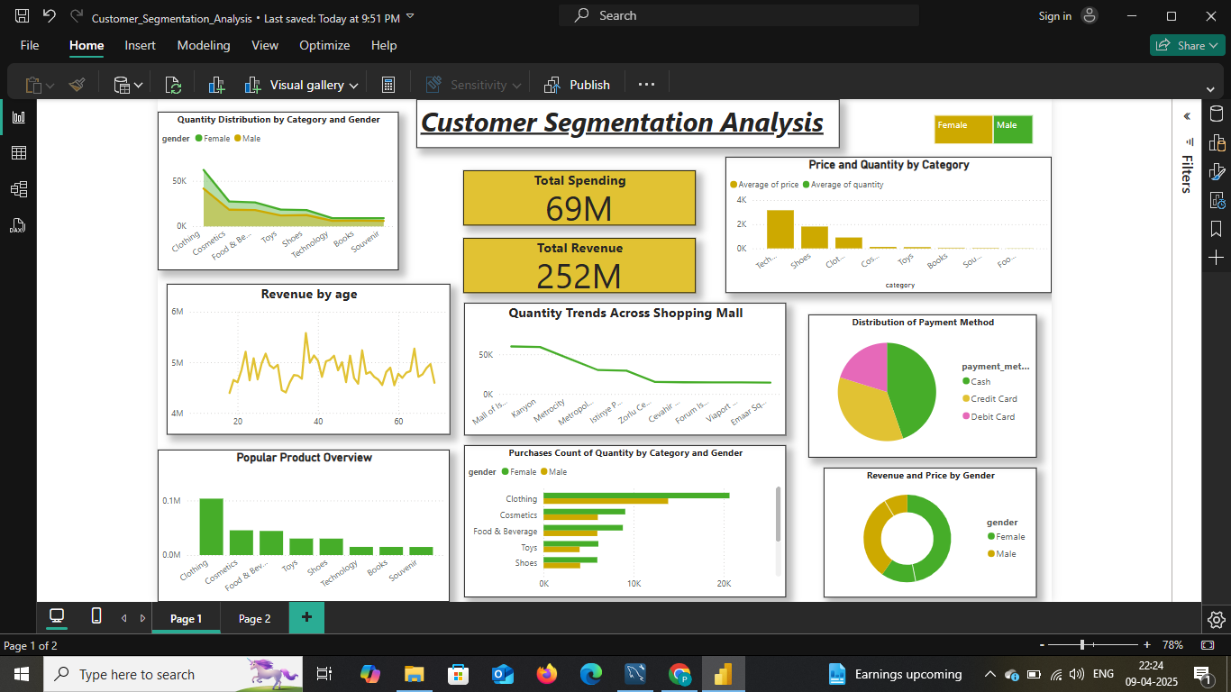
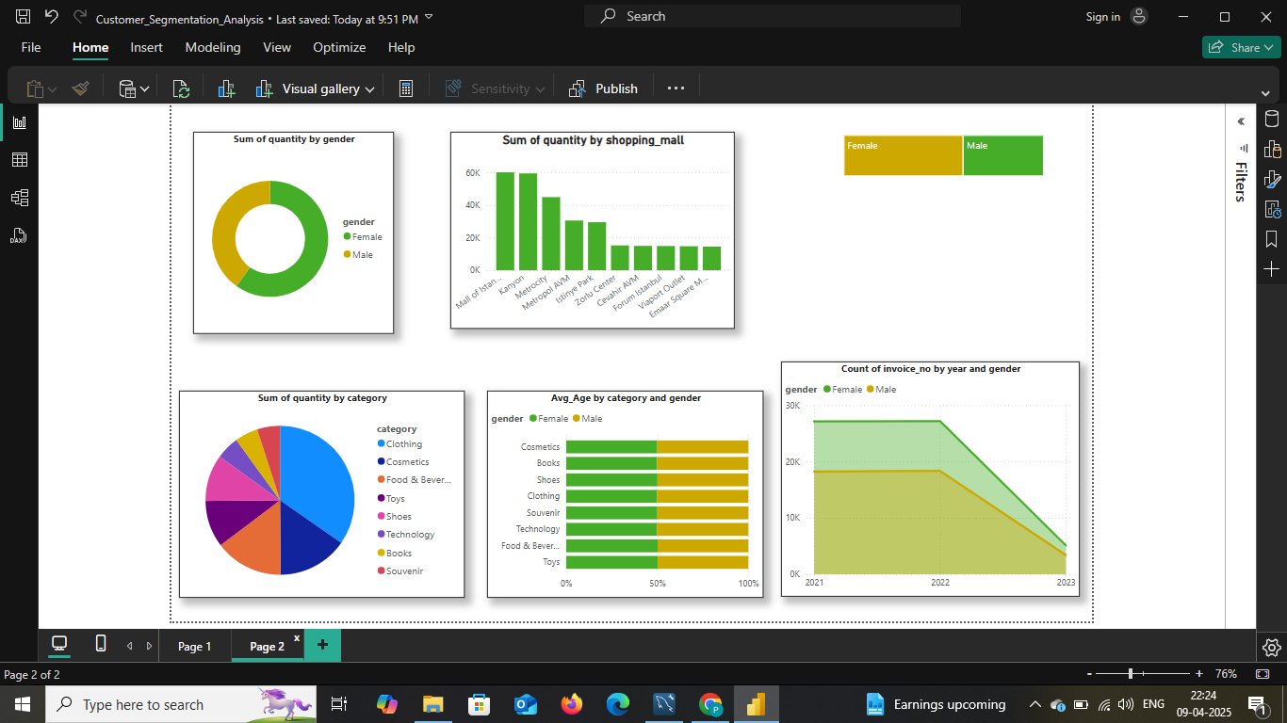
PowerBI Analysis
Visual Data Exploration
Customized Reporting
Visual Data Exploration is a pivotal aspect of our Customer Segmentation Analysis. The integration of powerful visualization tools, such as Tableau and PowerBI, allows us to delve into the intricate patterns and relationships within the data. The visual representations provide a dynamic and intuitive means of understanding customer behaviors, preferences, and trends. As you navigate through the visualizations, keep an eye out for key insights that will guide strategic decisions and enhance our understanding of customer segmentation dynamics.
Our Customer Segmentation Analysis surpasses basic data examination, integrating customized reporting to deliver a targeted view of pivotal business metrics. Our reporting strategy is designed to furnish insightful, actionable information that harmonizes with the distinct goals and strategies of the company. Each meticulously crafted report presents pertinent data points, facilitating informed decision-making and strategic planning. By tailoring our approach, we ensure that the reports not only meet but exceed the unique needs of the company, providing a comprehensive understanding of customer behavior, preferences, and trends.
For future reference, dashboard images are included in this presentation. Access the visuals via the following link: ​​https://postimg.cc/JDNCHv5t
For future reference, you can access the visuals via the following image link: https://postimg.cc/yg2CDR56

Slide 9

Conclusion
1. Gender & Age Dynamics: Uncover nuances in shopping behavior across genders and age groups.
2. Revenue Impact: Identify the primary contributors to revenue generation.
3. Purchase Categories: Understand how various product categories influence sales.
4. Payment Patterns: Discern relationships between payment methods and transaction details.
5. Informed by these insights, the company can refine strategies and elevate the customer experience. The PowerBI visualizations provide a dynamic platform for ongoing exploration.

