Slide 1

SMART INDIA HACKATHON 2026
TITLE PAGE
Problem Statement ID- 26205
Problem Statement Title- Personalized Education & Career Decision Support for Students
Theme- Student Innovation
PS Category- Software
Team ID- SBS01
Team Name- CyberForge

Slide 2
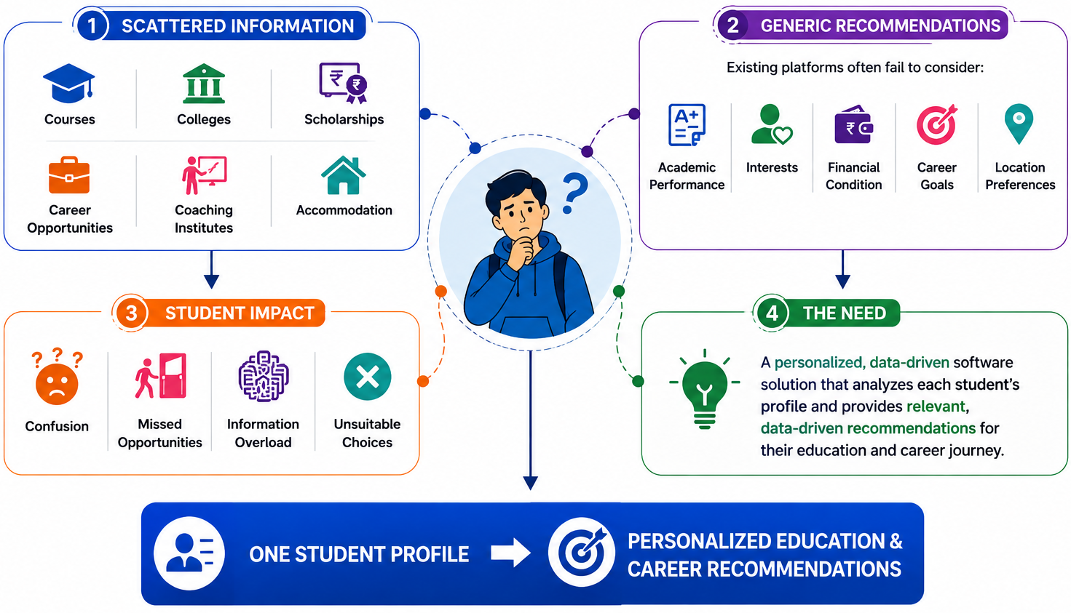
PROBLEM STATEMENT– EduPath
CyberForge

Slide 3
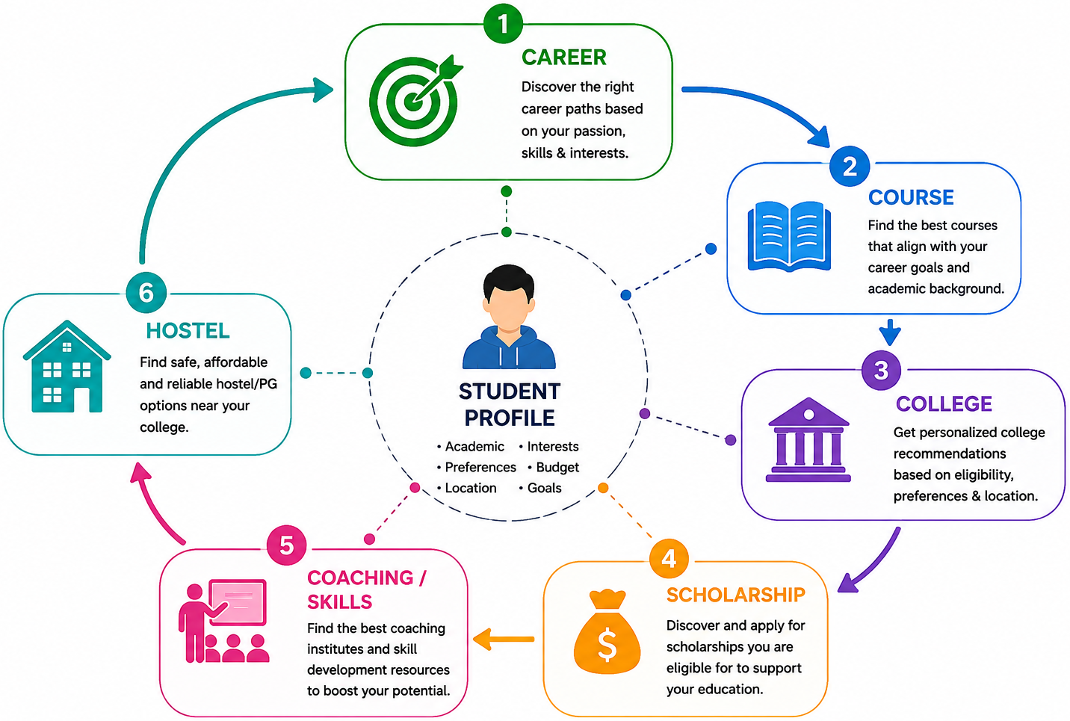
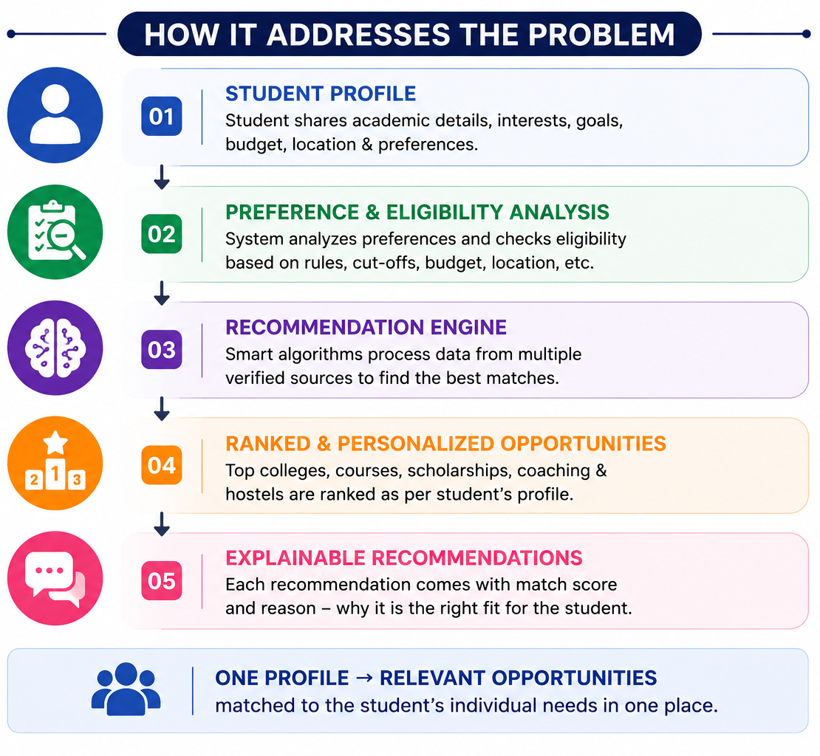





PROPOSED SOLUTION – EduPath
CyberForge

Slide 4
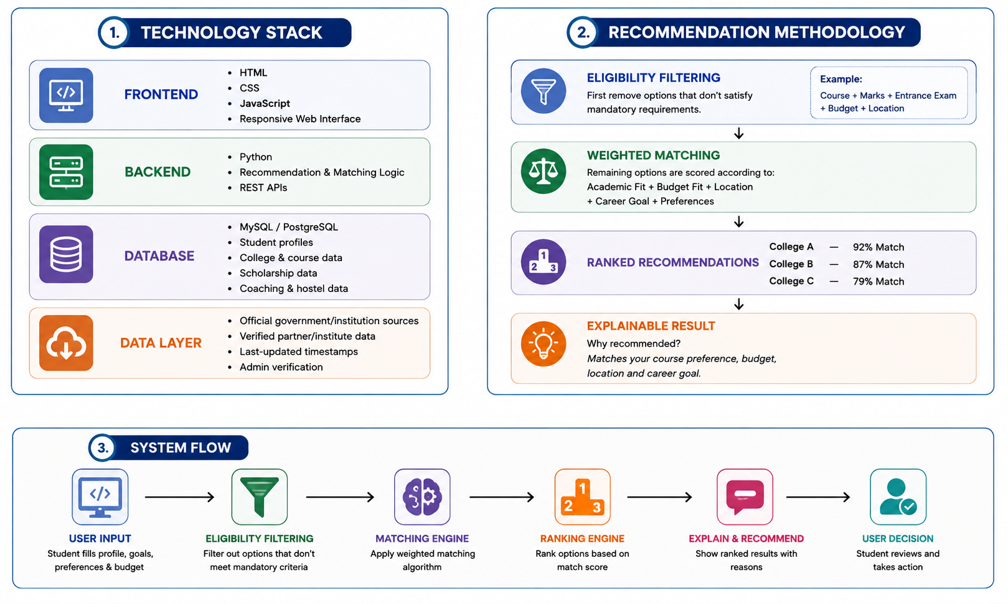
TECHNICAL APPROACH
CyberForge

Slide 5
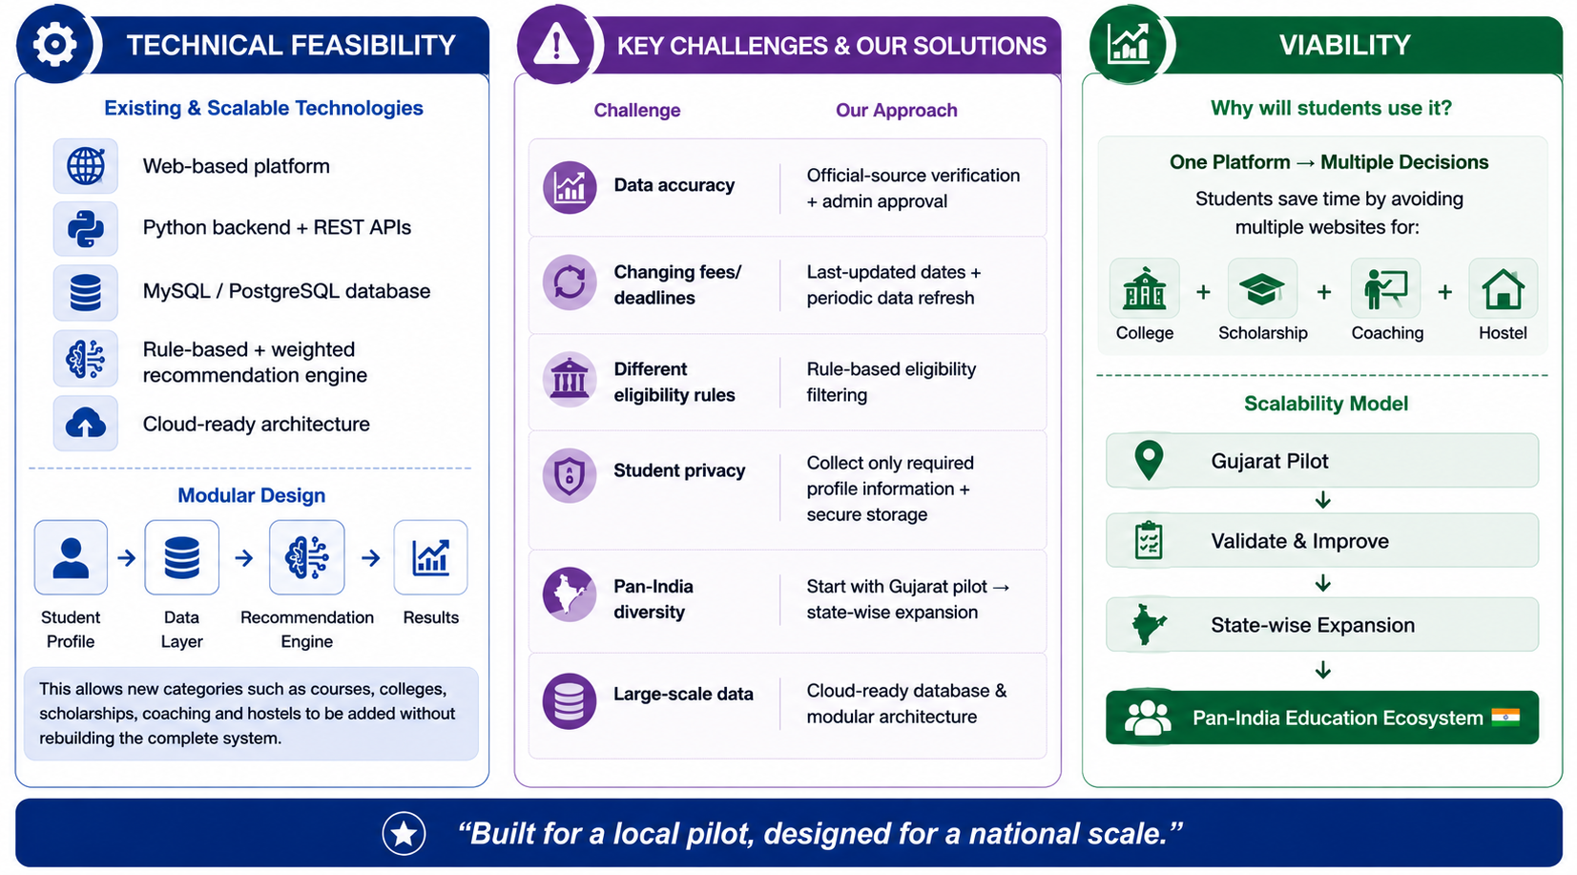
FEASIBILITY AND VIABILITY
CyberForge

Slide 6
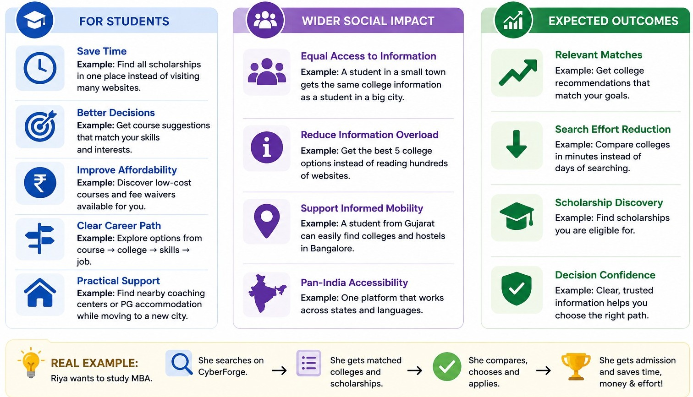
IMPACT AND BENEFITS
CyberForge

Slide 7
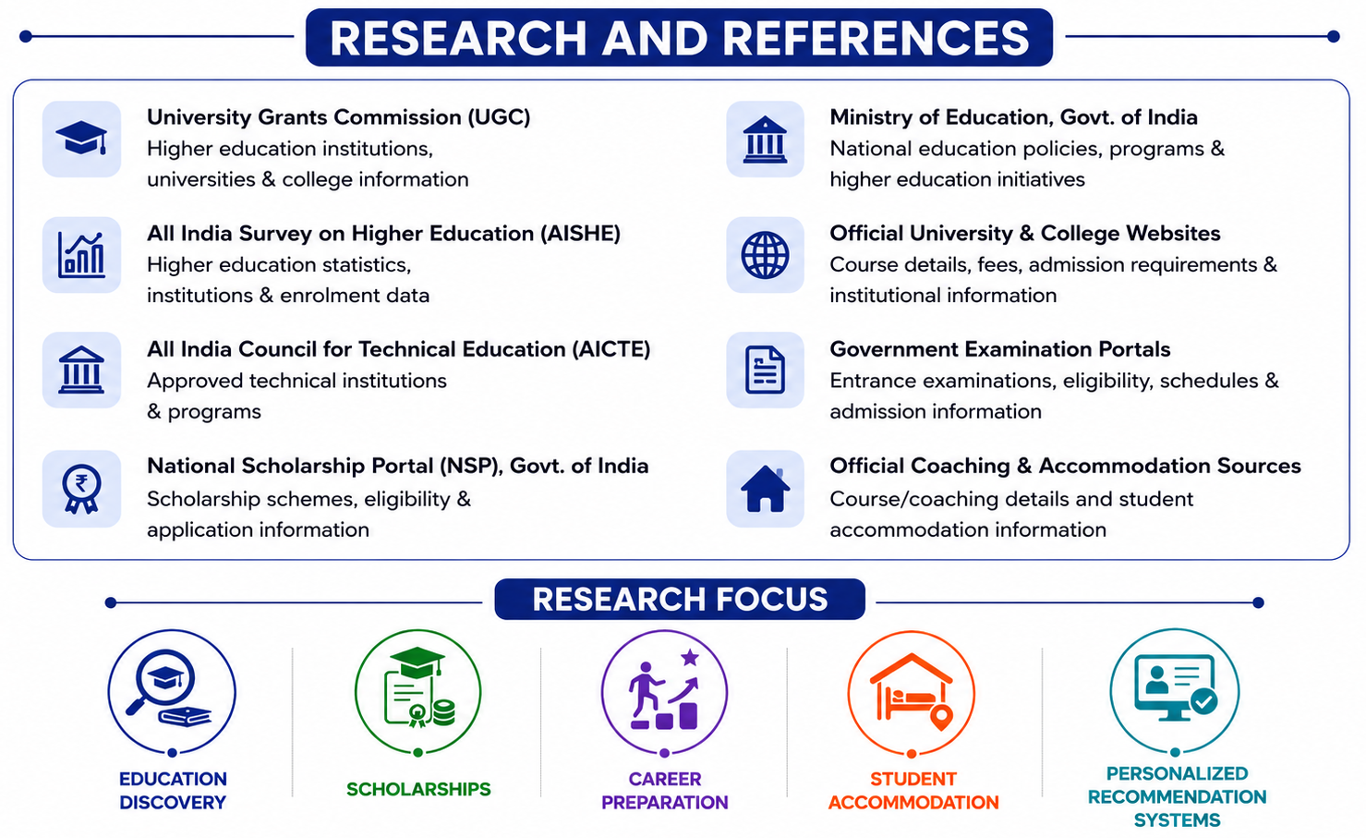
RESEARCH AND REFERENCES
CyberForge

Slide 8






CyberForge

