Slide 1
Basics of API Testing

Slide 2






Agenda of API Testing
API TESTING
TOOL SELECTION
WORKFLOW
API and API Testing
Right tool for API Testing
How API works ?
API Methods
ADVANTAGES
DEMO
Different API Methods
Advantages of API Testing
Live Demo

Slide 3
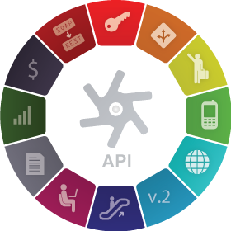
What is API?
API stands for Application Programming Interface.
API is an software to software interface, not a user interface.
With APIs, applications talk to each other without any user knowledge or intervention.
Implemented by writing function calls in the program.

Slide 4

What is API Testing?
API testing uses software to send calls to the API and get the output.
API testing treats the component under test as a black box.
The goal of API testing is to verify correct performance and error handling of the component prior to its integration into an application.

Slide 5
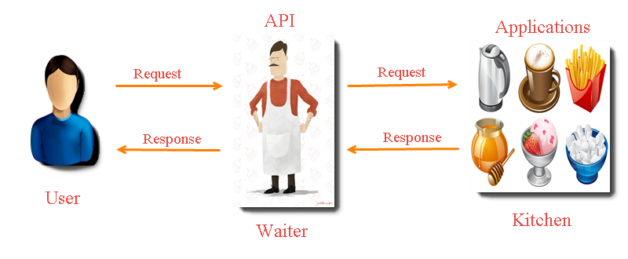
API Workflow

Slide 6
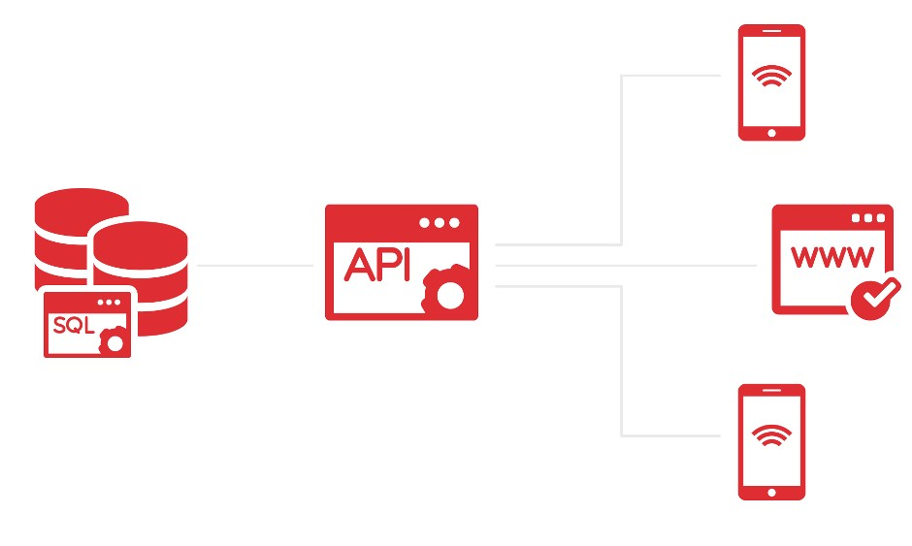
API Workflow
Response
Request
Response

Slide 7

REST API
REST – stands for Representational State Transfer.
It is a set of functions to which the developers performs requests and receive responses. In REST API interaction is made via HTTP protocol.
REST also allows computers to talk to each other over a network.
It involves using HTTP methods to send and receive messages, and does not require a strict message definition, unlike Web services.
REST messages often take the form of XML, or JavaScript Object Notation (JSON).

Slide 8
HTTP Methods
4 Commonly Used Methods:-
GET : - Provides a read only access to a resource.
POST :- Used to update an existing resource or create a new resource.
PUT :- Used to create a new resource.
DELETE :- Used to Remove a resource.
RESOUCE | GET | PUT | POST | DELETE
URL | Retrieve the member | Create / Replace a new resource | Create new entry | Used to remove a resource

Slide 9



What is API Testing ?
PUT REQUEST
PUT RESPONSE
GET REQUEST
GET RESPONSE
POST REQUEST
POST RESPONSE
DELETE
REQUEST
DELETE
RESPONSE

Slide 10
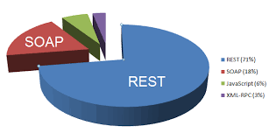
REST API Inputs
GET | POST | PUT | DELETE
Method - GET | Method - POST | Method - PUT | Method - DELETE
URL | URL | URL | URL
Custom-Header | Custom-Header | Custom-Header | Custom-Header
 | Input JSON

Slide 11
GET Methods
Request
GET
https://uat-beam-ms.livfame.com/v1/event/detail?beamId=7767
Response
Status : 200 OK
{
message: "Beam Detail fetched successfully"
data:
{
name : "name goes here"
eventStatus : "COMPLETED"
startTime : "10 Oct 2015 14:25:00"
viewCount : "2354"
likeCount : 88
disLikeCount : 99
commentCount : 5
duration : 1490
performerId : 10244
}
status: 1
}

Slide 12
POST Methods
Request
POST
URL : http://qa-api.livfame.com/api/v11_1
{
"email“ : "kkashyap1707@gmail.com",
"password“ : "admin",
"medium“ : "MANUAL",
"apiVersion“ : "1.0",
"appKey“ : "myAppKey",
"actionName“ : "login"
}
Response
Status : 200 OK
{
"status": 1,
"message": "Login successfully",
"data": {
"access_token": "rcd676up5kit3akd93a",
"email": "admn.famelive@gmail.com",
"roles": "[ROLE_USER]",
"userId": "1",
"isAccountVerified": true,
"timeZoneName": "GMT +05:30 - New Delhi",
"timeZoneId": 8,
"fameName": "admin.famelive",
"imageName": "zsdasdaw",
"userChannel": "a468784e6e2a9874619e7f",
},
"code": 10001
}

Slide 13
PUT Methods
Request
GET
https://uat-beam-ms.livfame.com/v1/event/detail?beamId=7767
Response
Status : 200 OK
{
message: "Beam Detail fetched successfully"
data:
{
name: "name goes here"
eventStatus: "COMPLETED"
startTime: "10 Oct 2015 14:25:00"
viewCount: "2354"
likeCount: 88
disLikeCount: 99
commentCount: 5
duration: 1490
performerId: 10244
}
status: 1
}

Slide 14
DELETE Methods
Request
GET
https://uat-beam-ms.livfame.com/v1/event/detail?beamId=7767
Response
Status : 200 OK
{
message: "Beam Detail fetched successfully"
data:
{
name: "name goes here"
eventStatus: "COMPLETED"
startTime: "10 Oct 2015 14:25:00"
viewCount: "2354"
likeCount: 88
disLikeCount: 99
commentCount: 5
duration: 1490
performerId: 10244
}
status: 1
}

Slide 15
HTTP Response Codes
Some HTTP response codes, which are often used with REST:-
200 OK: - Code indicates that the request was successful.
201 Created:- Code indicates that request was successful and a resource was created. It is used to confirm success of a PUT or POST request.
400 Bad Request :- It happens especially with POST and PUT requests, when the data does not pass validation, or is in the wrong format.
404 Not Found:- response indicates that the required resource could not be found.
401 Unauthorized:- error indicates that you need to perform authentication before accessing the resource.
405 Method Not Allowed:- HTTP method used is not supported for this resource.
409 Conflict:- Conflict request to create the same resource twice.
500 Internal Server Error:- Occurs due to some error on Server side.

Slide 16
Common Types of Tests in API Testing
Common API Bugs:-
Verify if API doesn’t return any response.
Based on input request, return request should be checked.
Verification of the API whether it triggers some other event or calls another API
Verification of the API whether it is updating any data structure
Delayed in API Response time
Response Data is not structured
Difficulty in connecting and getting response from API

Slide 17
Advantages of API Testing
Advantages of API Testing:-
Time Effective
Language Independent
Test Core Functionality
Reduce Testing cost
Reduced Risks

Slide 18
Challenges of API Testing
Challenges of API Testing:-
Main challenges in API testing is Parameter Combination, Parameter Selection, and Call Sequencing
There is no GUI available to test the application which makes difficult to give input values
Parameters selection and categorization required to be known to the testers
Exception handling function needs to be tested

Slide 19
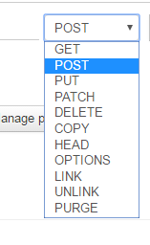
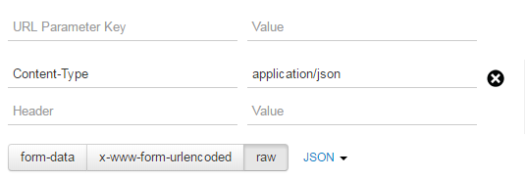
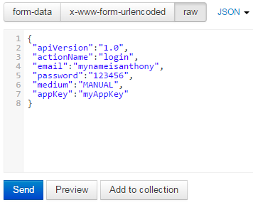
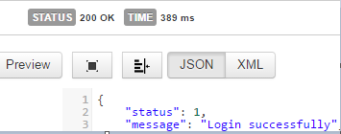
Basic Inputs
URL : http://qa-api.livfame.com/api/v11_1
Header
Method
Input JSON
Output Response

Slide 20

Questions

Slide 21
Keshav.Kashyap@tothenew.com

