Slide 1
k-Nearest Neighbors.
Local Learning.
Curse of Dimensionality.
Radu Ionescu, Prof. PhD.
raducu.ionescu@gmail.com
Faculty of Mathematics and Computer Science
University of Bucharest

Slide 2
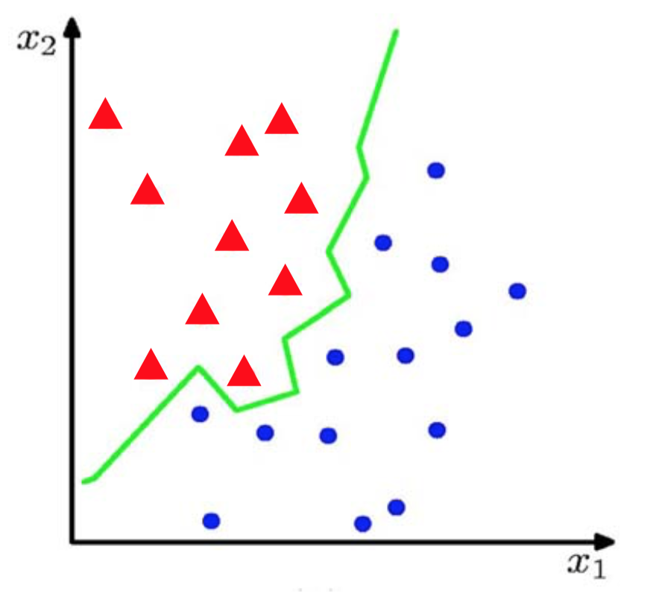
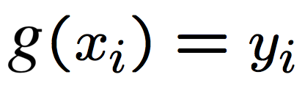
Classification from labeled samples
Suppose we have a set of N training examples:
The classification problem consists of estimating the function g(x) such that:

Slide 3
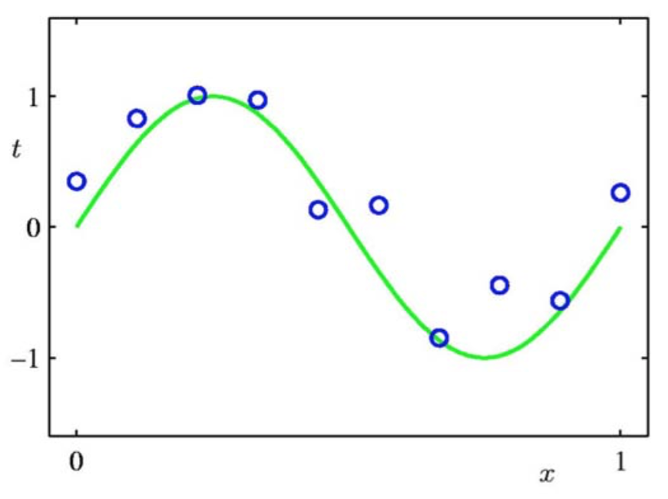
Regression from labeled samples
Suppose we have a set of N training examples:
The regression problem consists of estimating the function g(x) such that:

Slide 4

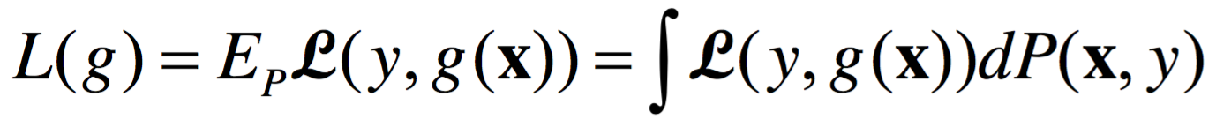
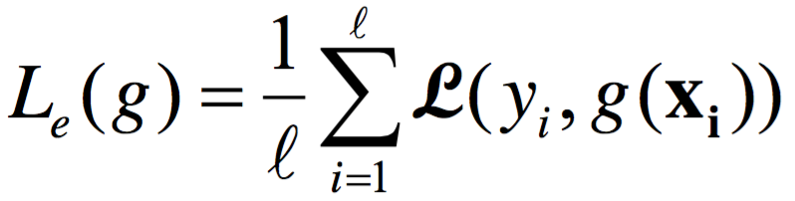
Learning from labeled samples
Suppose we have a set of N training examples:
The learning problem consists of estimating g(x) such that:
The loss function (e.g. MSE):
Generalization error:
Empirical (estimated) error:

Slide 5
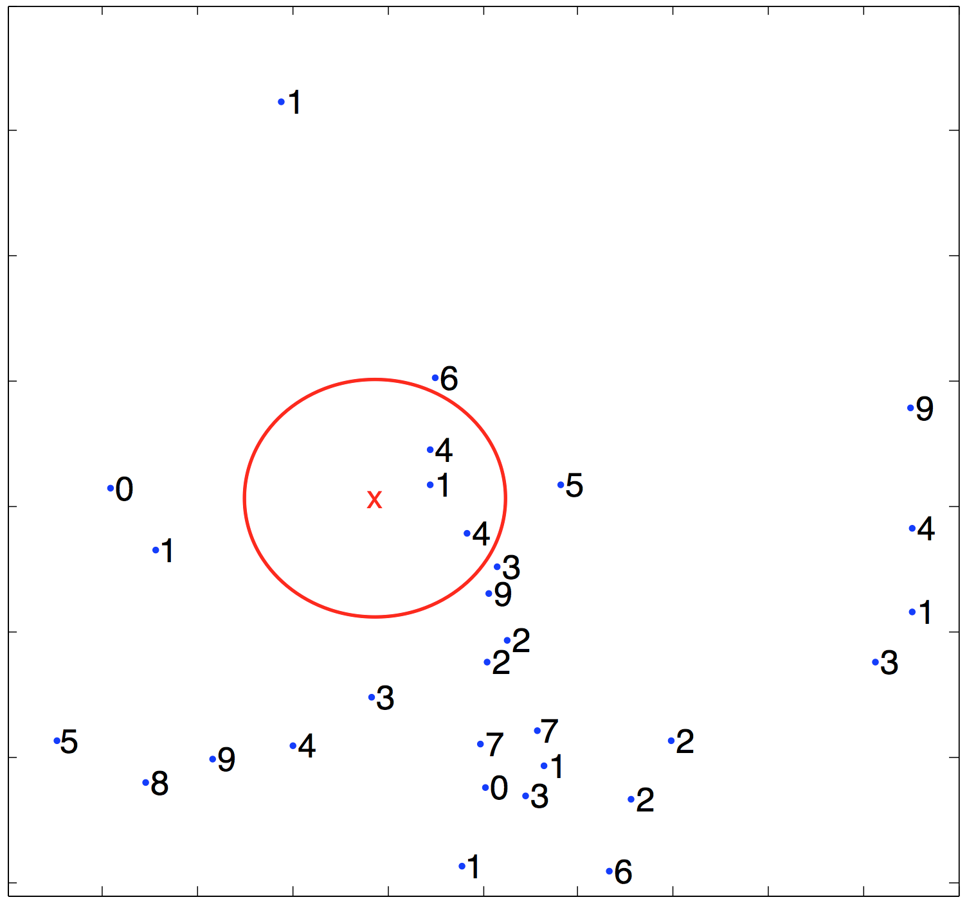
What is the label for sample x?

Slide 6
k-Nearest Neighbors

Slide 7
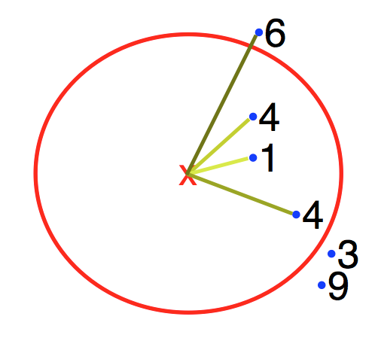
k-Nearest Neighbors (k-NN)
The k-NN algorithm:
1) For test sample x, we find the k nearest neighbors
2) We label the test sample x using a plurality voting on k neighbors

Slide 8
k-Nearest Neighbors (k-NN)
How do we break ties?
1) Choose a random label from the tied ones
2) Apply 1-NN (no ties possible)
3) Use the distances to the test sample as weights

Slide 9
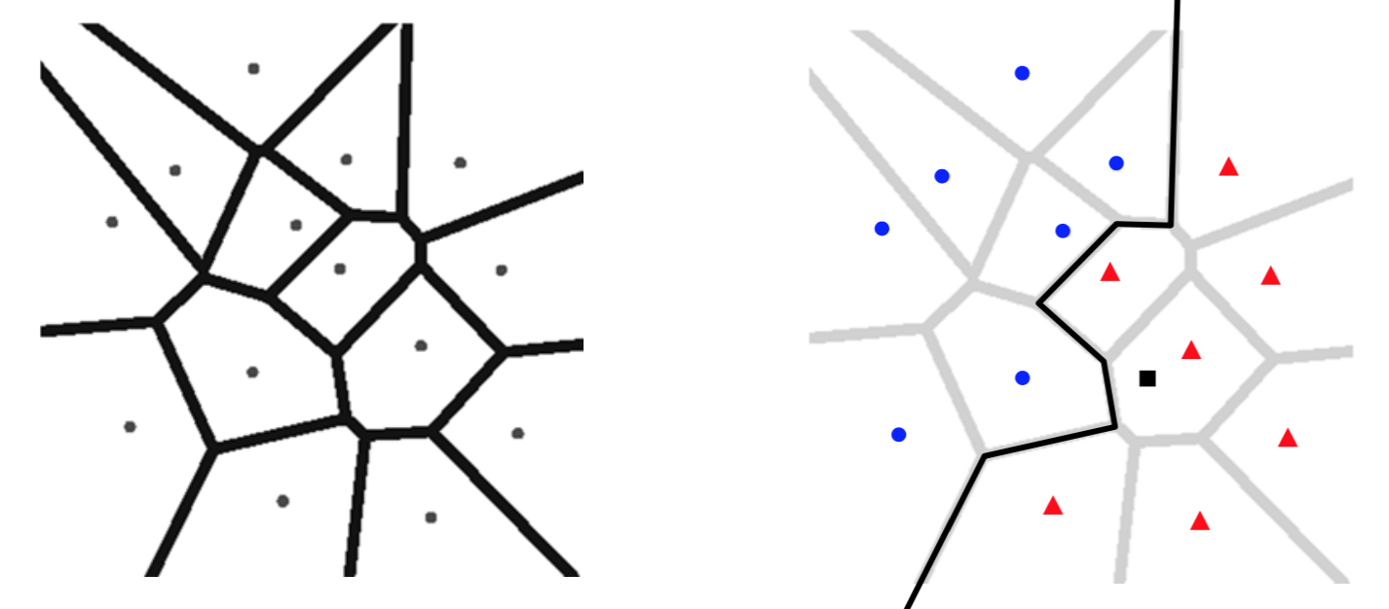
What happens for k = 1?
We obtain a Voronoi diagram:
The space is partitioned into regions
The separating borders pass through areas where the distances between training sample pairs are equal
The separating borders are nonlinear

Slide 10
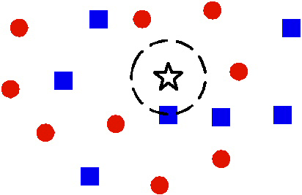
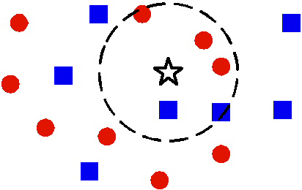
1-NN versus k-NN

Slide 11
1-NN versus k-NN

Slide 12
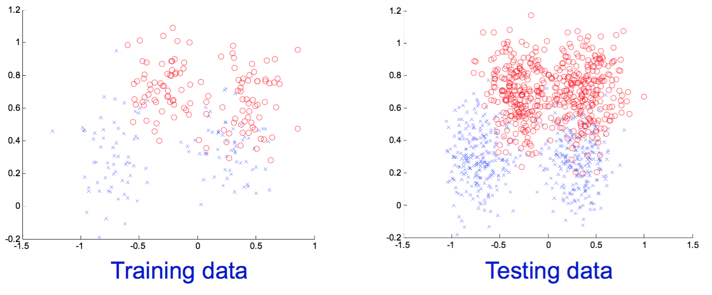
The underlying hypothesis of k-NN
The training data and the test data are sampled from the same distribution
Becomes unlikely for a representative pattern in the training set to be absent in the test set

Slide 13
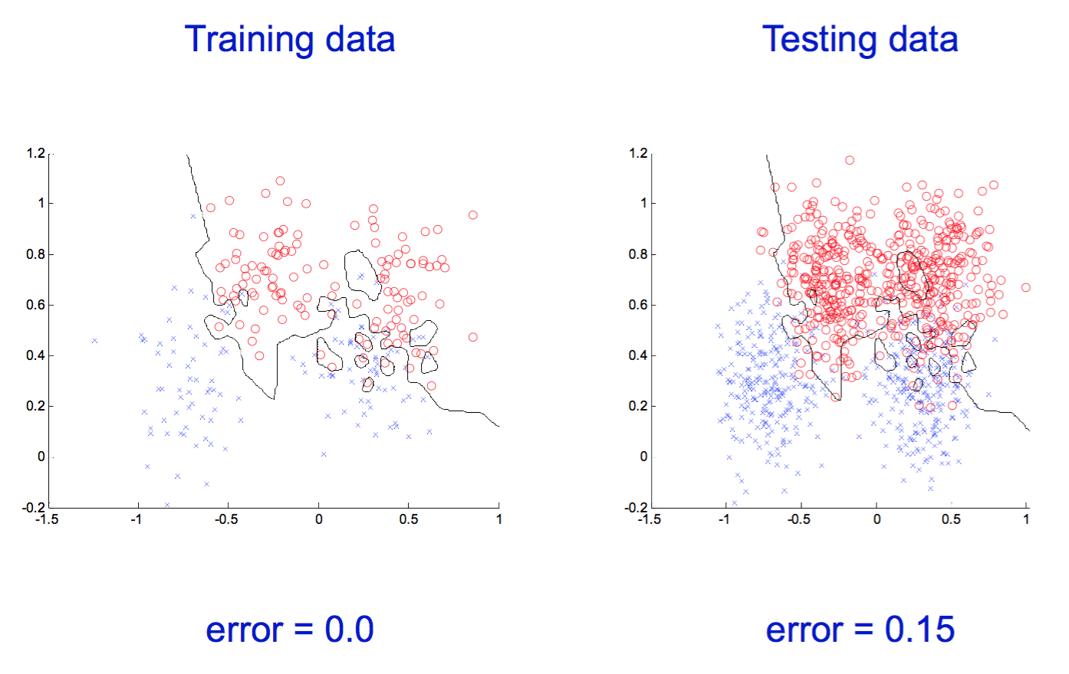
What happens for different values of k?
k = 1

Slide 14
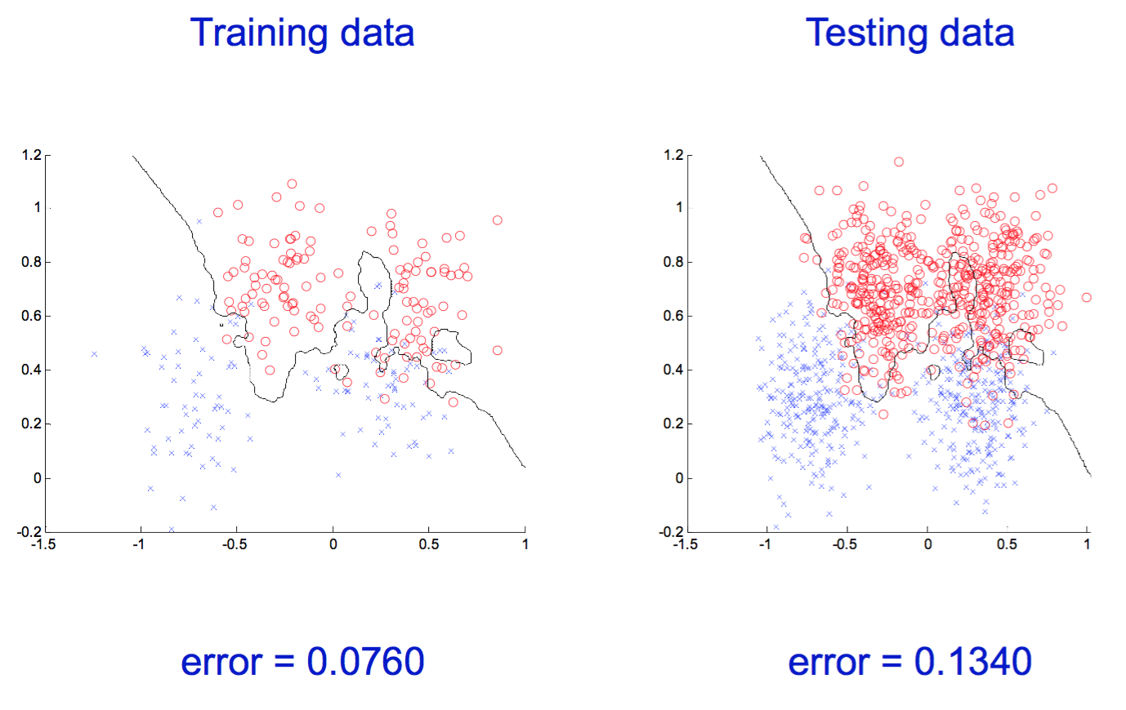
What happens for different values of k?
k = 3

Slide 15
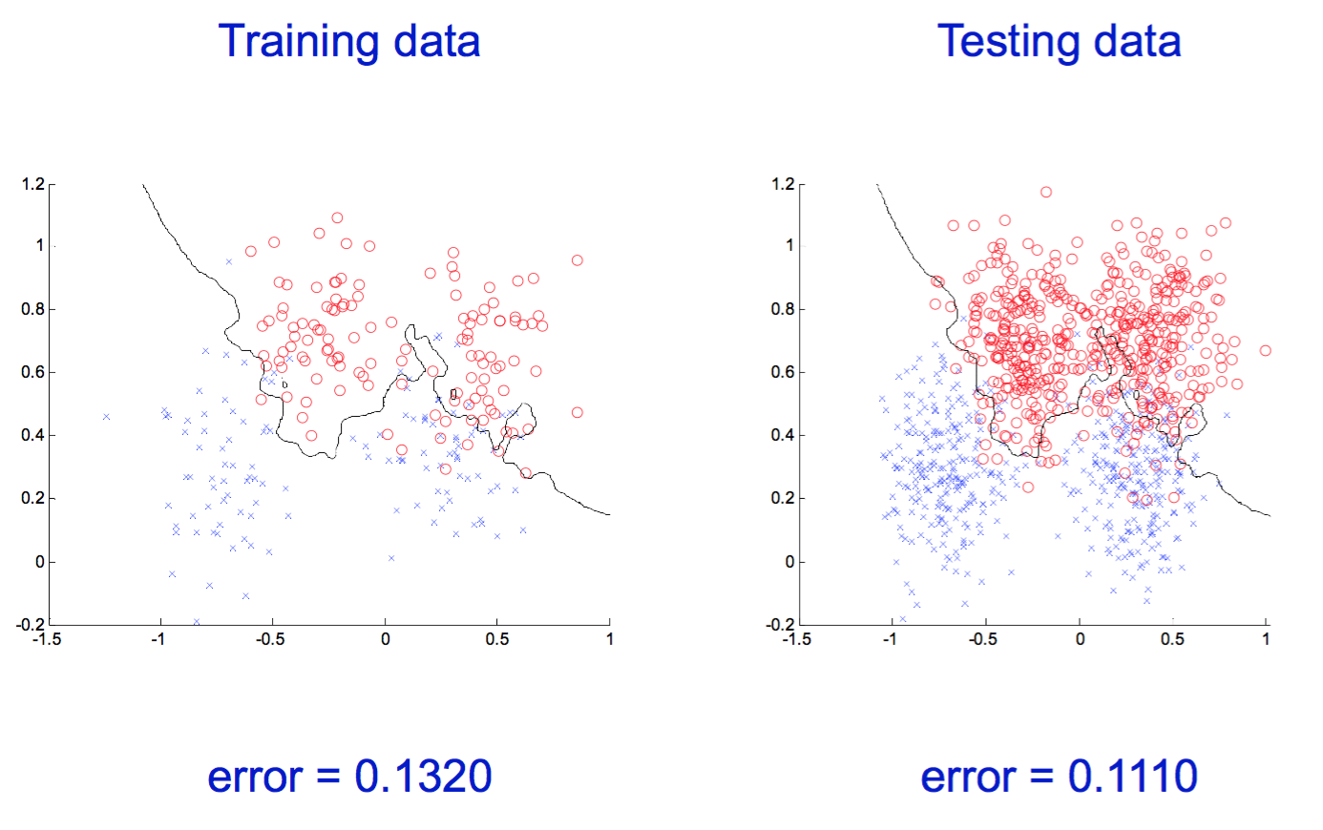
What happens for different values of k?
k = 7

Slide 16

What happens for different values of k?
k = 21

Slide 17
What do we need for a memory-based classifier?
A distance function:
  The Euclidean distance
  The Edit (Levenstein) distance
  The Hamming distance
How many neighbors should we consider?
How do we “train” the model on the examples from the vicinity?

Slide 18
Let’s consider a particular 1-NN
A distance function:
  E.g., the Euclidean distance
How many neighbors should we consider?
  1
How do we “train” the model on the examples from the vicinity?
  We just predict the label of the nearest neighbor

Slide 19
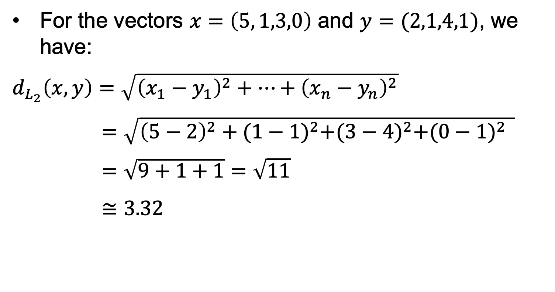
The Euclidean distance (L₂)
For the vectors $x=\left(5, 1,3,0\right)$ and $y=(2,1,4,1)$, we have:
$d_{L_{2}}\left(x,y\right)=\sqrt{{\left(x_{1}−y_{1}\right)}^{2}+…+{\left(x_{n}−y_{n}\right)}^{2}}$
$=\sqrt{{\left(5−2\right)}^{2}+{(1−1)}^{2}+{(3−4)}^{2}+{(0−1)}^{2 } }$
$=\sqrt{9+1+1}=\sqrt{11}$
$≅3.32$

Slide 20
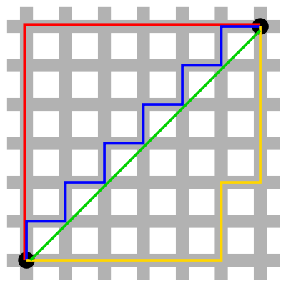
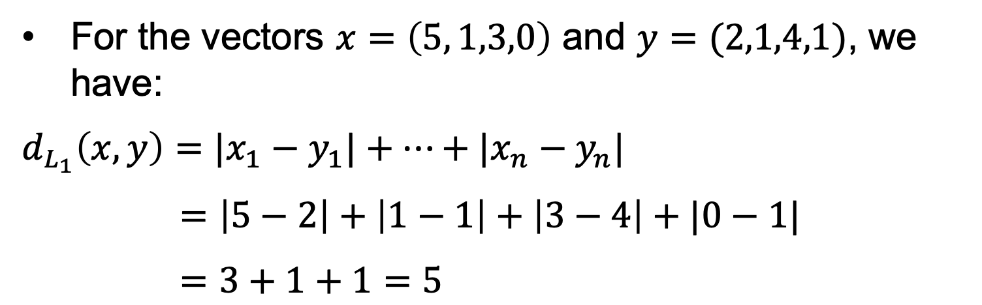
The Manhattan distance (L₁)
For the vectors $x=\left(5, 1,3,0\right)$ and $y=(2,1,4,1)$, we have:
$d_{L_{1}}\left(x,y\right)={|x}_{1}−y_{1}|+…+{|x}_{n}−y_{n}|$
$=\left|5−2\right|+\left|1−1\right|+\left|3−4\right|+|0−1|$
$=3+1+1=5$

Slide 21
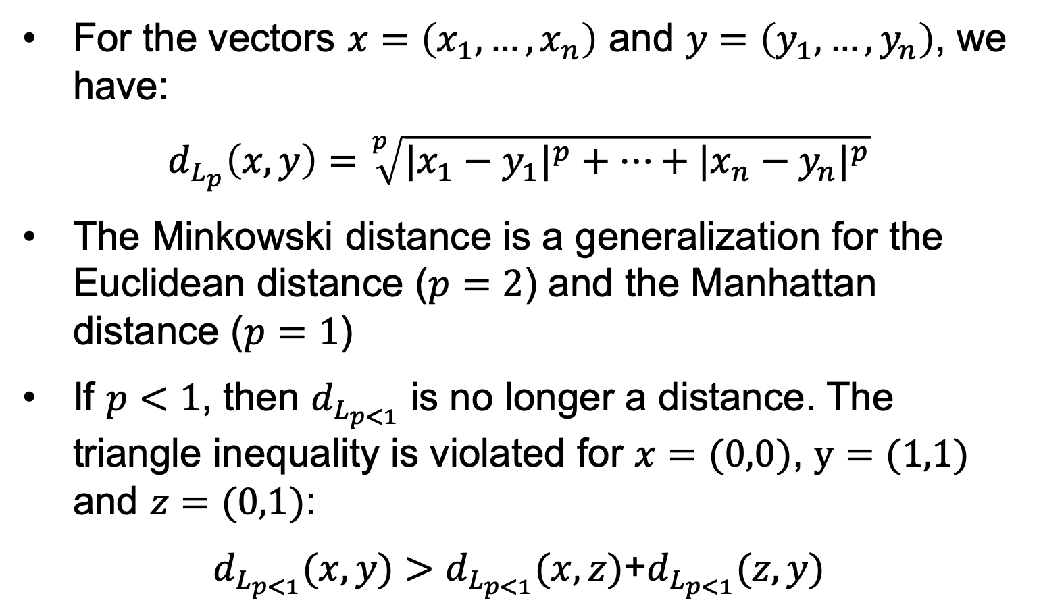
The Minkowski distance (L_{p})
For the vectors $x=\left(x_{1}, …,x_{n}\right)$ and $y=\left(y_{1},…,y_{n}\right)$, we have:
$d_{L_{p}}\left(x,y\right)=\sqrt[p]{{{|x}_{1}−y_{1}|}^{p}+…+{{|x}_{n}−y_{n}|}^{p}}$
The Minkowski distance is a generalization for the Euclidean distance ($p=2$) and the Manhattan distance ($p=1$)
If $p<1$, then $d_{L_{p<1}}$ is no longer a distance. The triangle inequality is violated for $x=(0,0)$, $y=(1,1)$ and $z=(0,1)$:
$d_{L_{p<1}}(x,y)>d_{L_{p<1}}(x,z)$+$d_{L_{p<1}}(z,y)$

Slide 22
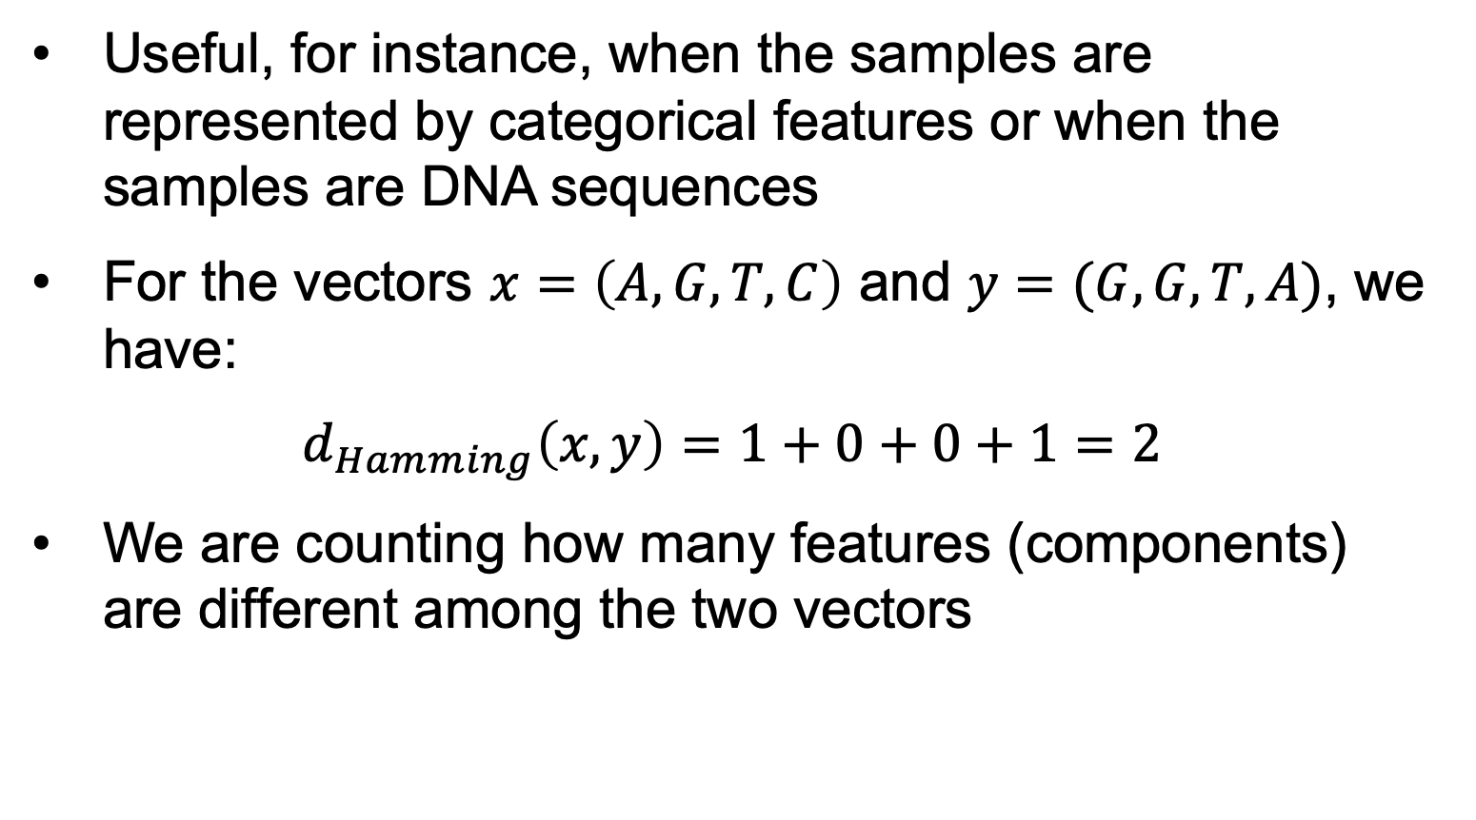
The Hamming distance
Useful, for instance, when the samples are represented by categorical features or when the samples are DNA sequences
For the vectors $x=\left(A, G,T,C\right)$ and $y=(G,G,T,A)$, we have:
$d_{Hamming}\left(x,y\right)=1+0+0+1=2$
We are counting how many features (components) are different among the two vectors

Slide 23
The Edit (Levenstein) distance
Useful, for instance, when the samples are strings (text documents, DNA sequences) or temporal sequences (videos)
The distance is given by the number of changes (insert, delete, replace) necessary to transform one object into the other
For video sequences, we use Dynamic Time Warping (DTW)

Slide 24
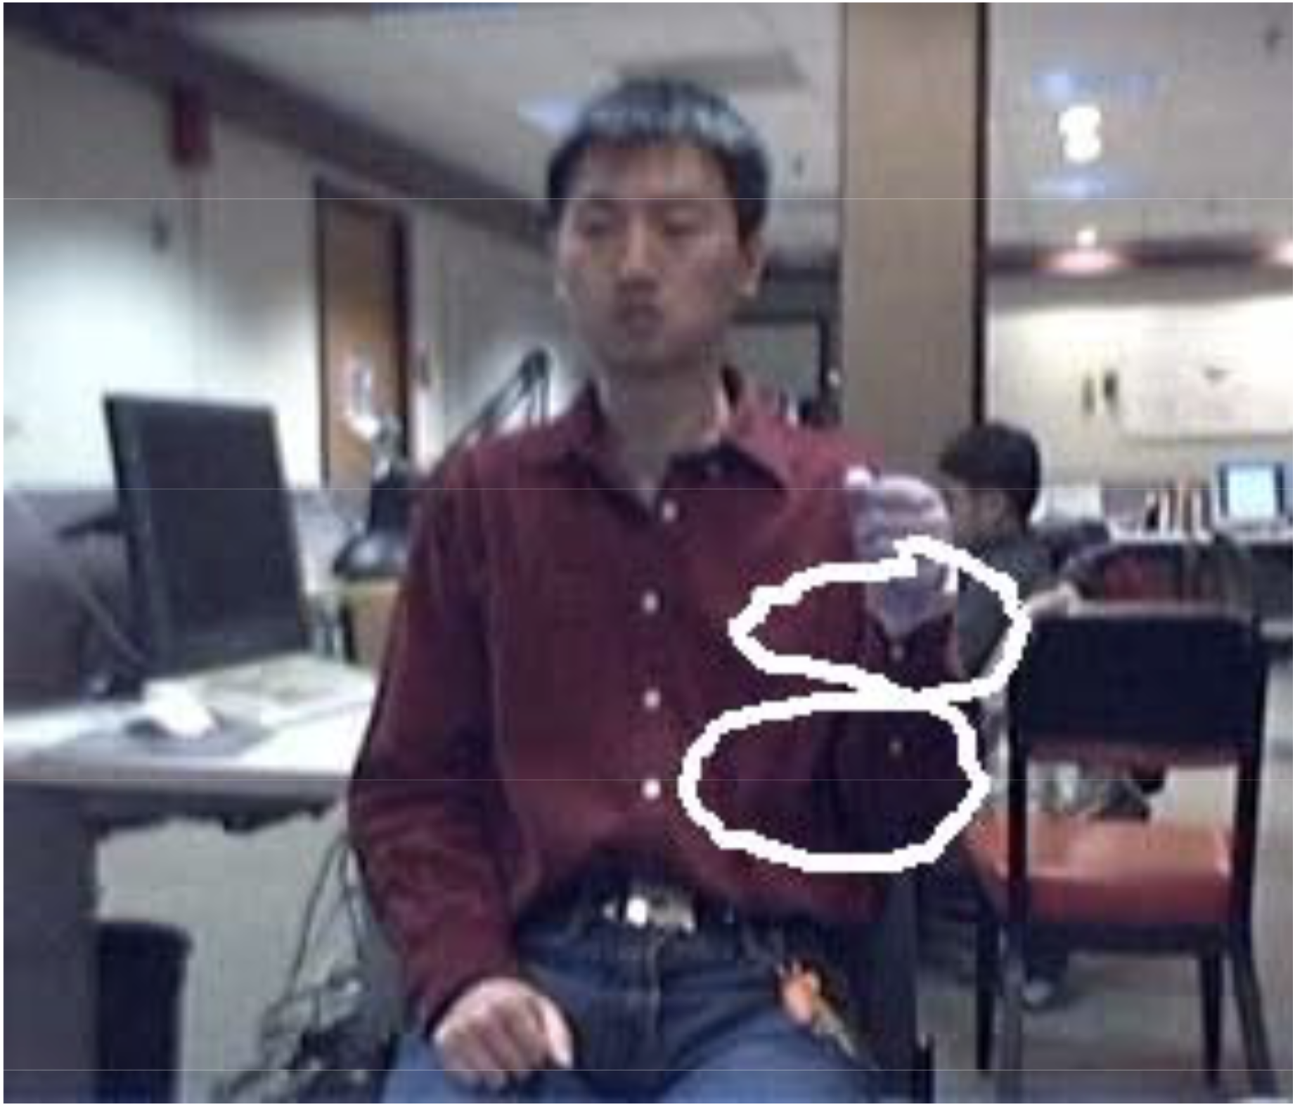
Application: Gesture recognition
What gesture corresponds to the motion performed by the user?

Slide 25
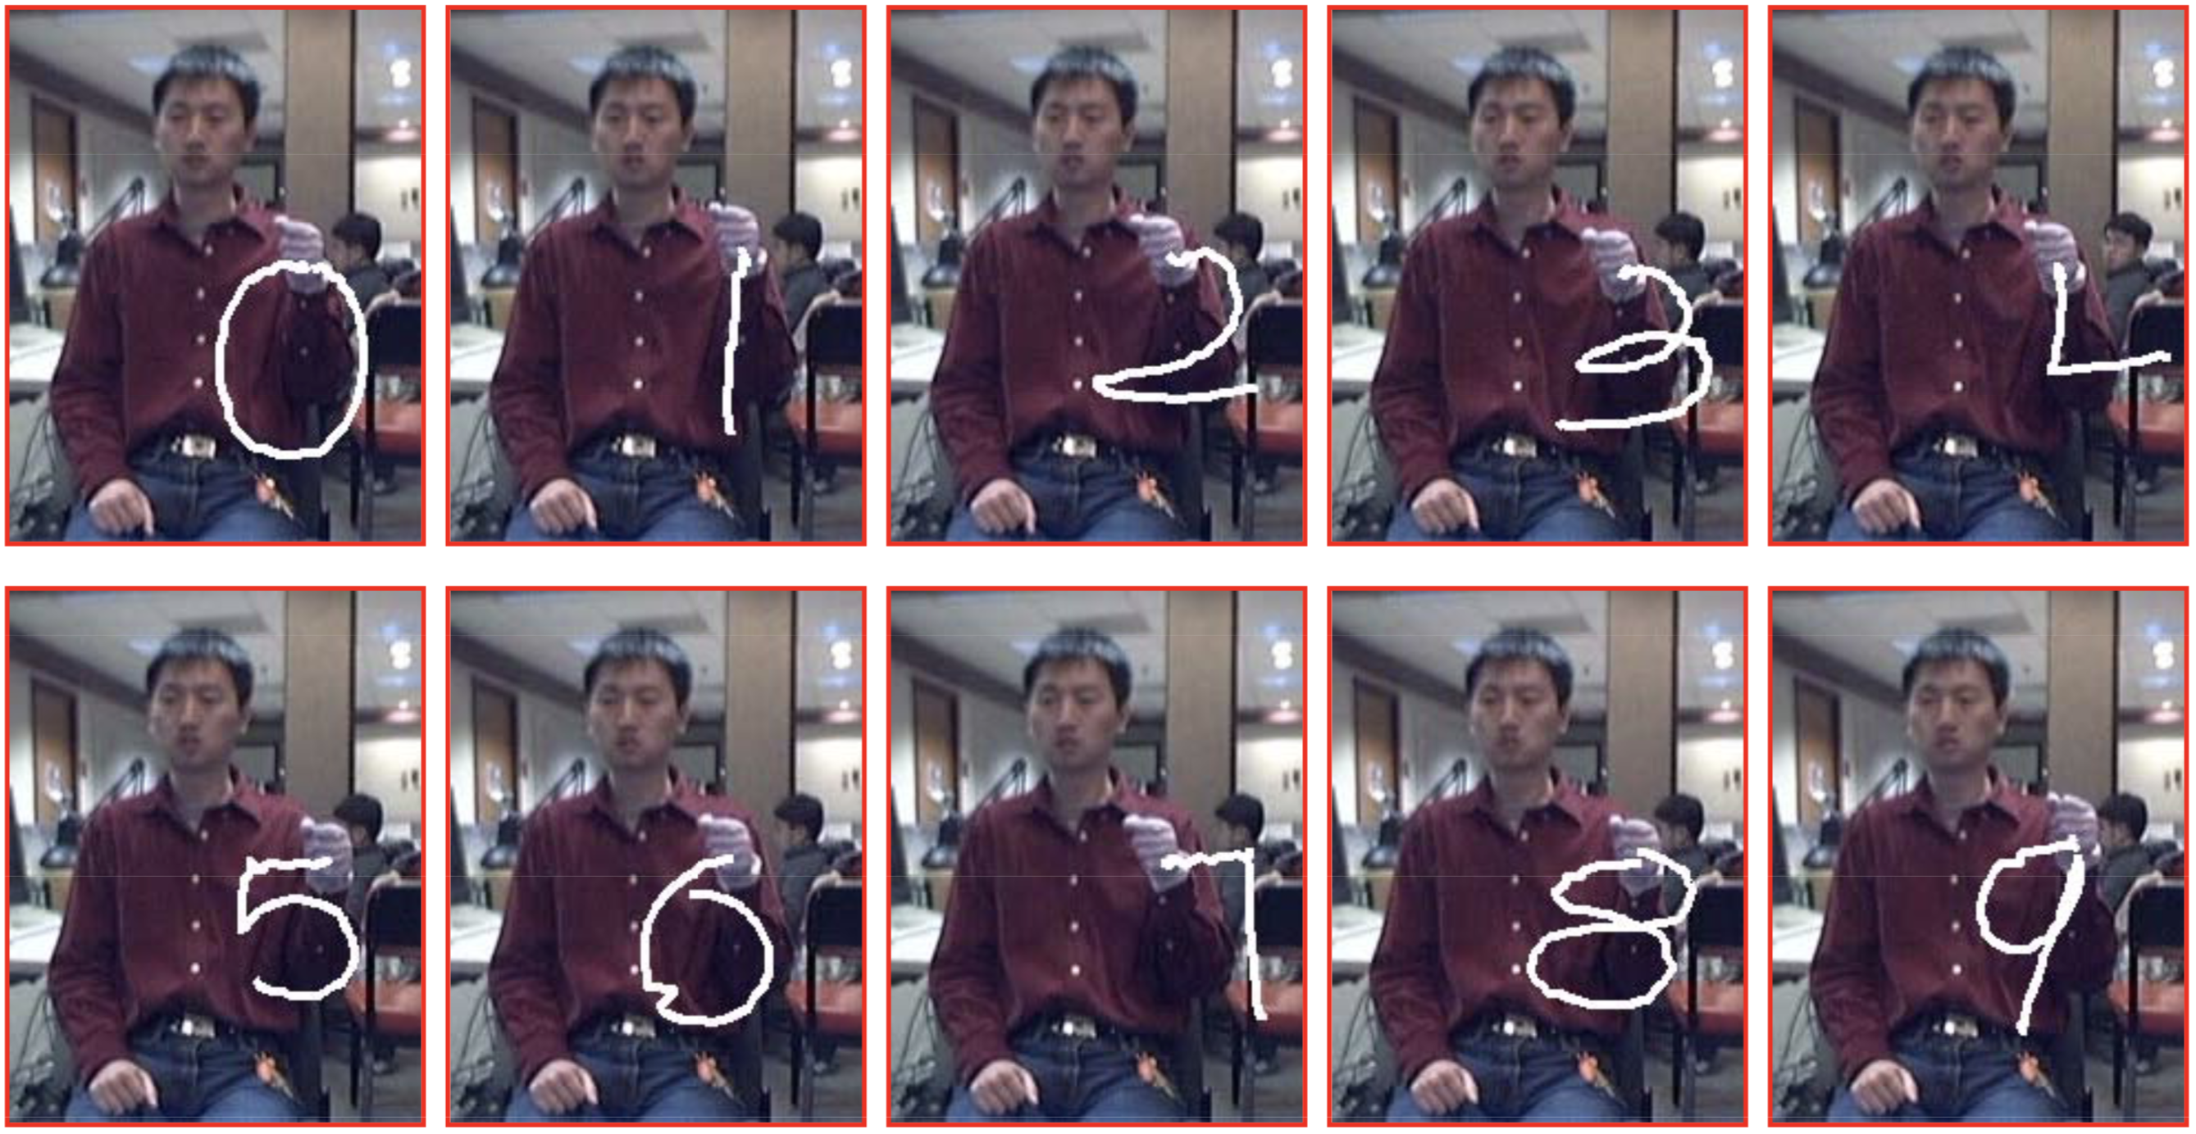
Let’s consider 10 gesture classes

Slide 26
Gesture recognition problem
We have to recognize 10 simple gestures performed by a user
Each gesture corresponds to a number from 0 to 9
Only the trajectory of the hand matters, not the handshape / fingers pose:
This is just a choice we make for this example application
Many systems, e.g. sign language, need to use handshape as well

Slide 27
Decomposing gesture recognition
We need modules for:
Computing how the person moved
Person detection / tracking
Hand detection / tracking
Handshape recognition?
Recognizing what the motion means
Motion estimation and recognition are quite different tasks
When we see someone using sign language, we know how they move, but not what the motion means

Slide 28
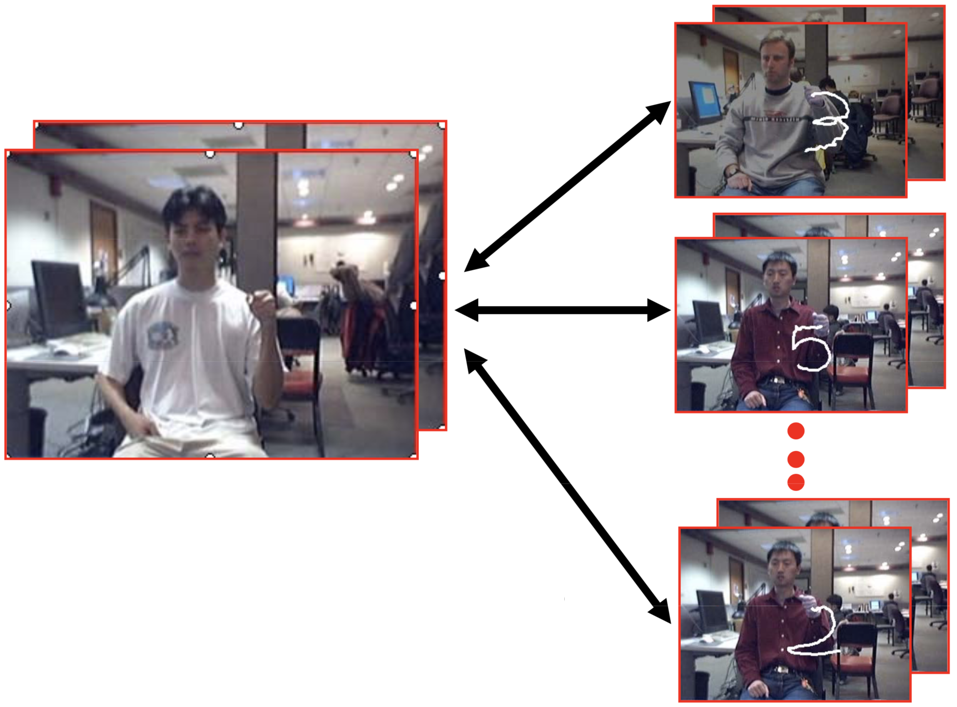
Gesture recognition
How do we determine the gesture class?
k-NN
How should we measure similarity / distance between gestures?

Slide 29
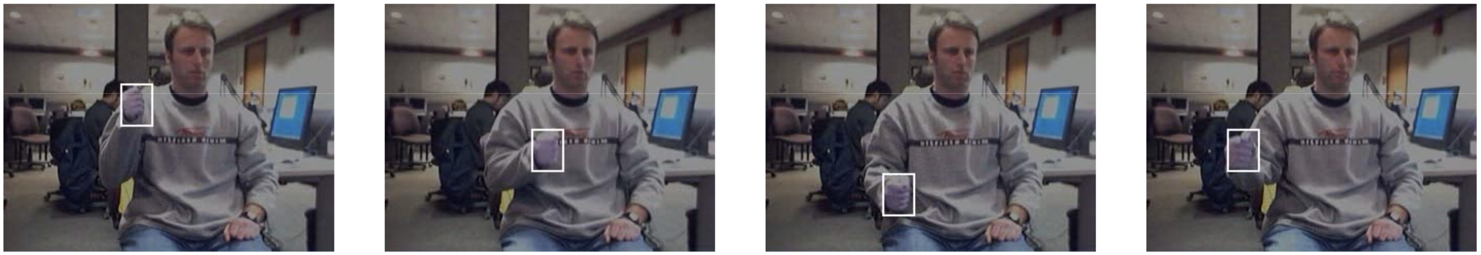
If hand location is known
• Assumption: hand location is known in all frames of the database gestures
• The training data can be annotated offline using manual annotation / colored gloves / sensors
• For the test data, we need a hand detector
(we do not cover this part)

Slide 30
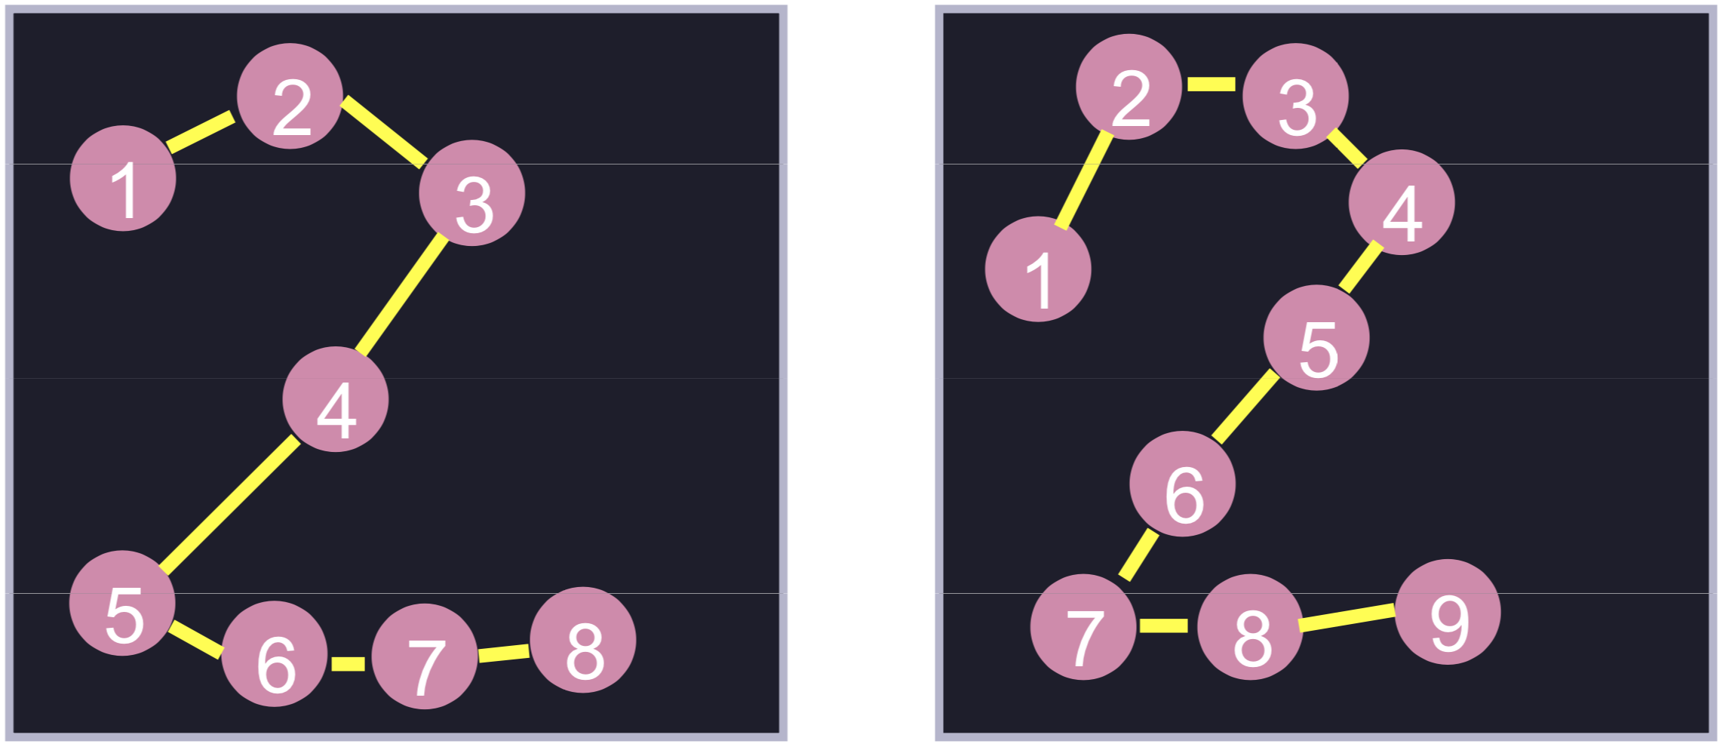
Comparing trajectories
We can make a trajectory based on the location of the hand at each frame
How do we compare trajectories?

Slide 31
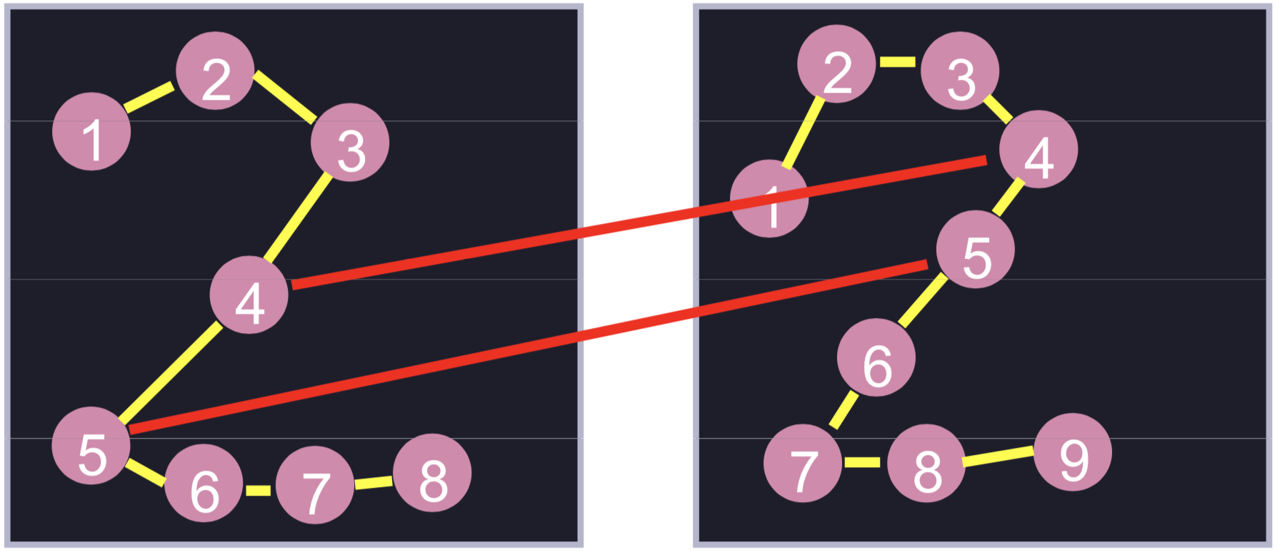
Matching trajectories
Comparing i-th frame to i-th frame is problematic
What do we do with frame 9 from the right?

Slide 32
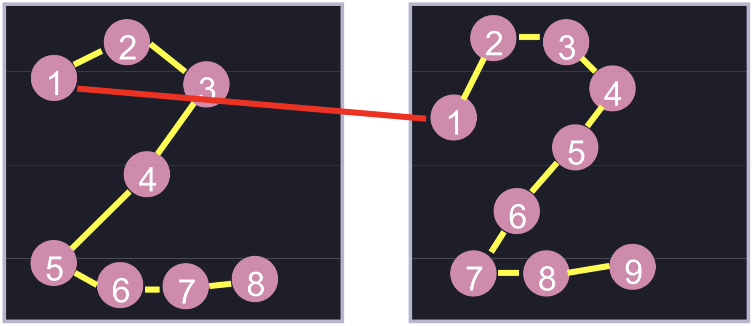
Matching trajectories
• We can align them:
((1, 1)

Slide 33
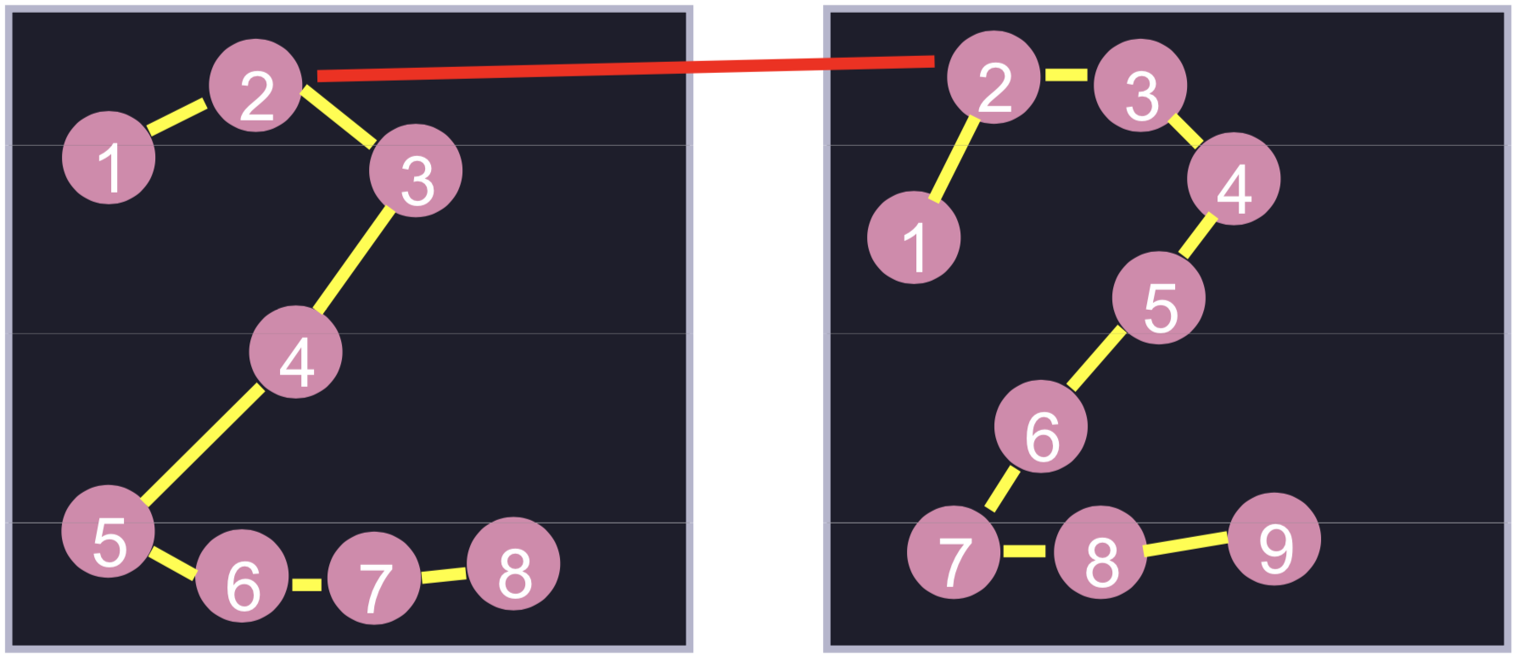
Matching trajectories
• We can align them:
((1, 1), (2, 2)

Slide 34
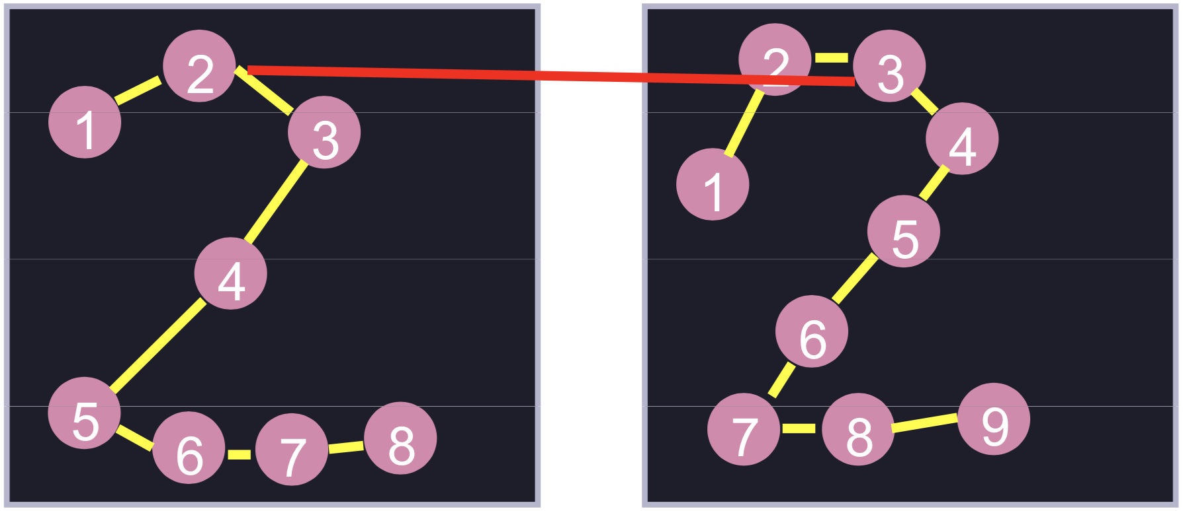
Matching trajectories
• We can align them:
((1, 1), (2, 2), (2, 3)

Slide 35
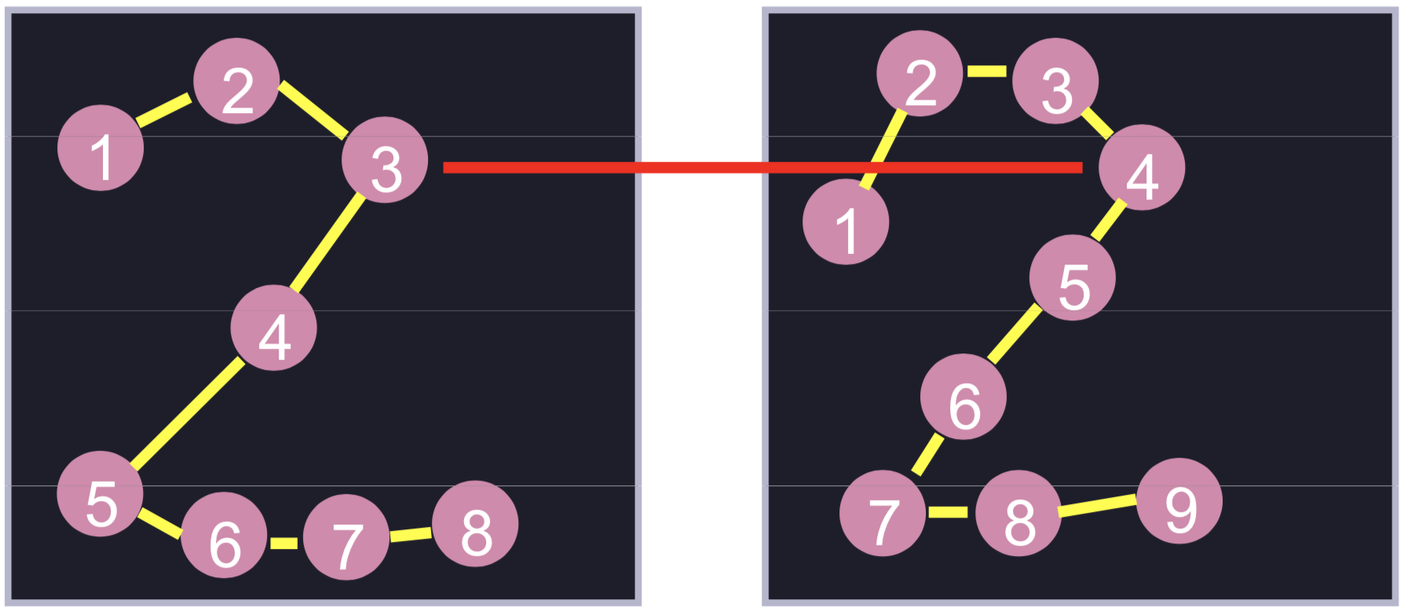
Matching trajectories
• We can align them:
((1, 1), (2, 2), (2, 3), (3, 4)

Slide 36
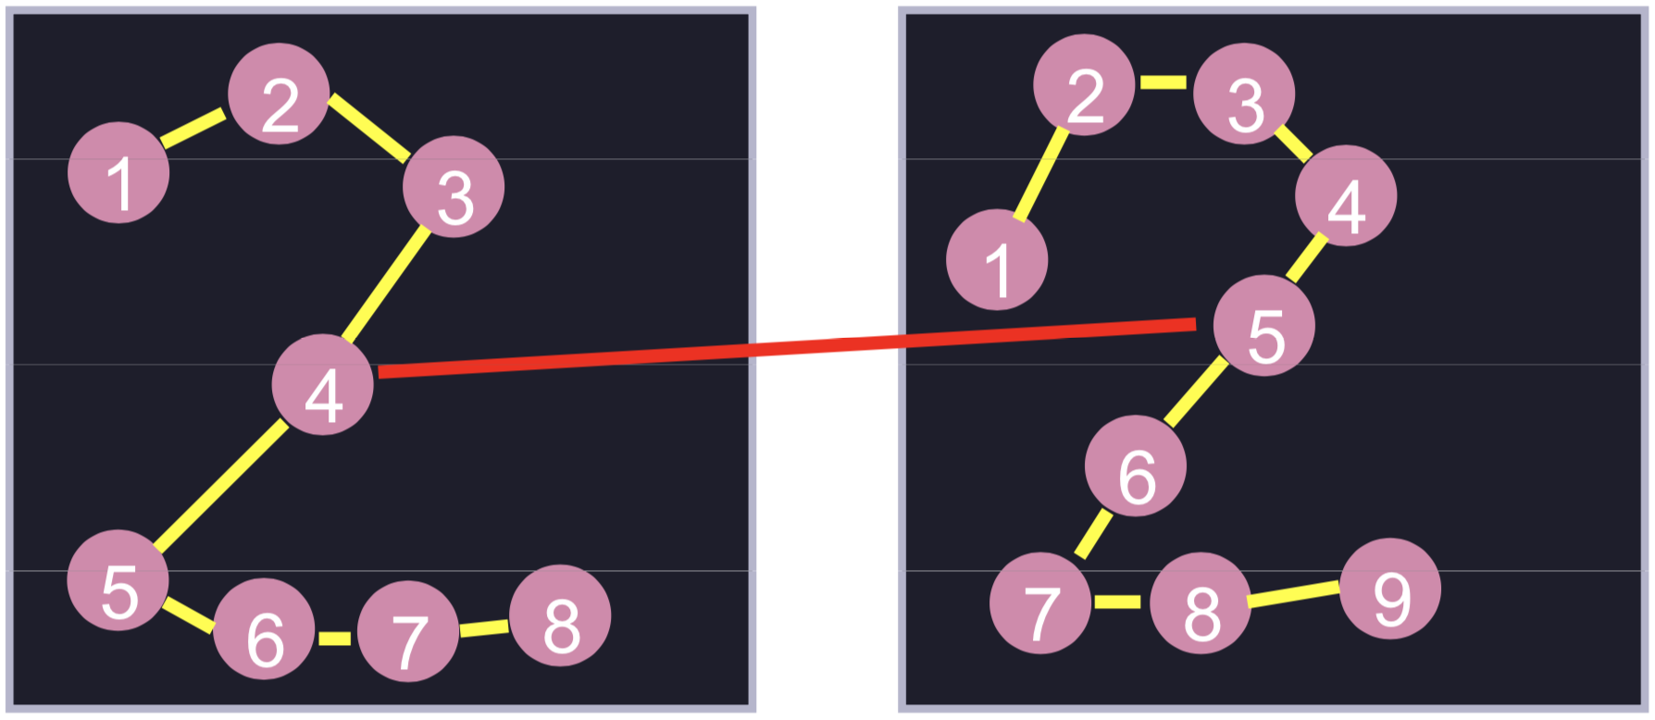
Matching trajectories
• We can align them:
((1, 1), (2, 2), (2, 3), (3, 4), (4, 5)

Slide 37
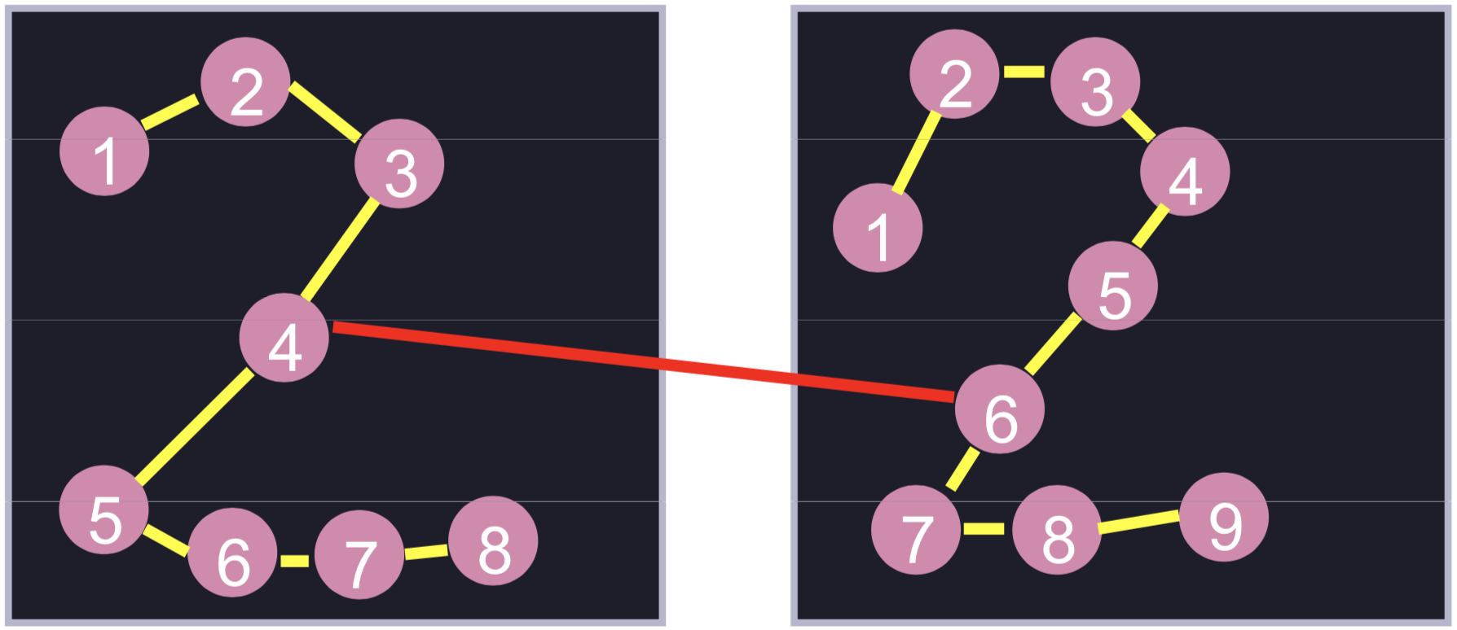
Matching trajectories
• We can align them:
((1, 1), (2, 2), (2, 3), (3, 4), (4, 5), (4, 6)

Slide 38
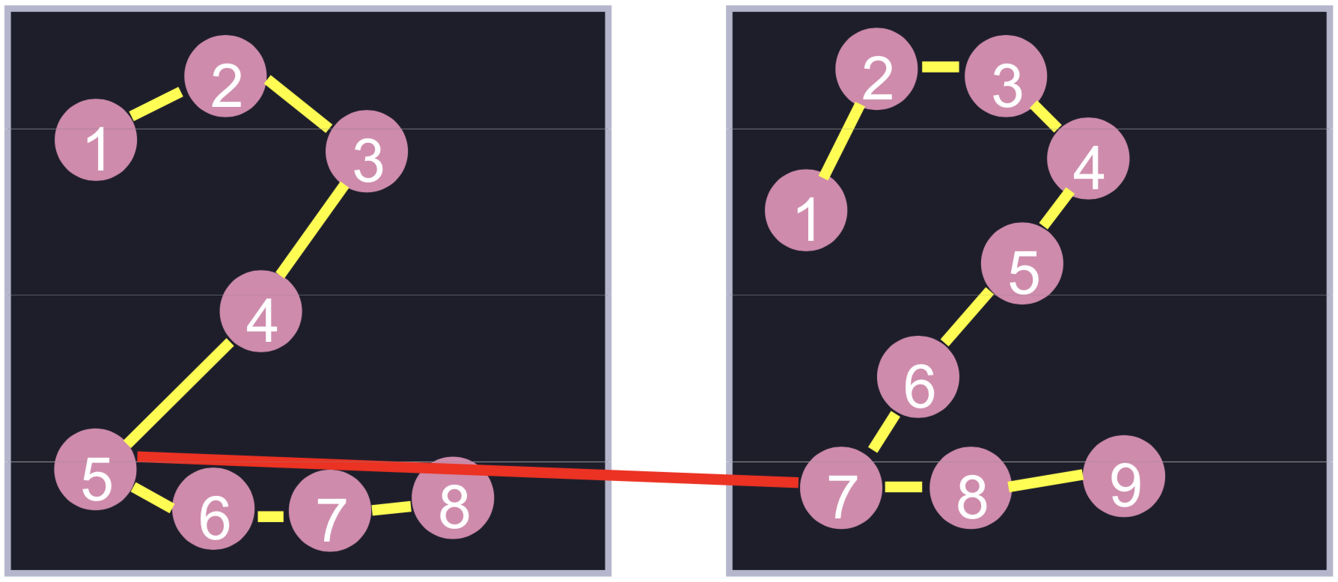
Matching trajectories
• We can align them:
((1, 1), (2, 2), (2, 3), (3, 4), (4, 5), (4, 6), (5, 7)

Slide 39
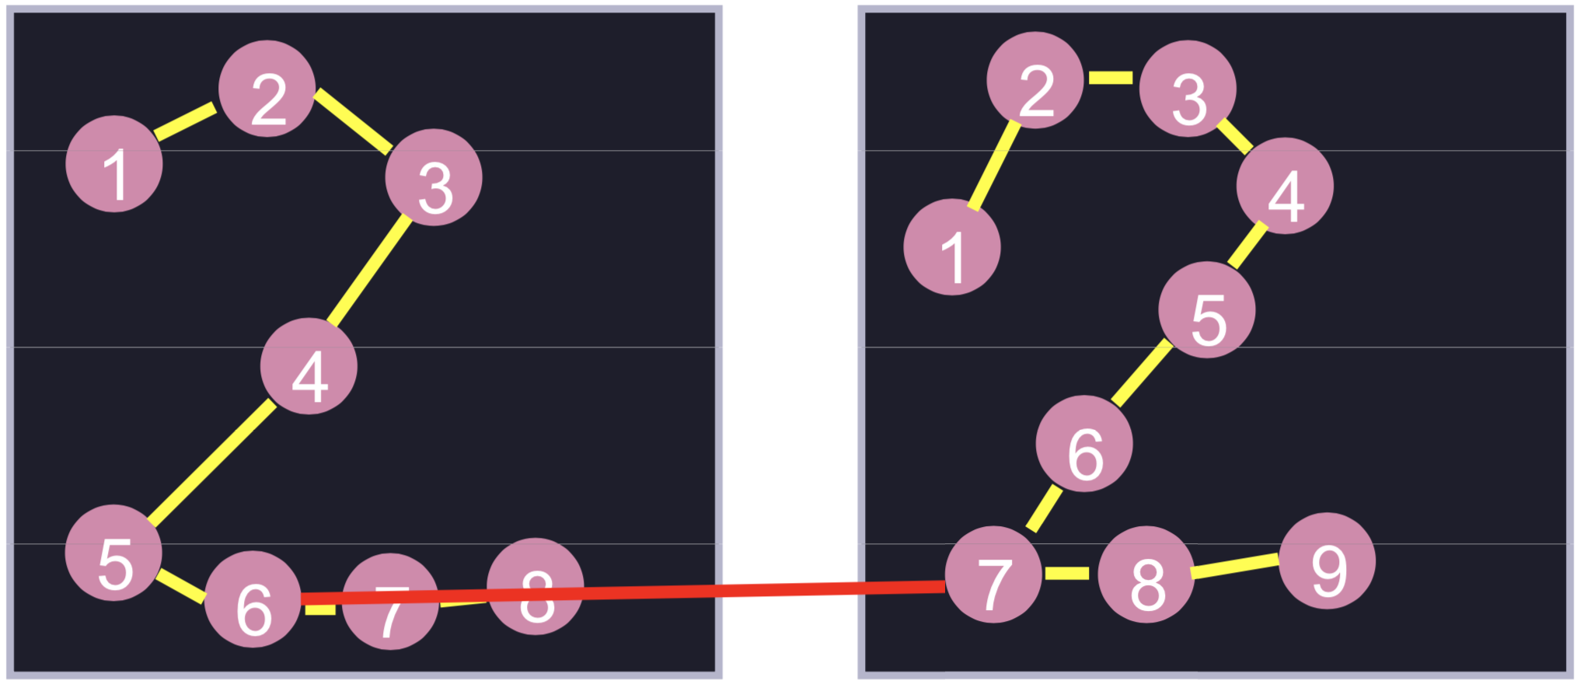
Matching trajectories
• We can align them:
((1, 1), (2, 2), (2, 3), (3, 4), (4, 5), (4, 6), (5, 7), (6, 7)

Slide 40
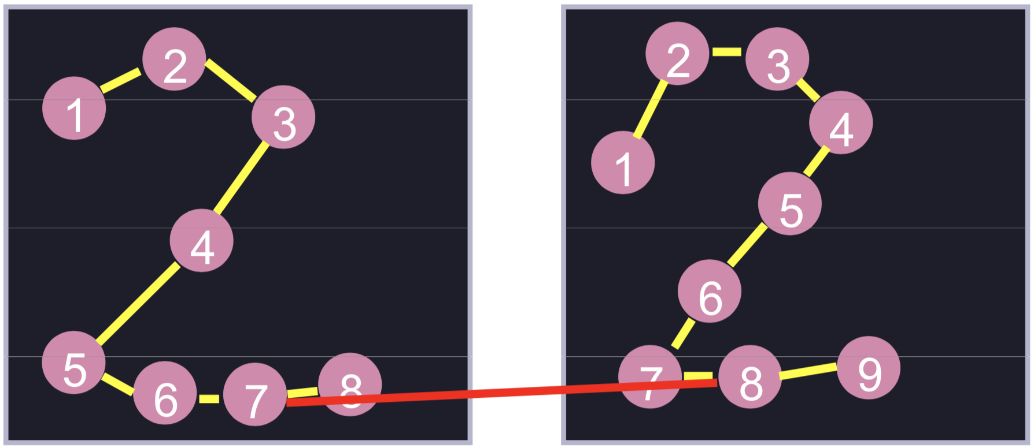
Matching trajectories
• We can align them:
((1, 1), (2, 2), (2, 3), (3, 4), (4, 5), (4, 6), (5, 7), (6, 7), (7, 8)

Slide 41
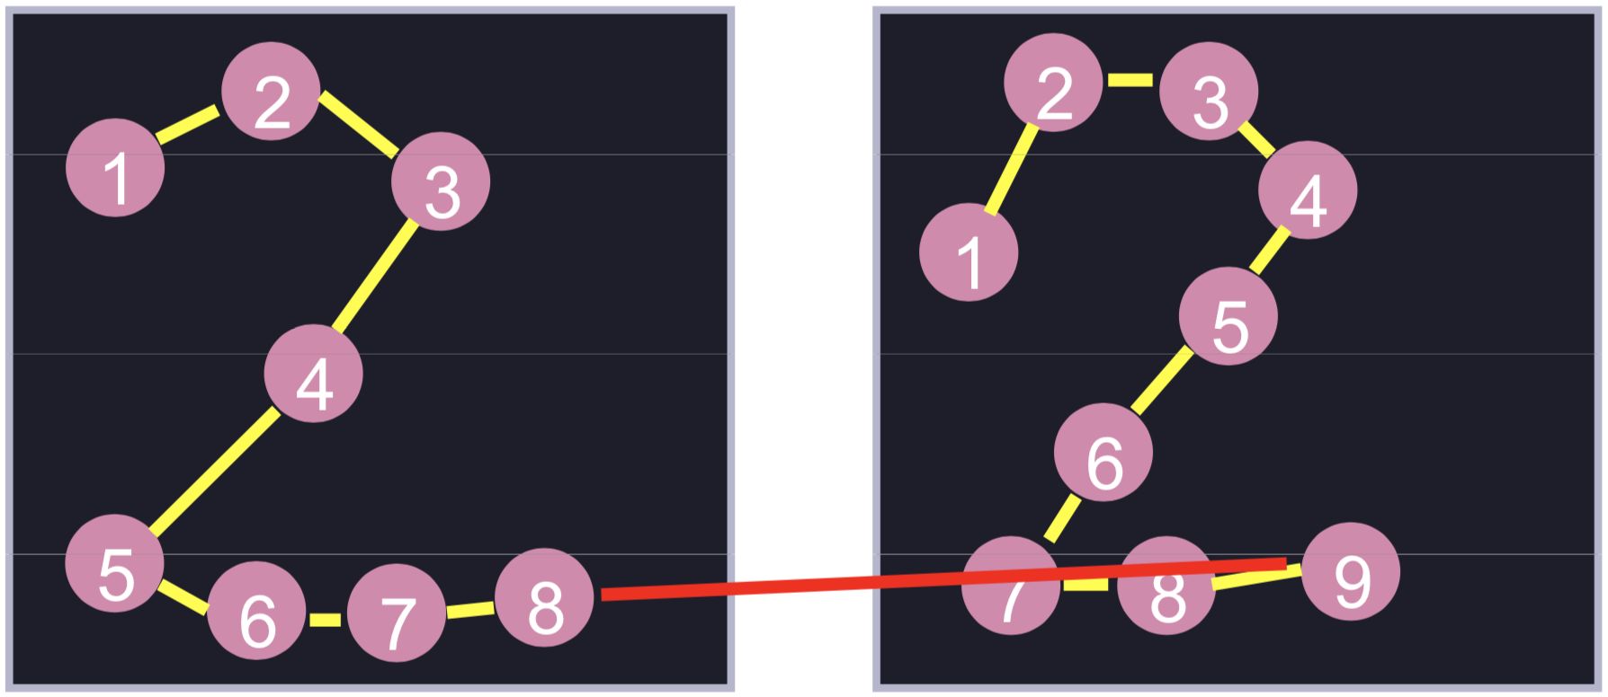
Matching trajectories
• We can align them:
((1, 1), (2, 2), (2, 3), (3, 4), (4, 5), (4, 6), (5, 7), (6, 7), (7, 8), (8, 9))

Slide 42
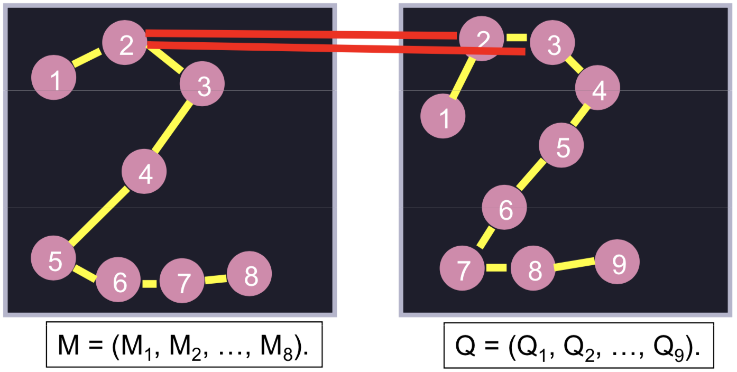
Matching trajectories
• We can align them:
((1, 1), (2, 2), (2, 3), (3, 4), (4, 5), (4, 6), (5, 7), (6, 7), (7, 8), (8, 9))
• Can be many-to-many:
M₂ is matched with Q₂ and Q₃

Slide 43
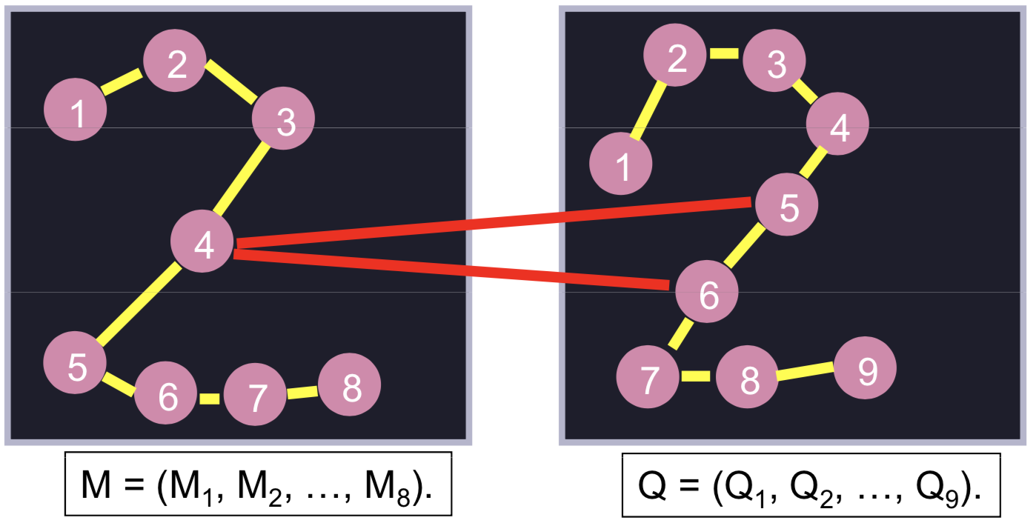
Matching trajectories
• We can align them:
((1, 1), (2, 2), (2, 3), (3, 4), (4, 5), (4, 6), (5, 7), (6, 7), (7, 8), (8, 9))
• Can be many-to-many:
M₄ is matched with Q₅ and Q₆

Slide 44
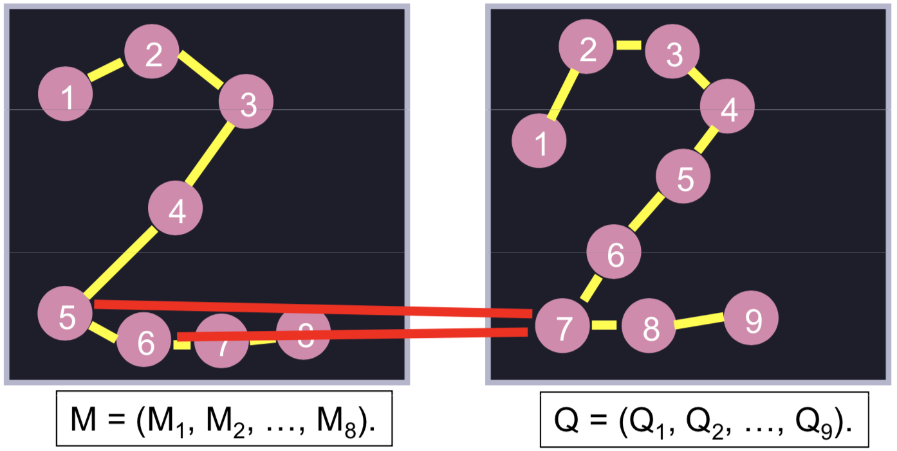
Matching trajectories
• We can align them:
((1, 1), (2, 2), (2, 3), (3, 4), (4, 5), (4, 6), (5, 7), (6, 7), (7, 8), (8, 9))
• Can be many-to-many:
M₅ and M₆ are matched with Q₇

Slide 45
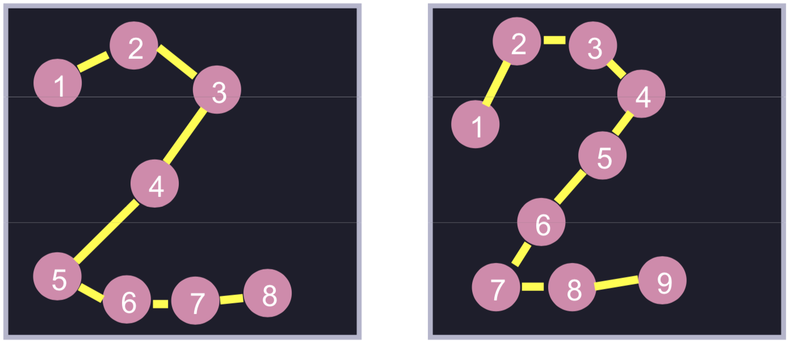
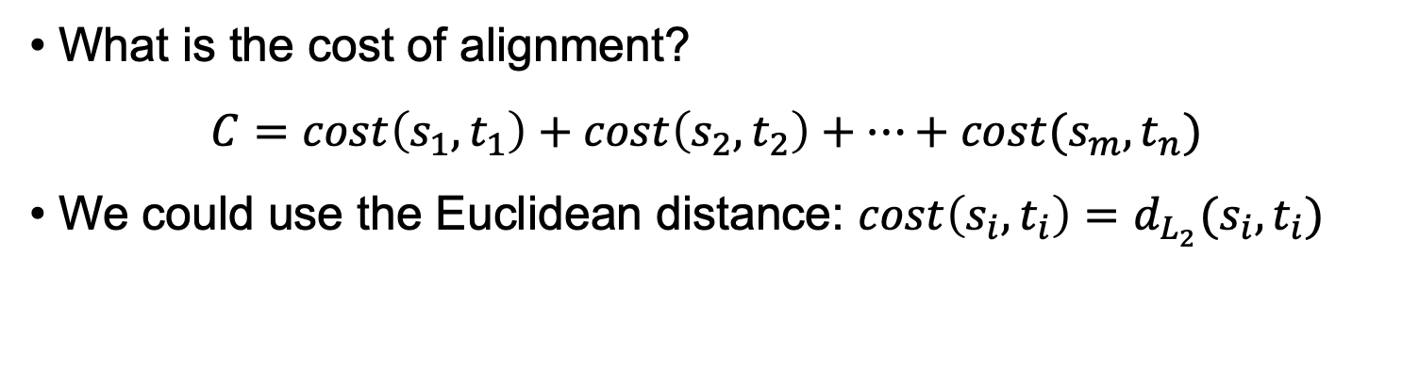
Matching trajectories
• What is the cost of alignment?
$$C=cost\left(s_{1},t_{1}\right)+cost\left(s_{2},t_{2}\right)+…+cost(s_{m},t_{n})$$
• We could use the Euclidean distance: $cost\left(s_{i},t_{i}\right)=d_{L_{2}}(s_{i},t_{i})$

Slide 46
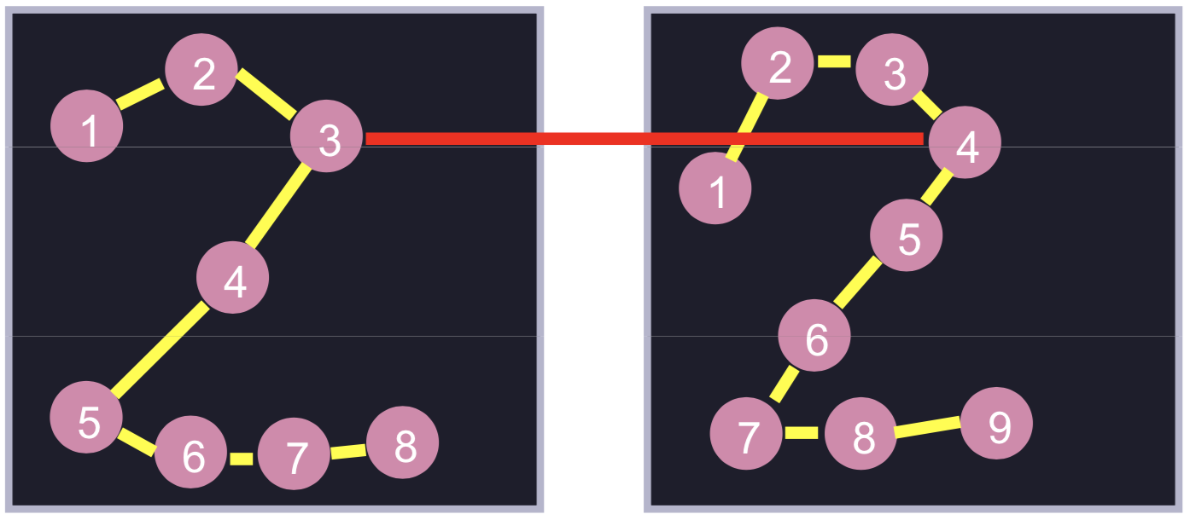
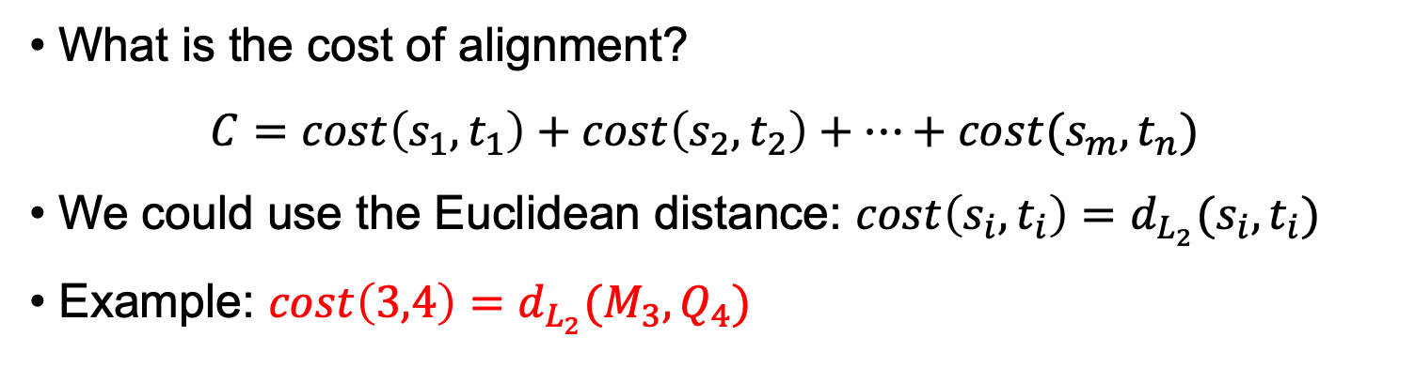
Matching trajectories
• What is the cost of alignment?
$$C=cost\left(s_{1},t_{1}\right)+cost\left(s_{2},t_{2}\right)+…+cost(s_{m},t_{n})$$
• We could use the Euclidean distance: $cost\left(s_{i},t_{i}\right)=d_{L_{2}}(s_{i},t_{i})$
• Example: $cost\left(3,4\right)=d_{L_{2}}(M_{3},Q_{4})$

Slide 47
Matching trajectories
• We can align them:
((1, 1), (2, 2), (2, 3), (3, 4), (4, 5), (4, 6), (5, 7), (6, 7), (7, 8), (8, 9))
• What are the rules of alignment?

Slide 48
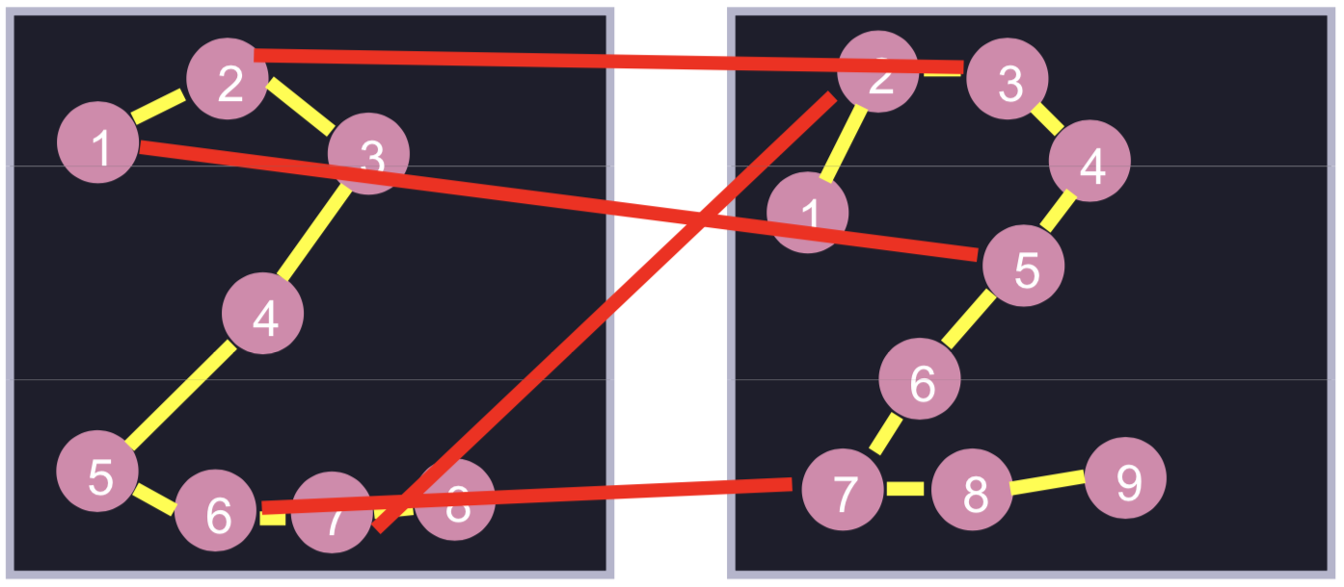
Matching trajectories
• We can align them:
((1, 1), (2, 2), (2, 3), (3, 4), (4, 5), (4, 6), (5, 7), (6, 7), (7, 8), (8, 9))
• What are the rules of alignment?
Is alignment ((1, 5), (2, 3), (6, 7), (7, 1)) legal?
Depends on what makes sense in our application

Slide 49
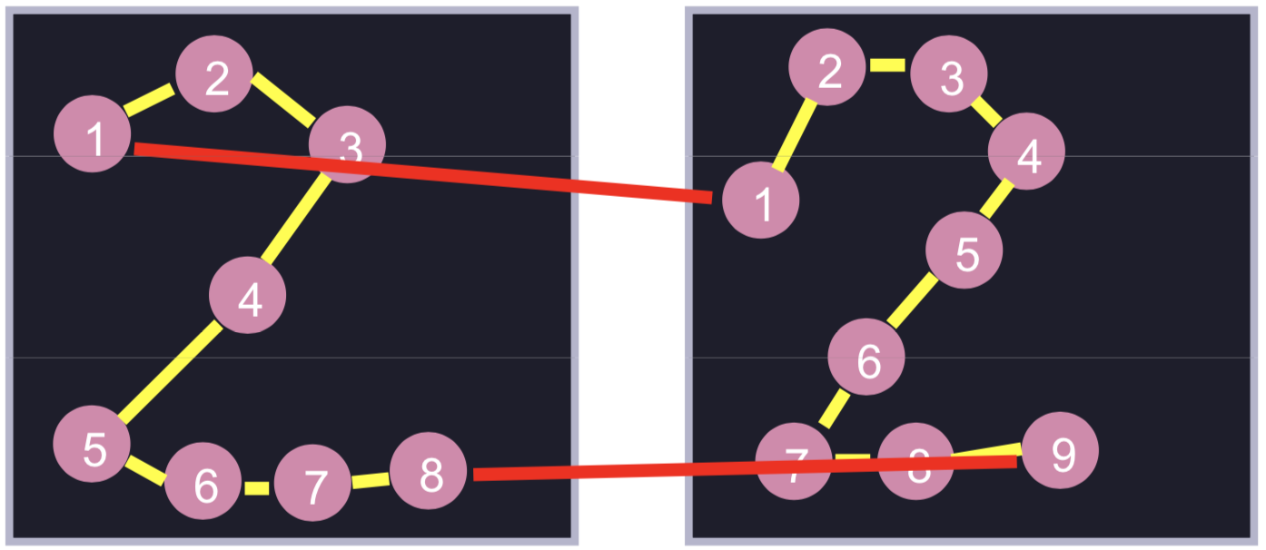
Rules of alignment for DTW
• We can align them:
((1, 1), (2, 2), (2, 3), (3, 4), (4, 5), (4, 6), (5, 7), (6, 7), (7, 8), (8, 9))
• DTW rules: boundaries
First elements match: (s₁,t₁)
Last elements match: (s_{m},t_{n})

Slide 50
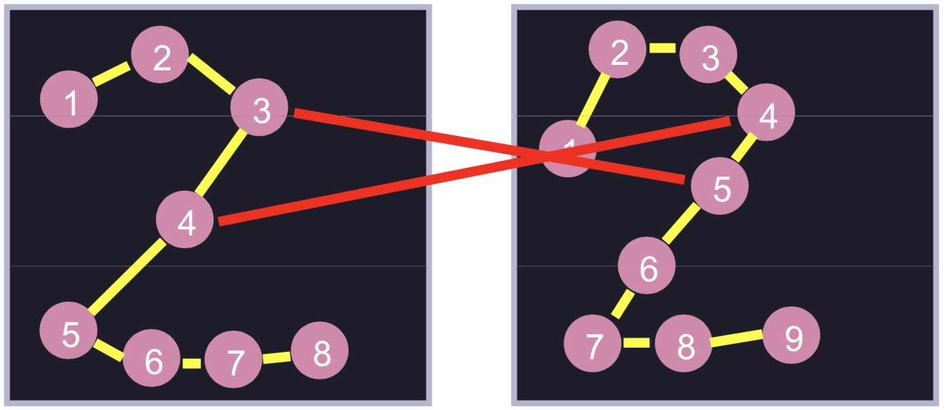
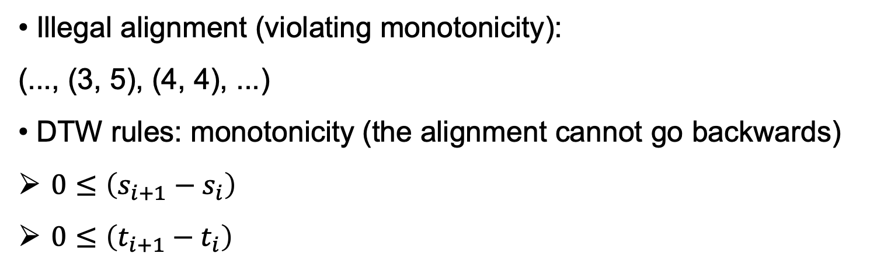
Rules of alignment for DTW
• Illegal alignment (violating monotonicity):
(..., (3, 5), (4, 4), ...)
• DTW rules: monotonicity (the alignment cannot go backwards)
$0≤\left(s_{i+1}−s_{i}\right)$
$0≤\left(t_{i+1}−t_{i}\right)$

Slide 51
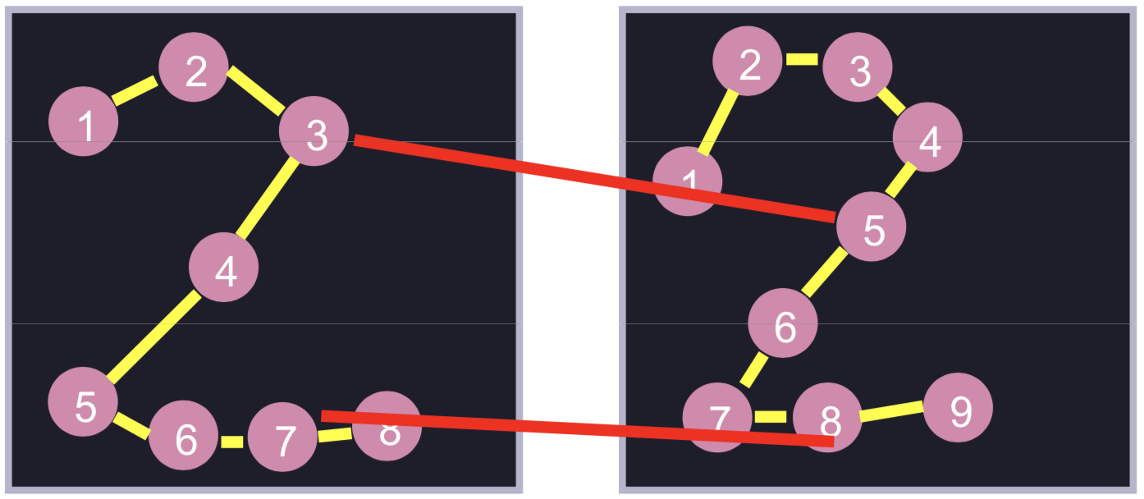
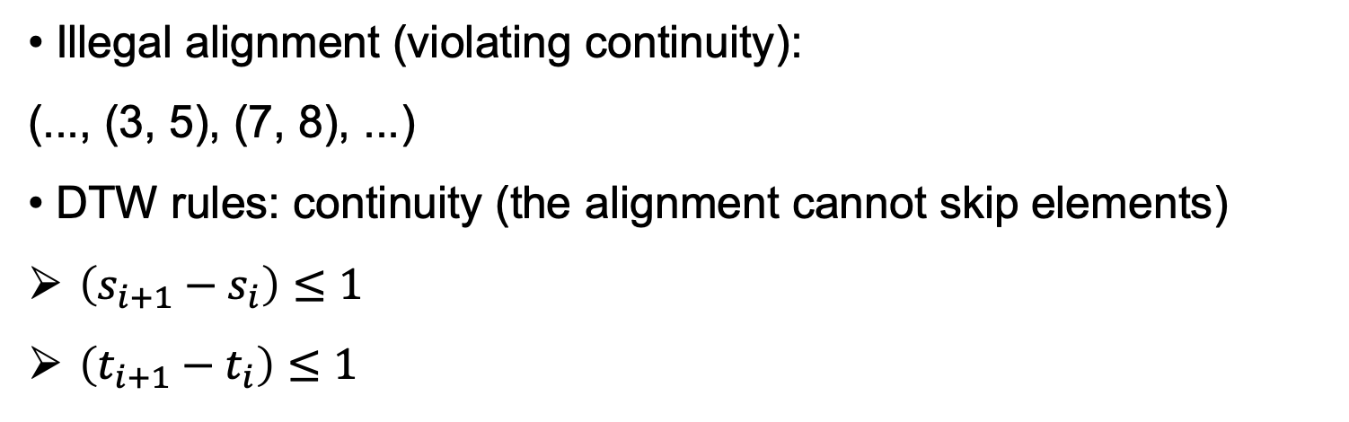
Rules of alignment for DTW
• Illegal alignment (violating continuity):
(..., (3, 5), (7, 8), ...)
• DTW rules: continuity (the alignment cannot skip elements)
$\left(s_{i+1}−s_{i}\right)≤1$
$\left(t_{i+1}−t_{i}\right)≤1$

Slide 52
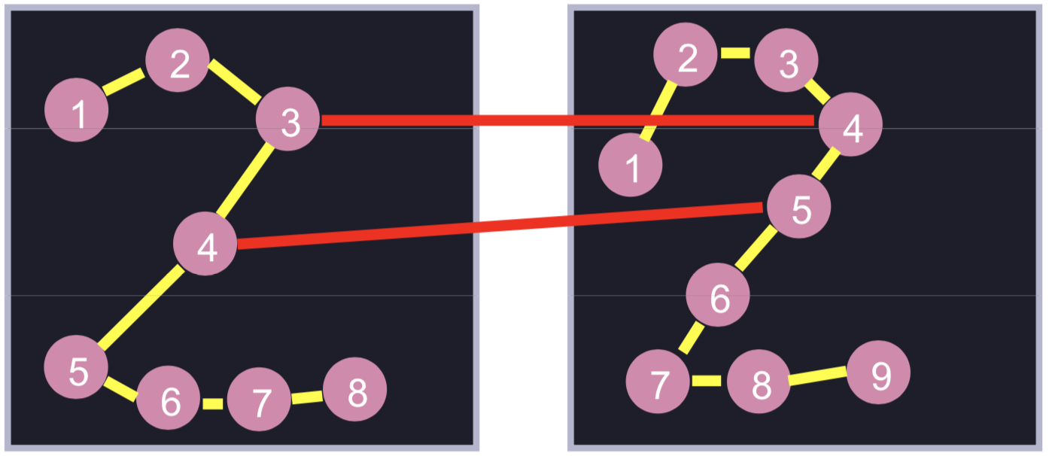
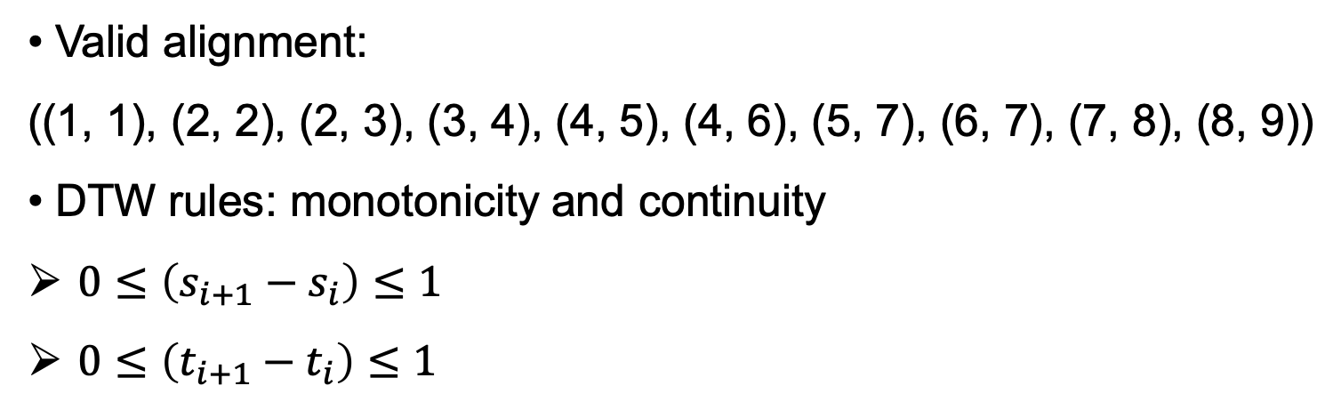
Rules of alignment for DTW
• Valid alignment:
((1, 1), (2, 2), (2, 3), (3, 4), (4, 5), (4, 6), (5, 7), (6, 7), (7, 8), (8, 9))
• DTW rules: monotonicity and continuity
$0≤\left(s_{i+1}−s_{i}\right)≤1$
$0≤\left(t_{i+1}−t_{i}\right)≤1$

Slide 53
Dynamic Time Warping
• Dynamic Time Warping (DTW) is a distance measure between sequences of points
• The DTW distance is the cost of the optimal alignment between two trajectories
The alignment must obey the DTW rules defined in the previous slides

Slide 54
Gesture recognition
How do we determine the gesture class? k-NN
How should we measure similarity / distance between gestures?
DTW

Slide 55

Computing DTW (Edit) distance
• Training sample: M = (M₁, M₂, ..., M₈)
• Test sample: Q = (Q₁, Q₂, ..., Q₉)
• Each M_{i} and Q_{j} can be, for example, a 2D pixel location of the hand (center of the bounding box)

Slide 56
Computing DTW (Edit) distance
• Training sample: M = (M₁, M₂, ..., M₈)
• Test sample: Q = (Q₁, Q₂, ..., Q₉)
• We want optimal alignment between M and Q
• Dynamic programming strategy:
Break problem up into smaller, interrelated problems P(i,j), which we solve using a recursive relation
Problem P(i,j): find optimal alignment between
(M₁, M₂, ..., M_{i}) and (Q₁, Q₂, ..., Q_{j})

Slide 57
Computing DTW (Edit) distance
• Solve problem P(1, j):
The optimal alignment is: ((1, 1), (1, 2), ..., (1, j))
• Solve problem P(i, 1):
The optimal alignment is: ((1, 1), (2, 1), ..., (i, 1))
• Solve problem P(i, j):
Find best solution from:
(i, j-1), (i-1, j), (i-1, j-1)
Add the pair (i, j) to the solution best solution from above

Slide 58
The DTW algorithm
• Input:
Training sample: M = [M₁, M₂, ..., M₈]
Test sample: Q = [Q₁, Q₂, ..., Q₉]
• Algorithm:
C = np.zeros((m, n))
C[0,0] = cost(M₁,Q₁)
for i in range(1,m):
C[i,0] = C[i-1,0] + cost(M_{i},Q₁)
for j in range(1,n):
C[0,j] = C[0,j-1] + cost(M₁,Q_{j})
for i in range(1,m):
for j in range(1,n):
C[i,j] = cost(M_{i},Q_{j}) + np.min(C[i-1,j],C[i,j-1],C[i-1,j-1])
• Return:
C[m-1,n-1]

Slide 59

The DTW algorithm
• For each cell (i, j):
Compute optimal alignment of M[1:i] and Q[1:j]
Answer depends only on (i-1, j), (i, j-1), (i-1, j-1)
Time: linear to size of table, quadratic to length of gestures

Slide 60
Regression from labeled samples
Suppose we have a set of N training examples:
The regression problem consists of estimating the function g(x) such that:

Slide 61
1-NN for regression tasks
y
This is the nearest point
This is the nearest point
This is the nearest point
This is the nearest point
x

Slide 62


k-NN for regression tasks
k-NN regression algorithm:
1) For each test sample x, we find the nearest k neighbors and their labels
2) The output-ul is the mean of the labels of the k neighbors:

Slide 63
Advantages and properties of k-NN
k-NN is a very simple model
Can be directly applied to multi-class problems
The decision boundary is non-linear
The quality of the results grows with the number of training samples
We have a single parameter that requires tuning (k)
The training error grows with k, but the decision boundary becomes smoother:
Regularization method that increases the generalization capacity (to some extent)

Slide 64
Disadvantages of k-NN
What does nearest mean? We have to define a distance
Is the Euclidean distance always the best choice?
The computational cost is quite high: we need to store and pass through the whole training set during inference (at test time)
Possible solutions to avoid the high computational time:
Partition the feature space using k-d trees
Use locality sensitive hashing
Suffers from the “curse of dimensionality”

Slide 65
Approximate k-NN based on k-d tree
Build a k-d tree from training data:
10
8
6
4
2
0
2
4
6
8
10

Slide 66
Approximate k-NN based on k-d tree
Build a k-d tree from training data:
pick random/alternate dimension, find median, split data, repeat
10
8
x
x>6
6
4
2
0
2
4
6
8
10

Slide 67
Approximate k-NN based on k-d tree
Build a k-d tree from training data:
pick random/alternate dimension, find median, split data, repeat
10
8
x
x>6
6
y
y>4
y>6
4
2
0
2
4
6
8
10

Slide 68
Approximate k-NN based on k-d tree
Build a k-d tree from training data:
pick random/alternate dimension, find median, split data, repeat
10
8
x
x>6
6
y
y>4
y>6
4
x>3
x>2
x>8
x>9
2
x
0
2
4
6
8
10

Slide 69
Approximate k-NN based on k-d tree
Build a k-d tree from training data:
pick random/alternate dimension, find median, split data, repeat
Find NN for test sample:
1) Find region containing test point
2) Compare to all points in region
10
8
x
x>6
6
y
y>4
y>6
4
x>3
x>2
x>8
x>9
2
x
0
2
4
6
8
10

Slide 70


Edited Nearest Neighbors
Eliminate training samples that have a different label from its nearest k neighbors
Regularization technique that produces smooth border by removing training outliers

Slide 71

Condensed Nearest Neighbors
Eliminate training samples that have no effect on the decision boundary
Algorithm:
1) Randomly select a set P of samples, at least one for each class
2) Each training sample that is not in P should be added to P, if the k-NN based on P classifies it incorrectly

Slide 72

Edited + Condensed Nearest Neighbors

Slide 73
Local Learning

Slide 74


Local Learning
Local learning algorithm:
1) select training samples located in the vicinity of the given test sample
2) train a classifier on the selected examples
3) apply the classifier to predict the class label of the test sample

Slide 75

Local Learning

Slide 76


Slide 77
Curse of dimensionality
In machine learning, we often use high-dimensional feature vectors
Example:
When we analyze gray-scale images of 200x200 pixels, then we are working with a feature space of 40.000 dimensions
If the images are color (represented in the RGB or HSV color spaces), the dimensionality of the feature space grows to 120.000

Slide 78

Curse of dimensionality
To “fill” a 1D space (e.g. $ℝ^{1}$) we need 5 data points:

Slide 79

Curse of dimensionality
To “fill” a 2D space (e.g. $ℝ^{2}$) we need 25 data points:

Slide 80

Curse of dimensionality
To “fill” a 3D space (e.g. $ℝ^{3}$) we need 125 data points:

Slide 81

Curse of dimensionality
To “fill” an nD space (e.g. $ℝ^{n}$) we need an exponential number of data points
If we have a large number of features that describe our data, then the system requires an extremely large training set in order to learn a model with good generalization
Most of the times, large training sets are not available in practice

Slide 82
Hughes phenomenon
Classifier performance
Feature space size
Optimal number of features
The Hughes phenomenon shows that, as the number of features grows, the performance of the classifier increases until we reach the optimal number of features
Adding more features while keeping the size of the training set unchanged degrades the classifier performance

Slide 83

Curse of dimensionality
Increasing the dimension of an Euclidean feature space, implies the addition of positive terms in the computation of the Euclidean distance:
$\left(x,y\right)=\sqrt{{\left(x_{1}−y_{1}\right)}^{2}+…+{\left(x_{n}−y_{n}\right)}^{2}}$
In other words, because the number of features grows for a fixed number of data samples, the feature space becomes increasingly sparse (less dense)

Slide 84

Curse of dimensionality
Average distance for 1000 points in the unit cube
By increasing the feature space size, the average distance grows rapidly
Hence, the more dimensions we have, the more data is necessary to overcome the curse of dimensionality!
When the distance between observations increases, the learning task becomes more difficult, since the probability of finding training samples that are truly similar with the test sample decreases

