Slide 1

Deep Recurrent Q-Learning for Partially Observable MDPs
UK JO
ALLPPT.com _ Free PowerPoint Templates, Diagrams and Charts

Slide 2
Background
Matthew Hausknecht & Peter Stone, The University of Texas at Austin
Accepted in AAAI 2015.
Adapting Recurrent variant layers to original RL is important to overcome partially observed MDP and showed better result than original one.
a variant of DQN

Slide 3
Abstract
RL is weak when handling for complex tasks with limited memory and constraints presuming that each state has observation include all histories until present time.
Deep Recurrent Q-Network (DRQN) could solve this problem adding first post-convolutional fully-connected layer with a recurrent LSTM from original Deep Q Network(DQN). In other words, it leverages advances in recurrent neural networks to solve POMDP.
Rather than stacking 4 or more frames like DQN as input observation, it is better regarding to generality and resource utilization
The bigger size of observation history is, the better performance is.
But, when trained with full observations and evaluated with partial observations, its performance degrades less than DQN

Slide 4
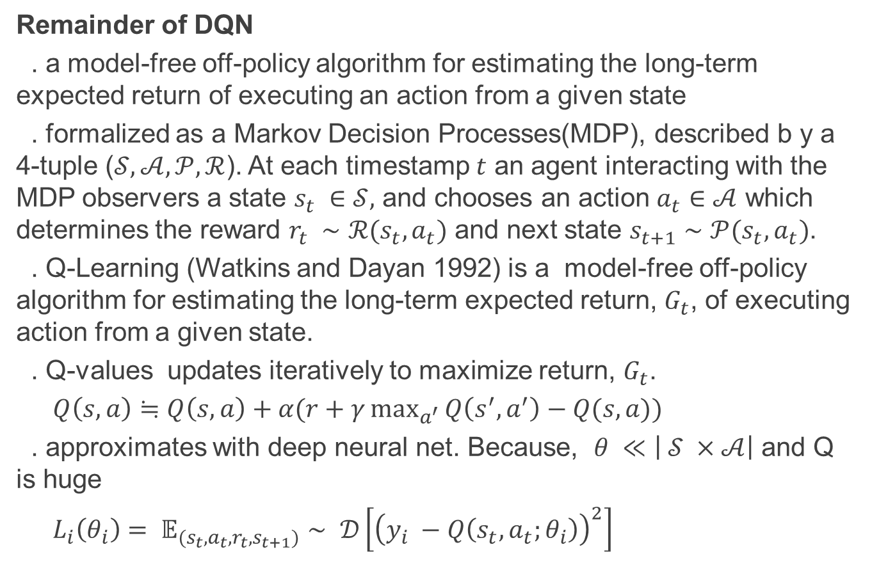
Introduction
Remainder of DQN
. a model-free off-policy algorithm for estimating the long-term expected return of executing an action from a given state
. formalized as a Markov Decision Processes(MDP), described b y a 4-tuple ($𝒮, 𝒜, 𝒫, ℛ$). At each timestamp $t$ an agent interacting with the MDP observers a state $s_{t} ∈𝒮,$ and chooses an action $a_{t}∈𝒜$ which determines the reward $r_{t} ∼ℛ(s_{t}, a_{t})$ and next state $s_{t+1}∼𝒫(s_{t},a_{t})$.
. Q-Learning (Watkins and Dayan 1992) is a model-free off-policy algorithm for estimating the long-term expected return, $G_{t}$, of executing action from a given state.
. Q-values updates iteratively to maximize return, $G_{t}$.
$Q\left(s,a\right)≒Q\left(s,a\right)+α(r+γ\max_{a^{′}}{Q\left(s^{′},a^{′}\right)−Q(s,a)) }$
. approximates with deep neural net. Because, $θ ≪\left| 𝒮 ×𝒜\right|$ and Q is huge
$L_{i}\left(θ_{i}\right)= 𝔼_{(s_{t}, a_{t}, r_{t},s_{t+1})}∼ 𝒟\left[{\left(y_{i} −Q\left(s_{t}, a_{t};θ_{i}\right)\right)}^{2}\right]$

Slide 5
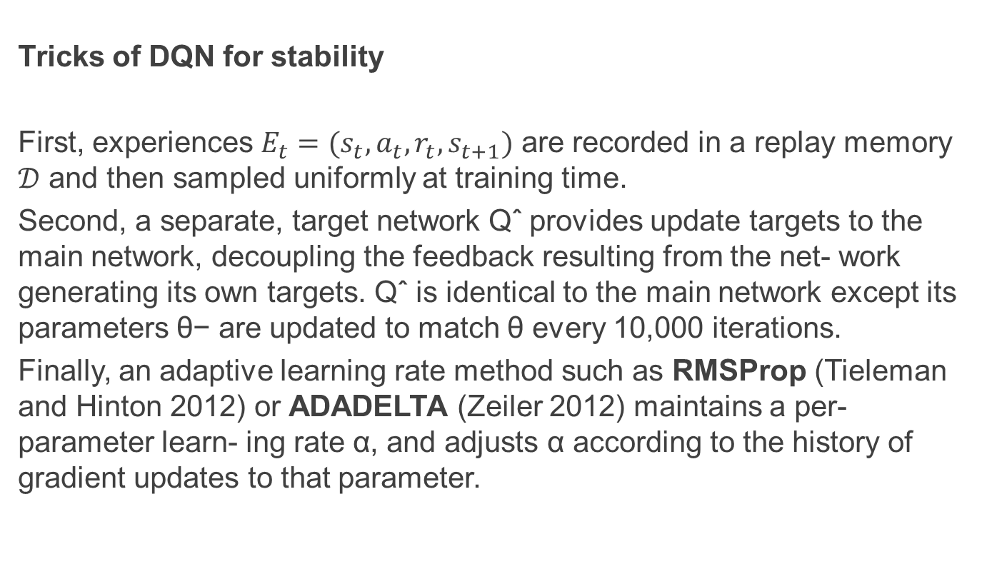
Introduction
Tricks of DQN for stability
First, experiences $E_{t}=(s_{t}, a_{t}, r_{t}, s_{t+1})$ are recorded in a replay memory $𝒟$ and then sampled uniformly at training time.
Second, a separate, target network Qˆ provides update targets to the main network, decoupling the feedback resulting from the net- work generating its own targets. Qˆ is identical to the main network except its parameters θ− are updated to match θ every 10,000 iterations.
Finally, an adaptive learning rate method such as RMSProp (Tieleman and Hinton 2012) or ADADELTA (Zeiler 2012) maintains a per-parameter learn- ing rate α, and adjusts α according to the history of gradient updates to that parameter.

Slide 6
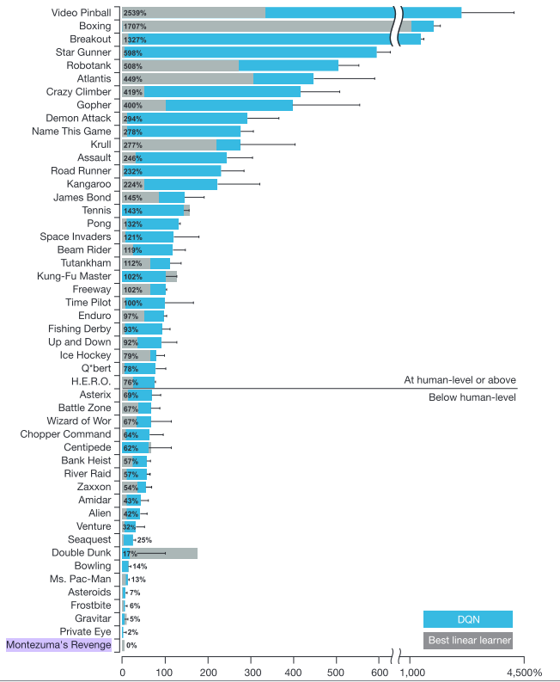
Introduction
DQN mapping from raw screen pixels to actions, these networks have been shown to achieve state-of-the-art performance on many Atari 2600 games!
But, it will be unable to master games that require the player to remember events more distant than four screens in the past. Cause these games is not MDP but POMDP!!
DRQN’s recurrency confers benefits as the quality of observations degrades

Slide 7
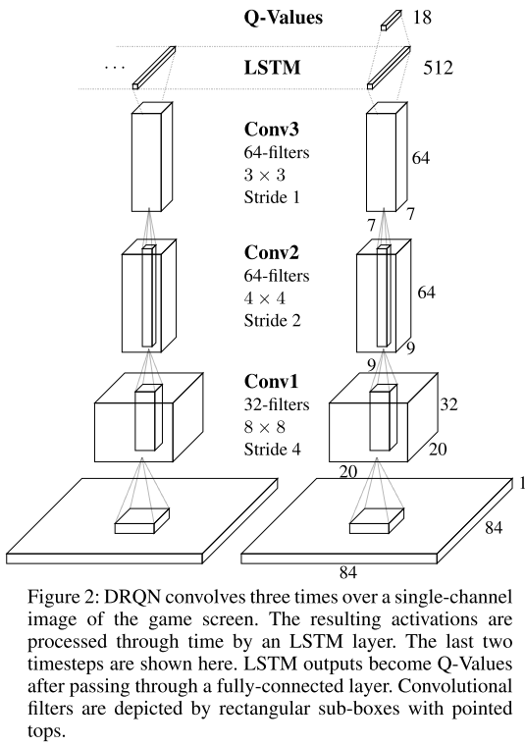
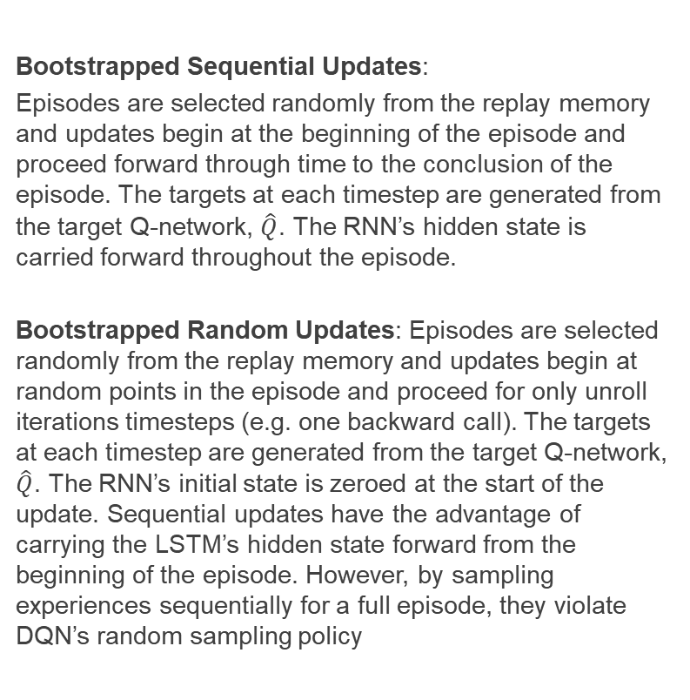
DRQN
Bootstrapped Sequential Updates:
Episodes are selected randomly from the replay memory and updates begin at the beginning of the episode and proceed forward through time to the conclusion of the episode. The targets at each timestep are generated from the target Q-network, $\hat{Q}$. The RNN’s hidden state is carried forward throughout the episode.
Bootstrapped Random Updates: Episodes are selected randomly from the replay memory and updates begin at random points in the episode and proceed for only unroll iterations timesteps (e.g. one backward call). The targets at each timestep are generated from the target Q-network, $\hat{Q}$. The RNN’s initial state is zeroed at the start of the update. Sequential updates have the advantage of carrying the LSTM’s hidden state forward from the beginning of the episode. However, by sampling experiences sequentially for a full episode, they violate DQN’s random sampling policy

Slide 8
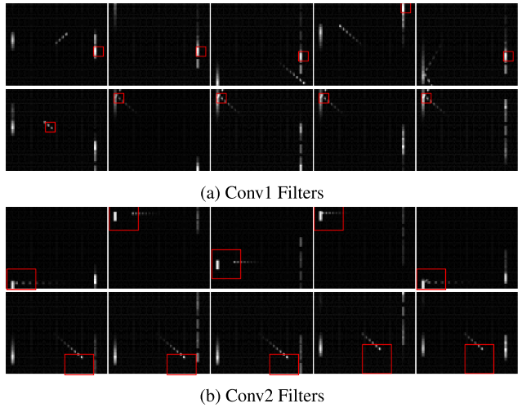
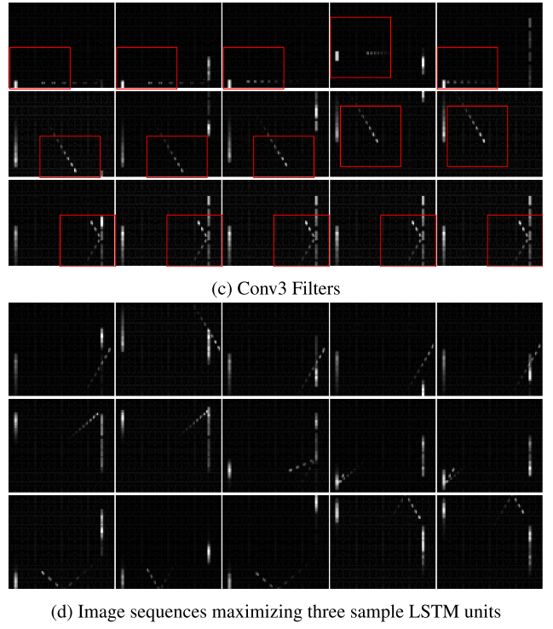
DRQN
(a) detect only the paddle. (b) begin to detect ball movement in particular directions and some jointly track the ball and the paddle. (c) track ball and paddle interactions including deflections, ball velocity, and direction of travel. (d) Despite seeing a single frame at a time, individual LSTM units also detect high level events, respectively: the agent missing the ball, ball reflections off of paddles, and ball reflections off the walls. Each

Slide 9
Evaluation
Used 9 Atari games
- Asteroids and Double Dunk feature naturally-flickering sprites making them good potential candidates for recurrent learning.
- Beam Rider, Centipede, and Chopper Command are shooters.
- Frostbite is a platformer similar to Frogger.
- Ice Hockey and Double Dunk are sports games that require positioning players, passing and shooting the puck/ball, and require the player to be capable of both offense and defense.
- Bowling requires actions to be taken at a specific time in order to guide the ball.
- Ms Pacman features flickering ghosts and power pills

Slide 10
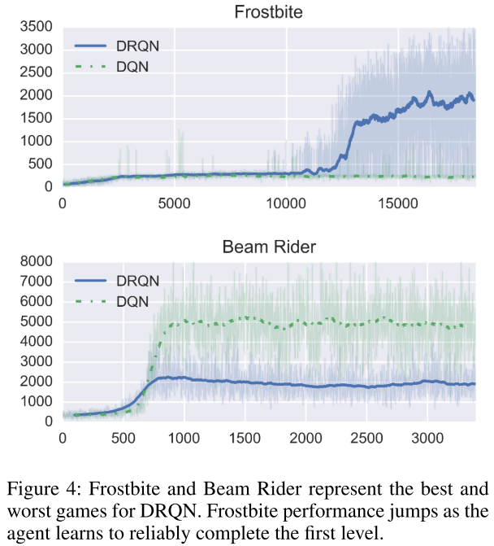
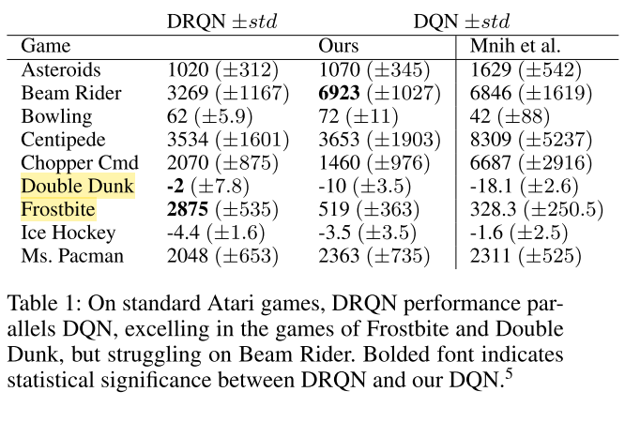
Evaluation
The game of Frostbite (Figure 1b) requires the player to jump across all four rows of moving icebergs and return to the top of the screen. After traversing the icebergs several times, enough ice has been collected to build an igloo at the top right of the screen.
Subsequently the player can enter the igloo to advance to the next level. As shown in Figure 4, after 12,000 episodes DRQN discovers a policy that allows it to reliably advance past the first level of Frostbite.

Slide 11
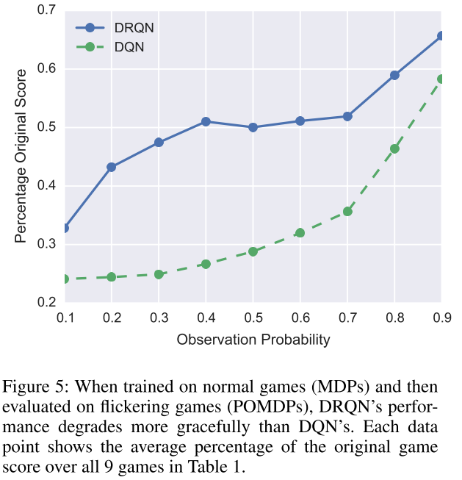
Evaluation
A Paper(Karpathy, Johnson, and Li 2015) show that LSTMs can learn functions at training time over a limited set of timesteps and then generalize them at test time to longer sequences.
Q) Can a recurrent network be trained on a standard MDP and then generalize to a POMDP at evaluation time?
A) To address this question, we evaluate the highest-scoring policies of DRQN and DQN over the flickering equivalents of all 9 gamesDRQN recurrent controllers have a certain degree of robustness against missing information, even trained with full state information

