Slide 1
“FENDER” Automatic memory fence inference
Presented by Michael Kuperstein, Technion
Joint work with Martin Vechev and Eran Yahav, IBM Research
Notes:
Larger context: Paraglide project, synthesis, etc.

Slide 2
Dekker’s Algorithm
p0: flag[0] := true while flag[1] = true { if turn ≠ 0 { flag[0] := false while turn ≠ 0 { } flag[0] := true } } // critical section turn := 1 flag[0] := false | p1: flag[1] := true while flag[0] = true { if turn ≠ 1 { flag[1] := false while turn ≠ 1 { } flag[1] := true } } // critical section turn := 0 flag[1] := false
Specification: mutual exclusion over critical section

Slide 3
Beyond Textbooks: Weak Memory Models
p0: flag[0] := true while flag[1] = true { if turn ≠ 0 { flag[0] := false while turn ≠ 0 { } flag[0] := true } } // critical section turn := 1 flag[0] := false | p1: flag[1] := true while flag[0] = true { if turn ≠ 1 { flag[1] := false while turn ≠ 1 { } flag[1] := true } } // critical section turn := 0 flag[1] := false
Re-ordering of operations
Non-atomic stores
Notes:
Will focus on Program Order, store atomicity is more subtle. Sarita Adve and Kourush Gharachorloo

Slide 4
Memory Fences
Enforce order, at a cost!
Fences are expensive
10s-100s of cycles
Example: removing a single fence yields 3x speedup in a work-stealing queue [Michael, et al. PPoPP ’09]
Where should we put fences?
Required fences depend on memory model
Different kinds of fences

Slide 5
Goal
“Correct and efficient fencing for the masses”
A tool to help the programmer place fences
For non-trivial finite-state programs
Under a realistic memory model
Safe
Efficient
Notes:
This is the goal, a subset of it has been achieved

Slide 6
Easy!
p0: flag[0] := true fence while flag[1] = true { if turn ≠ 0 { flag[0] := false while turn ≠ 0 { } flag[0] := true } } // critical section turn := 1 flag[0] := false | p1: flag[1] := true fence while flag[0] = true { if turn ≠ 1 { flag[1] := false while turn ≠ 1 { } flag[1] := true } } // critical section turn := 0 flag[1] := false

Slide 7
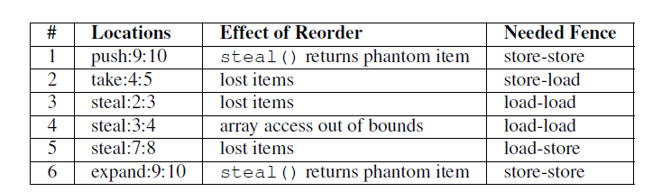
Chase-Lev Work-Stealing Queue
1 int take() {
long b = bottom – 1;
item_t * q = wsq;
bottom = b
long t = top
if (b < t) {
bottom = t;
return EMPTY;
}
task = q->ap[b % q->size];
if (b > t)
return task
if (!CAS(&top, t, t+1))
return EMPTY;
bottom = t + 1;
return task;
}
1 void push(int task) {
long b = bottom;
long t = top;
item_t * q = wsq;
if (b – t >= q->size – 1) {
wsq = expand();
q = wsq;
}
q->ap[b % q->size] = task;
bottom = b + 1;
}
1 int steal() {
long t = top;
long b = bottom;
item_t * q = wsq;
if (t >= b)
return EMPTY;
task = q->ap[t % q->size];
if (!CAS(&top, t, t+1))
return ABORT;
return task;
}
Notes:
Chase-Lev queue

Slide 8
In Practice - Hard
This is a real problem
Finding the best placement for fences is hard
Classical trade-off: correctness vs. efficiency
Existing tools are insufficient
CheckFence [Alur et al. PLDI ’07]

Slide 9
Our Approach: Overview
(Finite-State)
Program
P
FENDER
(Safety) Specification S
Program P’ with Fences
Memory Model
M
P’ satisfies the specification S under M
Notes:
P is finite-state!

Slide 10
Our Approach: Recipe
Compute reachable states for the program
Bad news:
Reachability problem undecidable even for finite-state programs running under sufficiently weak MM [Atig et al. POPL ’10]
So sometimes use an additional bound
Compute constraints that guarantee that all “bad states” are avoided
The constraints restrict non-determinism allowed by the memory model
Implement the constraints with fences

Slide 11
Our Approach: Ingredients
Operational semantics for weak memory models
An algorithm for finding order constraints
An algorithm for implementing constraints as fences in the program

Slide 12
Operational Semantics for WMM
Relaxation | W→R Order | W→W Order | R→RW Order | R others’ W early | R own W early
SC |  |  |  |  | ✓
IBM 390 | ✓
TSO | ✓ |  |  |  | ✓
PSO | ✓ | ✓ |  |  | ✓
Alpha | ✓ | ✓ | ✓ |  | ✓
RMO | ✓ | ✓ | ✓ |  | ✓
PowerPC | ✓ | ✓ | ✓ | ✓ | ✓
Classification due to Adve et al. IEEE Computer ‘95
Notes:
And there’s plenty more differences

Slide 13
Operational Semantics for WMM
Model store buffers
Model instruction reordering (execution buffers)
Variety of re-ordering rules

Slide 14
States and Transitions
Initially X = Y = R1 = R2 = 0
Processor A:
A₁: X = 1
A₂: Y = 1
Processor B:
B₁: R2 = Y
B₂: R1 = X
X = 0
Y = 0
R1 = 0
R2 = 0
X = 0
Y = 1
R1 = 0
R2 = 0
A₂
A₁:X = 1
B₁:R2 = Y
B₁:R2 = Y
A₂:Y = 1
B₂:R1 = X
A₁:X = 1
B₂:R1 = X
Notes:
This stuff in the corners is the execution buffers. Execution is no longer linear, so PCs make no sense.

Slide 15
Compute Reachable States
initial
(0,0,0,0)
A₁: X = 1
A₂: Y = 1
B₁: R2 = Y
B₂: R1 = X
A1
A2
B1
B2
A₁
A₂
B₂
B₁
(1,0,0,0)
(0,1,0,0)
(0,0,0,0)
(0,0,0,0)
A2
B1
B2
A1
B1
B2
A1
A2
B2
A1
A2
B1
A₂
A₁
B₁
B₂
A₂
(0,1,0,0)
(0,1,0,1)
(0,1,0,0)
B1
B2
A1
B2
A1
B2
A₁
B₂
legend
(x,y,r1,r2)
EB1 EB2
(1,1,0,1)
(0,1,0,1)
B2
A1
B₂
A₁
Specification
at final state
¬(R1 = 0 ∧ R2 = 1)
(1,1,1,1)
(1,1,0,1)
Error state
Notes:
Partial TS, just for illustration. Variables are (X,Y, R1, R2)

Slide 16
Avoiding states
To avoid a state
Avoid all incoming transitions
To avoid an incoming transition
Either avoid the transition itself
Or avoid the source state

Slide 17
Avoidable Transitions
Execution buffer is ordered
A transition not executing first instruction in the execution buffer can be avoided
By forcing a different transition to execute
Processor A
A₁: X = 1
A₂: Y = 1
A₃: Z = 1
A₄: W = 1
A₁
A₁:X = 1
A₂
A₂:Y = 1
A₃:Z = 1
A₃
A₄:W = 1
A₄
Notes:
How is it ordered? Good question…

Slide 18
Avoidable Transitions
To avoid A₃ in this state
Force A₁ to execute before A₃
Or force A₂ to execute before A₃
Language of ordering constraints
[A₁ < A₃] ∨ [A₂ < A₃]
Processor A
A₁: X = 1
A₂: Y = 1
A₃: Z = 1
A₄: W = 1
A₁
A₁:X = 1
A₂
A₂:Y = 1
A₃:Z = 1
A₃
A₄:W = 1
A₄
Notes:
Easy to phrase as a propositional formula

Slide 19
Computing Avoid Formulae
Ordering constraint
[l₁ < l₂]
l₂ may not be reordered with l₁
Associate a propositional variable with each constraint
“Avoid formulas” are (positive) propositional formulas over ordering constraints
Fixed-point computation computes an avoid formula for every state
Final constraint formula is the conjunction of avoiding all “bad states”

Slide 20
Back to our example
(0,0,0,0)
false
A₁: X = 1
A₂: Y = 1
B₁: R2 = Y
B₂: R1 = X
A1
A2
B1
B2
A₂
B₂
(0,1,0,0)
A1 < A2
(0,0,0,0)
B1 < B2
A1
B1
B2
A1
A2
B1
B₁
B₂
A₂
A₁
(0,1,0,1)
A1 < A2
(0,1,0,0)
A1 < A2 || B1 < B2
(1,0,0,0)
B1 < B2
A1
B2
A1
B1
A2
B1
B₂
B₁
A₁
A₂
(1,1,0,0)
A1 < A2
(1,1,0,0)
B1 < B2
A1
B1
A₁
B₁
(1,1,0,1)
[]
A1 < A2 && B1 < B2
Notes:
A different partial TS. All paths leading to the error state are shown.

Slide 21
Fence Placement
[A₁ < A₂] ∧ [B₁ < B₂]
Processor A
A₁: X = 1
fence(“store-store”)
A₂: Y = 1
Processor B
B₁: R2 = Y
fence(“load-load”)
B₂: R1 = X

Slide 22
Fence Placement
Trivial in the previous example
Satisfying assignment to the avoid formula
Every satisfied constraint realized as a fence
Only had to choose fence type
More complicated in practice
Which satisfying assignment to chose?

Slide 23
Data Structures
Treiber’s Stack
Michael & Scott’s Non-Blocking Queue
Idempotent Work-Stealing Queue
Chase & Lev’s Work-Stealing Queue
Found a missing fence in an implementation used for an earlier paper.
…

Slide 24
Sample Results: Michael-Scott Queue
Used the results from [Alur et al. PLDI ’07] as a reference
Reference contains 7 fences
RMO*: 3 found
2 unneeded due to environment issues (memory management)
2 unneeded due to lack of speculation
PSO: 1 found, TSO: No fences required
Notes:
RMO*, PSO*, TSO* - our approximations of the different SPARC models.

Slide 25
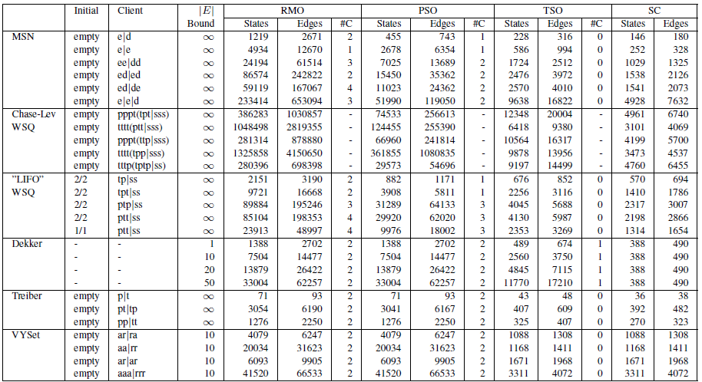
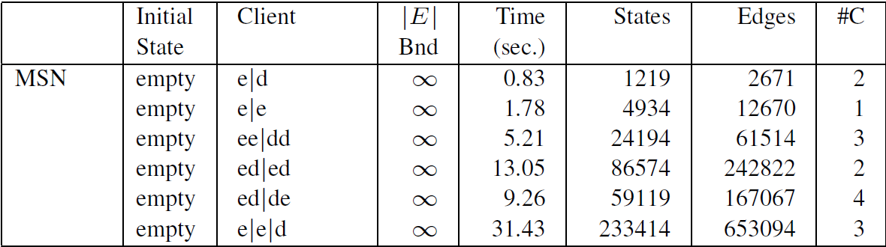
Results

Slide 26
Summary
Fence inference
Finite-state programs
Safe and optimal
Work in progress
Scalability
Abstraction
Over-approximation instead of bounding

