Slide 1
Synthesis of Memory Fences
Michael Kuperstein
Martin Vechev
Eran Yahav
Technion
IBM Research
Technion
(FMCAD’10, PLDI’11)

Slide 2
Textbook Example: Peterson’s Algorithm
Process 0:
while(true) {
store ent0 = true;
store turn = 1;
do {
load e = ent1;
load t = turn;
} while(e == true && t == 1);
//Critical Section here
store ent0 = false;
}
Process 1:
while(true) {
store ent1 = true;
store turn = 0;
do {
load e = ent0;
load t = turn;
} while(e == true && t == 0);
//Critical Section here
store ent1 = false;
}
Specification: mutual exclusion over critical section

Slide 3
Beyond Textbooks: Relaxed Memory Models
Process 0:
while(true) {
store ent0 = true;
store turn = 1;
do {
load e = ent1;
load t = turn;
} while(e == true && t == 1);
//Critical Section here
store ent0 = false;
}
Process 1:
while(true) {
store ent1 = true;
store turn = 0;
do {
load e = ent0;
load t = turn;
} while(e == true && t == 0);
//Critical Section here
store ent1 = false;
}
Re-ordering of operations
Non-atomic stores
Specification: mutual exclusion over critical section

Slide 4
Memory Fences
Enforce order… at a cost
S1; fence; S2 S1 must become observable before S2 starts executing
Fences are expensive
10s-100s of cycles
collateral damage (e.g., prevent compiler opts)
example: removing a single fence yields 3x speedup in a work-stealing queue
Required fences depend on memory model
Where should I put fences?

Slide 5
May Seem Easy…
Process 0:
while(true) {
store ent0 = true;
fence;
store turn = 1;
fence;
do {
load e = ent1;
load t = turn;
} while(e == true && t == 1);
//Critical Section here
store ent0 = false;
}
Process 1:
while(true) {
store ent1 = true;
fence;
store turn = 0;
fence;
do {
load e = ent0;
load t = turn;
} while(e == true && t == 0);
//Critical Section here
store ent1 = false;
}
Specification: mutual exclusion over critical section

Slide 6
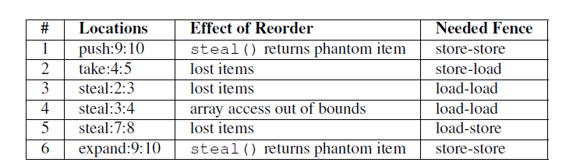
Chase-Lev Work-Stealing Queue
1 int take() {
long b = bottom – 1;
item_t * q = wsq;
bottom = b
long t = top
if (b < t) {
bottom = t;
return EMPTY;
}
task = q->ap[b % q->size];
if (b > t)
return task
if (!CAS(&top, t, t+1))
return EMPTY;
bottom = t + 1;
return task;
}
1 void push(int task) {
long b = bottom;
long t = top;
item_t * q = wsq;
if (b – t >= q->size – 1) {
wsq = expand();
q = wsq;
}
q->ap[b % q->size] = task;
bottom = b + 1;
}
1 int steal() {
long t = top;
long b = bottom;
item_t * q = wsq;
if (t >= b)
return EMPTY;
task = q->ap[t % q->size];
if (!CAS(&top, t, t+1))
return ABORT;
return task;
}
Specification: no lost items, no phantom items, memory safety
Notes:
Chase-Lev queue

Slide 7
Fender
Help the programmer place fences
Find optimal fence placement
Ideal setting for synthesis
Restrict non-determinism (re-ordering) s.t. program stays within set of safe executions
Trivial solution: fence after every store
Hard for a human even for small programs

Slide 8
Goal
Program
P
FENDER
Specification S
Program P’ with Fences
Memory Model
M
P’ satisfies the specification S under M

Slide 9
Naïve Approach: Recipe
Compute reachable states for the program
Compute constraints on execution that guarantee that all “bad states” are avoided
Implement the constraints with fences
Bad News [Atig et. al POPL’10]
Reachability undecidable for RMO
Non-primitive recursive complexity for TSO/PSO
(Even for programs that are finite-state under SC)
(solving a safety game)

Slide 10



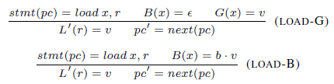
Store Buffers
fence
store
flush
ent0
…
P0
…
ent1
Main
Memory
turn
…
ent0
…
P1
…
ent1
turn
…
load

Slide 11
Unbounded store buffers
Process 0:
while(true) {
store ent0 = true;
store turn = 1;
do {
load e = ent1;
load t = turn;
} while(e == true && t == 1);
//Critical Section here
store ent0 = false;
}
ent0
…
P0
F
T
F
T
ent1
Main
Memory
turn
P1
ent0
ent1
turn

Slide 12
What can we do?
Under-approximate store buffers
Bound the length of execution buffers [KVY-FMCAD’10]
Bound context switches [Bouajjani et al.]
Dynamic synthesis of fences (In progress)
Over-approximate store buffers
Sound abstraction of buffer content [KVY-PLDI’11]

Slide 13
Abstract Interpretation for RMM
Idea: Bounded over-approximation of unbounded buffers
Hierarchy of abstract memory models
Strictly weaker than concrete TSO/PSO
Maintain partial-coherence

Slide 14
First Attempt: Set Abstraction
Process 0:
while(true) {
store ent0 = true;
fence;
store turn = 1;
fence;
do {
load e = ent1;
load t = turn;
} while(e == true && t == 1);
//Critical Section here
store ent0 = false;
}
Process 1:
while(true) {
store ent1 = true;
fence;
store turn = 0;
fence;
do {
load e = ent0;
load t = turn;
} while(e == true && t == 0);
//Critical Section here
store ent1 = false;
}
ent0
…
{ false }
{ }
P0
{ false, true }
{true}
{ }
ent1
…
Main
Memory
{ }
turn
…
{1}
{ }
{ }
ent0
…
P1
{ }
ent1
…
{ }
turn
…
{ }
Represents
B(ent0) = true; false B(ent0) = false; true
…
Abstract each store buffer as a set
Notes:
Last thing fence flushes has to be the last value written…
Not expressive enough to show correctness of the fenced program

Slide 15
Abstract Memory Models - Requirements
Intra-process coherence
a process should see the most recent value it wrote
Preserve fence semantics
The value written to main memory when flushed by a fence is the most recent value stored before the fence
Partial inter-process coherence
preserve as much order information as feasible (bounded)
Enable strong flushes
Sound
Simple construction!

Slide 16
Partial Coherence Abstractions
Allows precise fence semantics
Allows precise loads from buffer
Record what values appeared (without order or number)
Keeps the analysis precise for “well behaved” programs
Recent value
Unordered elements
Bounded length k
ent0
…
P0
ent0
P0
…
Main
Memory
ent1
Main
Memory
ent1
turn
…
turn
ent0
…
P1
ent0
P1
…
ent1
ent1
turn
…
turn

Slide 17
Why does it work?
Well behaved programs have structure
Stores that are important to communicate with other processors are fenced close to the store
Making unbounded number of writes to a memory location without a flush?
Seems esoteric
Your program is suspicious
flag := true
while other_flag = true {
flag := false
//Do something
flag := true
}

Slide 18
Adjusted Recipe
Compute (abstract) reachable states for the program using partial-coherence abstraction
Compute constraints on execution that guarantee that all “bad states” are avoided
Implement the constraints with fences
(solving a safety game with abstraction)

Slide 19
Precision/fences tradeoff
Different abstractions lead to different fences
Guaranteed to be sound – never miss a fence
More precise abstraction – potentially fewer fences
In the paper
SC-Recoverability
PSO as an abstraction of TSO
Partially disjunctive abstraction allows more aggressive merging of buffer, scales better

Slide 20
Synthesis Results
Mostly mutual exclusion primitives
Different variations of the abstraction
Program | FD k=0 | FD k=1 | PD k=0 | PD k=1 | PD k=2
Sense0 |  | ☺ |  | ☺ | ☺
Pet0 | ☺ | ☺ |  |  | ☺
Dek0 | ☺ | ☺ |  |  | ☺
Lam0 | T/O | T/O |  |  | T/O
Fast0 | T/O | T/O | ☹ | T/O | T/O
Fast1a |  |  | ☹ | ☺ | ☺
Fast1b |  |  | ☹ |  | ☺
Fast1c | T/O | T/O | ☹ |  | ☺
Notes:
FD can not handle Lam0, Fas0, Fast1c.
PD can handle Lam0 and Fast0 partially, and Fast1c fully.

Slide 21
Limitations…
More relaxed memory models
Need reasonable concrete semantics first
What if the program is infinite-space?
Or simply large
Partial-coherence isn’t enough
We want to also use “standard” abstract interpretation

Slide 22
Composing Abstractions
Trivial for value abstractions
Abstract buffers of abstract values
Challenging for more complex abstractions
Heap abstractions
Predicate abstractions
Buffers for “abstract locations” (?)
Notes:
Unclear even with concrete WMM

Slide 23
Summary
Partial-coherence abstractions
Verification without context bounds
but possibly with false alarms
Synthesis of fences
Precision affects quality of results
In progress
Combination of abstractions
Scalable (dynamic) fence inference
Other synchronization mechanisms
CCRs [TACAS’09]
Atomic sections [POPL’10]

Slide 24
Invited Questions
Do you ever need to use k>1 ?
In your abstraction, do you ever fall into the unordered set?
How far can we expect this to scale?
Why over-approximation for fence inference?
Can you explain how the inference works?

Slide 25
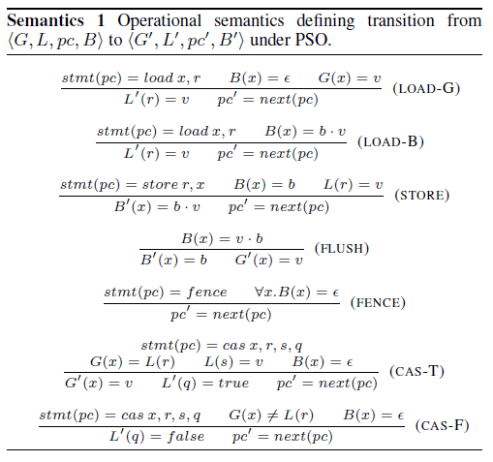

Slide 26
