Slide 1
Pattern-based Synthesis of Synchronization for the C++ Memory Model
Yuri Meshman, Noam Rinetzky, Eran Yahav
Notes:
Sentence entr: Hi, I’m Yuri,
Sentence ext: Our goal is
1. Hi, I’m Yuri
2. Restore correctness to programs correct under SC
3. When the memory model is relaxed
4. Memory order parameters
3. Our goal is

Slide 2
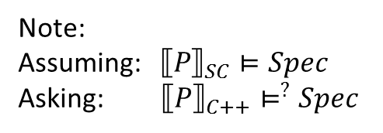
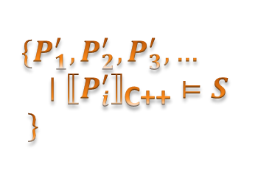
Goal
P
Verified
SynSynCpp
S
$$\{P_{1}^{′},P_{2}^{′},P_{3}^{′},…$$ $∣{←P_{i}^{′}→}_{\text{C}\text{++}}⊨S$
$$\}$$
Note:
Assuming: $←P→_{SC}⊨Spec$
Asking: $←P→_{C++}⊨^{?}Spec$
Notes:
Sentence entr: Our general goal is a tool
Sentence ext: We deal concurrent programs
Our general goal is a tool that
Receives a program and specification
P |= S /SC
P|= S /C++ => verified
Otherwise return P’
We deal concurrent programs

Slide 3
Dekker’s Algorithm
store (flag0, 0);
store (flag1, 0);
store (turn, 0);
Thread 0:
store(flag0, 1);
while(load (flag1) = 1 ){
if(load (turn) =1 ){
store (flag0, 0);
while(load (turn) = 1 ) yield();
store (flag0, 1);
} }
... // critical section
store (turn, 1);
store (flag0, 0);
Thread 1:
store (flag1, 1);
while(load (flag0) = 1 ){
if(load (turn) = 0 ){
store (flag1, 0);
while(load (turn) = 0 )yield();
store (flag1, 1);
} }
... // critical section
store (turn, 0);
store(flag1, 0);
spec: mutual exclusion over critical section
sequential consistency
Yes
Notes:
Sentence entr: This is the type of algorithms we will be dealing with
Sentence ext: Under C++ RMM (..doesn’t hold)
1. This is Dekker mutual exclusion algorithm.
2. Two threads. Each tries to enter CS.
3. S=
1. flag0 indicate intention to enter
2. turn used to solve conflicts both flags raised
3. For SC this holds.
4. Doesn’t hold for C++RMM.

Slide 4
Dekker’s Algorithm
store (flag0, 0);
store (flag1, 0);
store (turn, 0);
Thread 0:
store(flag0, 1);
while(load (flag1) = 1 ){
if(load (turn) =1 ){
store (flag0, 0);
while(load (turn) = 1 ) yield();
store (flag0, 1);
} }
... // critical section
store (turn, 1);
store (flag0, 0);
Thread 1:
store (flag1, 1);
while(load (flag0) = 1 ){
if(load (turn) = 0 ){
store (flag1, 0);
while(load (turn) = 0 )yield();
store (flag1, 1);
} }
... // critical section
store (turn, 0);
store(flag1, 0);
rf
rf
spec: mutual exclusion over critical section
sequential consistency
Yes
C++ relaxed model
No
Notes:
Sentence entr: Doesn’t hold for C++RMM
Sentence ext: To restore mutual exclusion under C++ RMM
1. Doesn’t hold for C++RMM.
2. Each process trying to enter the CS can see the values after the other exited.
3. To restore mutual exclusion we need to add synchronization, by changing the type of memory access.

Slide 5
Dekker’s Algorithm
store_{SC} (flag0, 0);
store_{SC} (flag1, 0);
store_{SC} (turn, 0);
Thread 0:
store_{SC}(flag0, 1);
while(load_{SC} (flag1) = 1 ){
if(load_{SC} (turn) =1 ){
store_{RLX} (flag0, 0);
while(load_{RLX} (turn) = 1 ) yield();
store_{RLX} (flag0, 1);
} }
... // critical section
store_{SC} (turn, 1);
store_{REL} (flag0, 0);
Thread 1:
store_{SC} (flag1, 1);
while(load_{SC} (flag0) = 1 ){
if(load_{SC} (turn) = 0 ){
store_{RLX} (flag1, 0);
while(load_{RLX} (turn) = 0 )yield();
store_{RLX} (flag1, 1);
} }
... // critical section
store_{SC} (turn, 0);
store_{REL}(flag1, 0);
spec: mutual exclusion over critical section
sequential consistency
Yes
Yes
C++ relaxed model
No
Notes:
Sentence entr: To restore mutual exclusion under C++ RMM
Sentence ext: In a nutshell
1. To restore mutual exclusion under C++ RMM
2. we have to add synchronizations mechanisms
3. We add synchronization by specifying instructions shared memory access
4. Adding memory order argument
5. We would like to automatically generate memory order arguments
6. How we do it is:

Slide 6
In a nutshell
Goal Automatic inference of efficient and correct synchronization under C++ memory model.
finite-state programs with bounded executions.
Challenge Adding minimal and correct synchronization.
Solution
Assume maximally relaxed parameters setting and
Iteratively remove behaviors until specification satisfied.
Notes:
Sentence entr: Our Goal is
Sentence ext: How we do it is:
1. Our Goal is
2. Too restrictive => Hinder performance
3. Assume maximal relaxed squares
4. Remove bad behaviors until specification is satisfied again.
5. Lets see an example

Slide 7
Dekker’s Algorithm
store_{RLX} (flag0, 0);
store_{RLX}(flag1, 0);
store_{RLX}(turn, 0);
store flag0, 0
Thread 0:
store_{RLX} (flag0, 1);
while(load_{RLX} (flag1) = 1 ){
if(load_{RLX} (turn) =1 ){
store_{RLX} (flag0, 0);
while(load_{RLX} (turn) = 1 ) yield();
store_{RLX} (flag0, 1);
} }
... // critical section
store_{RLX} (turn, 1);
store_{RLX} (flag0, 0);
sb
Thread 1:
store_{RLX} (flag1, 1);
while(load_{RLX} (flag0) = 1 ){
if(load_{RLX} (turn) = 0 ){
store_{RLX} (flag1, 0);
while(load_{RLX} (turn) = 0 )yield();
store_{RLX} (flag1, 1);
} }
... // critical section
store_{RLX} (turn, 0);
store_{REL}(flag1, 0);
store flag1, 0
sb
store turn, 0
asw
asw
store flag0, 1
store flag1, 1
sb
sb
load flag1
load flag0
critical section
rf
critical section
sb
sb
store turn, 1
rf
store turn, 0
sb
sb
store flag0, 0
store flag1, 0
Notes:
Sentence entr: assume max relaxed parameters
Sentence ext: receive an execution

Slide 8
What is an execution
store flag0, 0
sb
Execution trace is:
Instructions
relations: total/partial orders
Axioms on those relations
store flag1, 0
sb
store turn, 0
asw
asw
store flag0, 1
store flag1, 1
sb
sb
load flag1
load flag0
critical section
rf
critical section
sb
sb
store turn, 1
rf
store turn, 0
sb
sb
*rf – read from sb – sequence before asw – additionally synchronize with
sw – synchronize with
store flag0, 0
store flag1, 0
Notes:
Sentence entr: We have a trace
Sentence ext: this is an error trace
1. We have a trace
2. No details
3. Blue transitively orders the instructions 4. Brown does not. E.g. rf goes from store to load
5. This is error

Slide 9
Error trace 1 → find pattern LB
store flag0, 0
sb
load buffering
store flag1, 0
sb
store turn, 0
asw
asw
store flag0, 1
store flag1, 1
sb
sb
load flag1
load flag0
critical section
rf
critical section
sb
sb
store turn, 1
rf
store turn, 0
sb
sb
*rf – read from sb – sequence before asw – additionally synchronize with
sw – synchronize with
store flag0, 0
store flag1, 0
Notes:
Sentence entr: mutual exclusion breach
Sentence ext: to prevent it

Slide 10
Error trace 1 prevented
store flag0, 0
sb
store flag1, 0
sb
store turn, 0
asw
asw
store flag0, 1
store flag1, 1
sb
sb
load_{ACQ} flag1
load flag0
critical section
rf
critical section
sb
sw
sb
store turn, 1
rf
store turn, 0
sb
sb
*rf – read from sb – sequence before asw – additionally synchronize with
sw – synchronize with
store flag0, 0
store_{REL} flag1, 0
Notes:
Sentence entr: adding memory order parameters prevents the trace
Sentence ext: load flag0 reads from the top most intialization store

Slide 11
Dekker’s Algorithm
store_{RLX} (flag0, 0);
store_{RLX}(flag1, 0);
store_{RLX}(turn, 0);
Thread 0:
store_{RLX} (flag0, 1);
while(load_{ACQ} (flag1) = 1 ){
if(load_{RLX} (turn) =1 ){
store_{RLX} (flag0, 0);
while(load_{RLX} (turn) = 1 ) yield();
store_{RLX} (flag0, 1);
} }
... // critical section
store_{RLX} (turn, 1);
store_{RLX} (flag0, 0);
Thread 1:
store_{RLX} (flag1, 1);
while(load_{RLX} (flag0) = 1 ){
if(load_{RLX} (turn) = 0 ){
store_{RLX} (flag1, 0);
while(load_{RLX} (turn) = 0 )yield();
store_{RLX} (flag1, 1);
} }
... // critical section
store_{RLX} (turn, 0);
store_{REL}(flag1, 0);
spec: mutual exclusion over critical section
sequential consistency
Yes
C++ relaxed model
No
Notes:
Sentence entr: receive a placement
Sentence ext: still errors traces but preventing all…

Slide 12
Dekker’s Algorithm
store_{SC} (flag0, 0);
store_{SC} (flag1, 0);
store_{SC} (turn, 0);
Thread 0:
store_{SC}(flag0, 1);
while(load_{SC} (flag1) = 1 ){
if(load_{SC} (turn) =1 ){
store_{RLX} (flag0, 0);
while(load_{RLX} (turn) = 1 ) yield();
store_{RLX} (flag0, 1);
} }
... // critical section
store_{SC} (turn, 1);
store_{REL} (flag0, 0);
Thread 1:
store_{SC} (flag1, 1);
while(load_{SC} (flag0) = 1 ){
if(load_{SC} (turn) = 0 ){
store_{RLX} (flag1, 0);
while(load_{RLX} (turn) = 0 )yield();
store_{RLX} (flag1, 1);
} }
... // critical section
store_{SC} (turn, 0);
store_{REL}(flag1, 0);
spec: mutual exclusion over critical section
sequential consistency
Yes
Yes
C++ relaxed model
No
Notes:
Sentence entr: receive a solution
Sentence ext: Back to the general goal

Slide 13
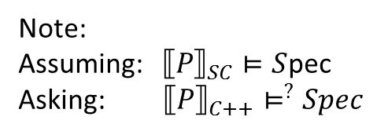
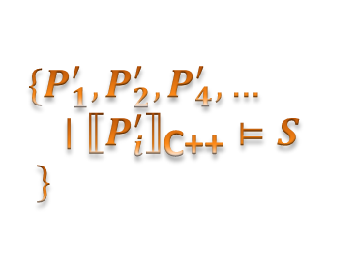
Goal
P
Verified
SynSynCpp
$$\{P_{1}^{′},P_{2}^{′},P_{4}^{′},…$$ $∣{←P_{i}^{′}→}_{\text{C}\text{++}}⊨S$
$$\}$$
S
Note:
Assuming: $←P→_{SC}⊨S$pec
Asking: $←P→_{C++}⊨^{?}Spec$
Notes:
Sentence entr: Our general goal is a tool
Sentence ext: More specifically about our tool

Slide 14

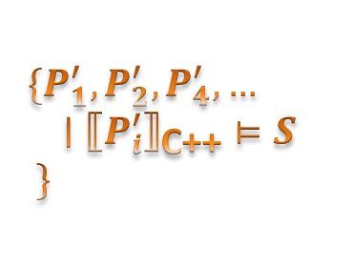


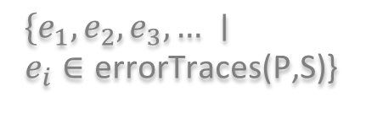
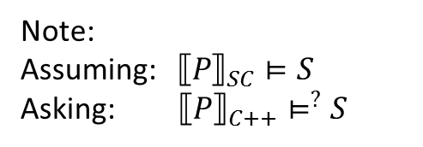
Synthesis of Synchronization for the C++ Memory Model
SynSynCpp
S
Model Checker
Verified
P
$$\{e_{1},e_{2},e_{3},… ∣$$
$e_{i}∈\text{errorTraces}\text{(}\text{P}\text{,}\text{S}\text{)}$}
$$SAT$$
$$φ$$
Detect patterns and avoid traces
All solutions to $φ$
$$\{P_{1}^{′},P_{2}^{′},P_{4}^{′},…$$ $∣{←P_{i}^{′}→}_{\text{C}\text{++}}⊨S$
$$\}$$
implement
Note:
Assuming: $←P→_{SC}⊨S$
Asking: $←P→_{C++}⊨^{?}S$
Notes:
Sentence entr: The program P and Specification S got to a model checker
Sentence ext: Challenges
1. P , S to model checker
2. model checker => verified / error traces.
3. error trace => collect preventions
4. each pattern => specific correction
5. all correction => phi =>SAT
6. SAT=> all solutions to \phi
7. memory access parameters to P
7. This gives all solution to the program
8. Challenges

Slide 15
Challenges
ModelChecker: Enumerate error traces?
How to detect patterns and avoid traces?
How to collect all blocked bad traces and produce a solution?
CDSchecker
Notes:
Sentence entr: Our challenges are
Sentence ext: The steps of our approach
1. CDSChecker does enumeration of all traces using DPOR and return all error traces violating the specification.

Slide 16
Step 1: Get an error trace
store flag0, 0
sb
store flag1, 0
sb
store turn, 0
asw
asw
store flag0, 1
store flag1, 1
sb
sb
load flag1
load flag0
critical section
rf
critical section
sb
sb
store turn, 1
rf
store turn, 0
sb
sb
store flag0, 0
store flag1, 0
Notes:
Sentence entr: Step 1 get error trace
Sentence ext: Step 2

Slide 17
Step 2: Find a pattern
Load Buffering pattern
load flag1
load flag0
sb
sb
rf
store flag0, 0
store flag1, 0
Notes:
Sentence entr: find pattern – in this case
Sentence ext: specific way to prevent pattern

Slide 18
Step 3: block the pattern
Load Buffering pattern
ACQ -- load flag1
ACQ -- load flag0
REL -- store flag0, 1
REL -- store flag1, 1
repeat 1-3 for all error traces
Notes:
Sentence entr: Two ways to prevent the pattern
Sentence ext: constract \phi
1. Two ways to prevent the pattern
2. Repeat 1-3.
3. Constract \phi

Slide 19






Step 4: construct $φ$
$$b_{1}$$
ACQ -- load flag1
$$b_{3}$$
ACQ -- load flag0
$$b_{2}$$
REL -- store flag0, 1
$$b_{4}$$
REL -- store flag1, 1
$$f_{Op1−To−Prevent−ErrTrace1}=b_{1}∧b_{4}$$
$$f_{Op2−To−Prevent−ErrTrace1}=b_{3}∧b_{2}$$
$$f_{Prevent−ErrTrace1}=f_{Op1−To−Prevent−ErrTrace1}∨f_{Op2−To−Prevent−ErrTrace1}∨…$$
$$φ=f_{Prevent−ErrTrace1}∧f_{Prevent−ErrTrace2}∧…$$
Notes:
Sentence entr: construct \phi
Sentence ext: feed \phi
1. To construct \phi add bools
2. Create bools
3. single option to prevent a trace
4. disjunction of all options to prevent a single trace
5. The function phi holds how to make the program correct by preventing all error traces
6. We take the phi we receive and feed it to a SAT solver

Slide 20





Step 5: Constructing Program Solution
$$b_{1}$$
ACQ -- load flag1
$$b_{3}$$
ACQ -- load flag0
$$b_{2}$$
REL -- store flag0, 1
$$b_{4}$$
REL -- store flag1, 1
$$SAT$$
avoidance = $\left\{b_{0}∧b_{1}∧b_{7}∧…,b_{2}∧b_{7}∧…,…\right\}$
$$φ$$
sol1
sol2
All solutions to $φ$
$$implement$$
Notes:
Sentence entr: The sat solver gives us the solutions to phi
Sentence ext: What are the patterns?
SAT => all solutions
Each solution => all error traces
b => synchronization/ memory order parameters
specific solution we need and implement it.

Slide 21
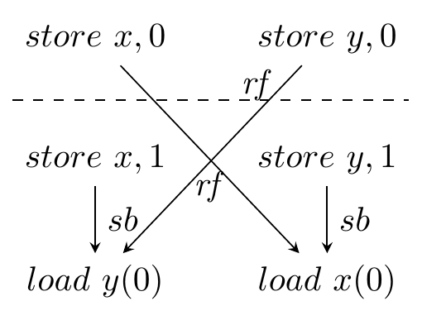
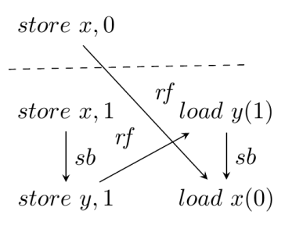
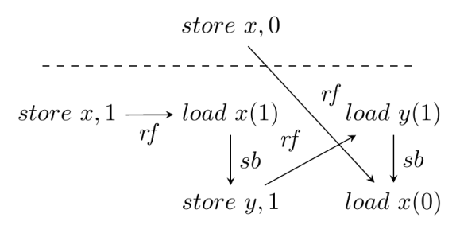
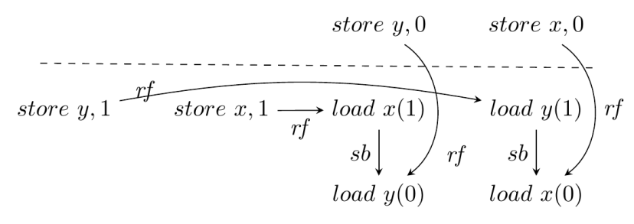
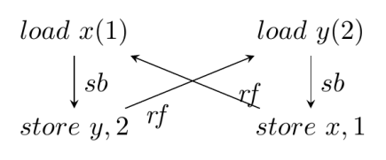
Litmus test patterns
First approach:
From litmus tests to patterns
(Store Buffering)
(Message Passing)
(Write Read Causality)
(Independent Reads Independent Writes)
(Load Buffering)
Notes:
Sentence entr: first intuition litmus
Sentence ext: lets abstract LB
1. first intuition litmus
2. Used to show C++
4. Each litmus test has its own way to be corrected.
3. Load buffering
4. Store buffering on x86 TSO
5. Non complete since
6. Lets abstract LB

Slide 22
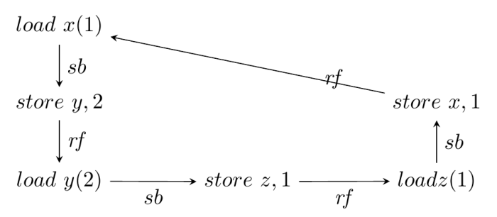
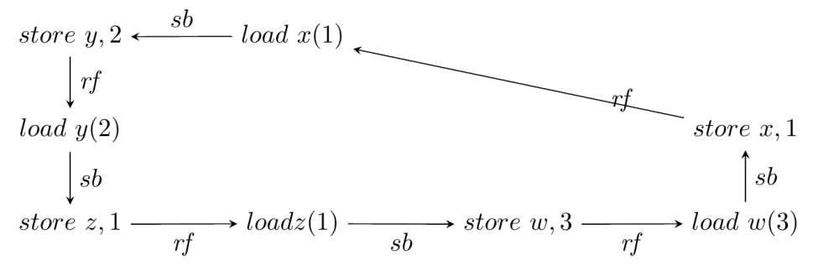
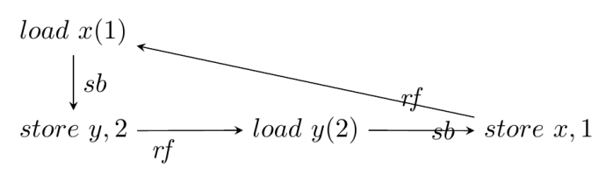
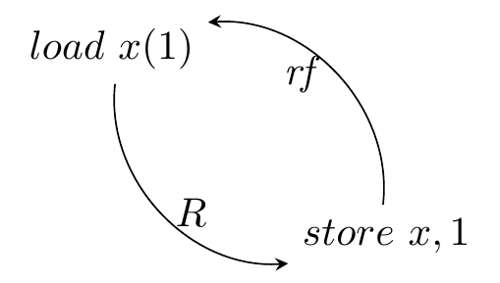
Patterns relaxation
Abstraction
Abstraction
Generalization
Unwinding
the cycle
(Load Buffering)
Notes:
Sentence entr: LB is a scycle
Sentence ext: generalize this leads to two patterns
1. LB => cycle
2. Unwind
3. Prevent REL-ACK
4. Extend to two pairs of load-store
5. 3 pairs
6. generalize

Slide 23
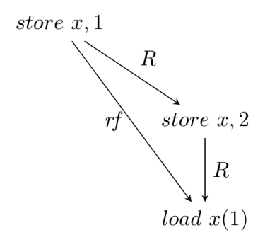
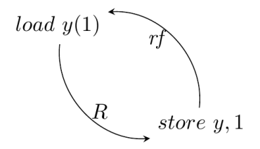
Abstract patterns
based on C++RMM RD property
RD_CL
RD_MS
Cycle
Missed Store
R one of two:
R = hb U rf --- preventable with Rel-Acq synchronization
R = possible order of instruction – preventable with SC
Notes:
Sentence entr: Those two abstract patterns are shown
Sentence ext: Those patterns gaves us our best results
Those two abstract patterns are shown
The R relation can be rfUsbUasw --- then the correction is by REL-ACQ
Or if we cannot find such relations R
It can be a possible execution order of the shown instruction – then the prevention is by adding those instructions to SC
A different way to reach the same abstract patterns is by looking at possible corrections at our disposal
A load must read from the last instruction before it in hb. We can add rf to hb
An SC load must read from the last Store that is in SC before it.
Those patterns gaves us our best results

Slide 24
Benchmarks
9 concurrent algorithms
Mutual exclusion algorithms
RCU where an update waits only for the reads whose consistency it affects
Safety specifications
mutual exclusion and reachability invariants
stack/RCU coherence invariants
Notes:
Sentence entr: We ran on 9 concurrent algorithms
Sentence ext: The results
We ran on 9 concurrent algorithms
Some mutual exclusion like dekker
Two versions of an RCU algorithm recently published
The specification was mutual exclusion or coheresion of shared structures

Slide 25
Results
Algorithm | Time (s) | # minimal solutions | Inferred synchronization (SC, REL, ACQ, RLX)
abp | 20s.89 | 5 | (5, 0, 0, 1), (4, 0, 0, 2), …
dekker | 3m:22 | 13 | (10, 1, 0, 8), (13, 0, 1, 5), …
d-prcu-v1 | 3m:14 | 7 | (7, 2, 1, 0), (7, 1, 0, 2), …
d-prcu-v2 | 3h:53m | 17 | (9, 2, 1, 4), (12, 1, 1, 2), ...
Kessel | 57m:16 | 2 | (13, 1, 0, 0), (14, 0, 0, 0)
peterson | 26m:41 | 2 | (11, 1, 0, 1), *(12, 1, 0, 0), (13, 0, 0, 0)
bakery | 10m:21 | 6 | (16, 1, 1, 0), (17, 0, 1, 0), …
ticket | 1m:08 | 4 | (9, 0, 0, 1), (8, 0, 0, 2), …
treiber stack | 1h:05 | 1 | (0, 5, 3, 4)
Memory access patterns hierarchy
RLX
REL
ACQ
SC
Notes:
Sentence entr: The results
Sentence ext: We have a tool
1. The results
2. Synthesis varies from few minutes to few hours
3. 4 element tuple 1=>SC; 4=>RLX; REL/ACQ middle
4. Not trivial
5. In summary

Slide 26
Synthesis of Synchronization for the C++ Memory Model
SynSynCpp
S
Model Checker
Verified
P
$$\{e_{1},e_{2},e_{3},… ∣$$
$e_{i}∈\text{errorTraces}\text{(}\text{P}\text{,}\text{S}\text{)}$}
$$SAT$$
$$φ$$
avoidance
Detect patterns and avoid traces
$$\{P_{1}^{′},P_{2}^{′},P_{4}^{′},…$$ $∣{←P_{i}^{′}→}_{\text{C}\text{++}}⊨S$
$$\}$$
implement
Note:
Assuming: $←P→_{SC}⊨S$
Asking: $←P→_{C++}⊨^{?}S$
Notes:
Sentence entr: We have a tool receiving P,S
Sentence ext: Before summary show small example
1. We have a tool receiving P,S outputing verified/P’
2. Before summary show small example

Slide 27
Summary
Tool: http://www.cs.technion.ac.il/~yurime/SynSynCpp/SynSynCppTool_v1stat.htm
Synthesis procedure for inferring memory order synchronizations for C++ RMM
Searching for violation patterns
Generalized concrete patterns to abstract ones
Successfully synthesized nontrivial memory order synchronization for challenging algorithms
Future Work:
Violation patterns and avoidance templates are not complete
Finite-state programs with bounded executions.
Notes:
Sentence entr: In summary
Sentence ext: Questions?

