Slide 1
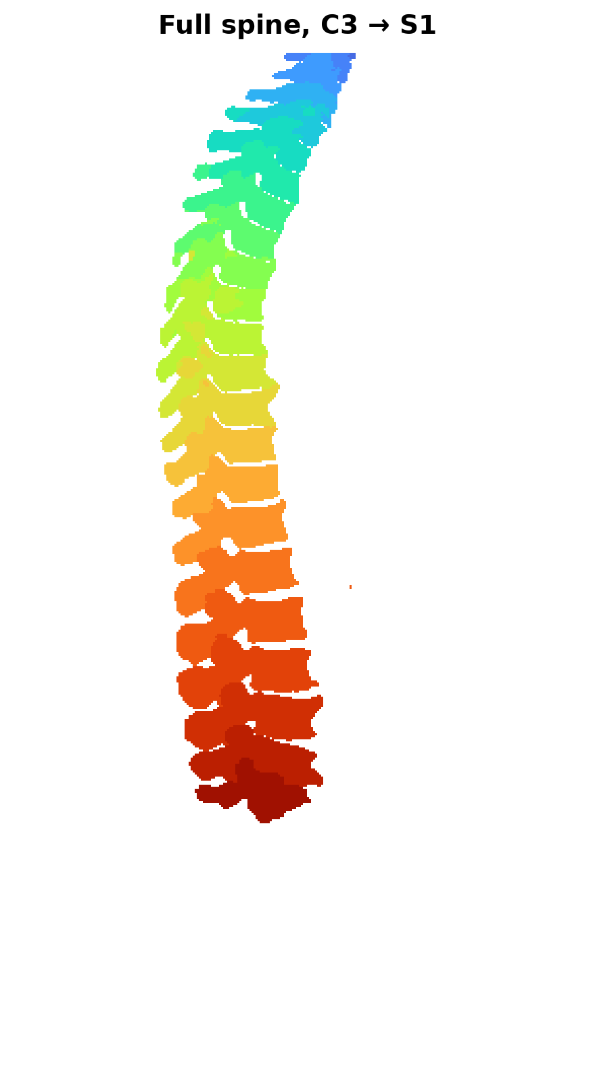
MEDICAL IMAGING · DEEP LEARNING
Automatic Spine
Segmentation
Labelling 25 individual vertebrae in CT scans with a self-configuring 3D U-Net
0.874
1,089
25
Dice, held-out
CT scans
vertebrae
Luis Prada · July 2026
Notes:
nnU-Net v2 multiclass segmentation of the spine. 1,089 CT scans from TotalSegmentator, 25 vertebra classes plus background. Final Dice of 0.874 on 218 scans the model never saw during training.

Slide 2
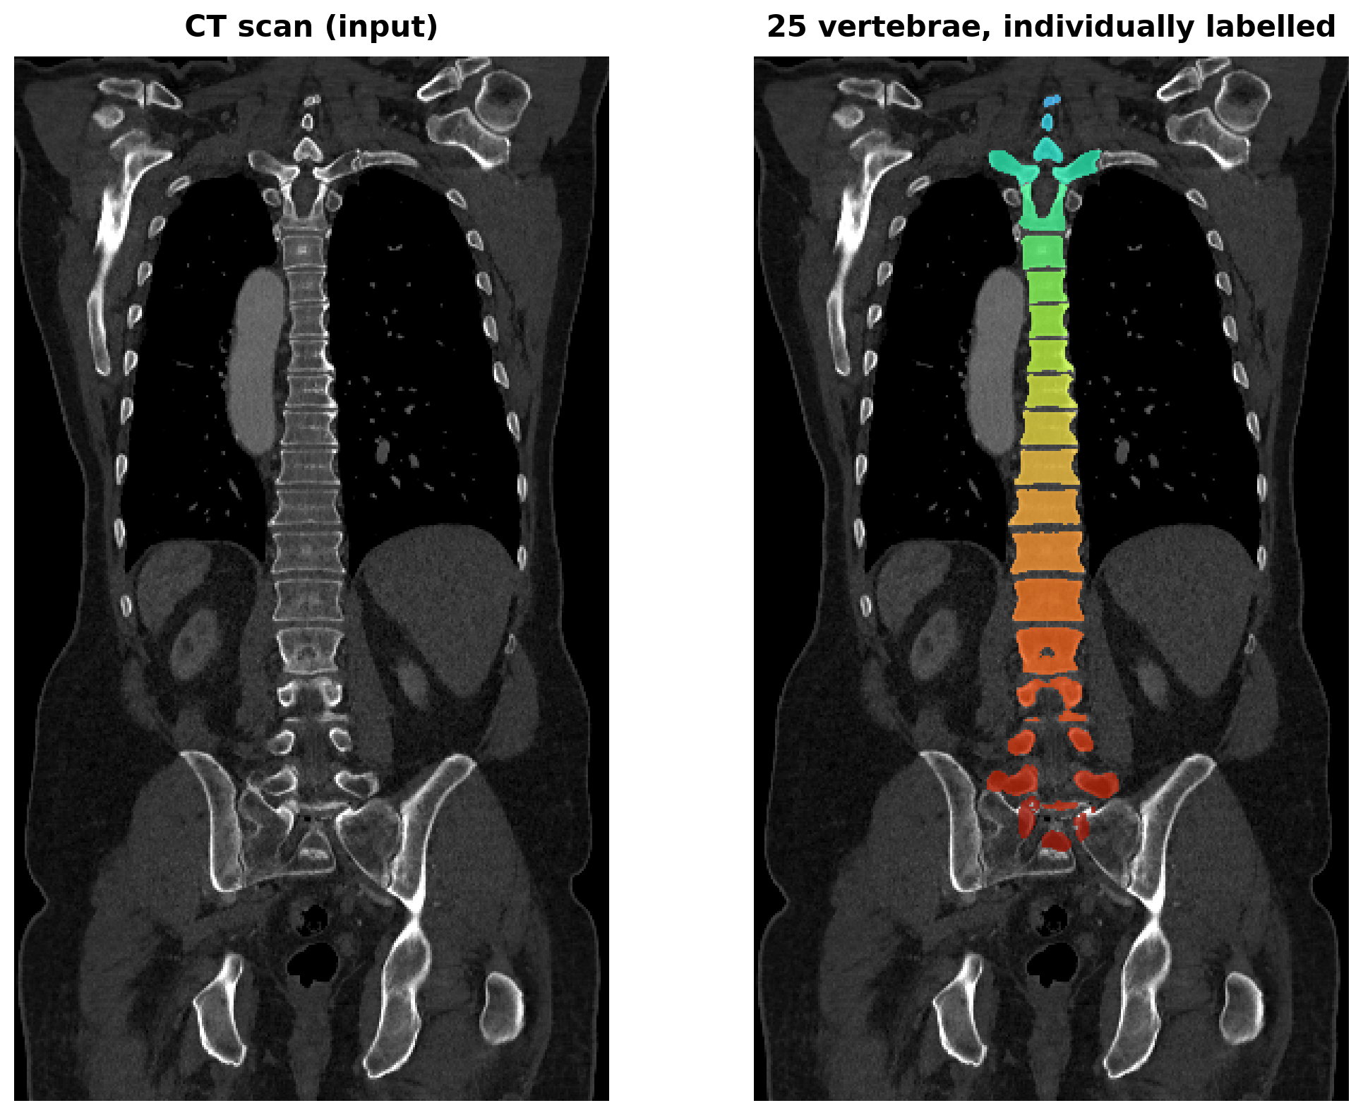
Why automate it
Vertebra-level labelling is the bottleneck in spine imaging
1
Manual segmentation is slow
Outlining 25 separate bones across hundreds of slices is painstaking, and it repeats for every patient.
2
It doesn't scale
Surgical planning, implant sizing and deformity tracking all need per-vertebra geometry.
3
Counting is error-prone
Vertebrae look nearly identical. Miscounting by one shifts every label below it.
Input: one CT volume → Output: 25 separately identified bones
Notes:
The task is multiclass, not binary. The model must not only find bone, it must know which vertebra it is looking at.

Slide 3
What was built
End-to-end pipeline, from raw scans to a measured model
DATA
MODEL
COMPUTE
1,089
3D U-Net
RTX 4090
paired CT scans
nnU-Net v2, full resolution
rented, 24 GB
871 / 218
128³
2h 10m
train / held-out
patch size, auto-chosen
training time
26
250
$2.42
classes with background
epochs, single fold
total cost
Source: TotalSegmentator via Kaggle (CC BY 4.0) · Split fixed with seed 42 for reproducibility
Notes:
The 218 held-out scans were separated before any training and never touched until final evaluation. nnU-Net cross-validates internally on the 871.

Slide 4
No architecture was designed by hand
nnU-Net reads the dataset and configures itself
What I specified
What nnU-Net decided
Folder structure and file naming
Modality is CT
25 vertebra labels
Train / hold-out split
Number of epochs
Patch size 128×128×128, batch size 2
6-stage encoder, 32→320 filters
Resample everything to 1.5 mm
CT intensity normalisation
Rejected a low-res cascade as unhelpful
The engineering leverage sits in data preparation, not model design — if the input format is wrong, there is no architecture to blame.
Notes:
This is the core idea of nnU-Net. It inspects image sizes, spacing and available GPU memory, then derives the architecture and training schedule automatically.

Slide 5
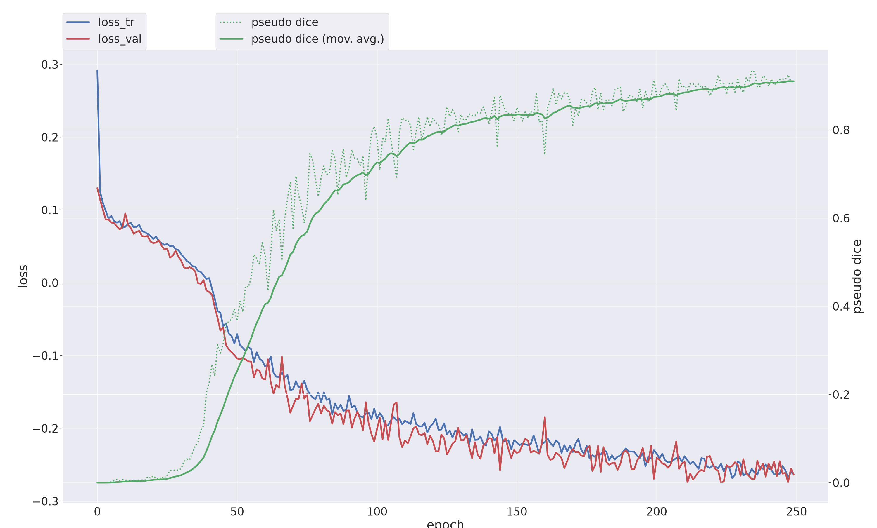
Training behaviour
250 epochs, 2 hours 10 minutes on a single RTX 4090
Flat until epoch ~30
With 26 classes the network first learns to predict background everywhere.
Then a sharp climb
Dice rises from 0.02 to 0.83 between epochs 30 and 150.
No overfitting
Training and validation loss track each other to the final epoch.
Loss is negative because nnU-Net minimises a combined Dice + cross-entropy objective — lower is better.
Notes:
The plateau at the start is expected for multiclass segmentation with heavy class imbalance. Roughly 99 percent of voxels are background.

Slide 6
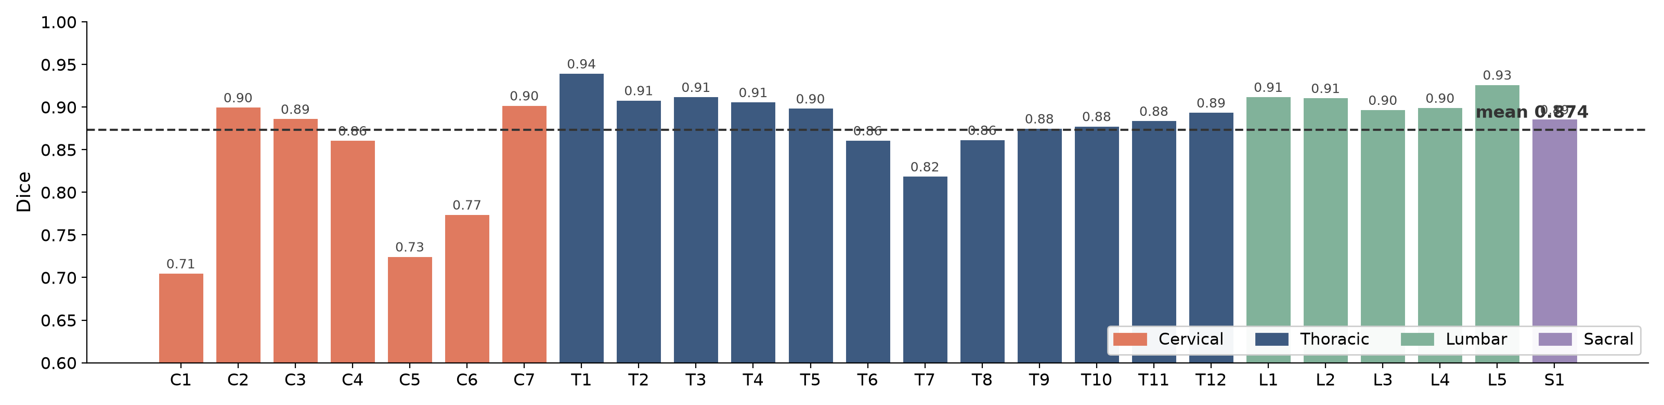
Results on 218 unseen scans
Held out before training, evaluated once at the end
0.874
0.831
0.940
0.706
Mean Dice
Mean IoU
Best vertebra (T1)
Worst vertebra (C1)
Dice measures overlap between prediction and expert annotation: 1.0 is perfect, 0 is no overlap.
Notes:
For reference the published tutorial this replicates reported 0.85 on its evaluation set. Internal cross-validation Dice was 0.884.

Slide 7
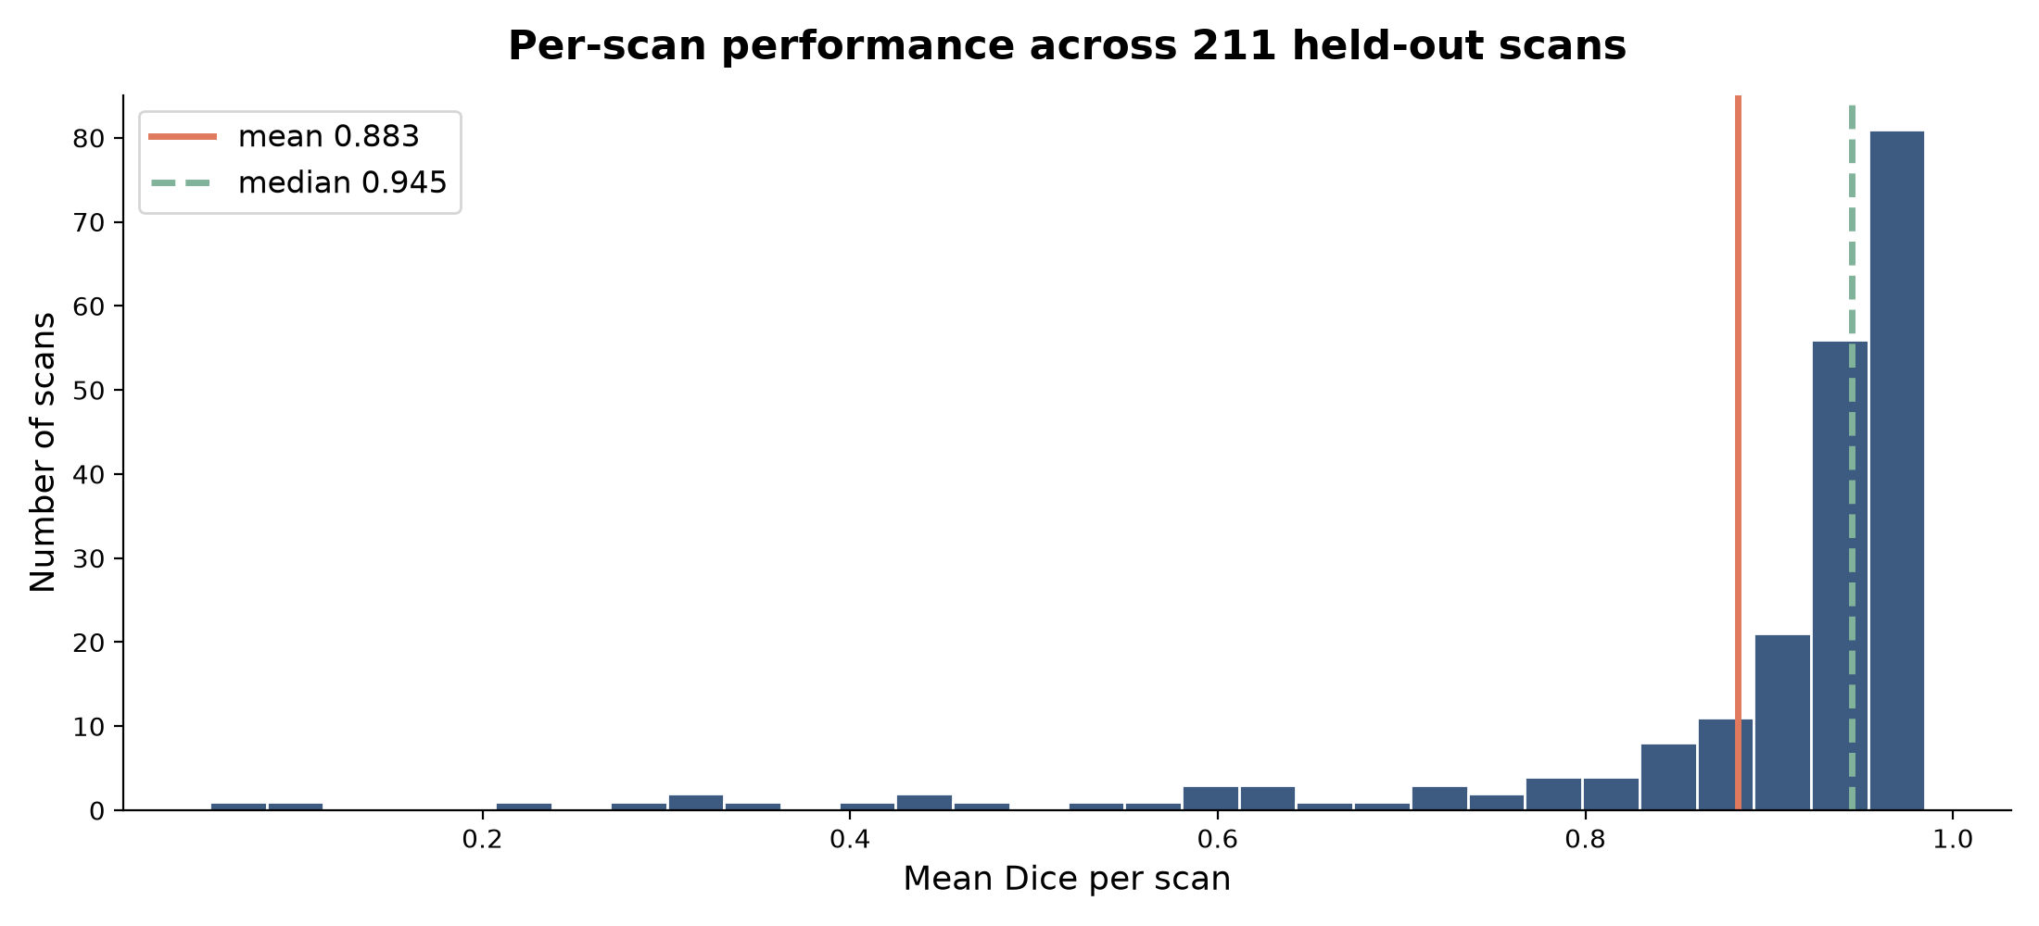
Where it struggles — and why
Every weak class is in the neck
Two causes
Small structures are punished
C1 averages ~730 voxels; L1 averages ~10,300. A handful of wrong voxels costs far more Dice on a small bone.
Cervical scans are rarer
Most CT studies in the dataset are chest or abdomen. The neck is often clipped at the edge of the field of view.
155 of 218
15 of 218
scans scored 0.90 or higher
scans fell below 0.60
Next step: add cervical-weighted training data rather than more epochs.
Notes:
The per-class breakdown is the actionable output. It says where to add data, not just that the model is 87 percent accurate.

Slide 8
Summary
Strongest through the trunk
1
Every thoracic and lumbar vertebra scores between 0.82 and 0.93 — the regions most used for surgical planning.
Data preparation is the real work
2
Model design was automated. Pairing, geometry checks and a reproducible split were where the engineering went.
Cheap to reproduce
3
$2.42 and 4.4 hours end to end on rented hardware, fully scripted and re-runnable.
nnU-Net v2 · 3d_fullres · 250 epochs · TotalSegmentator data (CC BY 4.0)
Notes:
Takeaway for a technical interview: the interesting engineering is the data pipeline and the evaluation design, not the architecture.

