Slide 1

Experiential Learning
UE20CS316: HCI_EL5
Team No:__10__
SRN PES2UG20CS510 NAME HARIPRADA
SRN PES2UG20CS508 NAME DEEPU DARSHAN S
SRN PES2UG20CS484 NAME SHIVA KS

Slide 2




UE20CS316: Human Computer Interaction-Experiential Learning

Slide 3
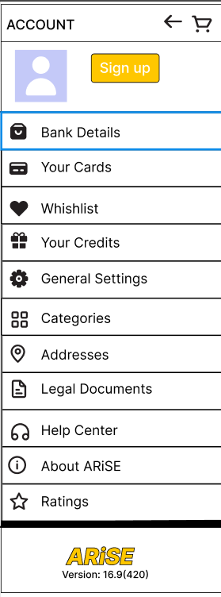
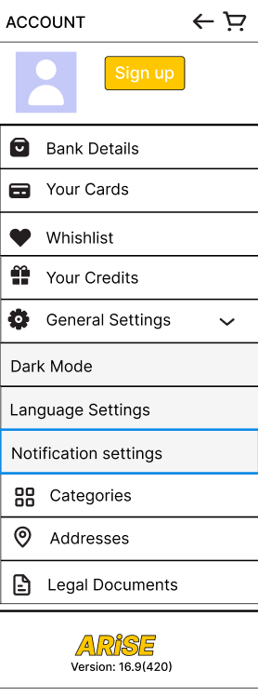
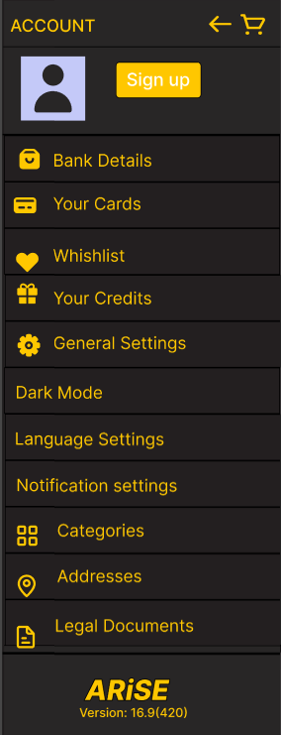
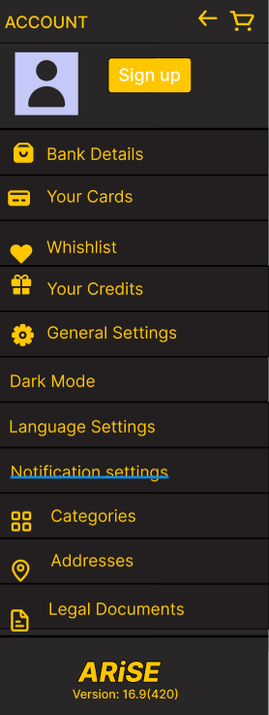
UE20CS316: Human Computer Interaction-Experiential Learning

Slide 4
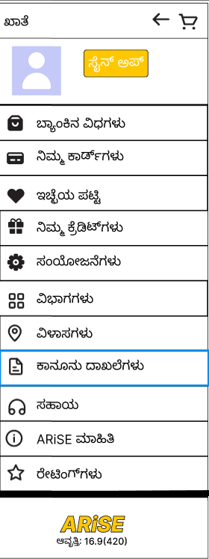
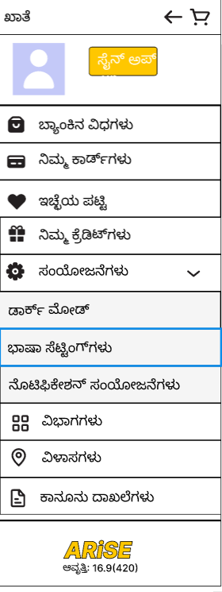
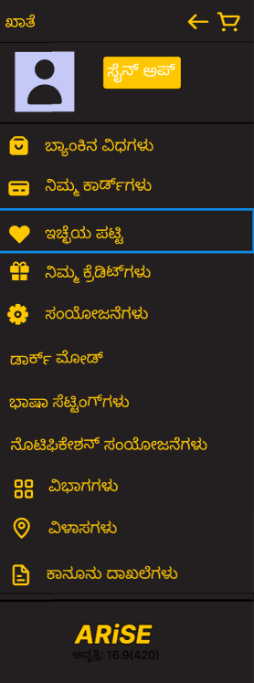
UE20CS316: Human Computer Interaction-Experiential Learning

Slide 5




UE20CS316: Human Computer Interaction-Experiential Learning

Slide 6
UE20CS316: Human Computer Interaction-Experiential Learning

Slide 7
UE20CS316: Human Computer Interaction - Hackathon
Add figma link of complete presentation
https://www.figma.com/file/DxjaIloN8yWLAw5eqPv8xZ/site?node-id=0%3A1&t=0D5kdDIq7EPKb64K-0

Slide 8
UE20CS316: Human Computer Interaction - Hackathon
Add figma link of complete presentation
https://www.figma.com/proto/DxjaIloN8yWLAw5eqPv8xZ/site?node-id=31%3A16&scaling=scale-down&page-id=0%3A1&starting-point-node-id=31%3A16&show-proto-sidebar=1

Slide 9

THANK YOU
Team Member Names
Hariprada PES2UG20CS510
DEEPU DARSHAN S PES2UG20CS508
SHIVA KS PES2UG20CS484
Notes:
sudo nano /etc/hostname

