Slide 1
Revolutionizing Agriculture: The Role of Robotics in Modern Farming

Slide 2
AGENDA
AGRICULTURE
DIFFICULTIES FACED IN AGRICULTURE
ROBOTICS IN AGRICULTURE
ADVANTAGES
AGRIBOT
AGRIBOT’SDESIGN

Slide 3
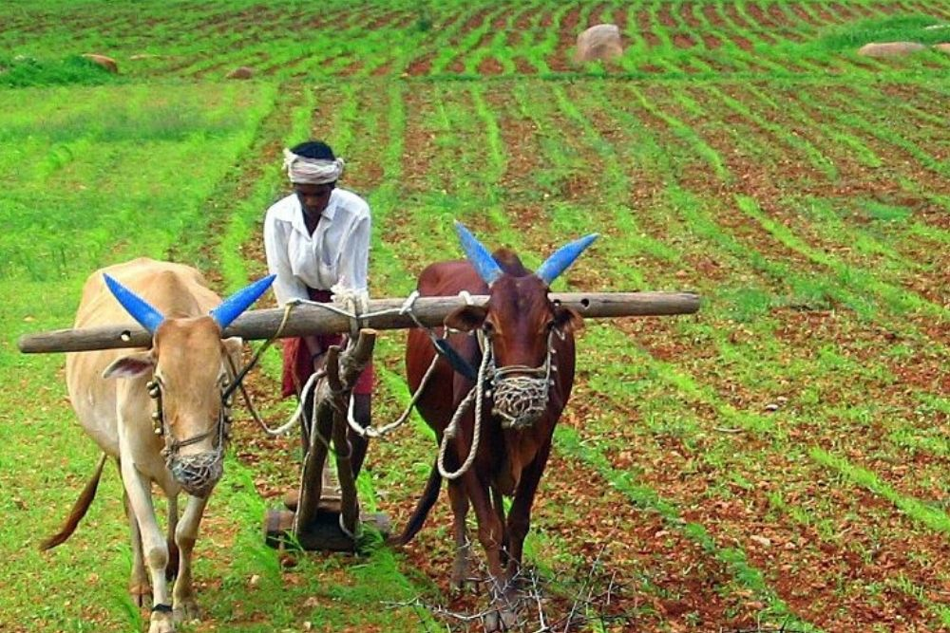
AGRICULTURE
Agriculture is the practice of cultivating the land, growing crops, and raising livestock. It involves preparing plant and animal products for consumption and distributing them to markets. Agriculture is a crucial source of food and materials like cotton, wool, and leather. It also supplies wood for construction and paper production. Agriculture products and methods differ across regions worldwide.

Slide 4
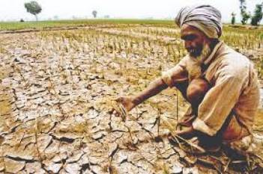
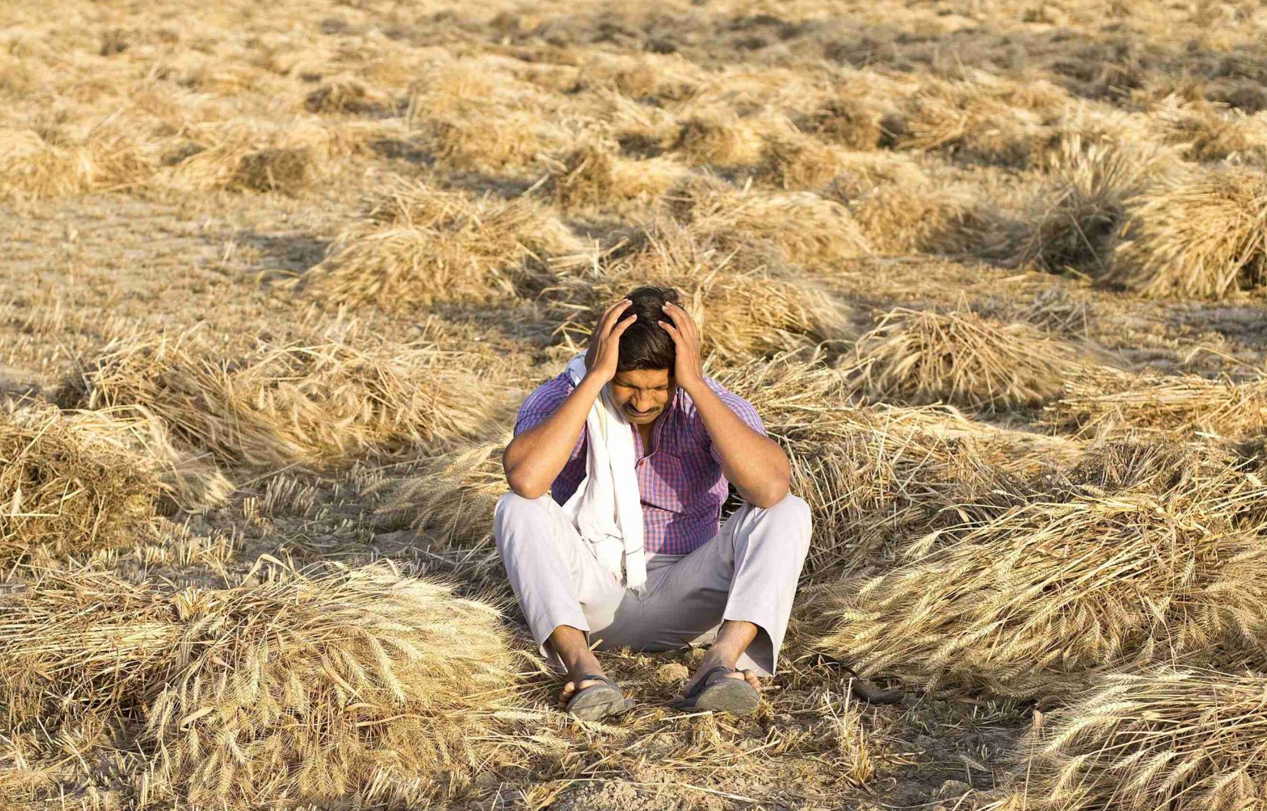
DIFFICULTIES FACED IN AGRICULTURE
Inadequate irrigation
Labor-intensive tasks like seeding and plowing, and crop management.
The difficulties of finding laborers.
Farmers struggle with limited knowledge of environmental conditions and pest control.

Slide 5
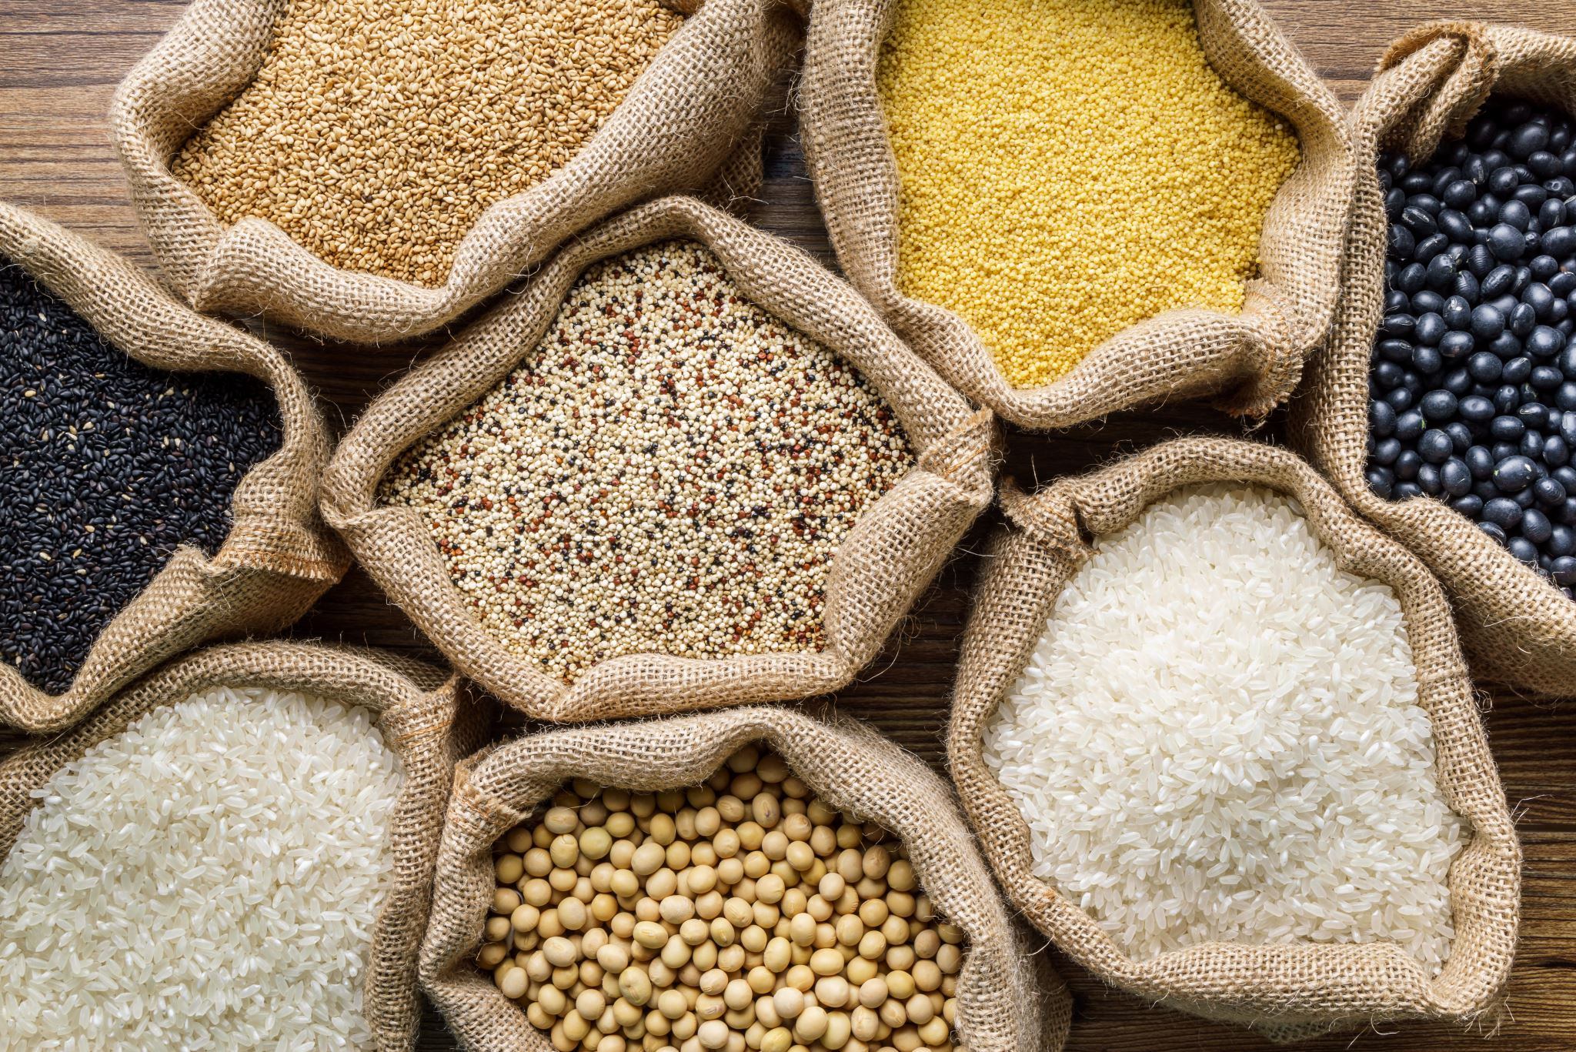
ROBOTICS IN AGRICULTURE
Robots and automation have become integral parts of farming and food production processes. They perform both complex and simple tasks, such as monitoring crops, measuring soil pH levels, picking and packing fruits and vegetables, and planting seeds. Automation is also used for ventilation systems, air control for livestock, milk production, and arable irrigation.
Seeding
Harvesting
Packing
Palletizing
Crop maintenance
Livestock applications

Slide 6

ADVANTAGES
Precision Farming
Monitoring and data collection
24/7 operations
Environmental Benefits
Risk Reduction

Slide 7
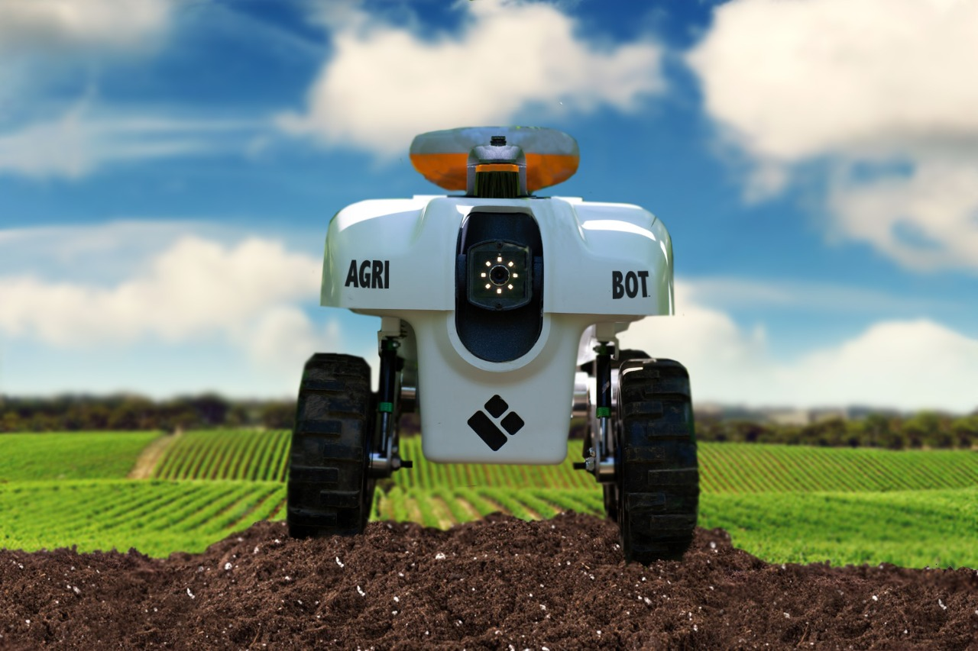
AGRIBOT
Agribot is an agricultural robot created to reduce the labor required for farming tasks while enhancing work speed and precision. It autonomously performs essential farming functions such as plowing fields, seeding, and covering seeds with soil. The robot features an optional plowing system switch and is controlled by a PSoC(Programmable System On Chip) controller from Cypress Semiconductor in the USA.

Slide 8

The introduction of robots in smart farming takes it to the next level, allowing for seeding, cropping, disease identification, and more. While some machines for these tasks have significant power and drawbacks like soil disruption, noise, and pollution, the AgriBot offers a lightweight, cost-effective, and eco-friendly alternative. It efficiently maps and seeds the field, particularly suited for small seeds in large areas, and can be easily operated through a user-friendly mobile app.

Slide 9


DESIGN
Android mobile application is available for the AgriBot. The app is designed using Android Studio
The robot is used to plant seeds over a farming area.
AWS server is used as the webserver for the AgriBot.

Slide 10
Thank you

