Slide 1
Restaurant Default Model
Pradeep Arkachar

Slide 2
Executive summary
Per the goal of this exercise, a couple of loan underwriting risk models have been developed to predict the likelihood of a restaurant loan going default.
The table below shows the summary metrics of the models. Results show that the gradient-boosting model marginally outperforms the logistic regression model.
 | Train (75%) AUC | Test(25%) AUC | Train (75%) KS | Test(25%) KS
Logistic Regression | 80% | 77% | 47% | 42%
Gradient Boosting Tree | 81% | 77% | 48% | 44%
The provided holdout data is scored using the gradient-boosting model.
An illustration of the credit decisioning system is presented to demonstrate how the underwriting model is typically used in the loan application process

Slide 3
Data
The train data contains the 365 days of daily processing volume ($) data, which includes restaurant account information such as ownership type, Restaurant category, and market segment. There is also a loan default status provided for these restaurants.
 | Observations | Unique Restaurants | Defaults | Default Rate
Train | 3,510,679 | 10812 | 1025 | 9.48%
Holdout | 1,471,016 | 4514 | Not provided
The holdout data has all the same variables as the training data except the loan.
Categorical variables such as ownership type and restaurant category were normalized.

Slide 4
Feature engineering
There are 365 days of daily processing volume and business hours recorded. New features are created based on the daily processing volume and daily business hours.
Trended features for processing volume and business hours are created that capture the following for 30 (1 month), 90 (3 months), and 180 days (6 months) windows. (1 year could have been created if there was more time. Typically, data from more than 6 months are less predictive compared to data from within 6 months)
average
total
std deviation
% change between two time periods
minimum
maximum
Counts of sales and hours below 1 std. (This captures the days low business indicating risk.)

Slide 5
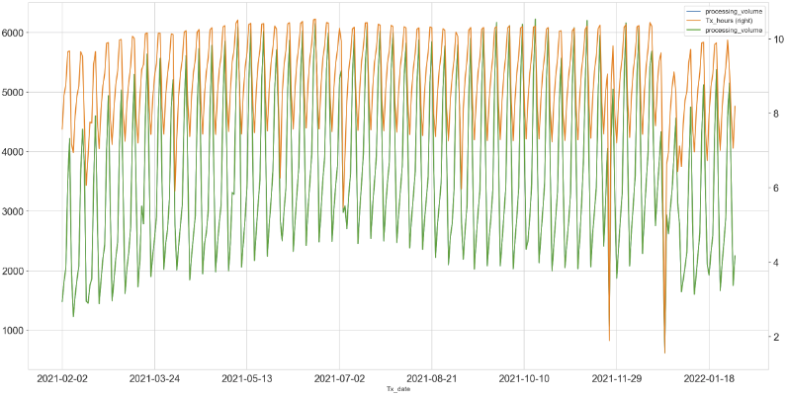
Time series of average processing volume and hours
The chart above shows the daily average processing volume and business hours across all the restaurants from the train data.
There is weekly seasonality as well as holiday season drops.

Slide 6
Weight of evidence transformation and information value calculation
The features were transformed using the weight of evidence (WoE) transformation and their information values IV) were calculated (refer to slide 15 in the appendix).
Weight of evidence transformation
Advantages:
a. Allows for a monotonic increasing/decreasing or a 'U' shaped relationship with the target. b. Just like any other bin, the missing values also get a weight based on the % distribution of events and non-events. c. Inherently scales all the variables to similar ranges. d. Categorical variables can also be converted to WoE without the need for creating multiple dummy variables. e. Outliers on either end are binned.
Disadvantages:
There will be a small loss in the predictive power of the variable due to binning process.
FeatureName | IV
pro_vol_3mth_avg_min | 1.24
pro_vol_6mth_avg_min | 1.22
pro_vol_tot_30days | 1.19
pro_vol_avg_30days | 1.19
pro_vol_tot_90days | 1.02
pro_vol_avg_90days | 1.02
hours_3mth_avg_min | 0.99
hours_6mth_avg_min | 0.97
hours_avg_30days | 0.95
hours_tot_30days | 0.95
pro_vol_3mth_avg_max | 0.90
pro_vol_avg_180days | 0.89
pro_vol_tot_180days | 0.88
hours_avg_90days | 0.83
hours_tot_90days | 0.83
hours_lt_30days_std_count | 0.81
hours_avg_180days | 0.76
pro_vol_lt_90days_std_count | 0.75
hours_lt_90days_std_count | 0.74
pro_vol_lt_30days_std_count | 0.74
pro_vol_6mth_avg_max | 0.74
hours_tot_180days | 0.73

Slide 7
Modeling considerations
The data is randomly split into train and test (75%/25% )
It was ensured that the features selected in the model have low variance inflation factor (VIF < 10) and low pairwise correlation ( < 0.75)
Gradient-boosting Model
A gradient-boosting model is also developed to take advantage of the non-linear relationship between the features and the target variable. Unlike a linear model, a gradient-boosting model is not affected by collinearity and high correlation between the features.
Hyperparameter tuning is used to control for overfitting.
Feature Reduction
Features with IV < 0.03 are excluded because they have weak predictive power
Recursive feature elimination (RFE) using the probatus package is used to efficiently determine the optimal number of features that give the most prediction in the model.
Benchmark Model
A logistic regression model is developed to establish a benchmark to determine the predictive power of the feature set.

Slide 8
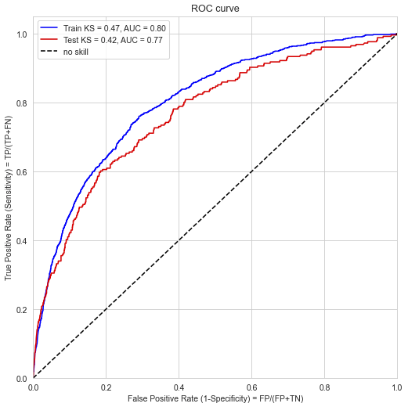
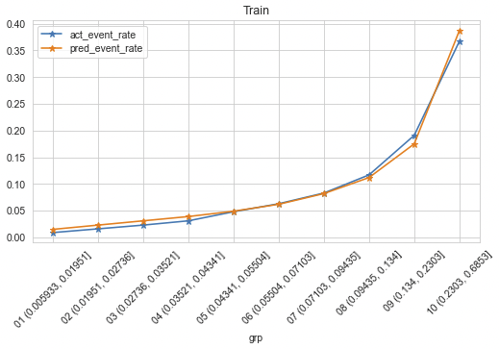
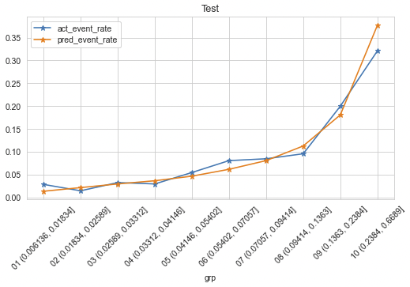
Logistic regression model
Features | Definition | % Contribution | Relationship with Default rate
pro_vol_avg_180days_woe | Processing volume - recent 180-day average | 41% | -
hours_6mth_avg_max_min_diff_woe | Hours - the difference in the recent 6-month max and min of the monthly average | 19% | +
pro_vol_lt_90days_std_count_woe | Processing Volume - number of times the processing volume has been less than the 1st std dev. in the recent 90 days | 17% | +
hours_6mth_avg_max_woe | Hours - the max of the monthly average in the recent 6 months | 13% | -
hours_lt_90days_std_count_woe | Hours - number of times the hours have been less than the 1st std dev. in the recent 90 days | 9% | +

Slide 9
Gradient boosting tree model
Features | Definition | % Contribution | Relationship with Default rate
pro_vol_6mth_avg_min_woe | Processing volume 6-month minimum of monthly average | 23% | -
pro_vol_3mth_avg_min_woe | Processing volume 3-month minimum of monthly average | 21% | -
pro_vol_avg_30days_woe | Processing volume recent 30-day average | 8% | -
hours_3mth_avg_max_min_diff_woe | Hours - the difference in the recent 3-month max and min of the monthly average | 7% | +
hours_avg_30days_woe | Hours recent 30-day average | 6% | -
hours_6mth_avg_min_woe | Hours minimum of recent 6-months monthly averages | 5% | -
hours_tot_30days_woe | Hours total in the recent 30 days | 5% | -
hours_6mth_avg_chg_pct_woe | Hours - % change between the recent month avg and avg from 6 months ago | 5% | U shaped, Lower the absolute value, lower the default rate
pro_vol_lt_90days_std_count_woe | Processing Volume - number of times the processing volume has been less than the 1st std dev. in the recent 90 days | 4% | +
hours_lt_30days_std_count_woe | Hours - number of times the hours have been less than the 1st std dev. in the recent 30 days | 4% | +
pro_vol_3mth_avg_chg_pct_woe | Processing volume - % change between the recent month avg and avg from 3 months ago | 4% | U shaped, Lower the absolute value, lower the default rate
hours_std_90days_woe | Hours - recent 90 days standard deviation | 4% | U shaped, Lower the absolute value, lower the default rate
hours_3mth_avg_chg_pct_woe | Hours - % change between the recent month avg and avg from 3 months ago | 3% | U shaped, Lower the absolute value, lower the default rate

Slide 10
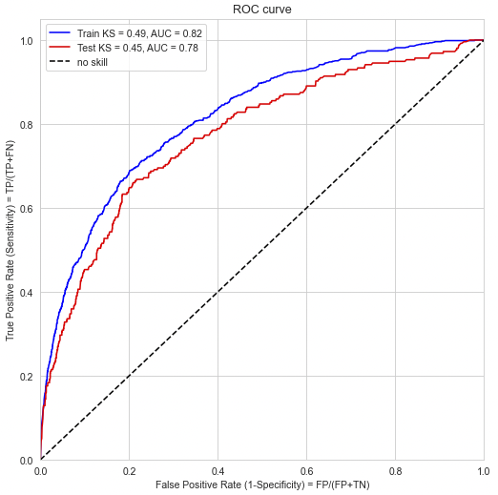
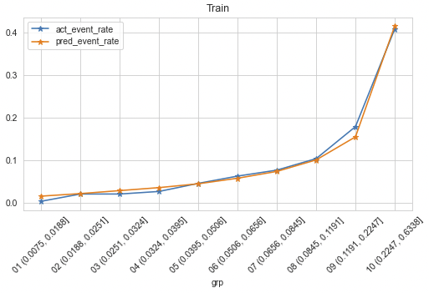
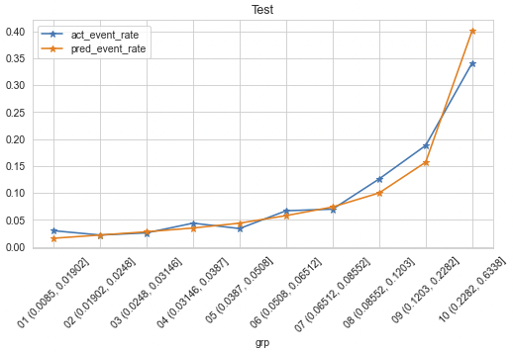
Gradient boosting tree model

Slide 11
Next steps
Feature engineering: Create some more trended variables based on volatility in business; Test seasonality features to capture seasonality – Weekly, monthly, quarterly
Explore trends by ownership, restaurant category, market segment
Algorithms: Compare the performance of other classification algorithms such as KNN Classifier, and Random Forest
Sampling: Test minority oversampling techniques such as SMOTE and ADASYN

Slide 12
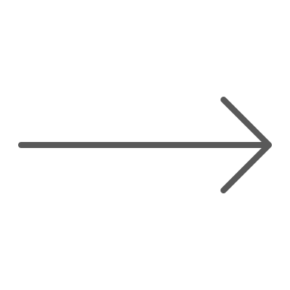





Illustration of a credit decisioning system
Models & Policies
Approve
Risk Model
Loan Size Model
Pricing Model
Loan Amount
Loan Apr
Loan Term
Approve
Approval Model
Fraud Model?
Decline
Policy rules
Refer
Decline
Reject Reasons
The workflow above sums up a typical credit decisioning system.
The credit applications are carefully evaluated using underwriting models plus policy rules.
If an application is approved, it is assigned a loan with APR and term else if it is declined, then reject reasons are provided based on the top attributes from the underwriting models. The application can also be sent for manual review if more documentation is needed.

Slide 13
Topics for discussion
How is days-past-due calculated and what is the default definition in the training data? (for e.g. 30+ days past due in the next 12 months)
Do the restaurants have to meet any quarterly minimum?
What other underwriting models are used? (Approval, profitability model)
How does the collections strategy work?
Charge off definition
Loss forecast, charge offs forecast

Slide 14
Appendix

Slide 15
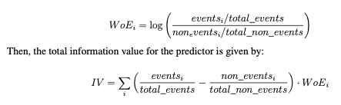
Weight of evidence transformation and Information Value calculation
A variable is binned using an optimal binning algorithm with respect to % distribution of events and non-events such that its information value (predictive power) is maximized. It is transformed to Weight of Evidence (WoE) using the formula below.
Information Value | Variable Predictiveness
Less than 0.02 | Not useful for prediction
0.02 to 0.1 | Weak predictive Power
0.1 to 0.3 | Medium predictive Power
0.3 to 0.5 | Strong predictive Power
>0.5 | Suspicious Predictive Power

Slide 16
Logistic regression model features

Slide 17
Logistic regression model features

Slide 18
Select features from gradient-boosting tree model

Slide 19
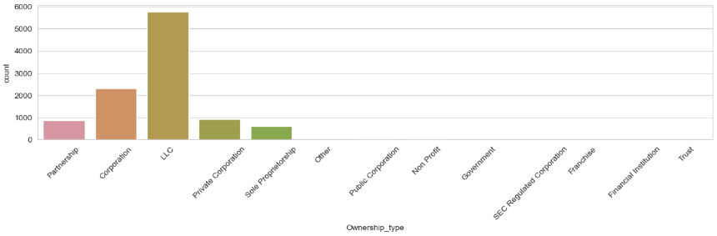
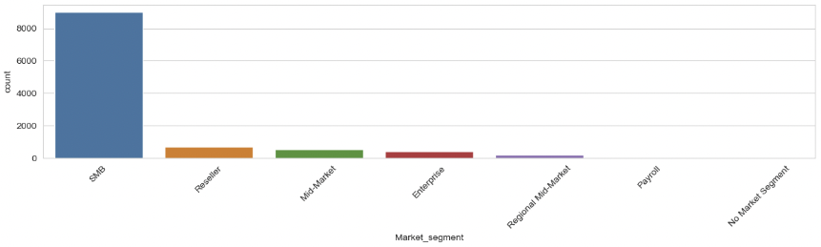
Ownership type and Market segment

Slide 20
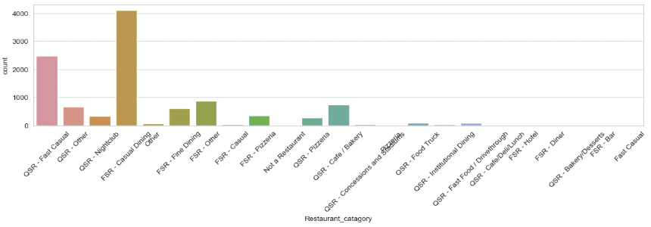
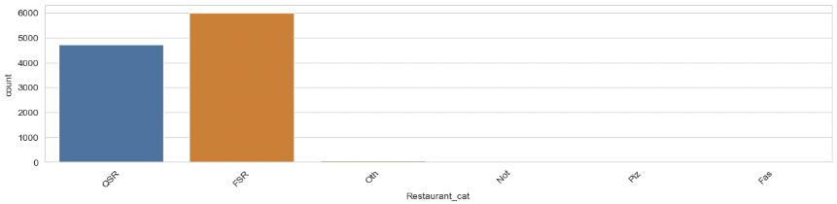
Restaurant categories

Slide 21
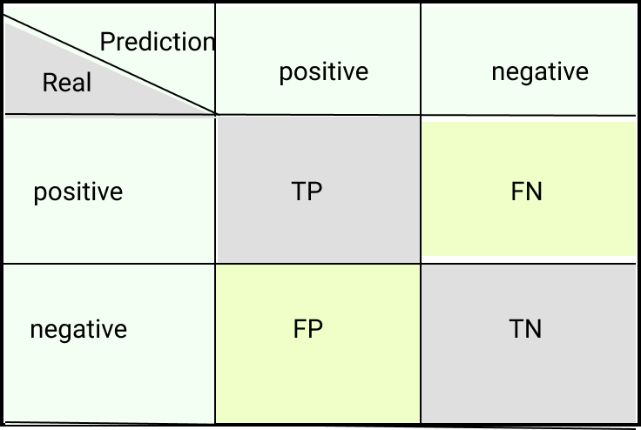
Confusion Matrix and evaluation metrics
Accuracy (% correctly predicted) = (TP + TN) / (TP+FN+FP+TN)
Recall (% of correct P predictions/TPR/Sensitivity) = TP/P = TP / (TP+FN) (useful in Fraud detection).
Precision (% actual positive) = TP/(Total Predicted Positive) = TP/(TP+FN) (useful in Spam detection).
False Positive Rate FPR = 1 – Specificity = 1 – [TN/(TN+FP)] = FP/(TN+FP)
Balance Accuracy = (Sensitivity + Specificity)/2
F1 = 2 * [(precision * recall) / (precision + recall)]

