Slide 1
Python Intro Lecture U: MDSC755 P: F@ll#2018
MDSC 755
Perry Radau
CAIR Research Associate
Nov. 5, 2018

Slide 2
Schedule
Why Use Python?
How to use it
Installing packages
Spyder walk-through
Jupyter notebook walk-through
Workspace
Simple math
Calling functions in python
Importing packages
Arrays and lists
String concatenation
More matrices
Data types
Data frames

Slide 3
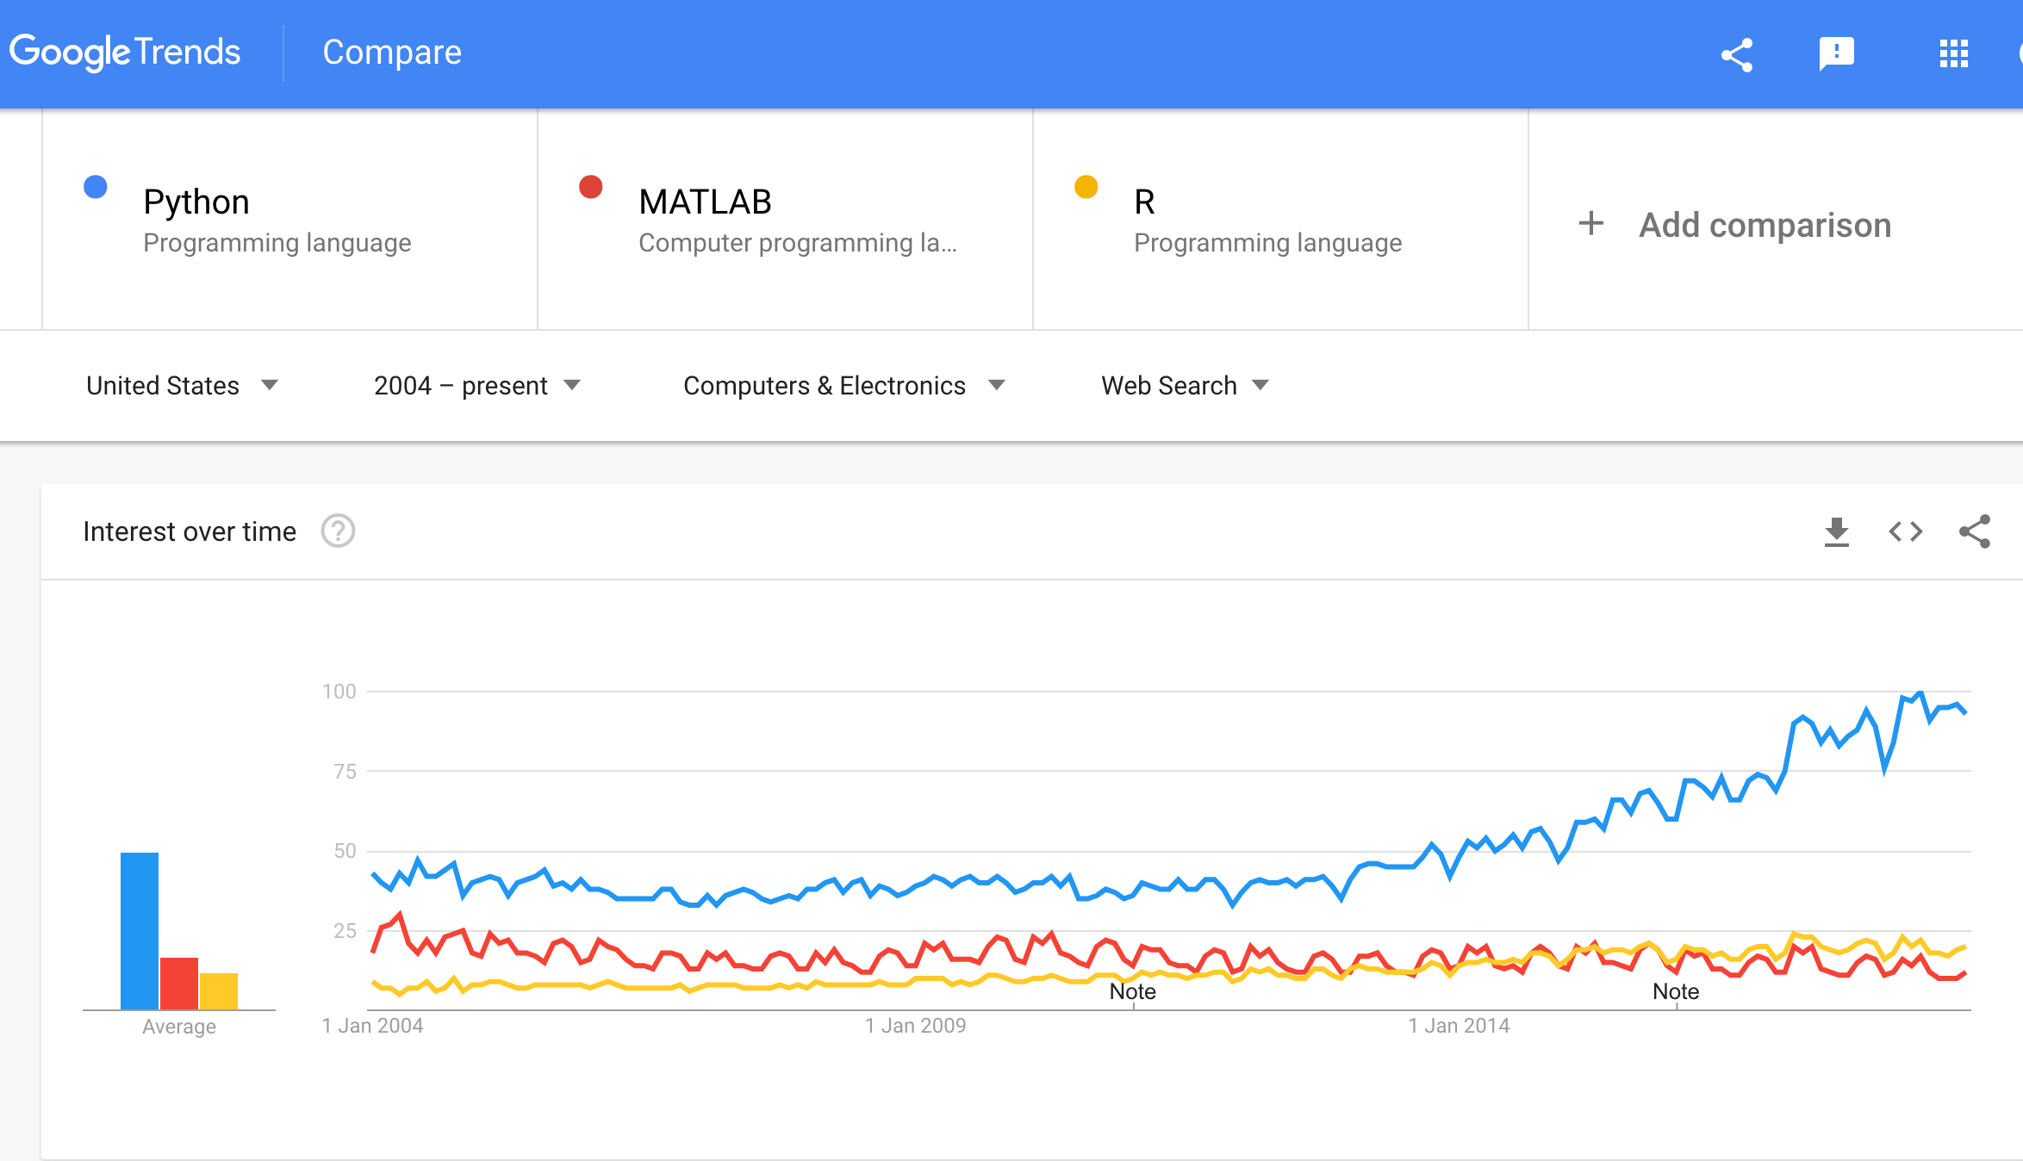
Why use Python?
free / open source.
has libraries for almost any problem.
Developing quickly due to interest of many companies, especially Google.

Slide 4
Benefits of Python
comprehensive, large libraries.
rapid growth.
wide use in software development companies.
disadvantage of Python compared with Matlab is primarily the existence of many useful Matlab utilities written by and for scientists (e.g. SPM).
disadvantage of Python compared with R is primarily that cutting edge statistical /graphing tools are easier to find (or only available) in R.
Compared with other languages (C++/Java) Python may be considered too high-level or difficult to debug (run-time errors, type casting).

Slide 5
How to use it?
Built-in as part of OS (e.g. macOS, Ubuntu).
Download a distribution (e.g. Anaconda) that may be newer, include a larger set of features with environment manager.
Some advantages and ease for beginners to using a Integrated Development Environment (IDE) like Spyder, which comes with the Anaconda distribution.

Slide 6
Installing packages
As with R, you will sometimes need to download and install required packages.
For a simple script you could use pip. E.g. to install SciPy package:
pip install scipy
However, conda (part of Anaconda) has many advantages because it is a general-purpose package manager (including non-Python languages) and can be used to create virtual environments. These features are useful for larger projects.
conda install scipy

Slide 7
Spyder walk-through
Code editor
Console (Terminal)
Variable explorer / File explorer
History log
Note: will start with a script template.
Blue buttons are for debug mode (e.g. to set breakpoints).
Green buttons are for normal execution.
Plots from plt.show() will appear in IPython console window but outside spyder the script will produce an interactive viewer containing the plot.

Slide 8
Jupyter Notebook
Jupyter notebook can contain both code and rich text elements like figures.
can be used with multiple languages including Python (and R).
the notebooks can be used and edited in the web browser.
this is a client-server application. The server running JN can be local or another computer you access.
The JN’s main components: kernel and dashboard.
Kernel runs the user’s code and manages variables etc.
Dashboard visible in web browser is used to manage kernel and the notebook(s).

Slide 9
Some basics
print(“My string!”) # display to the screen
Don’t need ‘;’ to terminate lines.
Indentation of lines is important! Indicates a block of code. e.g.
if x == 2.5:
print(“x is 2.5!”) # print if condition is met
success = True # print if condition is met
else:
print(“x is not 2.5”) # print if condition is NOT met
By convention, indents are 4 spaces. Editor prefs should be set to convert tabs to spaces. MUST be consistent!
Clear the environment: use the ‘eraser’ icon in the Variable explorer. This would effect stepping through your code (F9/black arrow) not the normal full execution (F5/green arrow).

Slide 10
Some (more) basics
In file paths specify os.sep instead of / or \ (for multi-platform use).
Comment with a #
Use ctrl+Enter to run a highlighted selection of code.
Killing a runaway script: use (ctrl + c) after highlighting the IPython console window.
Quit with quit() in the IPython console window to reset it and clear the variables.
Python vs. MATLAB table
https://cheatsheets.quantecon.org/
Be aware that in Python, loops often should be replaced by a specific Python function or alternative (e.g. list comprehension) that has higher performance.

Slide 11
Workspace
To understand your workspace you can use these commands from os package:
os.getcwd() Current working directory
os.chdir(<path>) Set current directory
os.listdir() Directory listing of current directory
e.g.
import os
home = os.getenv('HOME’) #user home directory
print('home', home)
os.chdir(home) #change working directory to user home directory
print(os.getcwd())
os.chdir(home + os.sep + 'Desktop’) # change working directory to user Desktop
print(os.getcwd())
print(os.listdir()) # print a list which has each file in current directory as an item.

Slide 12
Getting help
help(<function_name>) or ? <function>
Must be in IPython console
e.g. help(list)
Can specify function in package, e.g.
? os.listdir
...provided that the package has already been imported or is built-in.
StackOverflow is a good site to find answers to very specific questions.

Slide 13
Simple math
Basic math operators
Operator precedence
https://docs.python.org/3/reference/expressions.html#operator-precedence
Assignment (=)
Equality testing (==)

Slide 14
Math examples
5+10
5+10*3
5+10*3/24
a = 10/2
b = a + 4
c = b*2
c == b*2

Slide 15
Calling functions in Python
Generic function call to fname, returning myVariable.
myVariable = fname(input, p1=True, p2=“a string”, p3=myVar)
Example:
dfnew = pd.read_csv("D:/Dropbox/courses/MDSC755_progTrial/data/classList.csv", header=True, sep=",")
NOTE: In general if you want to extend your code line over 2+ lines without terminating then you need to use a backslash \ (and should use an indent for clarity). e.g.
dfnew = pd.read_csv("D:/Dropbox/courses/MDSC755_progTrial/data/classList.csv", \
header=True, sep=",") #indented line

Slide 16
Importing packages
import <package> as <pkgname>
- will read in a package and make that packages modules/methods available under ‘pkgname’ (defaults to ‘package’)
import numpy as np
Now we can use the numpy average function by
calling
np.average(<myarray>)

Slide 17
Arrays and lists
Indexing starts at 0. (Base 0 indexing is standard or recommended in most languages.) e.g. Index 4 elements by
0,1,2,3
Lists are for any type of Python variable (e.g. strings and numbers).
Arrays from the numpy package are better suited to numeric operations.
Make arrays by initializing with a list:
mylist = [5,10,15,25,40]
myarray = np.array(mylist)
myarray = np.array([5,10,15,25,40]) #alternative one-liner.
Index into arrays. e.g. the 5th element is
myarray[4] #40
myarray[5] # IndexError: index 5 is out of bounds for axis 0 with size 5

Slide 18
Arrays and indexing
myarray[0:3] # a list of the first three elements
#range object give us way to produce list.
# list comprehension puts it into list.
b = [x for x in range(1, 25, 2)] #start, limit, step
len(b) # will give you the length (# elements)
b[1] # 2nd element
b[1:5] # 2-5th elements
b[:5] # up to and including the 5th element
b[5:] # 6th element and following.
Notes:
b = [1, 3, 5, 7, 9, 11, 13, 15, 17, 19, 21, 23]

Slide 19
Some ‘array’ ops
# Create two lists
v1 = [5, 9, 3, 4]
v2 = [10, 11, 12, 13]
# Create 2D array from the 2 lists, by default as rows.
result = np.array([v1, v2])
print(result)
# Create two vectors (1D arrays)
vector1 = np.array([5, 9, 3, 4])
vector2 = np.array([10, 11, 12, 13])
# Create 2D array from the 2 vectors, with axis 0 indicating ‘down’,
i.e. each vector will become a row.
result = np.concatenate([vector1], [vector2], axis=0)
print(result)
# take the transpose
tran = result.T

Slide 20
String concatenation
Some string commands. Single quote and double quote are usually interchangeable but must be paired correctly.
str1 = 'Happy unBirthday’
str2 = “to me”
str3 = 'again’
str1 + ‘-’ + str2 #concatenate with separator
str1 + str2 + str3 # concat without separator
“-”.join([str1, str2, str3]) #concat multiple strings
str1.replace(“ un”,”, happy “) #replace a substring
str1.split(“ “) #split a string into a list by separator.

Slide 21
More matrices
Number of rows and columns:
arr = np.array([[1,2,3],[4,5,6]])
arr.shape[0] #number of rows
arr.shape[1] #number of columns

Slide 22
Examples
myArray1 = np.array([1,2,3,4,5])
myArray2 = np.array([2,4,6,8,10])
myArray3 = np.array([3,6,9,12,15])
myMat12 = np.concatenate(([myArray1], [myArray2]), axis=0)
myMat123 = np.concatenate(([myArray1], [myArray2 ], [myArray3] ), axis=0)

Slide 23
Array / matrix exercises
# make an array A with numbers from 5 to 100 in increments of 10
# and an array B from 1 to 10
# make an array C that has A in the first row and B in the second
# B in the third and A in the fourth
# take the first three columns of C and put them in D and the last
#three columns of C and put them in E
# combine D and E column-wise and assign to F
# how many rows and columns does F have?
# make a matrix that is 2 x 100 and contains 200 uniform random
# generated, put into U
# make TU the transpose of U
# make a histogram to look at the distribution
# and repeat with normally distributed data and 5 x 500

Slide 24
Data types
numbers, strings, lists, dictionaries, tuples, sets. (built-in types)
dictionary Like a list but
- it is not ordered (index is not used).
- elements are accessed by a key string.
- curly braces
height = {“Harry”:5.9, “Sally”:5.2}
height[“Sally”] # to obtain height of Sally
height[“Sally”] = 5.3 #Sally has grown so assign new height.
tuple Like a list but not changeable. Uses () parentheses.
pi = (“PI”, 3.14) # constant
set Like a list but is not ordered and ensures uniqueness of elements.
useful for math set operations like union and intersection.
myset = set([2,3,6,7,8,2,6])
{8, 2, 3, 6, 7}

Slide 25
Data frames
Excellent for storing tables of data: multiple columns of data that correspond to one another
Create using pandas package
import pandas as pd
#could use lists instead of arrays
datadict = {"col1":myArray1, "col2":myArray2}
#put the arrays into columns
myDF = pd.DataFrame(datadict)

Slide 26
Data frames
# create three variables and assemble into a data frame. This time use lists in your dictionary.
n = [2, 3, 5] s = ["aa", "bb", "cc”] b = [True, False, True] df = pd.DataFrame({‘num’:n, ’str’:s, ’bool’:b})
# to access the column having elements of n as a Series object.
df[‘num’]

Slide 27
Data frame exercises
# read the class list data into a data frame
# plot a histogram of the Material variable
# show the numLanguages for students in the ‘Psych’, ‘BME’ and ‘NEU’ programs
# use the t.test function to compare numLanguages between the programs (ie, 3 pairwise tests)

Slide 28
Github
The Jupyter Notebook
Python_for_Psychologists.ipynb
is available on github here:
https://github.com/pradau/python_for_psychologists

