Slide 1

Leveraging the Power of Regression Discontinuity Designs for Program Evaluation: An Institutional Simulation Using R
Gabe Avakian Orona, M.P.H.
CAIR 2016
November 17, 2016

Slide 2
Goals for today:
Introduce Regression Discontinuity Design (RDD)
Introduce R
Simulate an RDD using R
Encourage the use of this technique and R at your home campus

Slide 3
Regression…so what?
Ideal for situations when there is a cut-score in which subjects above/below a threshold receive program resources or an intervention
The variable used to determine the threshold is called the “rating” or "forcing” variable.
Examples: Accuplacer scores, GPA, household income
Quasi-experimental design used to estimate the rigor and validity of a Randomized Control Trial (RCT)
The Dept of Edu (2011) considers regression discontinuity to be one of the most rigorous quasi-experimental methods

Slide 4
Internal Validity
3. Imprecise Control
No one single entity or factor should determine a rating score
For instance, a committee vs. an individual
4. Clear discontinuity for treatment status at the cut-point
Not too relevant for today

Slide 5
Types of Regression Discontinuity Designs (RDD)
With regard to Treatment Assignment:
Sharp Design: Where the cut-point perfectly predicts who does/doesn’t receive intervention
Fuzzy Design: Where there exists “cross-overs” (for various reasons)
With regard to Analytic Approach:
Non-parametric: local randomization approach
Parametric: uses every observation in the sample
Today we will be employing a sharp, non-parametric RDD

Slide 6
The Scenario
The STEM grant director wishes to administer supplemental instruction (SI) exclusively to students who have GPAs below a certain level. A team of experts establish a GPA cut-point prior to viewing any actual data. A threshold of 2.5 is established: students below this cut-point will receive SI, those above will not.
The director wants to determine if acute semester administration of SI proves effective in relation to final grade (numeric).

Slide 7
Typical Intervening Mechanism in Program Evaluation, “Program Theory”
STEM Supplemental Instruction

Slide 8
Typical Intervening Mechanism in Program Evaluation, “Program Theory”
STEM Supplemental Instruction
Enhanced Study Skills/Content Clarification

Slide 9
Typical Intervening Mechanism in Program Evaluation, “Program Theory”
STEM Supplemental Instruction
Enhanced Study Skills/Content Clarification
Semester Final Grade

Slide 10
Direct Relationship, "Program Theory”
STEM Supplemental Instruction
Semester Final Grade

Slide 11
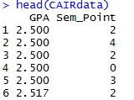
Simulation Data
Institutional Data:
- Taken from supplemental instruction STEM report, N = 589
- Scores are adjusted on outcome for demonstration purposes

Slide 12
Simulation Data
Rating Variable: Preexisting GPA (GPA) (r_{i})
Cut-Point: GPA of 2.5 (T_{i})
Outcome: Final Grade (0 – 4) (y)

Slide 13

Model
$$Yi=α+β0Ti+β1ri+ ε$$
Relationship between GPA and Final Grade
Individual scores on the rating variable (GPA; centered)
Estimated marginal mean
Treatment status (0,1)
Marginal impact of program

Slide 14
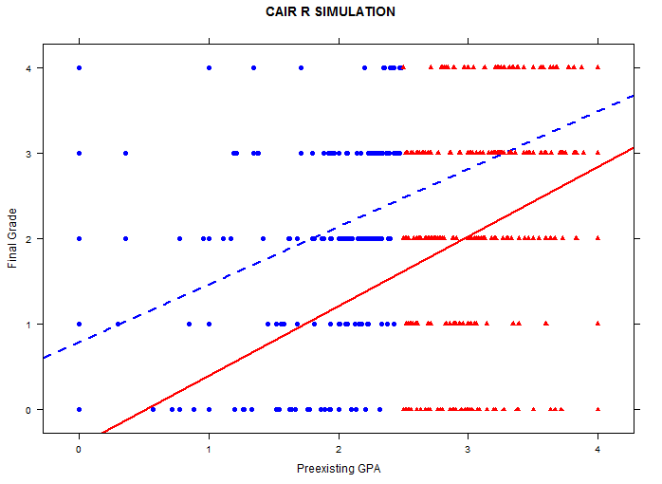
Counterfactual Framework
What would have been for control students if they had received treatment
Counterfactual Outcomes
Factual Outcomes
Factual Outcomes
Counterfactual Outcomes
What would have been for treated students if they had not received the treatment

Slide 15
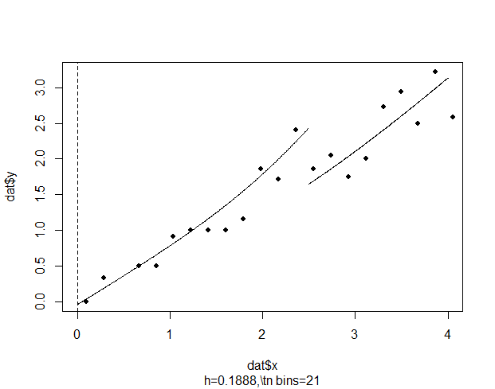
Conceptual Framework
Control Group
Treatment Group

Slide 16
Conceptual Framework
Discontinuity
“Local Randomization”
“Bandwidth”

Slide 17
What determines the bandwidth?

Slide 18
What determines the bandwidth?
There are several methods to determine the bandwidth for purposes of a local linear regression:
1. Visual Inspection of forcing variable/Manual
2. Statistical Recommendation/Automatic:
a) Cross-Validation Technique
b) Imbens and Kalyanaraman (IK) ,2009: “Plug” In procedure
*In this simulation, we will be using IK technique

Slide 19
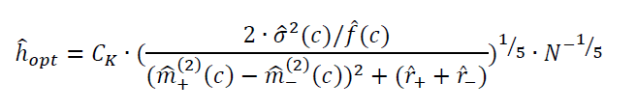
What determines the bandwidth?
There are several methods to determine the bandwidth for purposes of a local linear regression:
1. Visual Inspection of forcing variable/Manual
2. Automatic/Statistical Recommendation:
a) Cross-Validation Technique
b) Imbens and Kalyanaraman (IK) (2009): “Plug” In procedure
*In this simulation, we will be using IK technique, as this is automatically generated within the function used in todays analysis

Slide 20

What determines the bandwidth?
There are several methods to determine the bandwidth for purposes of a local linear regression:
1. Visual Inspection of forcing variable/Manual
2. Automatic/Statistical Recommendation:
a) Cross-Validation Technique
b) Imbens and Kalyanaraman (IK) (2009): “Plug” In procedure
*In this simulation, we will be using IK technique, as this is automatically generated within the function used in todays analysis

Slide 21
Downloading R
https://www.r-project.org/
- R
https://www.rstudio.com/
- R studio

Slide 22
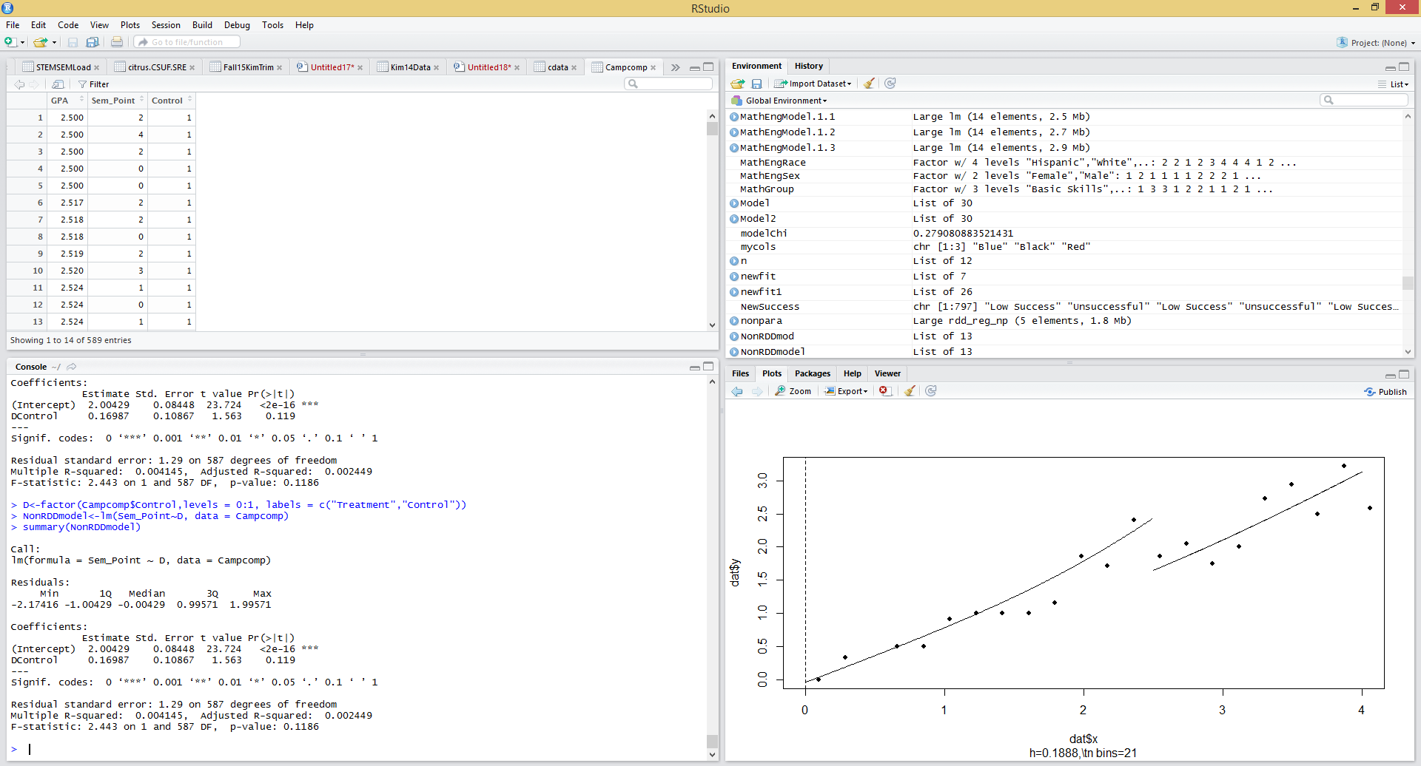

Slide 23
How R works
Download a package:
Require it:
Use the functions in the package:

Slide 24
How R works
3. Use the functions in the package:
Object Name<- function(object)

Slide 25
How R works
3. Use the functions in the package:
Object Name<- function(object)

Slide 26
How R works
3. Use the functions in the package:
Object Name<- function(object)

Slide 27
How R works
3. Use the functions in the package:
Object Name<- function(object)

Slide 28
How R works
3. Use the functions in the package:
Object Name<- function(object)

Slide 29
RDD in R
Step 1: Determine the bandwidth
Step 2: Specify the model
Step 3 : Run the analysis

Slide 30
RDD in R
Step 1: Determine the bandwidth
Step 2: Specify the model
Step 3 : Run the analysis

Slide 31
RDD in R
Step 1: Determine the bandwidth
Step 2: Specify the model
Step 3 : Run the analysis

Slide 32

RDD in R
Step 1: Determine the bandwidth
Step 2: Specify the model
Step 3 : Run the analysis

Slide 33
RDD in R
Step 1: Determine the bandwidth
Step 2: Specify the model
Step 3 : Run the analysis
$$Yi=α+β0Ti+β1ri+ ε$$

Slide 34
RDD in R
Step 1: Determine the bandwidth
Step 2: Specify the model
Step 3 : Run the analysis

Slide 35
RDD in R
Step 1: Determine the bandwidth
Step 2: Specify the model
Step 3 : Run the analysis

Slide 36
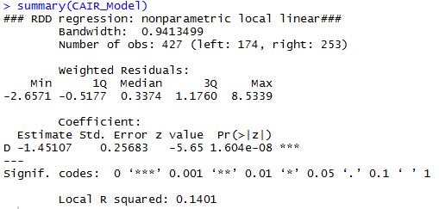
RDD in R

Slide 37
RDD in R

Slide 38
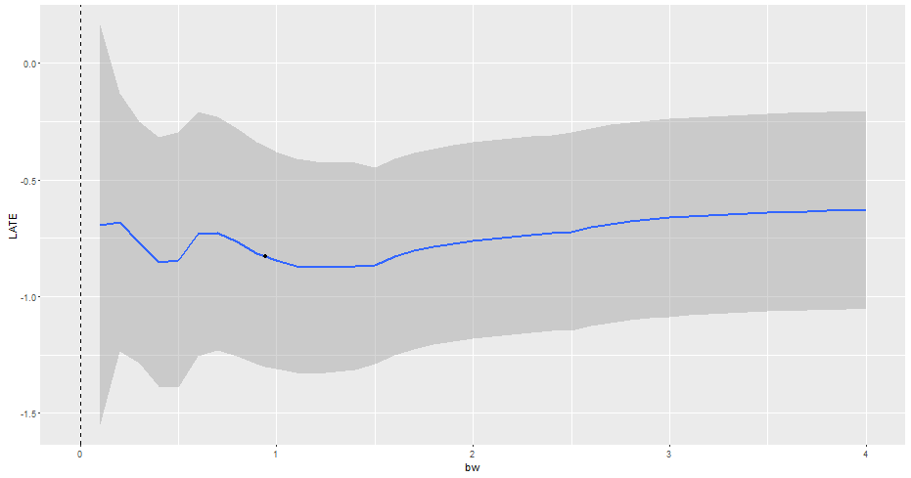
Sensitivity : Stability of Point Estimate

Slide 39
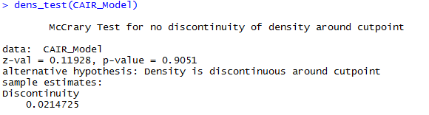
McCrary Test
A test of internal validity
Alternative Hypothesis: Density is discontinuous around the cut-point

Slide 40
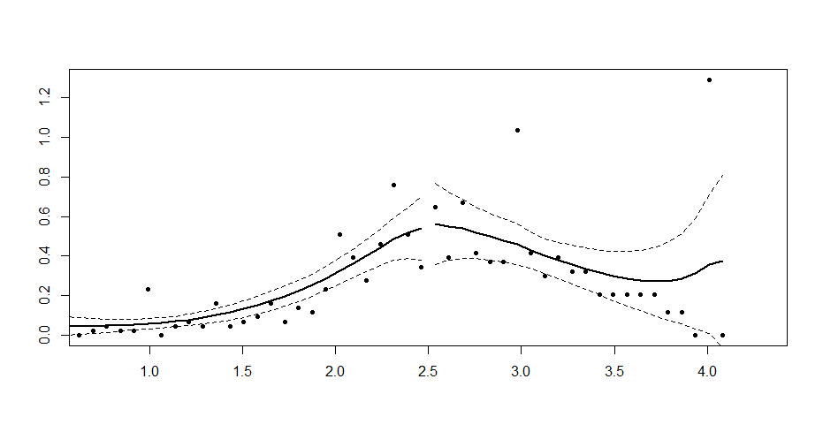
McCrary Test

Slide 41
Linear Regression
Assigning Groups:

Slide 42
Linear Regression
Assigning Groups:
Specifying the linear model:

Slide 43
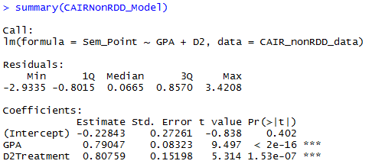
Linear Regression
Assigning Groups:
Specifying the linear model:
Obtaining the output:

Slide 44
Linear Regression
Assigning Groups:
Specifying the linear model:
Obtaining the output:

Slide 45
RDD vs. MLR
Treatment Effect in RD analysis: 1.45
Treatment Effect in MLR analysis: .81
1.45 - .81 = .64 difference in treatment effect
*When talking about final grade, this is quite a difference!

Slide 46
Conclusion
Cursory presentation of RDD:
Some theory and mathematics were presented
You have the “framework” to dive deeper
We covered a sharp, non-parametric RDD; consider fuzzy designs and parametric analysis
Regarding R:
Steep learning curve, however this gentle introduction to the basic mechanics (packages – functions – objects)
Plenty of R resources (Just Google, they are everywhere)

Slide 47
Recap
Benefits of RDD:
Rigor of RCT using an observed variable
Useful method for program evaluation when there is a threshold determining participation
Useful for education field
Can be retrospective or prospective
Benefits of using R:
It’s free
Can be more efficient than other software (SPSS, etc)
Can handle more complex analyses
Multiple working datasets
It’s free!!!

Slide 48
References
Flaster, A., & DesJardins, S. L. (2014). Applying Regression Discontinuity Design in Institutional Research. New Directions for Institutional Research, 2014(161), 3-20.
Jacob, R. T., Zhu, P., Somers, M. A., & Bloom, H. S. (2012). A practical guide to regression discontinuity (pp. 1-91). New York: MDRC.
U.S. Department of Education. (2011). What Works Clearinghouse: Procedures and standards handbook (version 2.1). Washington, DC: Author. Retrieved from : http://ies.ed.gov/ncee/wwc/pdf/reference_resources/wwc_procedures_v2_1_standards_handbook.pdf
Lee, H., & Munk, T. (2008). Using regression discontinuity design for program evaluation. In Proceedings of the 2008 Joint Statistical Meeting (pp. 3-7).
Imbens, G. W., & Lemieux, T. (2008). Regression discontinuity designs: A guide to practice. Journal of econometrics, 142(2), 615-635.
Schochet, P., Cook, T., Deke, J., Imbens, G., Lockwood, J. R., Porter, J., & Smith, J. (2010). Standards for Regression Discontinuity Designs. What Works Clearinghouse.
Melguizo, T., Bos, J. M., Ngo, F., Mills, N., & Prather, G. (2015). Using a regression discontinuity design to estimate the impact of placement decisions in developmental math. Research in Higher Education, 1-29.
Stigler, M., & Quast, B. (2015). Package ‘rddtools’.

Slide 49


Slide 50
