Slide 1
JDBC
java API to connect and execute query with the database

Slide 2
Java JDBC
Java JDBC is a java API to connect and execute query with the database. JDBC API uses jdbc drivers to connect with the database.
Before JDBC, ODBC API was the database API to connect and execute query with the database. But, ODBC API uses ODBC driver which is written in C language (i.e. platform dependent and unsecured). That is why Java has defined its own API (JDBC API) that uses JDBC drivers (written in Java language).

Slide 3
JDBC Driver
JDBC Driver is a software component that enables java application to interact with the database.There are 4 types of JDBC drivers:
JDBC-ODBC bridge driver
Native-API driver (partially java driver)
Network Protocol driver (fully java driver)
Thin driver (fully java driver)

Slide 4
JDBC-ODBC bridge driver
The JDBC-ODBC bridge driver uses ODBC driver to connect to the database. The JDBC-ODBC bridge driver converts JDBC method calls into the ODBC function calls. This is now discouraged because of thin driver.
Advantages:
easy to use.
can be easily connected to any database.
Disadvantages:
Performance degraded because JDBC method call is converted into the ODBC function calls.
The ODBC driver needs to be installed on the client machine.

Slide 5
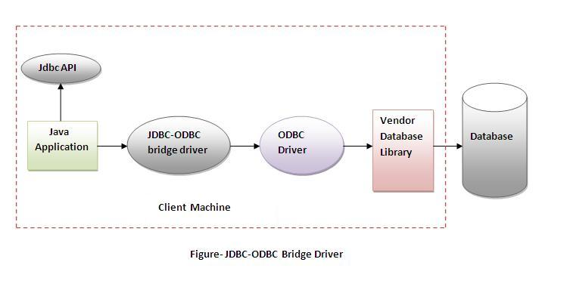
JDBC-ODBC bridge driver

Slide 6
Native-API driver
The Native API driver uses the client-side libraries of the database. The driver converts JDBC method calls into native calls of the database API. It is not written entirely in java.
Advantage:
performance upgraded than JDBC-ODBC bridge driver.
Disadvantage:
The Native driver needs to be installed on the each client machine.
The Vendor client library needs to be installed on client machine.

Slide 7
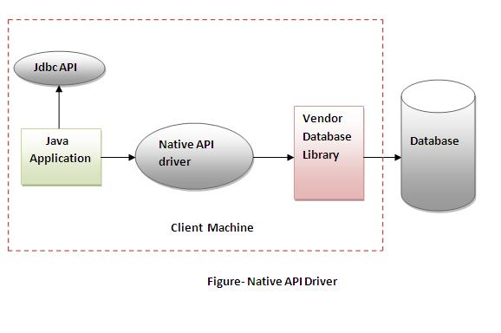
Native-API driver

Slide 8
Network Protocol driver
The Network Protocol driver uses middleware (application server) that converts JDBC calls directly or indirectly into the vendor-specific database protocol. It is fully written in java.
Advantage:
No client side library is required because of application server that can perform many tasks like auditing, load balancing, logging etc.
Disadvantages:
Network support is required on client machine.
Requires database-specific coding to be done in the middle tier.
Maintenance of Network Protocol driver becomes costly because it requires database-specific coding to be done in the middle tier.

Slide 9
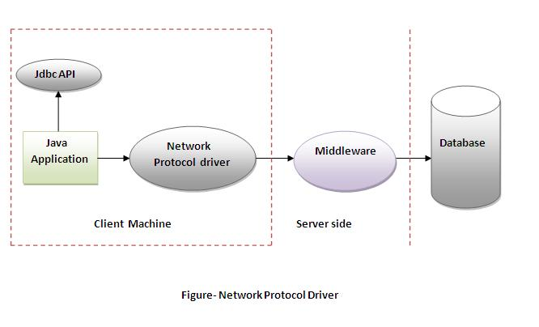
Network Protocol driver

Slide 10
Thin driver
The thin driver converts JDBC calls directly into the vendor-specific database protocol. That is why it is known as thin driver. It is fully written in Java language.
Advantage:
Better performance than all other drivers.
No software is required at client side or server side.
Disadvantage:
Drivers depends on the Database.

Slide 11
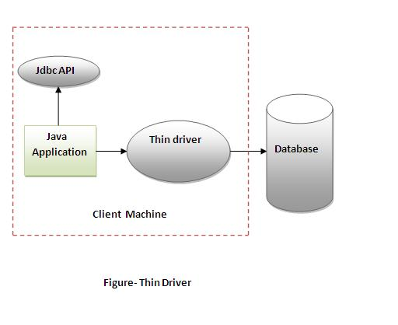
Thin driver

Slide 12
5 Steps to connect to the database in java
There are 5 steps to connect any java application with the database in java using JDBC. They are as follows:
Register the driver class
Creating connection
Creating statement
Executing queries
Closing connection

Slide 13
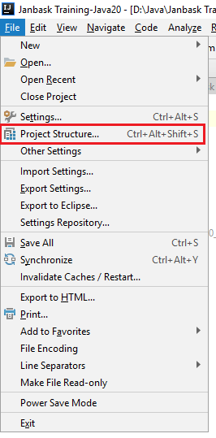
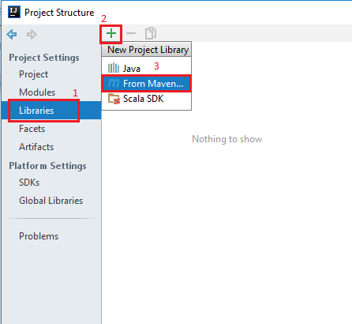
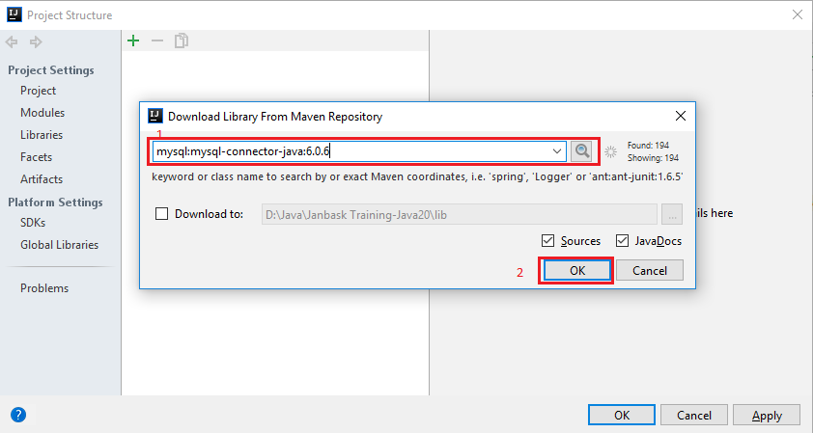
Add Maven dependency for drivers
2
1
3

Slide 14
Example: Connect to MySql Database
For connecting java application with the mysql database, you need to follow 5 steps to perform database connectivity.
In this example we are using MySql as the database. So we need to know following informations for the mysql database:
Driver class: The driver class for the mysql database is com.mysql.jdbc.Driver.
Connection URL: The connection URL for the mysql database is jdbc:mysql://localhost:3306/trainingdb where jdbc is the API, mysql is the database, localhost is the server name on which mysql is running, we may also use IP address, 3306 is the port number and sonoo is the database name. We may use any database, in such case, you need to replace the sonoo with your database name.
Username: The default username for the mysql database is root.
Password: Password is given by the user at the time of installing the mysql database.

