Slide 1

Customer Segmentation
Understanding customer behavior using data to offer better services.

Slide 2
Opportunity
Objective: To identify different segments in the existing customer based on their spending patterns as well as past interaction with the bank.

Slide 3
Definition
We are trying to segment the bank customers to be able to:
Better market our products
Tailor our services to better meet customer needs based on the segments that they belong to.

Slide 4
Questions to be answered
What are the characteristics of each cluster/segment of customers?
Based on the characteristics of each group of customers how can we tailor our service offerings?

Slide 5
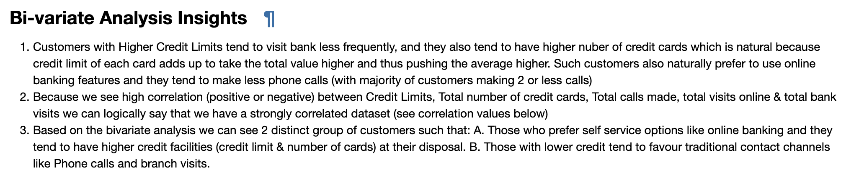
What does the data says

Slide 6
How might we
Based on our EDA, and model building we have segmented the customers in 3 groups.
The distinction between each group is clearly apparent.
We have been able to extract actionable insights from the data which we feel would be very helpful to our operations teams.

Slide 7
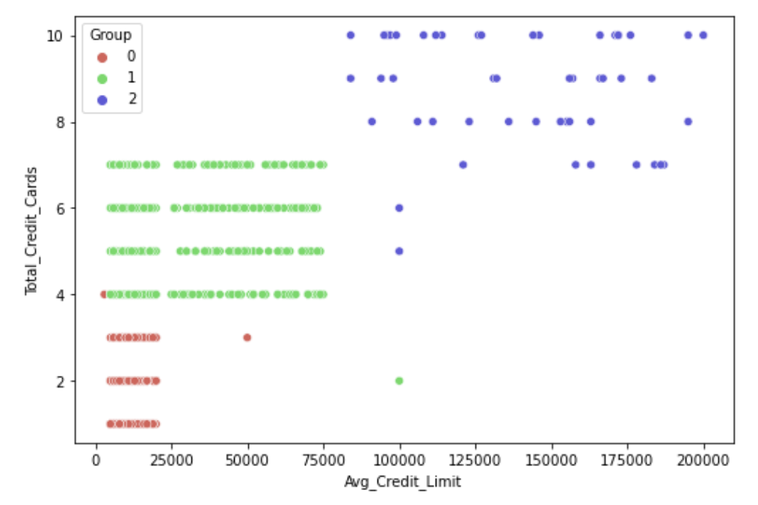
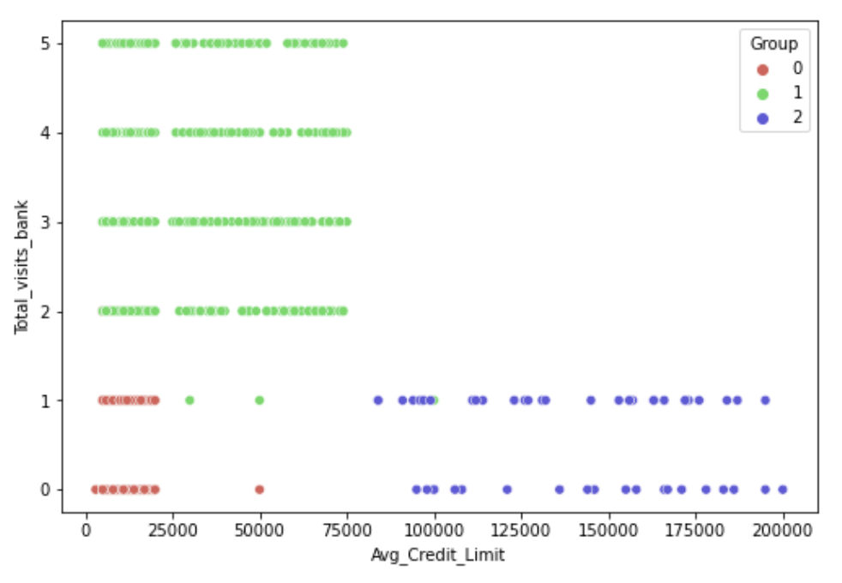
Customer Segments

Slide 8
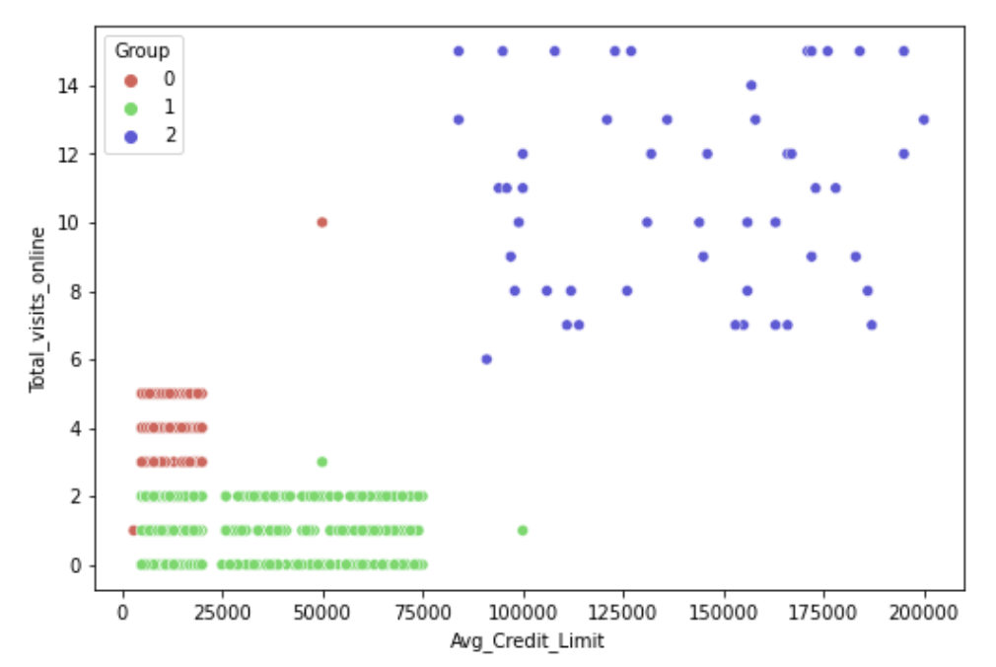
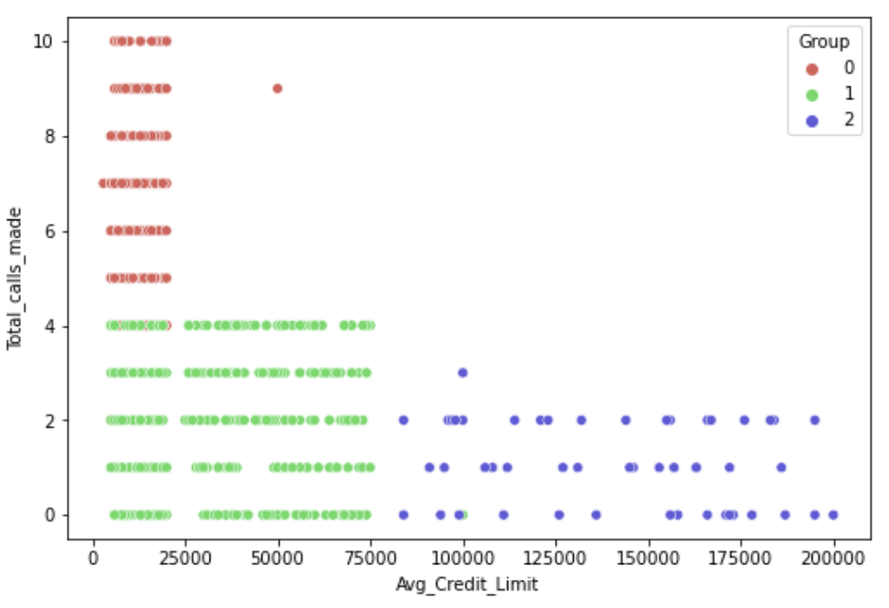
Customer Segments

Slide 9
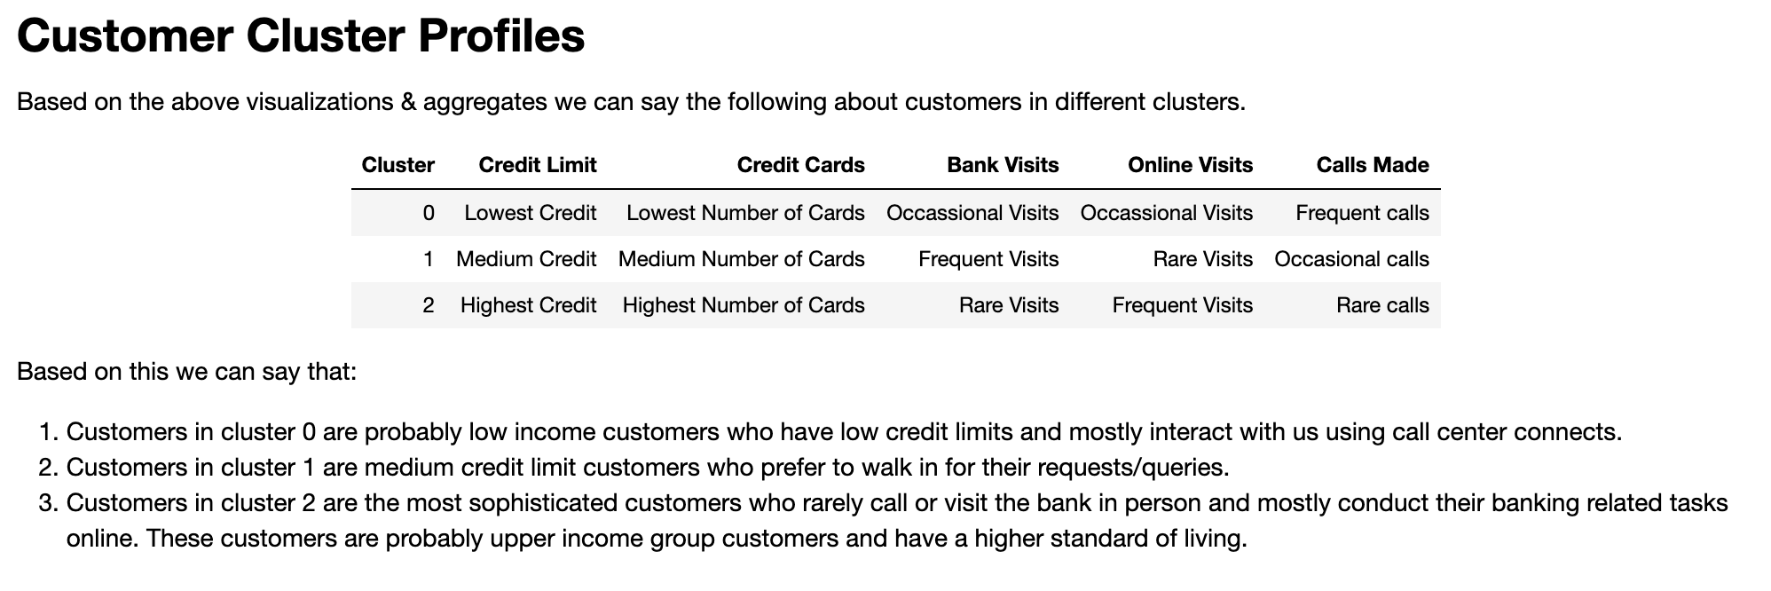
Observations

Slide 10
Key takeaways & Recommendations
We have 3 prominent customer segments and we can combine this data with the spending habits of customers belonging to each segment and run targeted campaigns through respective contact points to increase customer spending. For example the the lower credit limit segment (0/2) contacts us mostly through phone so we can have marketing campaigns advertised on the IVR/Customer Care Agents etc. The same way medium credit limit segment (1/0) can be targeted using in-branch banners & branch staff
We can run customer awareness campaigns to try to get most of our customers (especially low/medium credit segments) to use internet banking - this would reduce our costs on manpower and improve overall bottom-line. Also this would reduce the service times for customers and result in better customer satisfaction overall.
We can run promotional campaigns on various e-commerce websites targeted at high credit limit segment (2/1) to increase customer spending
Proposals for multiple Initiatives

Slide 11
Questions
Feedback/ideas

