Slide 1

Final Project Presentation
UNDER SUPERVISION OF
From –SAHILPRASHAD Dr. SANTOSH KUMAR

Slide 2
CONTENTS
INTRODUCTION
THEORIES
METHODOLOGY
RESULT
APPLICATION
CONCLUSION

Slide 3

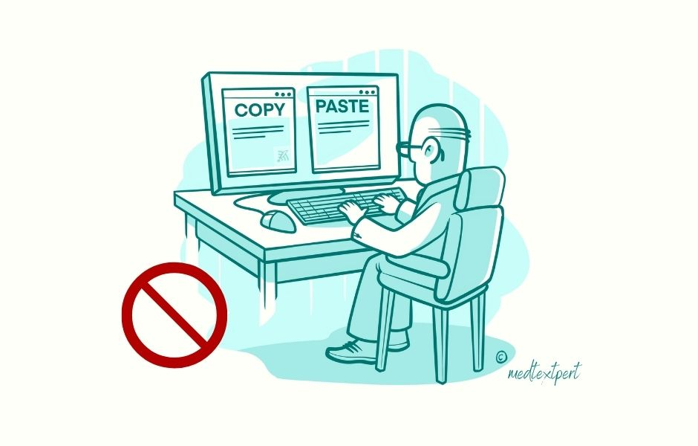
OVERVIEW
License plate recognitioni the extraction of license plate information from camera
It makes use of the technology of image processing,optical character recognition
It plays an impotant role in Intelligent Transport System

Slide 4
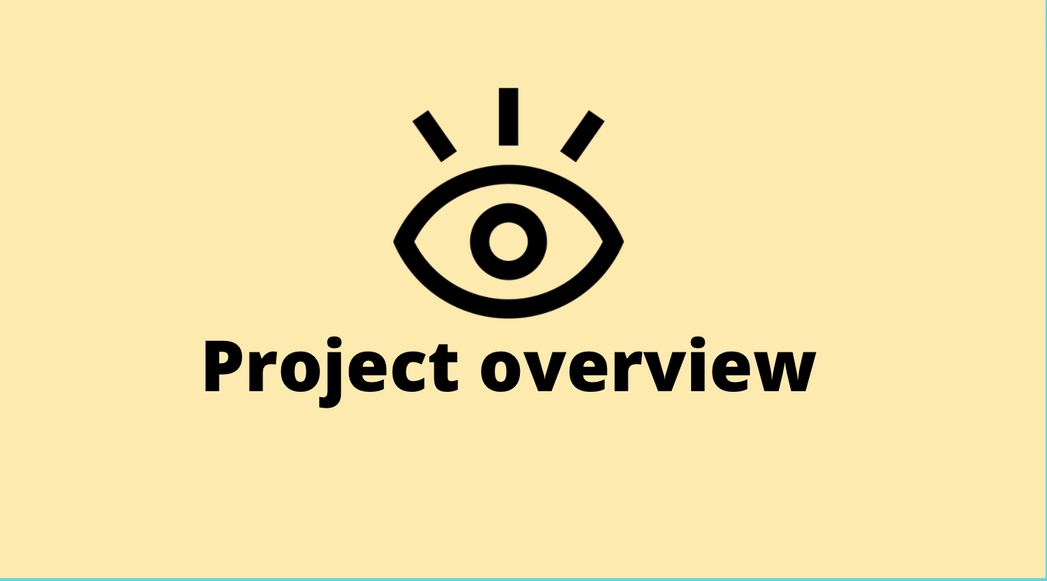
OBJECTIVE
To study different algorithms of image processing
To build a model to demonstrate the operations after the license plates are recognised
To learn machine learning and its library.

Slide 5

Image acquisition
Camera is essential element of LNPR system
Camera is used to capture image of vehicle containing license plate information
Camera can be triggered by:
1.Hardware
2.Software
3. Free Flow

Slide 6

Image Pre-processing
Image capture need pre-processing
To reduce the noise of background
To sharpen plate information
To enhance the processing speed of recognition

Slide 7
Image Restoration
Improving the apperance of an image such as changing brightness and contrast etc.
Restoration technique is based mathematical or prablistic model of image degradation

Slide 8
DATA ANALYSIS PLAN
Dataset has been divided as the training and the testing datasets. To train efficiently and effectively, we have considered 80% of total images as training dataset and the 20% of total images as testing data set to test the prediction accuracy. For simplicity, the images in our training data collection are classified into two categories as “with mask” and “without mask”. used a lightweight image classifier, MobileNetV2, which gives high accuracy and is well suited for mobile devices. In pre-processing steps, resized image to 224 × 224 pixels to maintain consistency.
Trained model is deployed using OpenCV, many deep learning frameworks TensorFlow, Caffe and Torch use OpenCV for deployment. Model is applied on the real time video frames captured using webcam to detect people in the frame wearing mask or not.

Slide 9
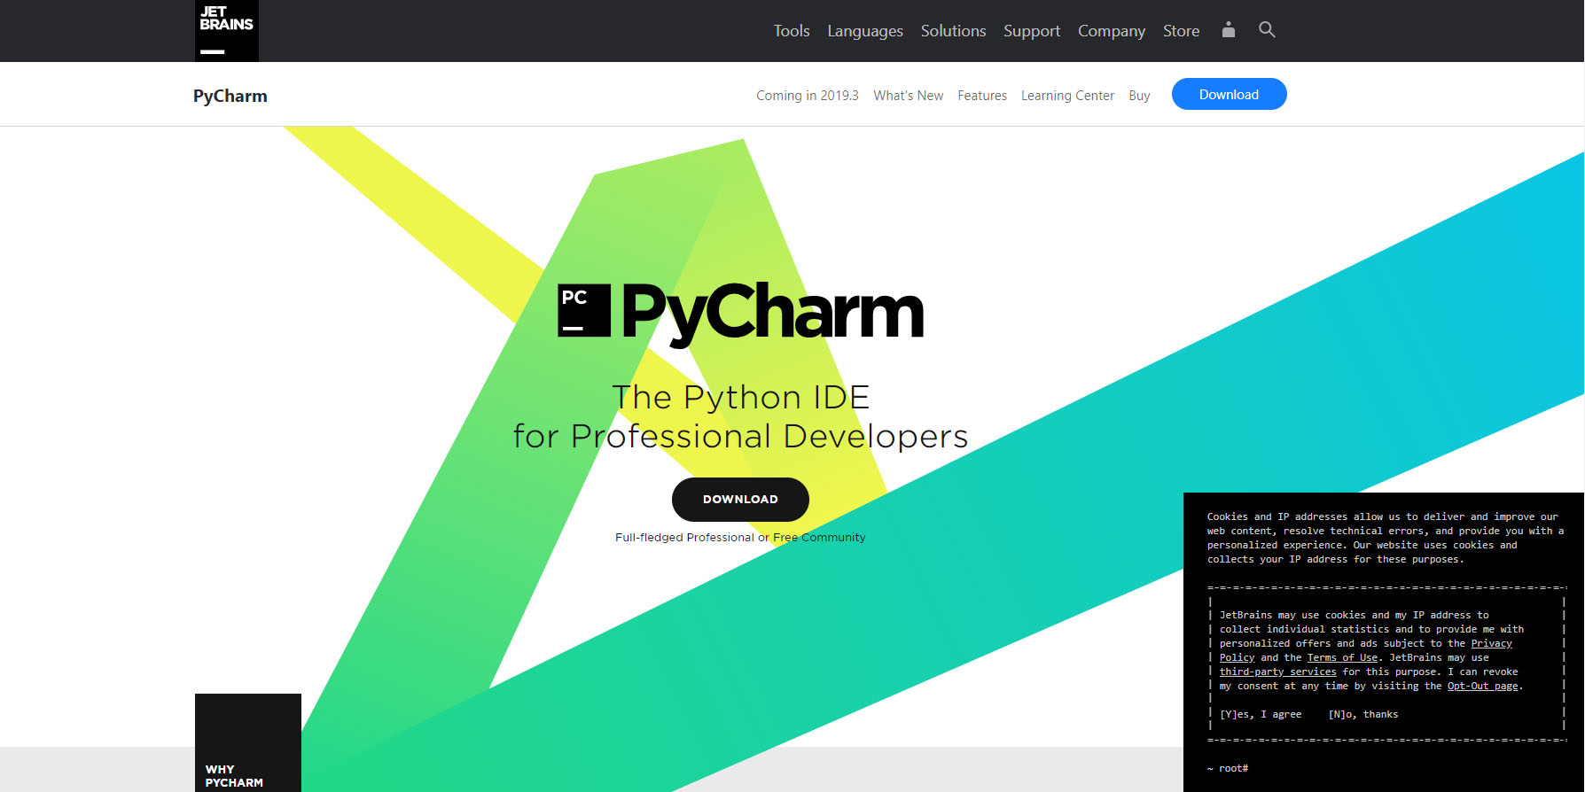
SOFTWARE USED
PyCharm:PyCharm is a dedicated Python Integrated Development Environment (IDE) providing a wide range of essential tools for Python developers, tightly integrated to create a convenient environment for productive Python, web, and data science development.

Slide 10
Image segmentation
Image is broken down into various sub-group.
Reducing the complexity.
Distinguish each character by Image Scissoring algorithm.
Enhance the accuracy of Optical Character Recognition.

Slide 11
Character Recognition
Generate the plate information from input image
The basic process:
Sample of characters are input for training in advance
Input image of segment characters.
Comparing input image with trained data.
Output the results.

Slide 12
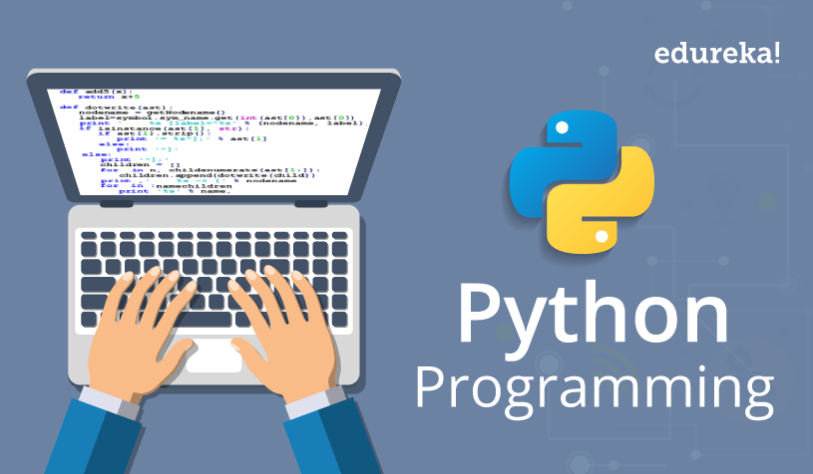
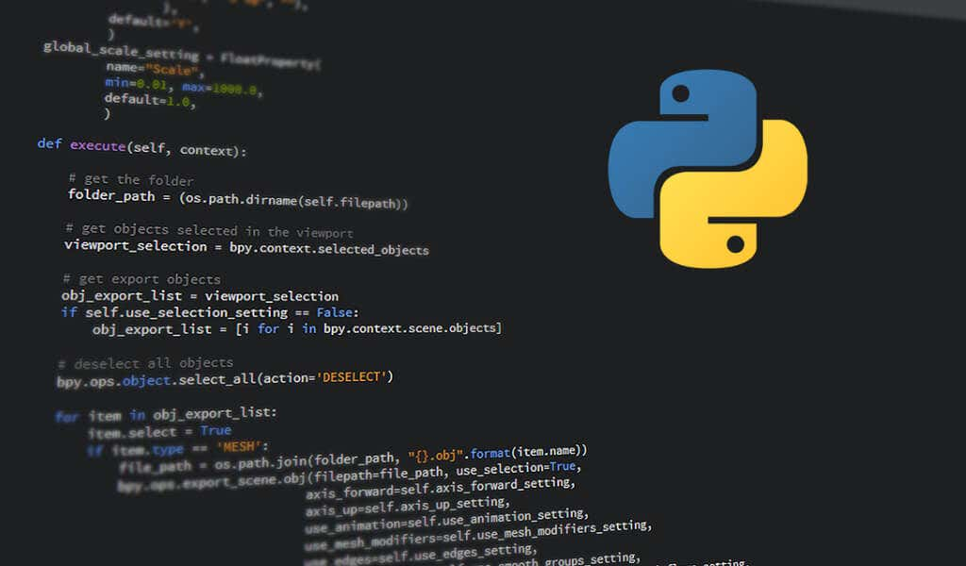

PYTHON
Python is a high-level, interpreted, general-purpose programming language. Its design philosophy emphasizes code readability with the use of significant indentation.

Slide 13


OPENCV
It is a cross-platform library using which we can develop real-time computer vision applications. It mainly focuses on image processing, video capture and analysis including feature like face detection and object detection.Currently Open CV supports a wide variety of programming languages like C++, Python, Java etc. and is available on different platforms including Windows, Linux, OS X, Android, iOS etc.

Slide 14

NUMPY
NumPy is a library for the Python programming language, adding support for large, multi-dimensional arrays and matrices, along with a large collection of highlevel mathematical functions to operate on these arrays. The ancestor of NumPy, Numeric, was originally created by Jim Hugunin with contributions \ from several other developers. In 2005, Travis Oliphant created NumPy by incorporating features of the competing Num array into Numeric, with extensive modifications. NumPy is opensource software and has many contributors

Slide 15
CONCLUSION
LNPR application has been developed on android phone making use of open source libraries.
Different algorithms for images acquisition,image processing, plate detection, and character recognition has been implemented

