Slide 1
Reports
File created on: 19/01/2021 02:37:17 GMT

Slide 2


Slide 3
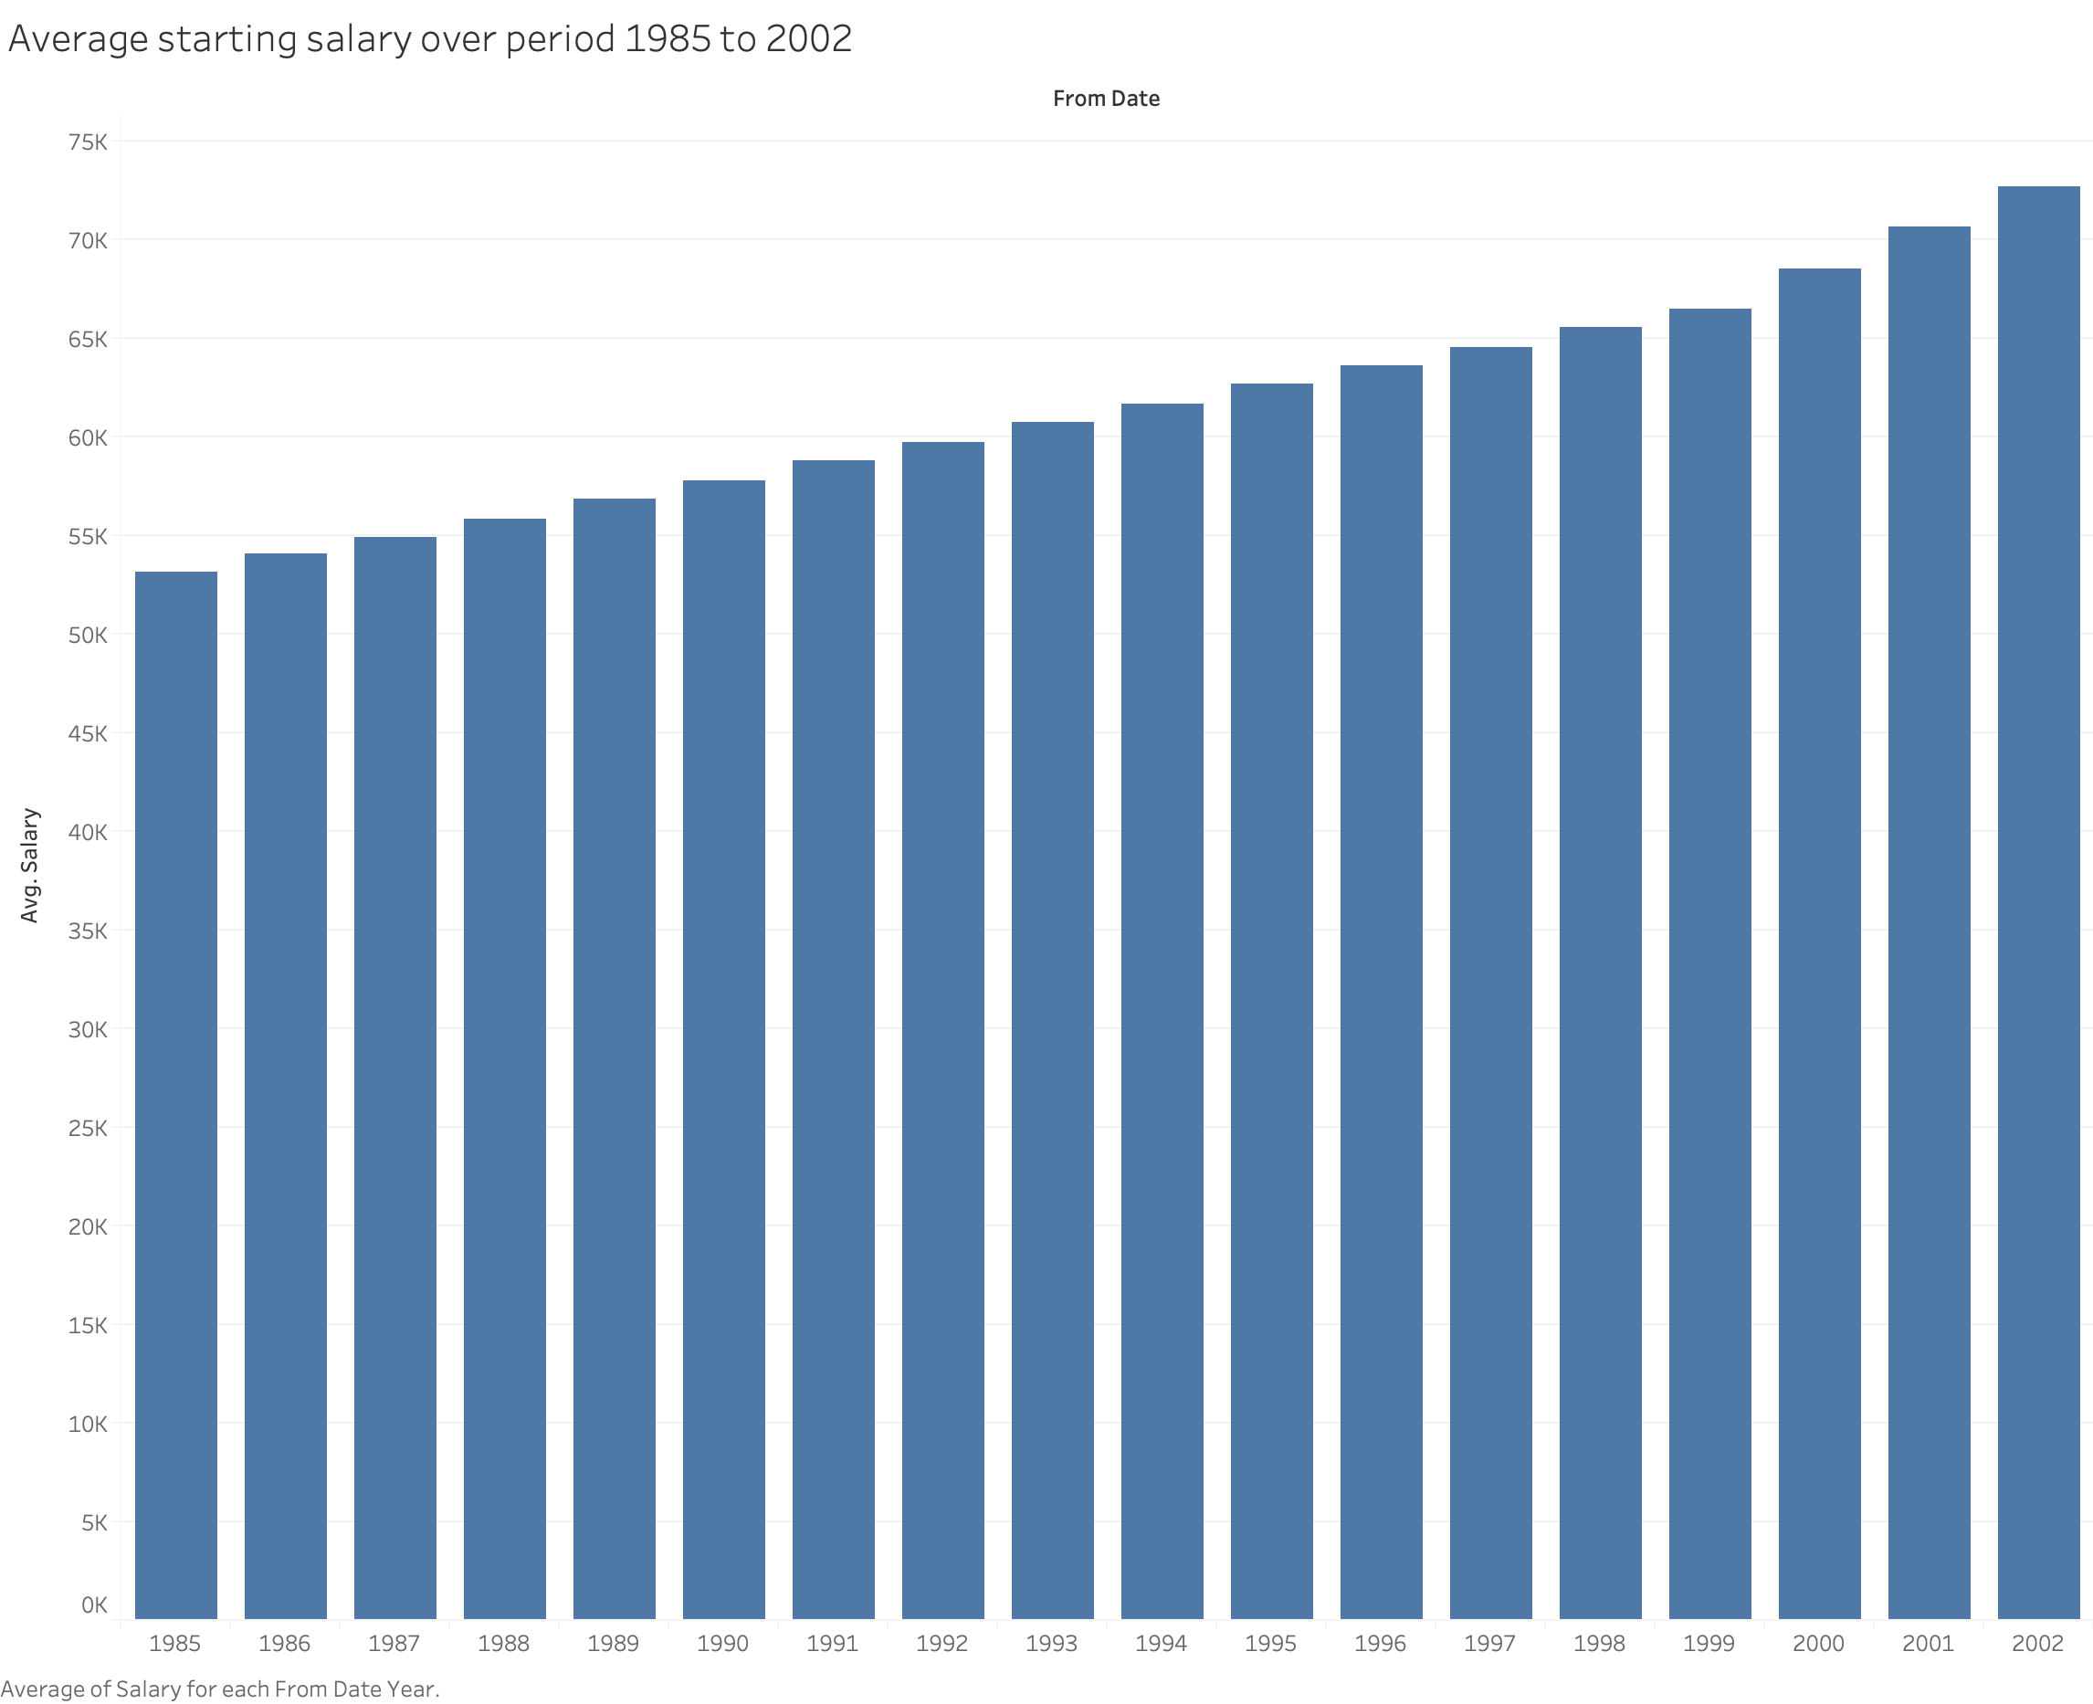

Slide 4
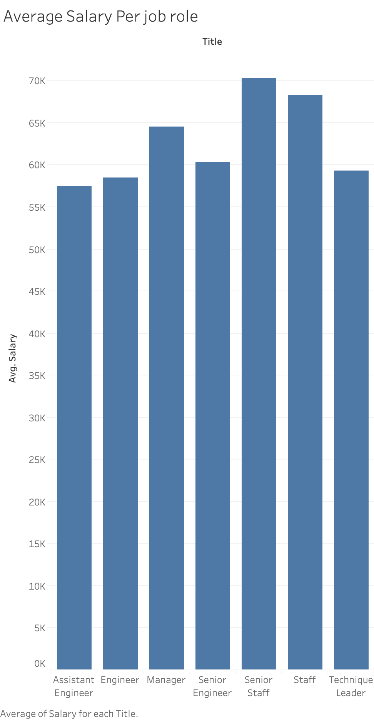

Slide 5
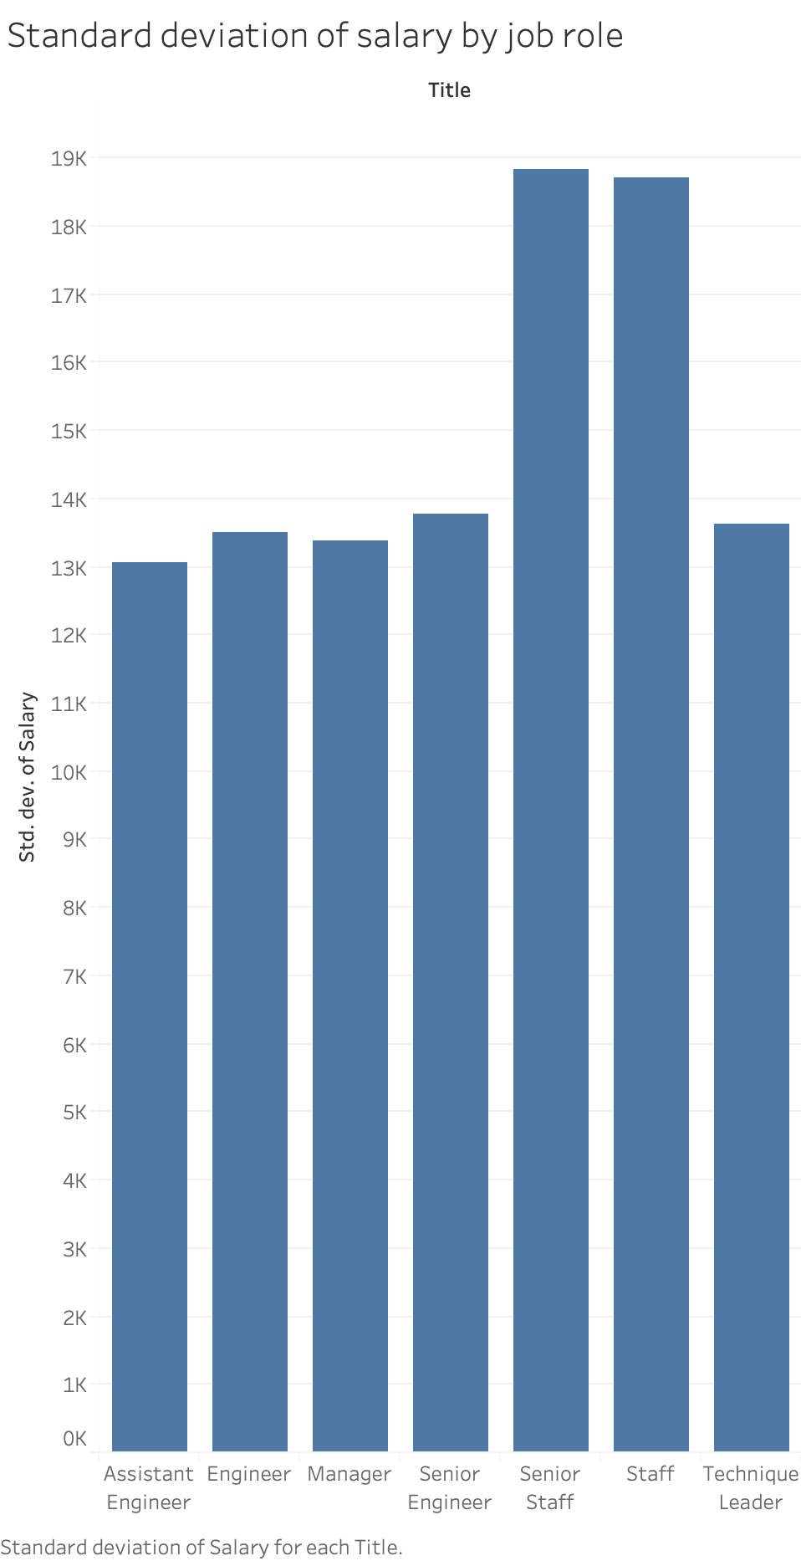

Slide 6
