Slide 1
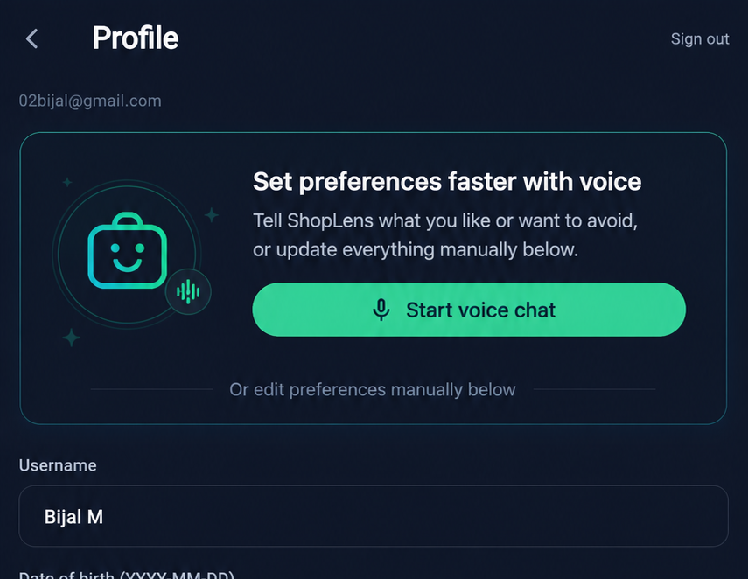
Voice assistant roadmap
One profile entry point today, richer personalization over time
Start with a guided voice option inside profile settings, then let the assistant keep learning from real shopping conversations.
Future updates to voice chat
1
Keep it in profile settings
Use voice at the start of profile setup while still showing users they can edit everything manually below.
2
Learn from live search chat
As users talk to find products, ShopLens can keep refining preferences in the background to personalize future results.
3
Add sizes and measurements
Store fit and sizing details in the profile so users can go straight from discovery to purchase without re-entering size info.
Profile settings + voice onboarding

