Slide 1
Ministry/ Organization name:
Poornima Institute of Engineering and Technology, Jaipur
Problem Statement : Intelligent attendance solution for MGNREGA workers.
Problem Statement No. : MK203 Team Name : SNAPDRAGON2.0 Team Leader Name: Pradeep Singh Choudhary College Code : C-25158

Slide 2
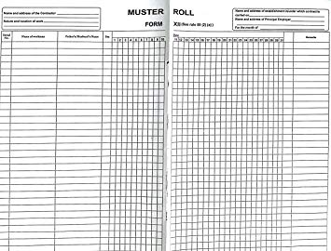
Problems Faced Till Now:-
Muster Rolls are not maintained & checked properly by the Panchayats.
Corruption has been cited as a problem in MGNREGA implementation due to fraud Attendance.
Delay in fund allocation & payment of wages .
Irregularities at work sites are common.
Mates are often incapable of managing the worksites.
Workers are not Arriving On time for Work.

Slide 3
Solution
Smart Attendance
Entry Attendance
Exit Attendance
Report Submission
Attendance Taken through Web/App IN online mode.
Attendance is verified by Supervisor.
After taking Attendance report is daily updated in database.

Slide 4
Solution
Make an web application of attendance by using Aadhar Enabled Biometric Attendance System(AEBAS) of the workers for attendance.
Entry attendance using Web application in which supervisor can access the workers report by a work-site code.
Taking Random attendance decided by Machine Learning Algorithm after the entry of workers whose notification will be automatically announced to Supervisor.
Exit attendance to verify the worker.
Absentee during random attendance will be marked as absent for whole day.
Absentee during exit attendance will be counted as half day.

Slide 5
Solution
Update the report sheet daily with pictures of Work.
Weekly SMS will be send to workers to confirm their attendance to them.
After completion of work attendance of total working days will be provided to each worker.
Wages to be paid to workers shall be calculated on the basis of no. of days counted.
Wages will be paid to individual’s Bank Account.
Workers can add complaints which will be shown directly to Admin.

Slide 6
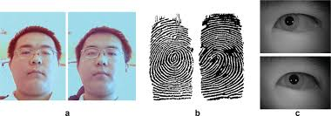
Tools And Technology
WEB Development -> HTML , CSS, Javascript, Php, Bootstrap.
Database Used -> SQL.
For Notification -> Fast2SMS API
Machine Learning -> Algorithms Used:-
Face Detection ->1) Open cv2 Library.
2)Face-recognition module,Cascade Library
Biometric -> 3)Scan Line Algorithm
HARDWARE :
1)Fingerprint Biometric Device.
2)Webcamera.

Slide 7
UML Diagram
Database of Workers through Aadhar Linking
Manager Record
Verify Reports
Check Complaints
Admin Panel
Wages Generation
Add new Work
Management of Workers:-Attendance
Work Assigning
Manager Panel
Take Pictures of Work
Work Analyzing
Notification
View Banking Transaction Systems
Worker Panel
Add Complaints
View Attendance

Slide 8
Module to be used
Fund Module
Admin Module
Worker Module
Registration of Jobcards
Fund Transfer from Central Govt.
Fund Transfer from State Govt.
Planning of Works
Demand for Work
Work Estimation
State Employed Guarantee Fund
Work Allocation
Technical Approval
District
Generation of E-MR
E-FMS
Financial & Admin Approval
Attendance
Payment of Wages
Measurement
Payment of Material
Shelf of Work
Wage List Generation
Admin Expenditure

Slide 9
Team with expertise
Team Leader Name :- Pradeep Singh Choudhary (9694807325,9664149754) Mail Id: 2017pietcspradeep078@poornima.org
Team Members :-
Nikhil Jain(7976699116)
Sachin Saurabh(8094682702)
Nishita Bihani(6350386531)
Manish Agarwal(7062788365)
Pradeep Singh Tomar(8278664750)
Team Mentor :- Dr. Amit Kumar Gupta(7014402055)

