Slide 1
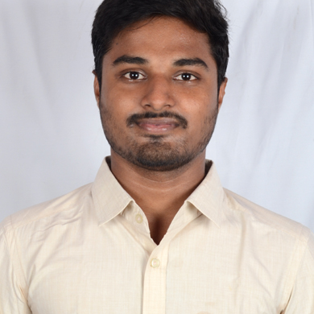
Venkata Sathya Pradeep
Analyst/Software Engineer
Bachelor of Technology in
Electronics Instrumentation Engineering
2016 - 2020
Banglore
Skills
Venkata-sathya-pradeep.bachu@capgemini.com
+91 8374155713
Backend | Java Basics, OOPS, Generics, Collections, Arrays, Loops and Stream API
Framework | Spring Boot, Spring Core, Spring Data JPA
Frontend | Components, Hooks, Event handling, Redux, Reducers, Testing using Jasmin & Karma
Database | PostgreSQL and MongoDB
Tools | Git, Postman, Gradle, IDE, Eclipse, Visual Studio Code
A4
Full Stack Developer trained on Java Hands on experience in
Core Java
Spring Framework
Git and GitHub
JPA with Hibernate
MongoDB and Postgres
HTML, CSS and JavaScript
React
Project on IPL Fantasy League
IPL Fantasy League is a web-based application for bidding. This application will have two types of users namely, admin and bidder.
Bidder can sign in with the help of email-id or social login.
Admin is responsible for scheduling and rescheduling of matches, updating team stats.
Tools used are Visual Studio Code & Spring Boot.

