Slide 1
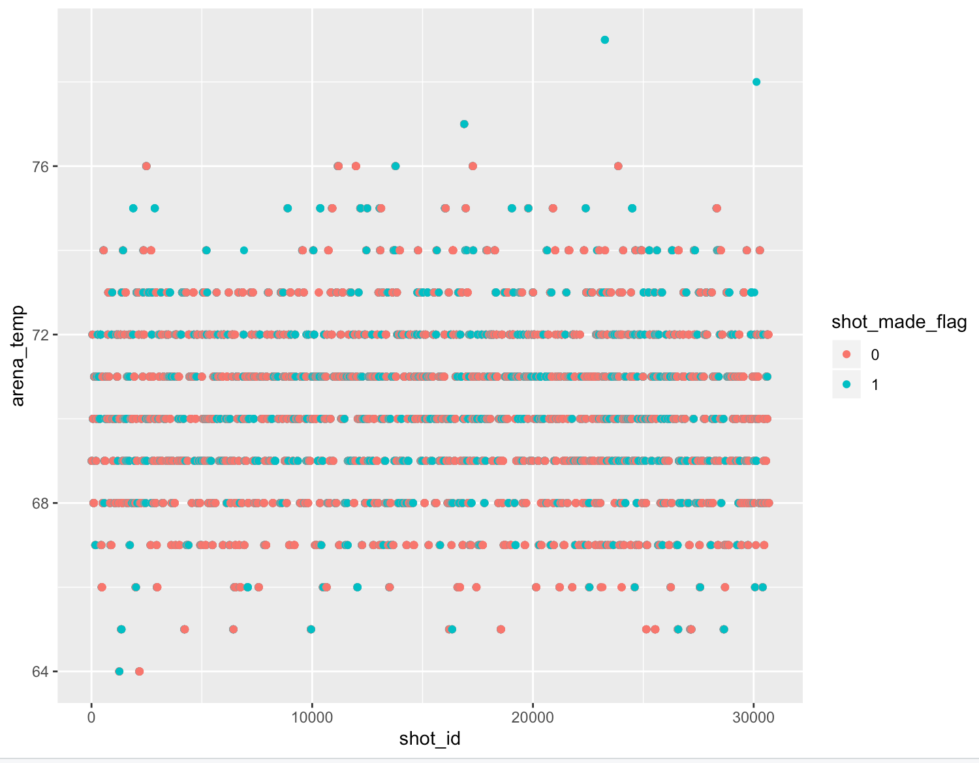
Analysis of Kobe Data Most of the shots made b/w 65 and 75 temp

Slide 2
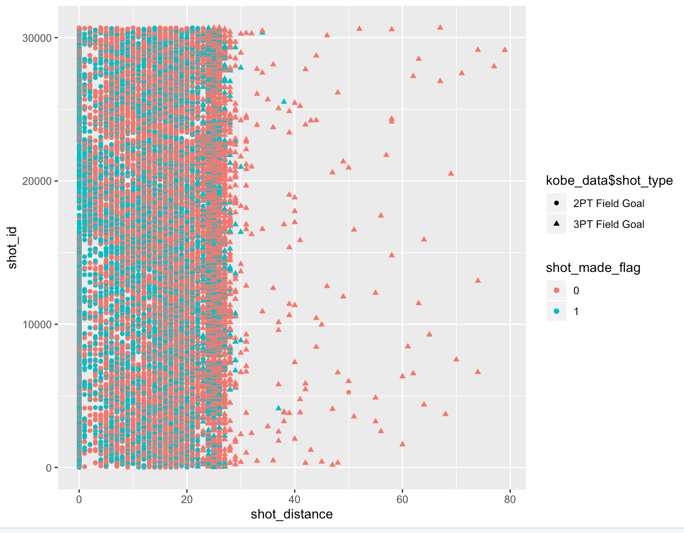
Most shots made when shot distance is below 25

Slide 3
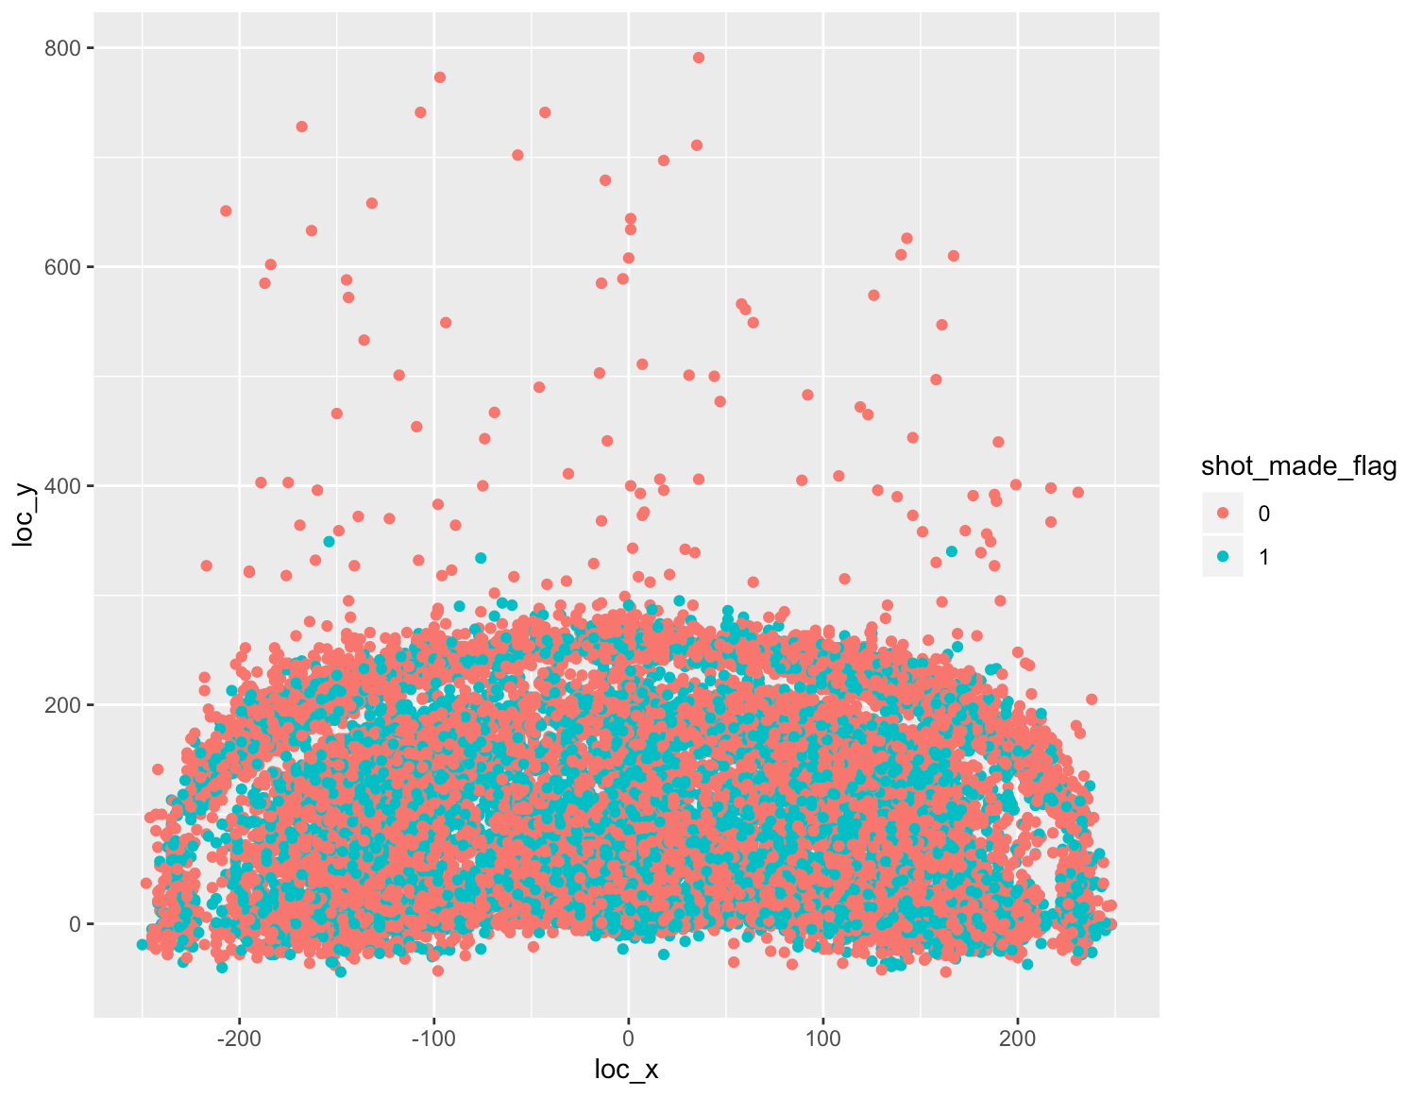
Court x-y coordinates has influence on success of shot

Slide 4
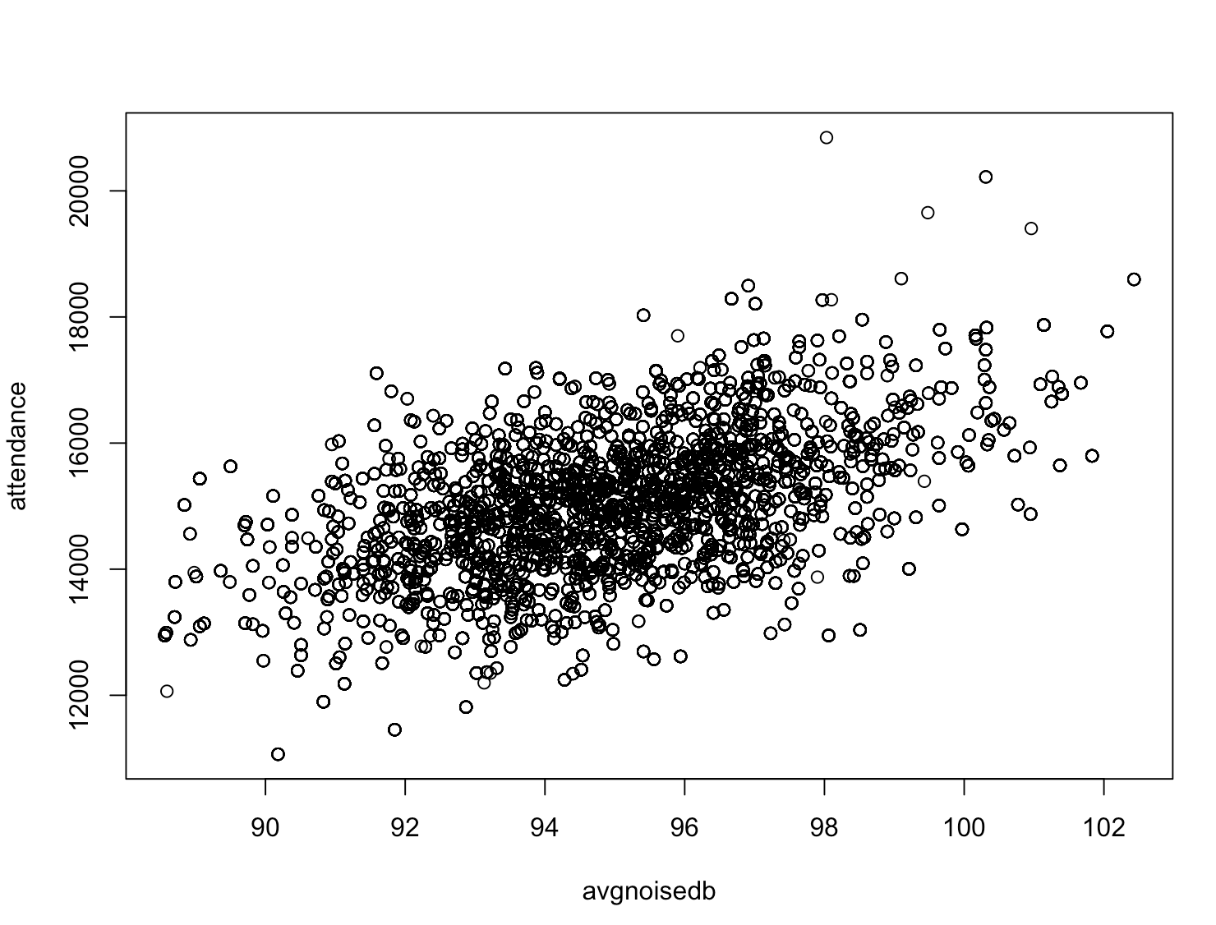
Attendence and noise has correlation

Slide 5
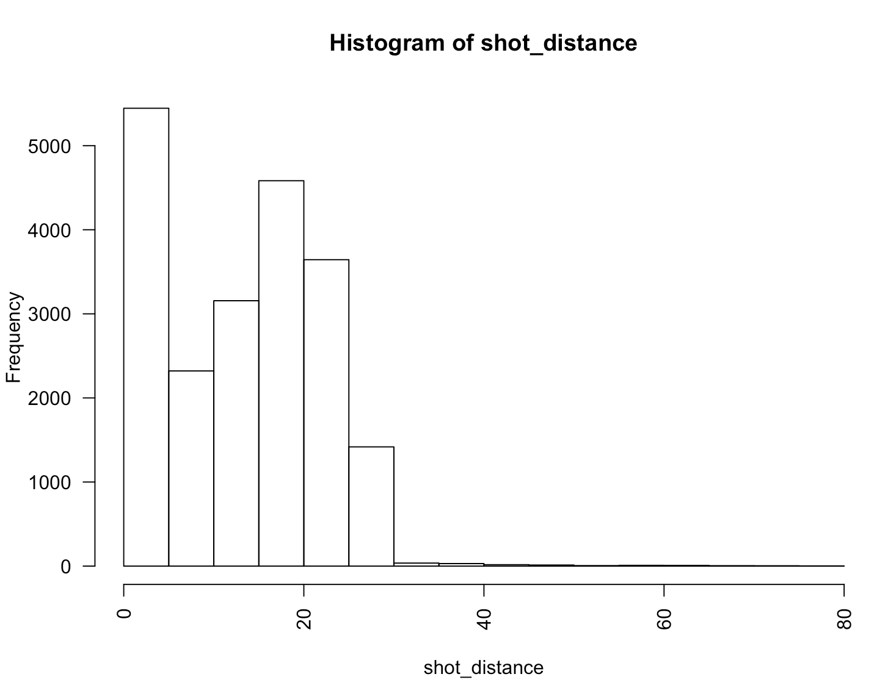
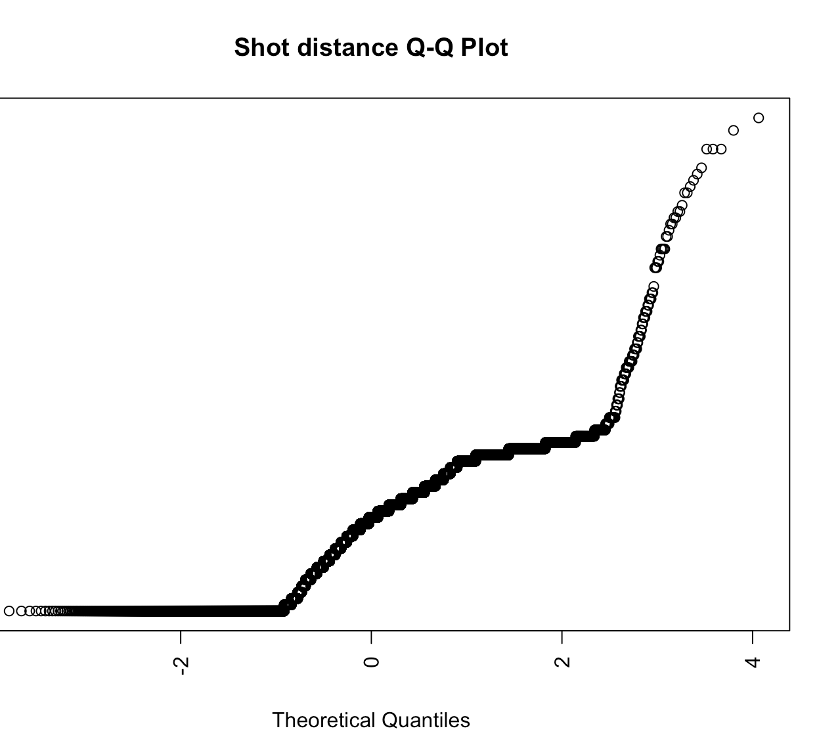
Checking for normality
Most continuous explanatory vars are normally distributed.
Shot_distance seem to have some skewed ness but most of the frequency is around zero. The skewedness does not warrant for a transformation.

Slide 6
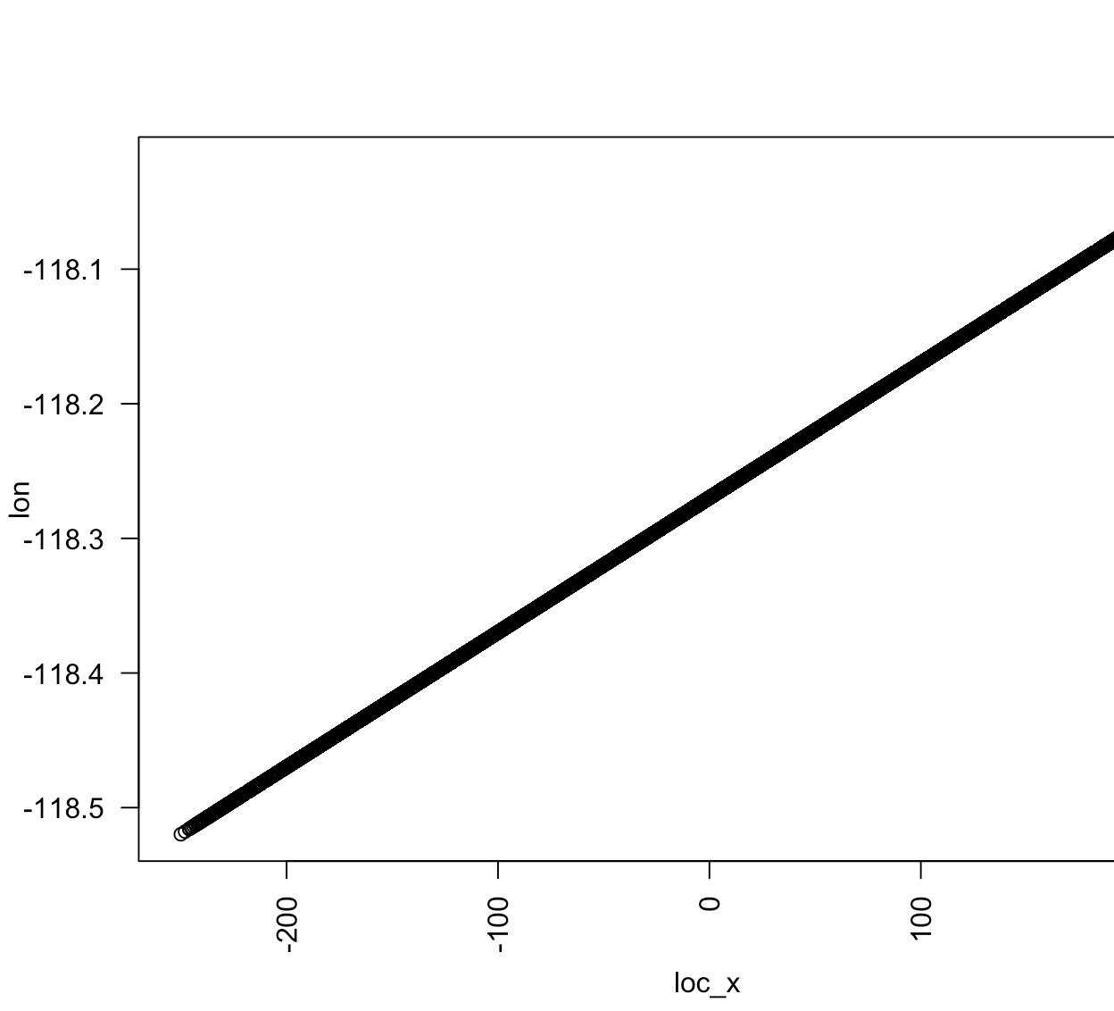
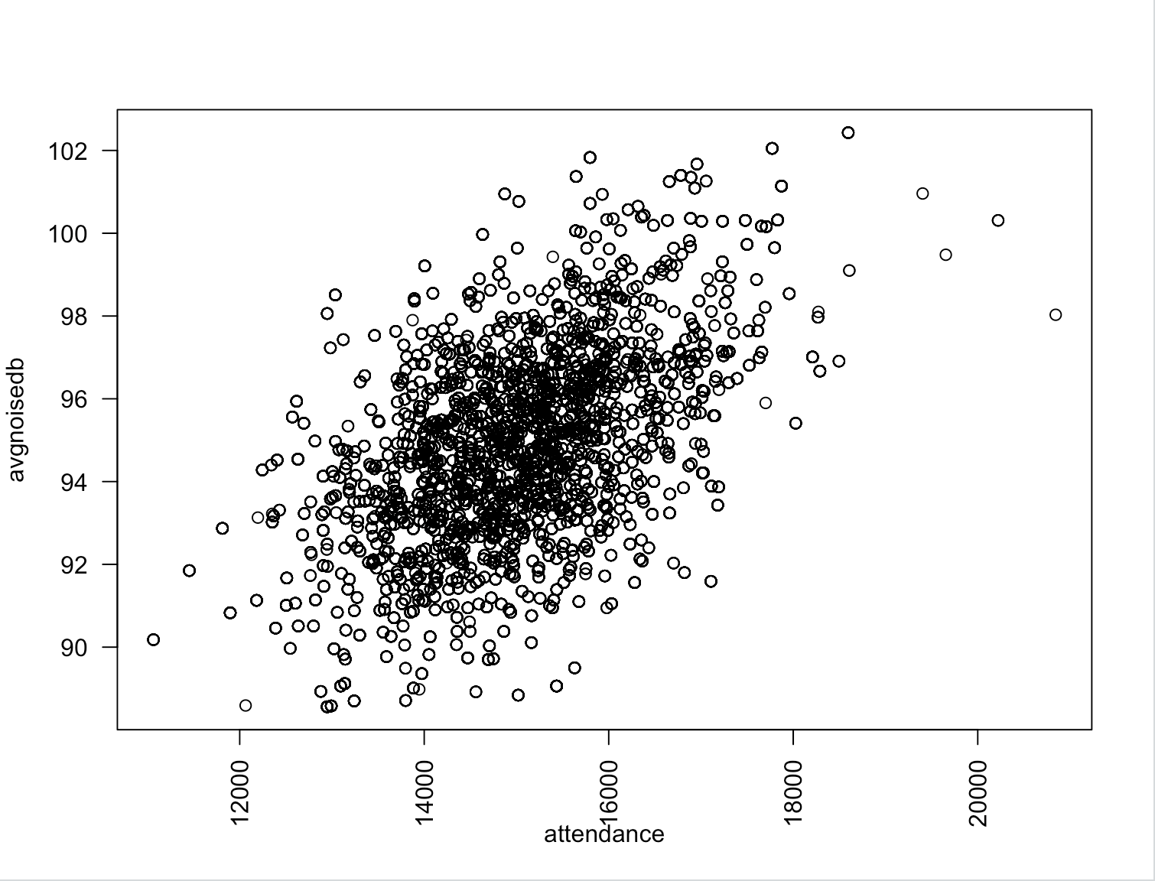
multicolinearity
Attendance and avgnoise are correlated
Loc_x and lon are correlated.

Slide 7
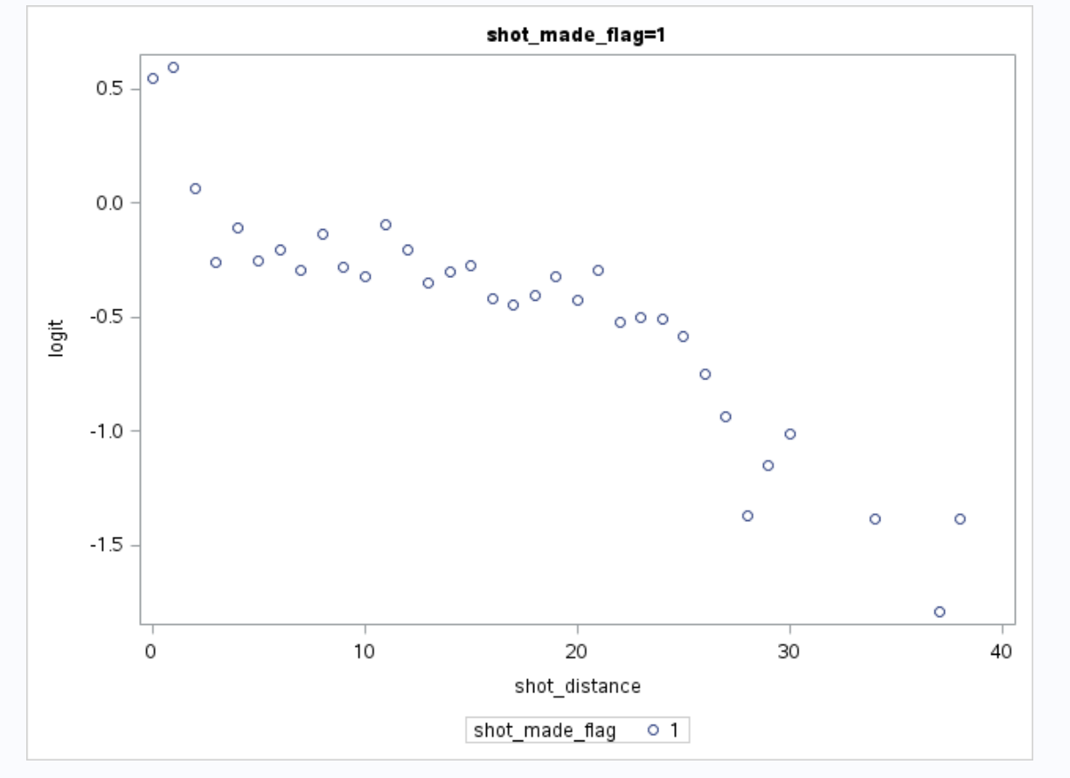
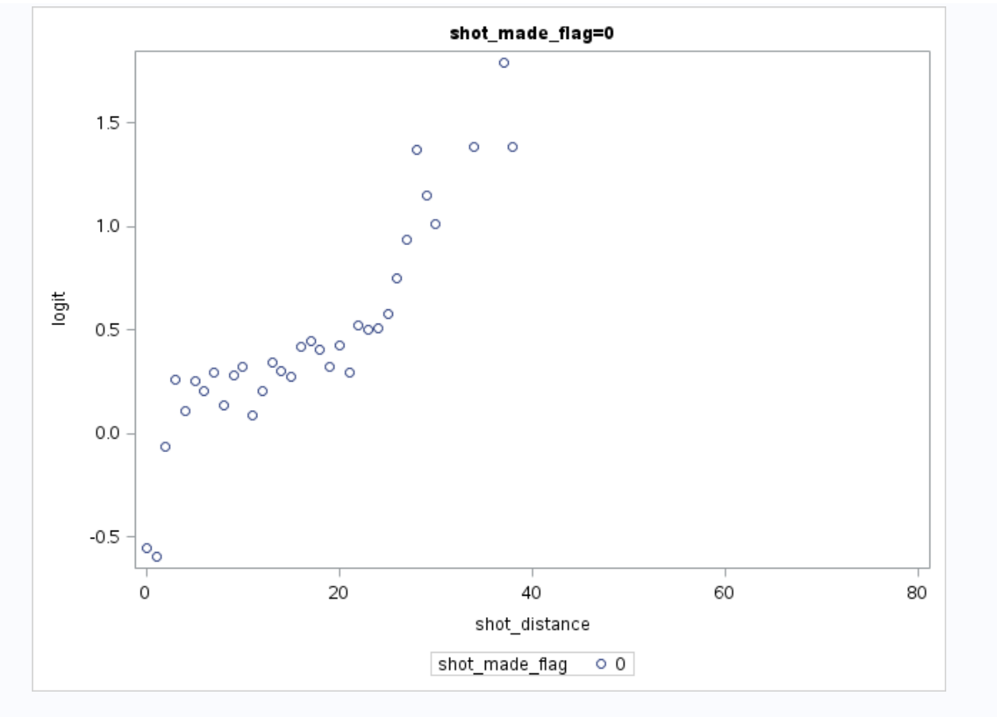
Logit variation with shot distance

Slide 8
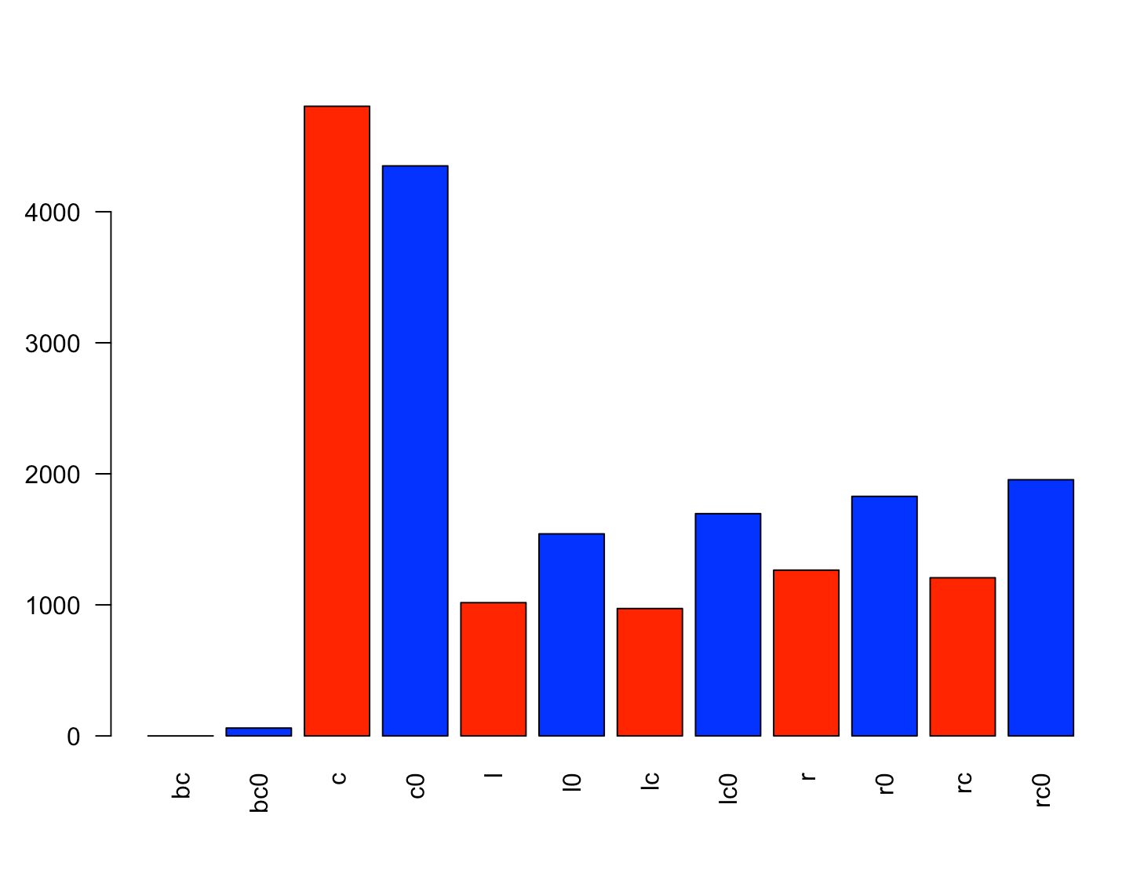
Shot made and missed by zone area
Red bars represent shot made and blue is shot missed. Center zone shots has more shots made than missed. All other areas have more missed than made. Back center (bc) is the least. Zero shot made and 60 shots missed.

