Slide 1
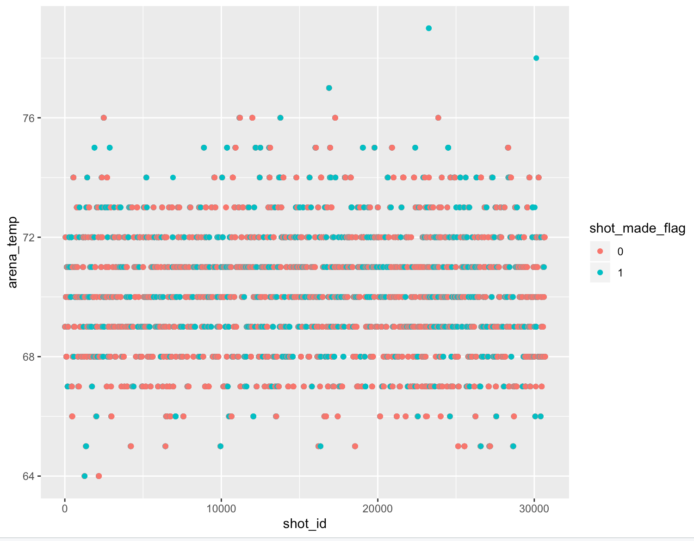
Analysis of Kobe Data Most of the shots made b/w 65 and 75 temp

Slide 2
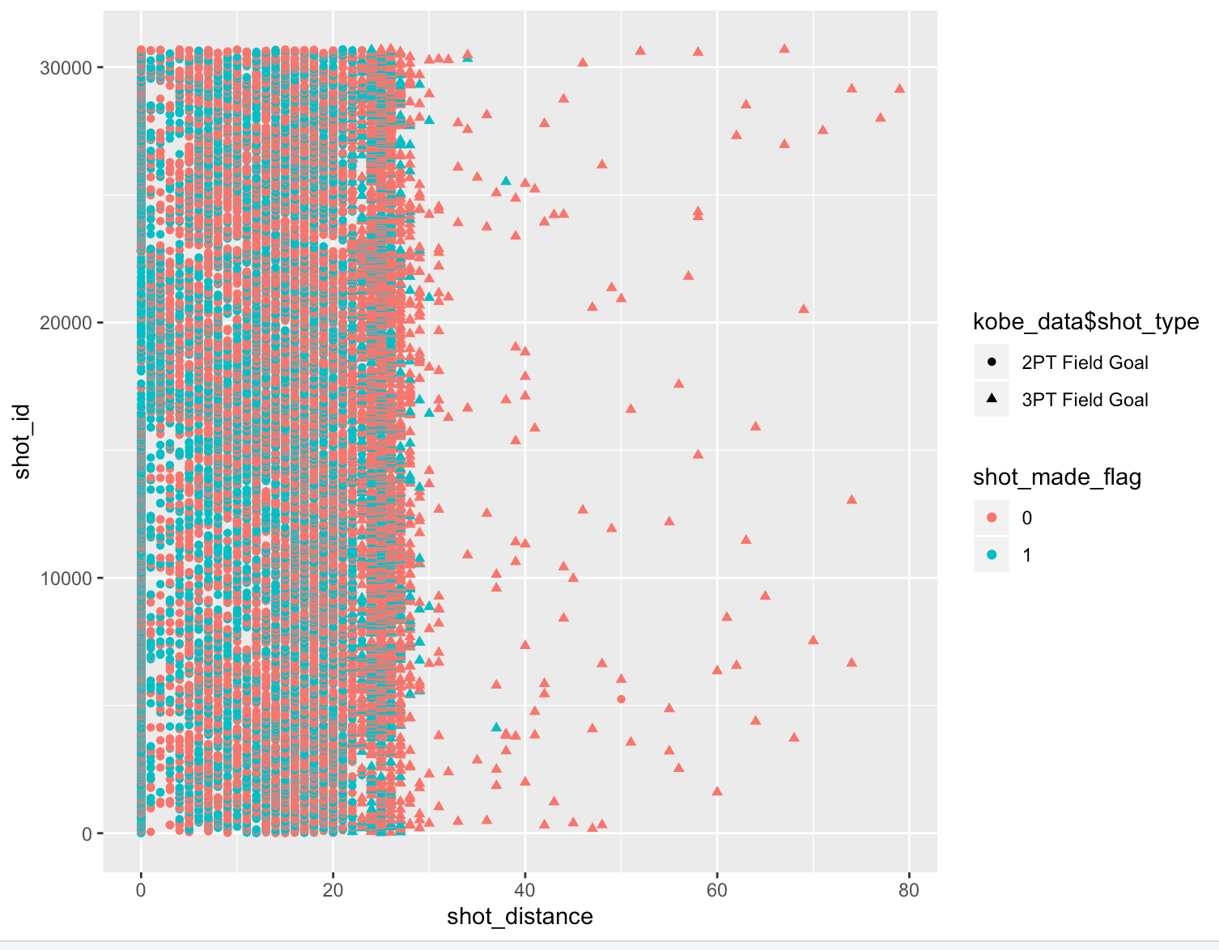
Most shots made when shot distance is below 25

Slide 3
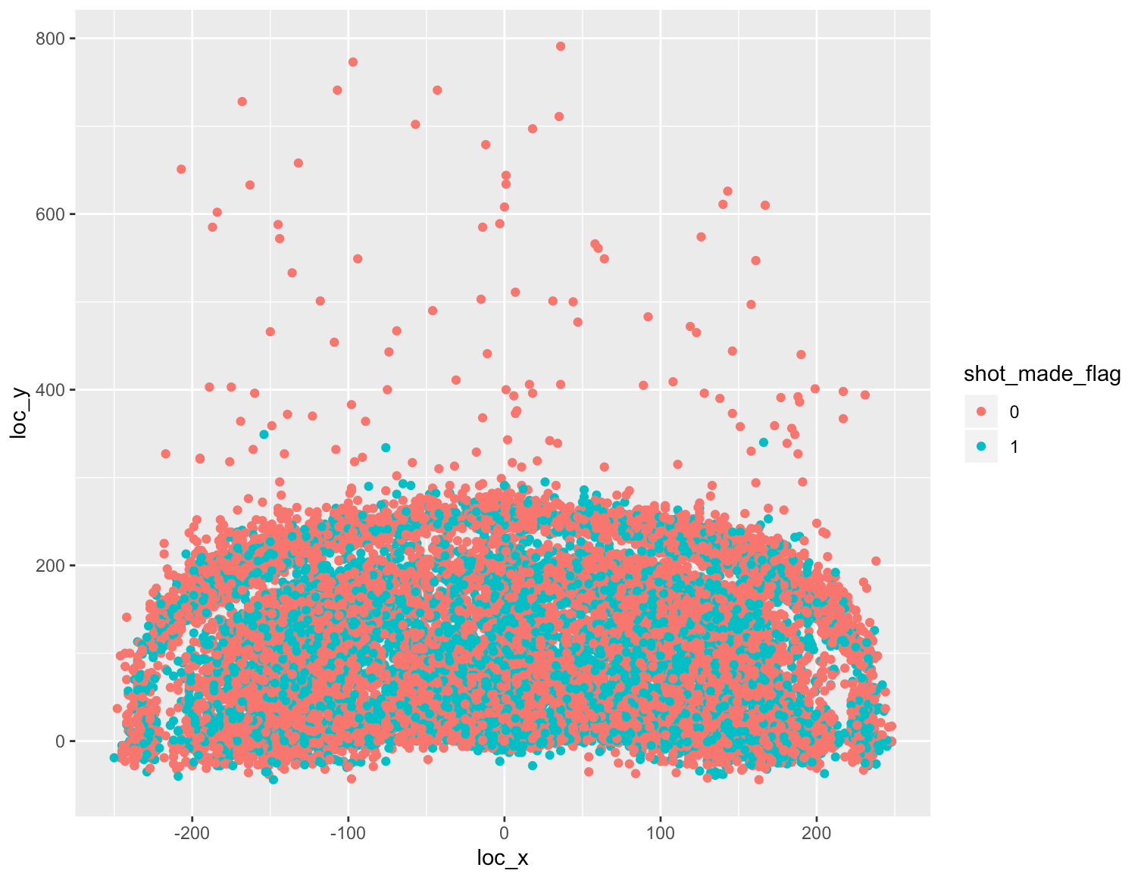
Court x-y coordinates has influence on success of shot

Slide 4
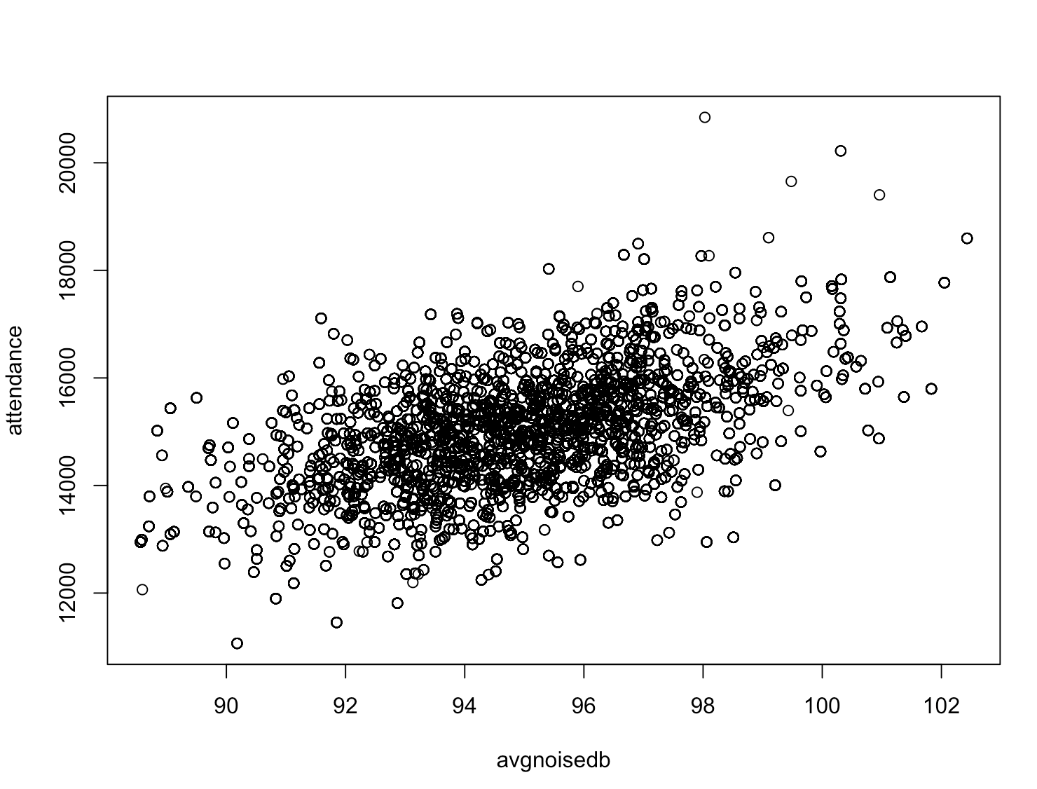
Attendence and noise has correlation

Slide 5
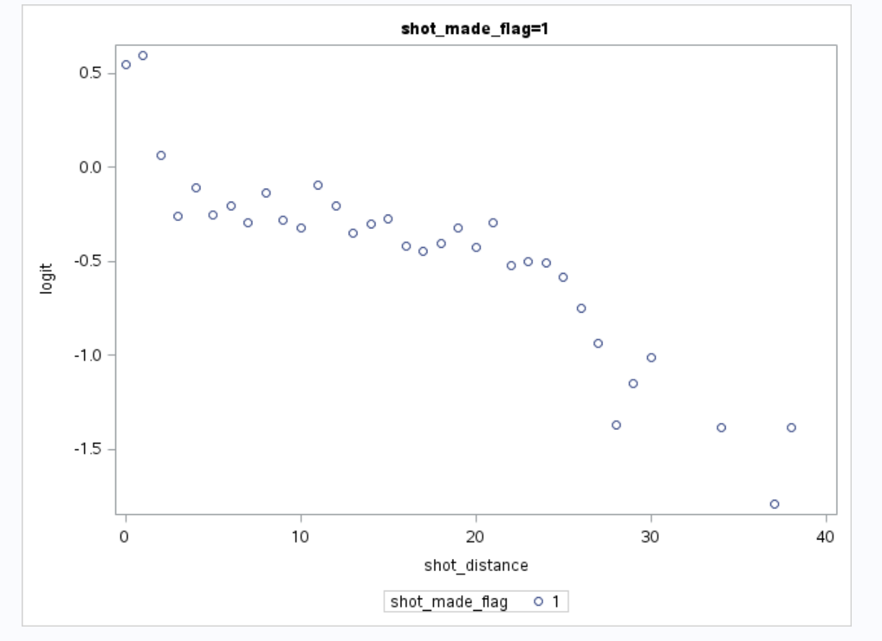
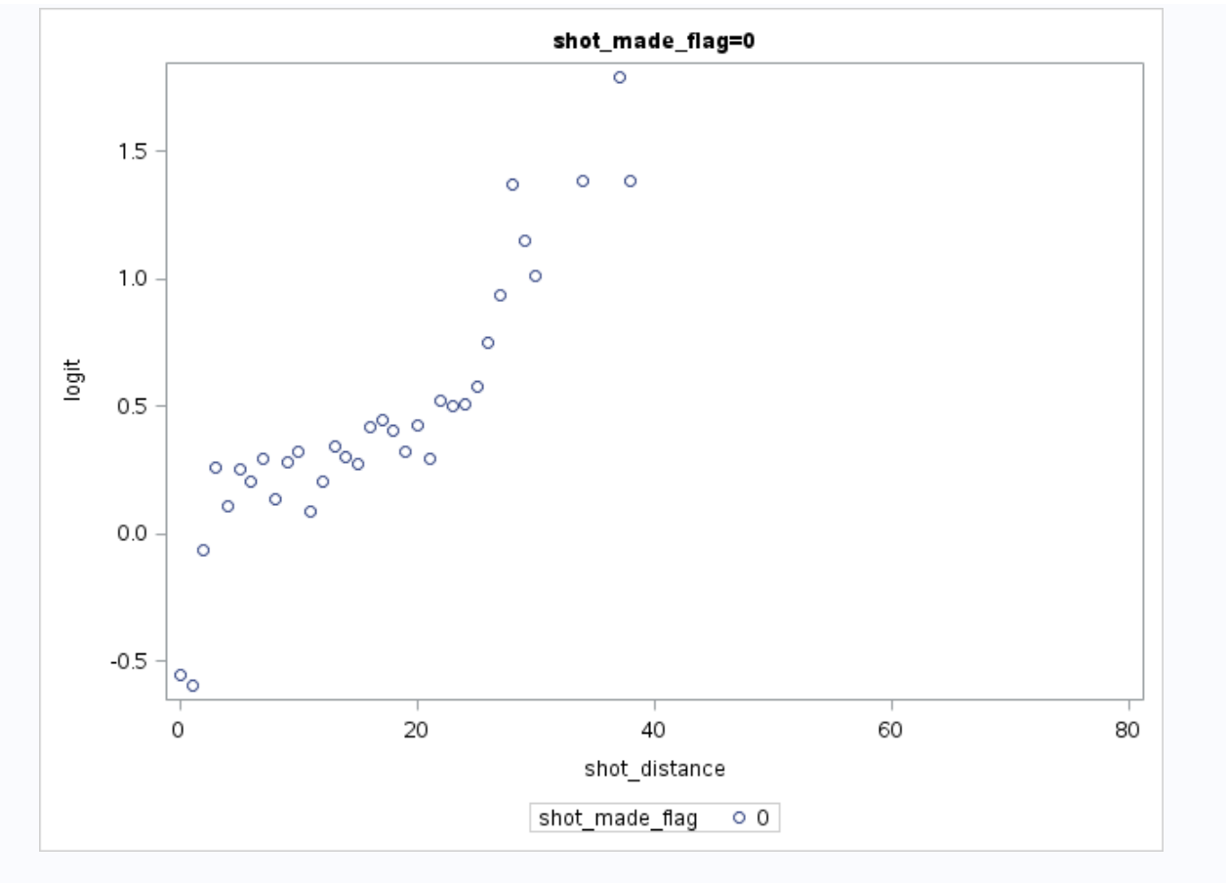
Logit variation with shot distance

