Slide 1
Case Study 1 – Beer!
A data exploration project. Explore the features of beers and breweries.

Slide 2

Description of data set.
2410 different beers produced by 510 breweries in United States.
The features known about each beer type
Brewery Name
City and State
Beer Name
IBU (International Bitterness Unit)
ABV (Alcohol by Volume, e.g., 0.045 = 4.5%)
Style (American IPA, German Pilsner, etc.)
Ounces (12 or 16)
IBU – Measures the isohumulone in a beer – this is an acid imparted from the hops. https://www.craftbeerjoe.com/craft-beer-styles/hoppy-vs-bitter/
Notes:
https://www.craftbeerjoe.com/craft-beer-styles/hoppy-vs-bitter/
IBU - It measures the isohumulone in a beer – this is an acid imparted from the hops.

Slide 3
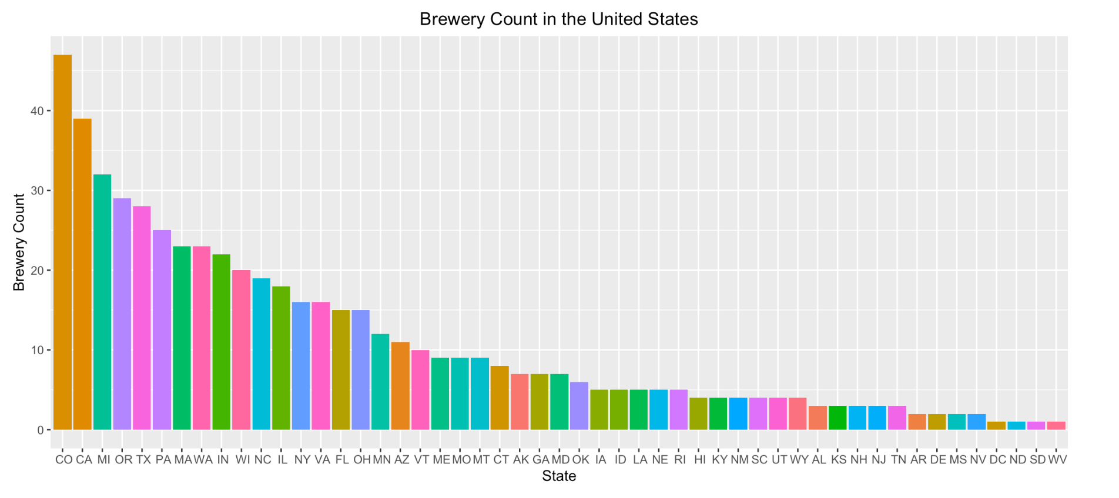
Breweries across the geography
Want to setup a new brewery. Which state could be the best?
From the plot below , Colorado and California rank the 1st and the 2nd. This indicates that conditions are conducive to run a brewery in these states. Or it could be saturated, and West Virginia is the place to go.

Slide 4
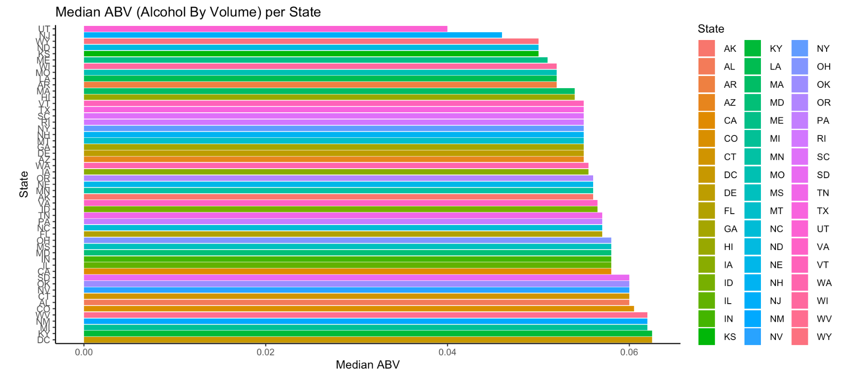
Alcohol by Volume
Which state produces beers with high median alcohol volume?
DC and KY are topping the chart in the bar plot below

Slide 5
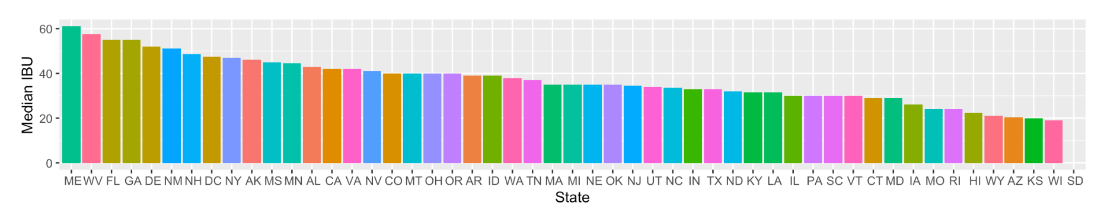
Bitterness of the Beers
Which state produces the least median bitterness.
Median bitterness of Beers from Kansas and Wisconsin are lowest.
Notes:
Note that malts can balance out the effect of IBU. Should consider Relative & Perceived Bitterness. More malts generally mean a higher ABV. No data for SD.

Slide 6

Maximum Bitterness and Alcohol content
Upslope Brewing Company Boulder, Colorado produces beer with alcohol content at 0.128 which is the highest alcohol content among all types of beers. The name of the beer is “Lee Hill Series”. Surely you will be on top of the hill.
Astoria Brewing Company in the city of Astoria , Oregon produces beer with IBU value of 138 which has the highest bitter score among all the beers. It has be aptly named as “Bitter Bitch Imperial”.

Slide 7

Alcohol by Volume Summary
There are 62 cases with no ABV data, which could be non-alcoholic beer.
The lowest is .001, which is considered non alcoholic and the highest is 12.8%, which is quite high for a beer.
50% of the data lies between 5 and 6.7 % ABV, which seems typical of beer.

Slide 8

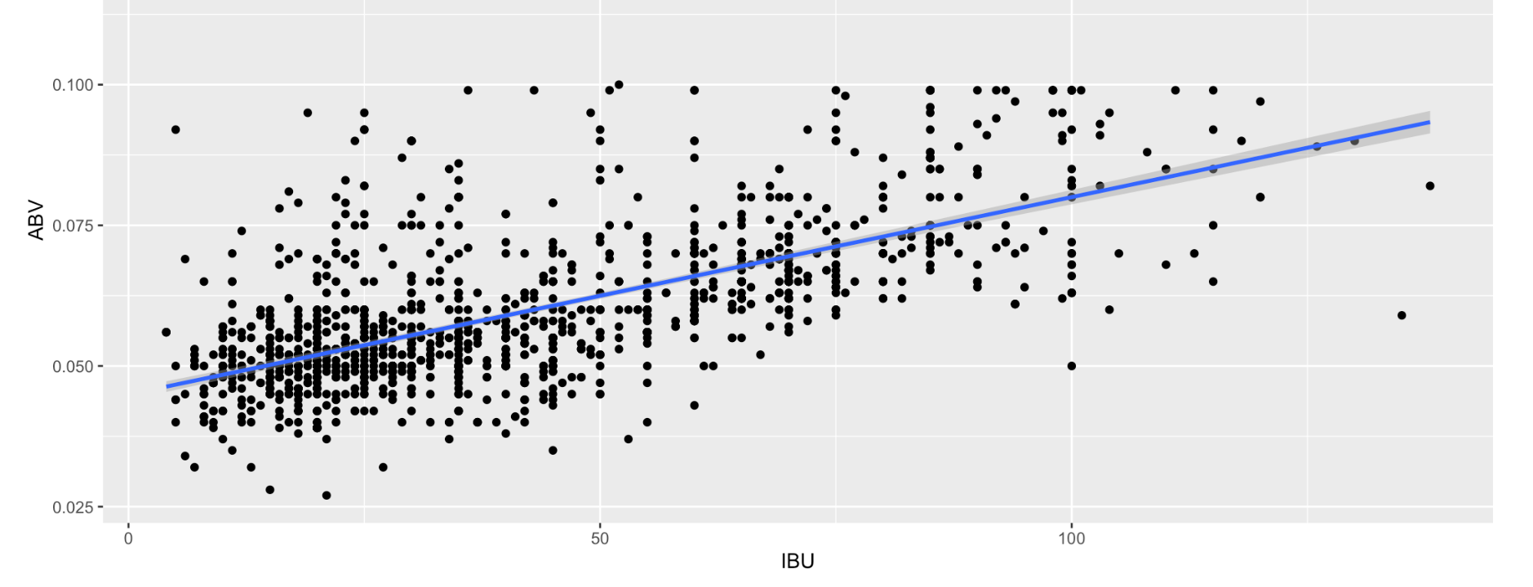
Alcohol by volume and Bitterness unit
Is there a relation between ABV and IBU?
The scatter plot below suggests that there a positive correlation between ABV and IBU. As alcohol content goes up, the bitterness also goes up.

Slide 9
Beer with high alcohol under bitterness of 50
Beer named Bourbon Barrel Batch 666: Sympathy for the Devil has highest alcohol content at 0.099 and IBV value at 36
Notes:
Beer named Bourbon Barrel Batch 666: Sympathy for the Devil has highest alcohol content at 0.099 and IBV value at 36

Slide 10
