Slide 1

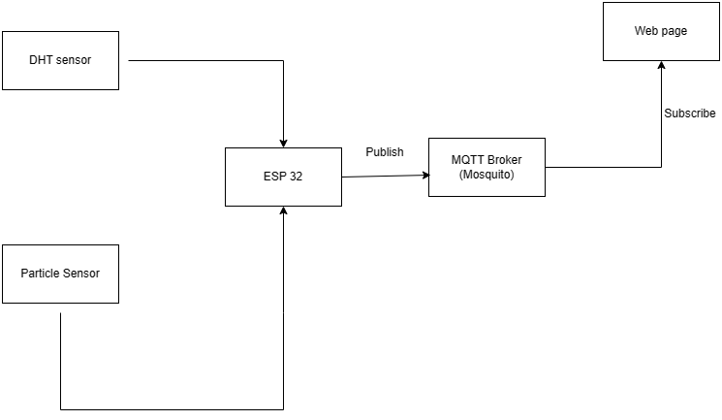
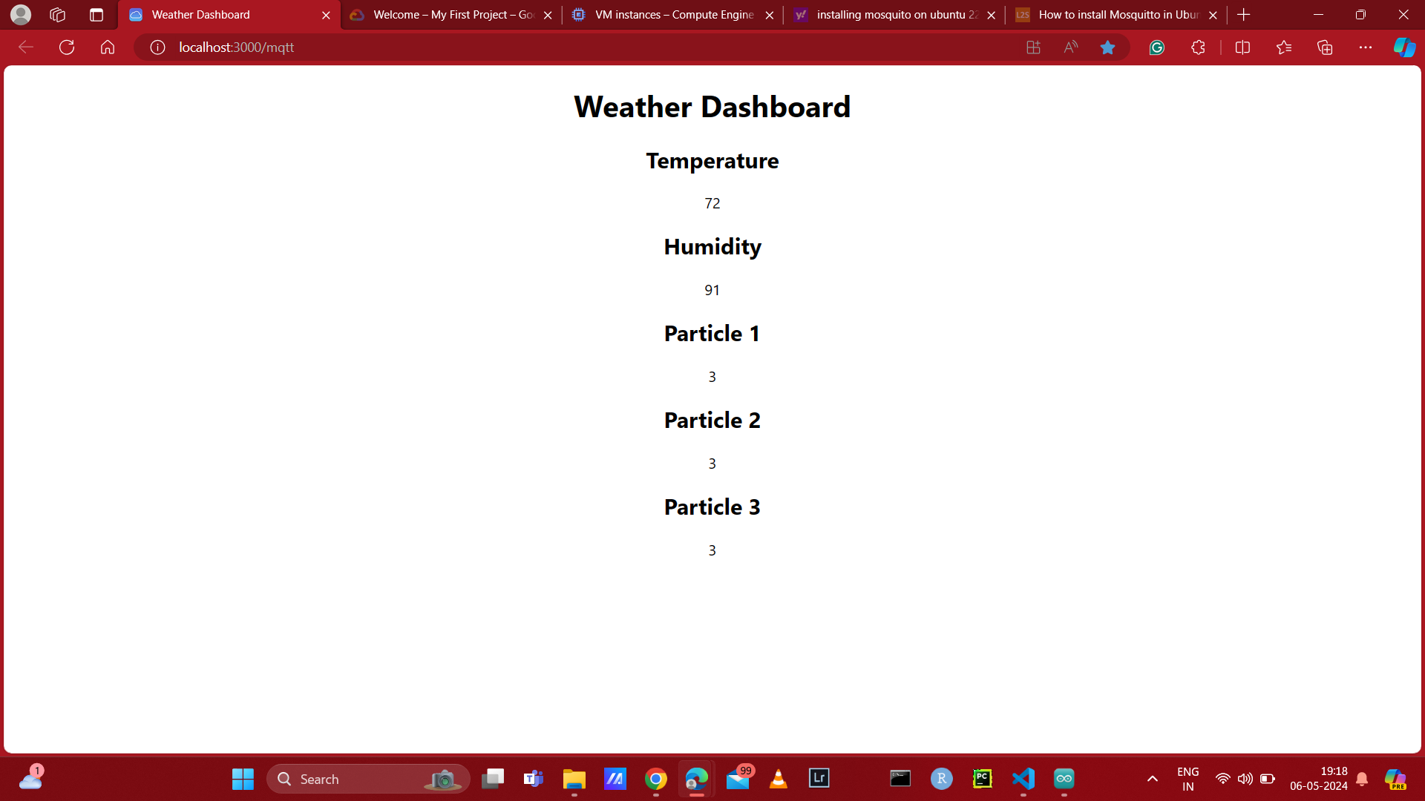


System for Monitoring Weather Conditions and Particle Matter
Sai Pradeep Reddy Kukunooru , Venkata Nageswara Rao Tota, Sai Prashanth Nagisetti, Abhinaya Pailla, Supraja Abbadi, Rishitha Reddy Dudyala, Nitika Methukupally
Advisor: Sarah Choi, University of Missouri – Kansas City
MOTIVATION:
In recent years we have seen increased interest in air purifiers and weather applications. The system can be defined as a mechanism for determining the ppm levels and weather accurately. We rely heavily on the weather and particle sensor to accurately measure the required parameters and also to display and store this using MQTT and GCP servers for further analysis.
So, our main motivation is to implement a system which can monitor weather and particles (PPM) in any environment.
MOTIVATION:
CURRENT PROBLEMS
WORKING OF THE MODEL
At times particle sensor gives us a checksum error and turns off automatically If we run it for a long time.
Our project faces a critical need for regular maintenance and monitoring. Without these measures, system downtime and failures may occur.
The ESP32 serves as the main sensor and establishes a Wi-Fi connection upon power-up.
Once connected to Wi-Fi, it connects to the MQTT broker.
Functioning as a publisher, the ESP32 reads data from humidity and particle sensors.
If the data is valid, the ESP32 publishes it to the MQTT broker.
Simultaneously, a React-based webpage acts as a subscriber, receiving the published data.
Upon receiving data, the React app validates it.
Validated data is then displayed on the webpage, showing sensor readings.
The webpage dynamically updates with each reception of new data from the ESP32.
OUR SOLUTION: Particle sensing
Using particle and weather sensor we measure the ppm and other parameters indoors. It is of low cost, does not require extra hardware requirements.
The primary benefit of having a cloud server is that this data doesn’t require a lot of processing power and can be preserved for later examination.
PPM, Temperature and Humidity
Particle 1: It is the particle measuring of pm 1.0 standard
Particle 2: It is the particle measuring of pm 3 standard
Particle 3: It is the particle measuring of pm 10.0 standard which detects larger particles in the air.
Temperature: It is the current temperature measurement.
Humidity: Measures the current humidity in the air.
Display
Mosquito broker: Lightweight MQTT broker, based on publish/ subscribe model.
GCP: To host MQTT broker on React-based web page.
CONCLUSION
IoT Devices:
ESP 32
Particle Sensor
Temperature, humidity and Particle sensor
Currently, we accurately display temperature, humidity, and PPM levels.
Future work includes developing a more advanced storage system and conducting comprehensive measurements of various characteristics.
GitHub
Video link

