Slide 1
DNS Server Lecture
VARAINS

Slide 2
overview
NFS & Autofs : - User home directory
NIS :- User information
(passwd,shadow,group)
DNS :- Host information
(hosts)

Slide 3
DNS
Domain name server
a server to translate IP aliases to addresses
As you know, IP (internet protocol) works by providing every Internet machine with a unique address
as humans, we tend not to be able to remember lengthy strings of numbers so its easier for us to name our machines
DNS allows us to reference machines by name and still use IP

Slide 4
Name Resolution
The domain name service (DNS) is implemented by a domain name server
The term domain name refers to the name of multiple hosts on the Internet that are collectively referred to
The most widely known top-level domain is .com
Within a top-level domain, an organization has its own domain or domains
Network hosts are given names called hostnames
A fully qualified domain name (FQDN) combines a hostname with the name of its domain

Slide 5
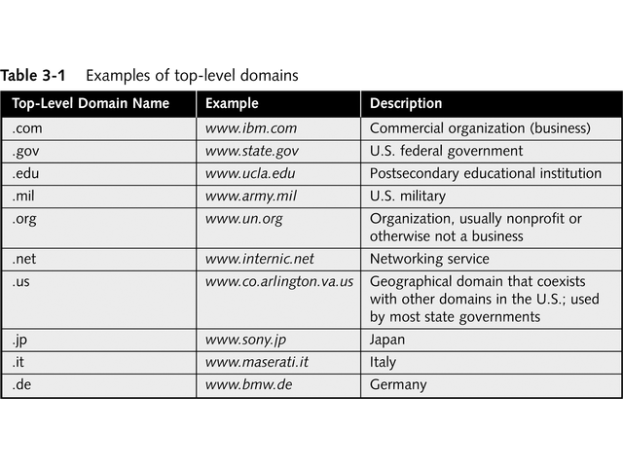

Slide 6
DNS Hierarchy
.
edu
com
org
jp
rpi
albany

Slide 7
DNS is used to map host names to IP addresses on the Internet
Also called name resolution or address resolution
Whenever a host is added, a configuration file has to be manually changed
There can be many hosts on a single computer

Slide 8
Configuring the DNS Resolver Manually
The resolver is the client part of DNS
It makes requests to a DNS server so that other workstation programs can use the IP address of a given server to make a network connection
The resolver is configured by a single file in Linux: /etc/resolv.conf
Configure the resolver by storing the IP address of one or more DNS servers in the resolv.conf file, proceeded by the keyword nameserver

Slide 9
The hosts File
Another way to convert an IP address to a domain name is store the IP address and corresponding domain names in a text file called /etc/hosts on your host
The /etc/hosts.conf or /etc/nsswitch.conf files determine the order in which the resolver looks to various sources to resolve IP addresses

Slide 10
DNS Components
Name server – also known as DNS server
supports name-to-address and address-to-name resolution
Name resolver – also called DNS client
Can contact DNS server to lookup name
Used by browsers, e-mail clients, and client utilities such as ping and tracert

Slide 11
Zone File Configuration
Forward Lookup
These zones contain entries that map names to IP addresses
Reverse Lookup
These zones contain entries that map IP addresses to names

Slide 12
Configuring Client DNS
Modify /etc/resolv.conf
The following line directs the client to use the DNS server at 192.168.1.200
nameserver 192.168.1.200
The following line associates this computer with the varains.com domain
domain varains.com

Slide 13
LAB
# /etc/resolv.conf
domain varains.com
192.168.1.200
Daemon
Service nscd restart
/etc/init.d/nscd restart

Slide 14
nslookup
Nslookup
nslookup is an interactive resolver that allows the user to communicate directly with a DNS server.
nslookup is usually available on Unix workstations.

Slide 15
Summary
DNS is an application that translates names to IP addresses and IP addresses to names
Organized in a hierarchical structure
Servers come in many forms: primary, secondary, caching, forwarding
To configure DNS, set up a forward and reverse zone
Use ping, nslookup, and dig to troubleshoot DNS

