Slide 1

Academic Year 2024 - 25 S5 MINI PROJECT - I First Review
PROJECT TITLE
DEVELOPMENT OF VERSATILE FITNESS TRACKER
BIP PROJECT ID
26S5MIN529
CATERGORY
INTERNAL
BATCH MEMBERS
PRADEEP TT(7376222CT140)
NAVEEN KUMAR B(7376222CT136)
GUIDE
MR. MAHESH KUMAR K
Assistant Professor
Department of Computer Science and Design

Slide 2
AIM & OBJECTIVES OF THE PROJECT (Problem Statement)
Problem Statement :
The problem statement for this project is to develop a versatile fitness tracker that addresses the need for comprehensive, real-time monitoring of various health metrics such as physical activity, heart rate, sleep patterns, and calories burned. Existing solutions often lack customization and user-friendly interfaces. The goal is to create a multi-functional device that offers accurate tracking, personalized insights, and goal-setting features, helping users maintain a healthier lifestyle through accessible and actionable fitness data.
Aim :
The aim of this project is to develop a versatile fitness tracker capable of monitoring physical activities, heart rate, sleep patterns, and calories burned. The device will feature real-time data analysis, goal tracking, and user-friendly interfaces, offering comprehensive fitness insights to promote a healthy and active lifestyle.
Objective :
Monitor real-time physical activity and heart rate.
Track sleep patterns and overall fitness levels.
Analyze calories burned and distance covered.
Provide personalized fitness goals and progress tracking.
Ensure user-friendly interface and data accessibility.

Slide 3
LITERATURE SURVEY
Sl.No. | Journal Paper Title with Author | Works carried out ( with details of Methods/ Materials/ Software/ Algorithms / fabrication / techniques/ components used ) | Information gathered relevant to your project
1 | "Design and Implementation of an Advanced Fitness Tracker for Holistic Health” by Michael Brown, Jessica Davis, David Kim | Analyze existing fitness trackers to identify gaps and user needs and create detailed profiles of potential users | Increasing interest among diverse age groups, parti-cularly millennials and Gen Z, in health
2 | "Innovative Fitness Tracking: A Multi-Parameter Approach to Health and Wellness“ by Anna White, Robert Green, Laura Chen | Conduct research on existing fitness tracking technologies and multi-parameter health monitoring systems. | Increasing interest in holistic health solutions that track various wellness parameters.
3 | "Development of a Versatile Fitness Tracker: Integrating Real-Time Health Monitoring and User Engagement“ by John Smith, Emily Johnson, Sarah Lee | Real-time heart rate monitoring, activity tracking (steps, distance, calories burned), sleep tracking and analysis | Continuous monitoring of heart rate, blood pressure, blood oxygen levels, and body temperature.

Slide 4
LITERATURE SURVEY
Sl.No. | References ( Journal Papers Only) | Works carried out ( with details of Methods/ Materials/ Software/ Algorithms / fabrication / techniques/ components used ) | Information gathered relevant to your project
4 | "Creating a Comprehensive Fitness Tracker: Features, Challenges, and Future Directions“ by Kevin Taylor, Michelle Hall, Chris Patel | Create user personas to guide feature develop-ment based on diverse user demographics. | Integration for logging meals and tracking caloric and nutrient intake.
5 | "Versatile Fitness Tracker Development: Enhancing User Experience through Technology Integration“ by Rachel Adams, Jason Scott, Emily Clark | Understand demogr-aphics, fitness levels, and preferences, identify strengths, weaknesses | Monitoring sleep stages and quality, with insights to improve sleep hygiene.
6 | “Examination of how fitness trackers sync with mobile apps for personalized health insights” by Sarah Davis | Analyze industry reports to understand current developments | Allow users to customize what metrics they want to see and how they are visualized.

Slide 5
SCOPE OF THE PROJECT
Develop a comprehensive fitness tracker that integrates various health metrics.
Enhance user engagement through personalized insights and community features.
Ensure seamless synchronization with mobile applications for real-time data access.
Development of a user-friendly mobile app with an intuitive interface.
Customizable dashboards for displaying health metrics.
Focus on intuitive UI/UX principles to enhance usability.
Customization options for dashboards and notifications.
Continuous user feedback loops for iterative improvement.
Goal setting and progress tracking.
Social features for sharing achievements and participating in challenges.
Gamification elements to motivate users.

Slide 6
NEED FOR THE CURRENT STUDY
The following are the Needs for the Current study :
Proactive Health Management
Enhanced User Engagement
User Engagement
Preventative Health Care
Support for Preventive Care

Slide 7
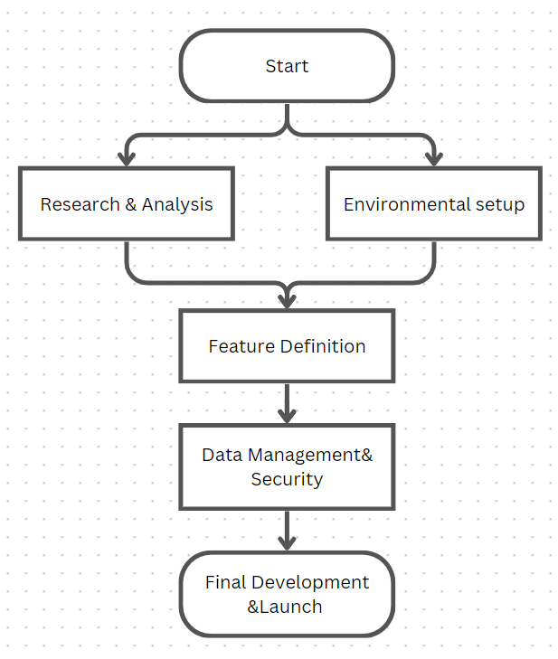
PROPOSED METHODOLOGY ( Flow Chart)

Slide 8
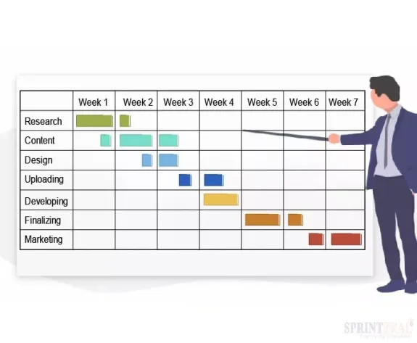
PROPOSED METHODOLOGY ( Gantt Chart)

Slide 9
CHOICE OF COMPONENTS / MODULES / METHODS/TECHNIQUES EQUIPMENT USED FOR PROJECT DEVELOPMENT
Methods :
System Design
Graphics Rendering
Interactive Features
User Interface Equipment
Performance Optimization
Techniques :
User Surveys
Wireframing
Prototyping
Iterative Testing
Data Protection

Slide 10
DESIGN(S) (HARDWARE / SOFTWARE ARCHITECTURE)
HARDWARE ARCHITECTURE :
Layered Architecture :
User Interface Layer
Application Logic Layer
Data Management Layer
Security and Compliance :
User Authentication
Data Encryption
Compliance
Monitoring and Maintenance :
Logging and Monitoring
User Feedback

Slide 11
INDIVIDUAL CONTRIBUTIONS TO THE WORK
Batch Member 1 : PRADEEP TT – 7376222CT140
Frontend – HTML , CSS , JAVASCRIPT
Angular

Slide 12
INDIVIDUAL CONTRIBUTIONS TO THE WORK
Batch Member 2 : NAVEEN KUMAR B – 7376222CT136
Backend – Node.js
Database Management

Slide 13
INDIVIDUAL CONTRIBUTIONS TO THE WORK
Batch Member 3 : (Reg No.& Name )
.....
….
…
….
….

Slide 14
INDIVIDUAL CONTRIBUTIONS TO THE WORK
Batch Member 4 : (Reg No.& Name )
.....
….
…
….
….

Slide 15
PENDING WORKS AND PLAN FOR COMPLETION
Completed the Frontend
Working on database management
Needs further development in the backend

Slide 16
PLAN FOR PUBLICATIONS
Journal / Conference Identified for Submission
Tentative Dates for Submission / Presentation / Acceptance

Slide 17
Status on Partial Completion and Submission of Project Report
List of Documents to be Submitted
SL.No | List of Documents | Status ( Provide the drive link of prepared document)
1 | Cover Page & Title Page (Both are in same format)
2 | Bonafide Certificate
3 | Declaration
4 | Acknowledgement
5 | Chapter I – Introduction
6 | Chapter 2 – Literature Survey

Slide 18
Any Other Relevant Details

Slide 19
Any Other Relevant Details

Slide 20
REFERENCES ( Journal Papers/ Books / Website in IEEE Format )
1. Douglas-Walton J. A Study of Fitness Trackers and Wearables. [2021-07-15]. https://tinyurl.com/3efv4mte .
2. Comstock J. Eight Years of Fitbit News Leading up to Its Planned IPO. 2015. [2020-07-30]. https://tinyurl.com/fhkdrxxa .
3. Dormehl L. Today in Apple History: It’s Time for Apple Watch. [2021-04-25]. https://tinyurl.com/nsdc4fem .
4. Vogels E. About One-in-Five Americans Use a Smart Watch or Fitness Tracker. [2020-06-30]. https://www.pewresearch.org/fact-tank/2020/01/09/about-one-in-five-americans-use-a-smart-watch-or-fitness-tracker/
5. Mccarthy J. One in Five U.S. Adults Use Health Apps, Wearable Trackers. 2019. [2020-06-30]. https://news.gallup.com/poll/269096/one-five-adults-health-apps-wearable-trackers.aspx .

