Slide 1

TOSCA
Taking the first steps
By : Pradeep Giri

Slide 2
Topics Covered
About Tosca
Tosca Advantages
Basic Workflow
Demo

Slide 3
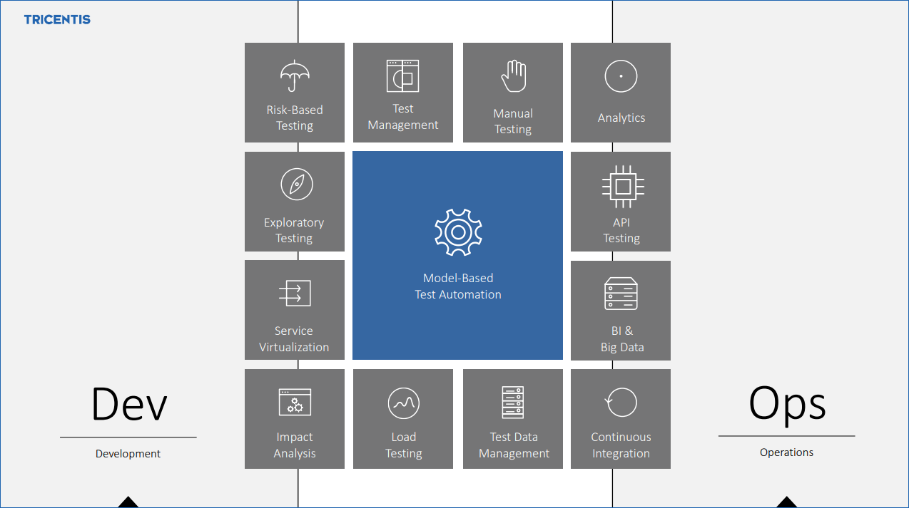
About Tricentis Tosca
Tricentis Tosca is a Continuous Testing platform that delivers fast feedback for Agile and DevOps. It allows you to design automated, functional, end-to-end software tests across all layers of your enterprise architecture.

Slide 4
One Stop Solution
Performs GUI and non-GUI testing
Test and verify Application Programming Interfaces (APIs)
Perform load testing with Tricentis Flood
Identify and manage your test data with the Tricentis Tosca Test Data Service
Record and simulate services with Tosca Orchestrated Service Virtualization
Ensure data quality throughout all stages of your Data Warehouse testing cycle with Tosca BI
Test your mobile applications

Slide 5
Advantages
Script less automation
Easy to learn, so you can train your team within very less time compared to other automation tools. So you can start automation very early
Model based automation, you do not need to write framework for this. It is already present
Reusability of assets and copy-paste features for test cases and modules
Test management and manual testing is also present
Can be integrated with HP ALM, can run selenium scripts
Mass updates - Tosca provides its own query language same as SQL called as TQL. you can change many test cased together using this

Slide 6
Basic Work Flow
Requirements
Test Case Design
Test Cases
Execution
Modules

Slide 7
Demo

Slide 8
References:
https://documentation.tricentis.com/en/1200/index.htm#resources

Slide 9
Thank You!!

