Slide 1
Design of Diagnosis System for Remote Area
ASHISH KUMAR PATEL : S20160020111(ECE)
PRADEEP TURAN : S20160010065(CSE)
GUIDE : DR.RAJA VARA PRASAD

Slide 2
Abbreviation
ANN - Artificial Neural Network
BMI - Body Mass Index
BP - Blood Pressure
SBP - Systolic Blood Pressure
DBP - Diastolic Blood Pressure
hR - Heart Rate
gl - Glucose Level

Slide 3
INTRODUCTION
This Project is an attempt to solve a healthcare problem society is facing.
•
•
Main objective of this project is to design a remote
healthcare
system.
•
Our project comprises of four main steps-
➢ Detection of patient’s vital life signs using sensors
➢ Sending data to cloud storage
➢ Providing the detected data for remote viewing
•
Remote viewing of the data will enable doctor or guardian to monitor a
patient’s
health progress.
• This monitoring system will be useful for elderly or chronically ill patients who would
like to avoid a long hospital stay.

Slide 4
Blood Glucose Monitoring System
Conventional way of detecting glucose levels involves pricking the finger and collecting blood sample.
Not only painful and blood consuming but also time consuming and expensive.
We will be designing a system which is pain-free, cheaper and predict diabetes in less time.
Acetone is one of the organic compound present in the exhaled breath.
To find acetone level in blood, we are using TGS822 sensor.
 | ACETONE CONCENTRATION(ppm)
Healthy Person | <1.1
Diabetic Person | >1.8

Slide 5
Results
We used Linear regression to calculate the blood glucose level from acetone.
Parameter | Weight
Acetone | 88.83358634
Intercept | 11.746736101317197
Standard Error
Blood Glucose Level
18.09814997

Slide 6
Blood Pressure Estimation
• Blood pressure depends on many factors like glucose level, heart rate, BMI, age.
• We are using these factors to estimate the systolic and diastolic blood pressure.
• The American Diabetes Association reports that from 2000 to 2012, 71% percent of adults
with diabetes had a blood pressure of greater or equal to 140/90
• The National Heart Lung and Blood Institute (NHLBI) points out that losing 10 pounds in weight can
reduce blood pressure.
• On average, systolic blood pressure (SBP) rises with age, while diastolic blood pressure (DBP) increases
to age 50 and then declines.
• For each increased heartbeat there is a 0.090-mmHg increase in SBP of boys and a 0.063 mmHg
increase in SBP of girls.
• Regarding DBP, the increase is 0.179 mmHg in boys and 0.161 mmHg in girls

Slide 7
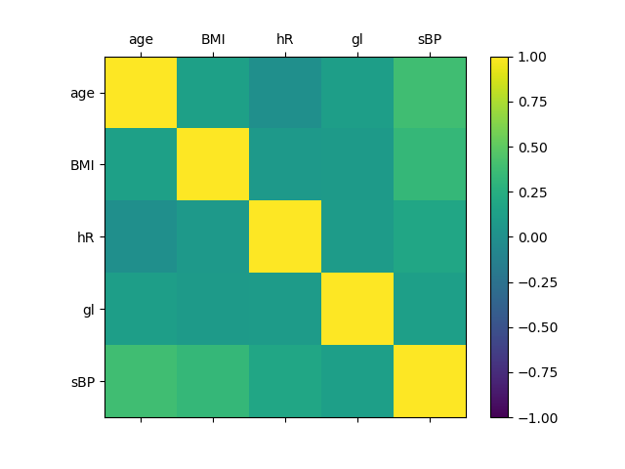
Correlation Matrix for SBP

Slide 8
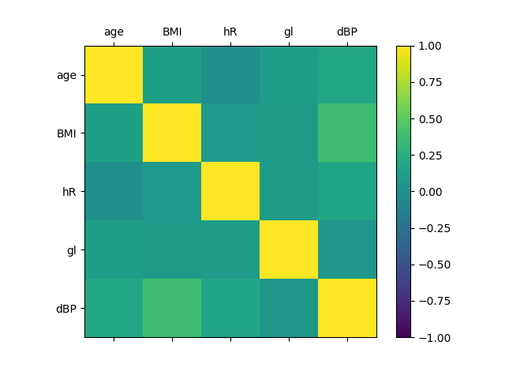
Correlation Matrix for DBP

Slide 9
Calculation of SBP and DBP
•
We have used linear regression on our dataset to find out SBP and DBP.
•
Dataset has six parameters- Age, BMI, Heart Rate, Glucose, SBP, DBP.
•
There are 3837 samples present in the dataset.
•
We used pandas, numpy, sklearn libraries of python.

Slide 10
Results
• Calculated weights of four different parameters-
Age BMI Heart Rate Glucose
Diastolic BP 0.21848732 1.0297836 0.1547047 -0.0028892
Systolic BP 0.89399439 1.4117326 0.29656676 0.04750127
Standard Error
Diastolic BP 10.75179
Systolic BP 18.9953

Slide 11
Predicting Cardiac Risks
•
BP,
Predicting cardiac risk based on age, BMI, heart rate, systolic
diastolic
BP,
glucose.
•
We used binary classification using ANN.
•
We used keras, pandas, numpy, sklearn python
libraries.
•
Glucose and diabetes predictions were done in
previous presentation while sBP, dBP
we calculated using linear regression.
• Down-sampled the dataset to make it balanced.

Slide 12
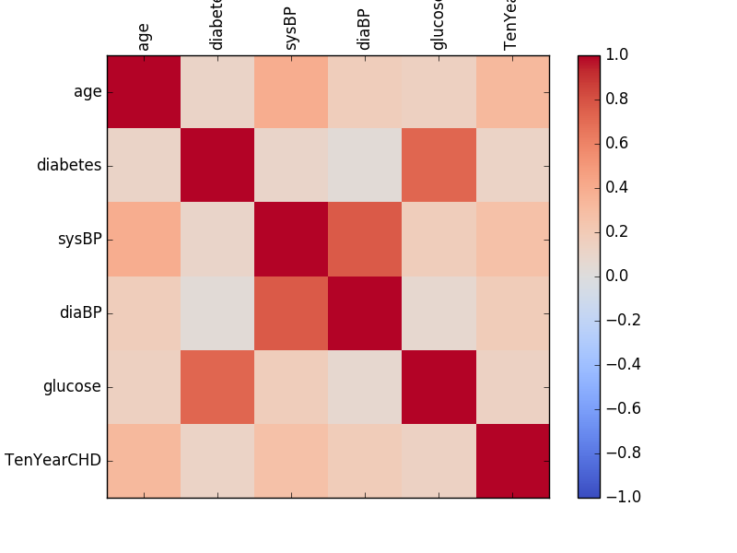
Correlation Matrix for Cardiac risks

Slide 13
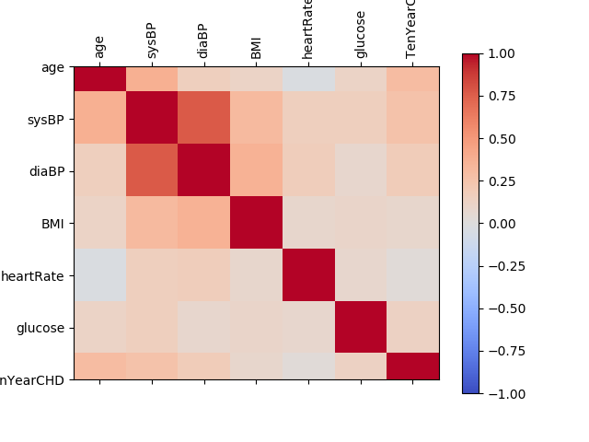
Correlation Matrix for Cardiac risks(including BMI)

Slide 14
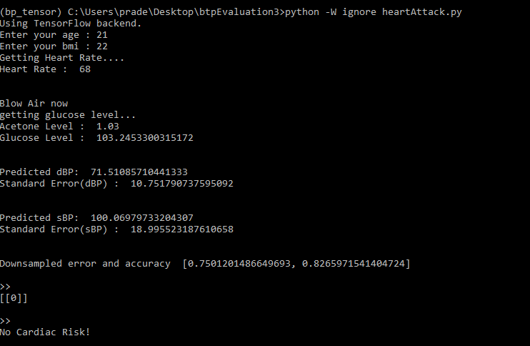
Results
Accuracy Error
With BMI 85.528 % 0.6023
Without BMI 82.007 % 0.6113

Slide 15


Slide 16


Slide 17
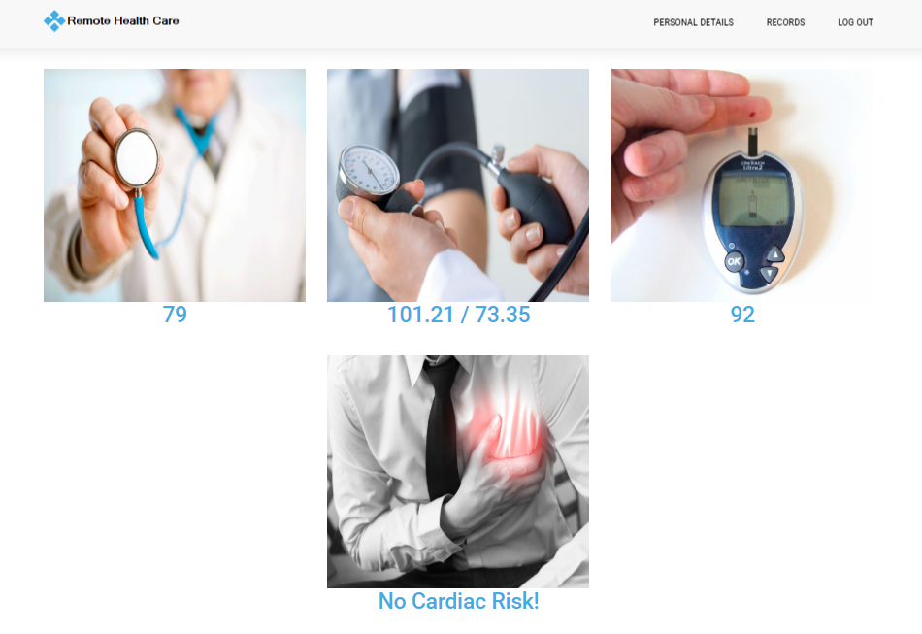

Slide 18
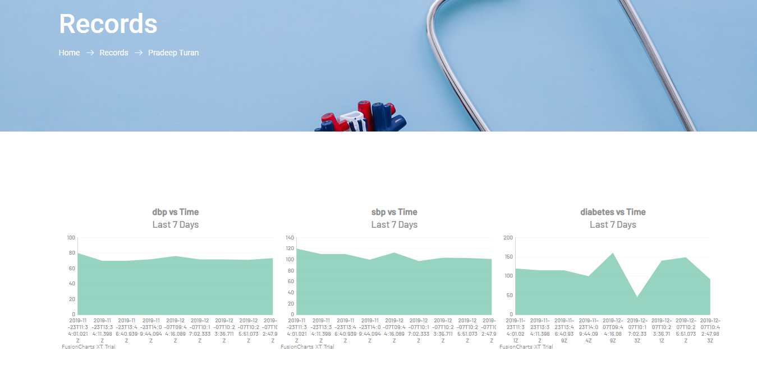

Slide 19
Challenges
Available dataset is too small for regression.
•
•
Dataset is not balanced, so it needs to be balance for
better prediction.
•
Dataset has many missing and undesirable values.

Slide 20
References
• Dataset from https://www.kaggle.com/neisha/heart-disease-prediction-using-logistic-regression/data
• Rajendra Gadhavi , Dipak M. Solanki , Kiran Rami , Samir Bhagora , Nilesh Thakor.” Relationship between blood pressure and BMI: a cross sectional study among government employees of Gujarat state, India 05 June 2015 ”.
• Jiunn-Diann Lin, Yen-Lin Chen, Chung-Ze Wu, Chang-Hsun Hsieh, Dee Pei, Yao-Jen Liang, and Jin-Biou Chang.
”Identification of Normal Blood Pressure in Different Age Group”.
• Soo-young Ye, Gi-Ryon Kim, Dong-Keun Jung, Seong-wan Baik, and Gye-rok Jeon “Estimation of Systolic and Diastolic Pressure using the Pulse Transit Time”. World Academy of Science, Engineering and Technology International Journal of Biomedical and Biological Engineering Vol:4, No:7, 2010
Anand Thati , Arunangshu Biswas , Shubhajit Roy Chowdhury and Tapan Kumar Sau. “Breath acetone-based non-invasive detection of blood glucose levels. “International journal on smart sensing and intelligent systems vol. 8, no. 2, June 2018.

Slide 21
THANK
YOU

